Slide 1
#morethanbooks: Scalable Outreach Programming
Rachel Yzaguirre

Slide 2
Learning Outcomes
How to empower staff to be flexible
How to capitalize on staff talents and interests
How to utilize supplies you already own
Examples of successful table-top and long-form programs

Slide 3
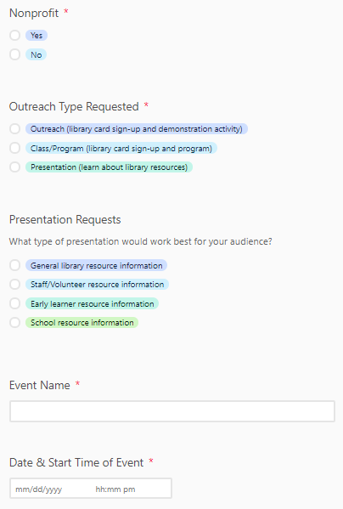
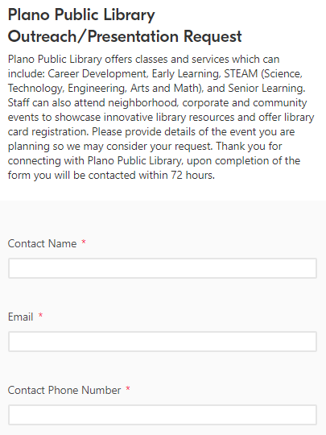
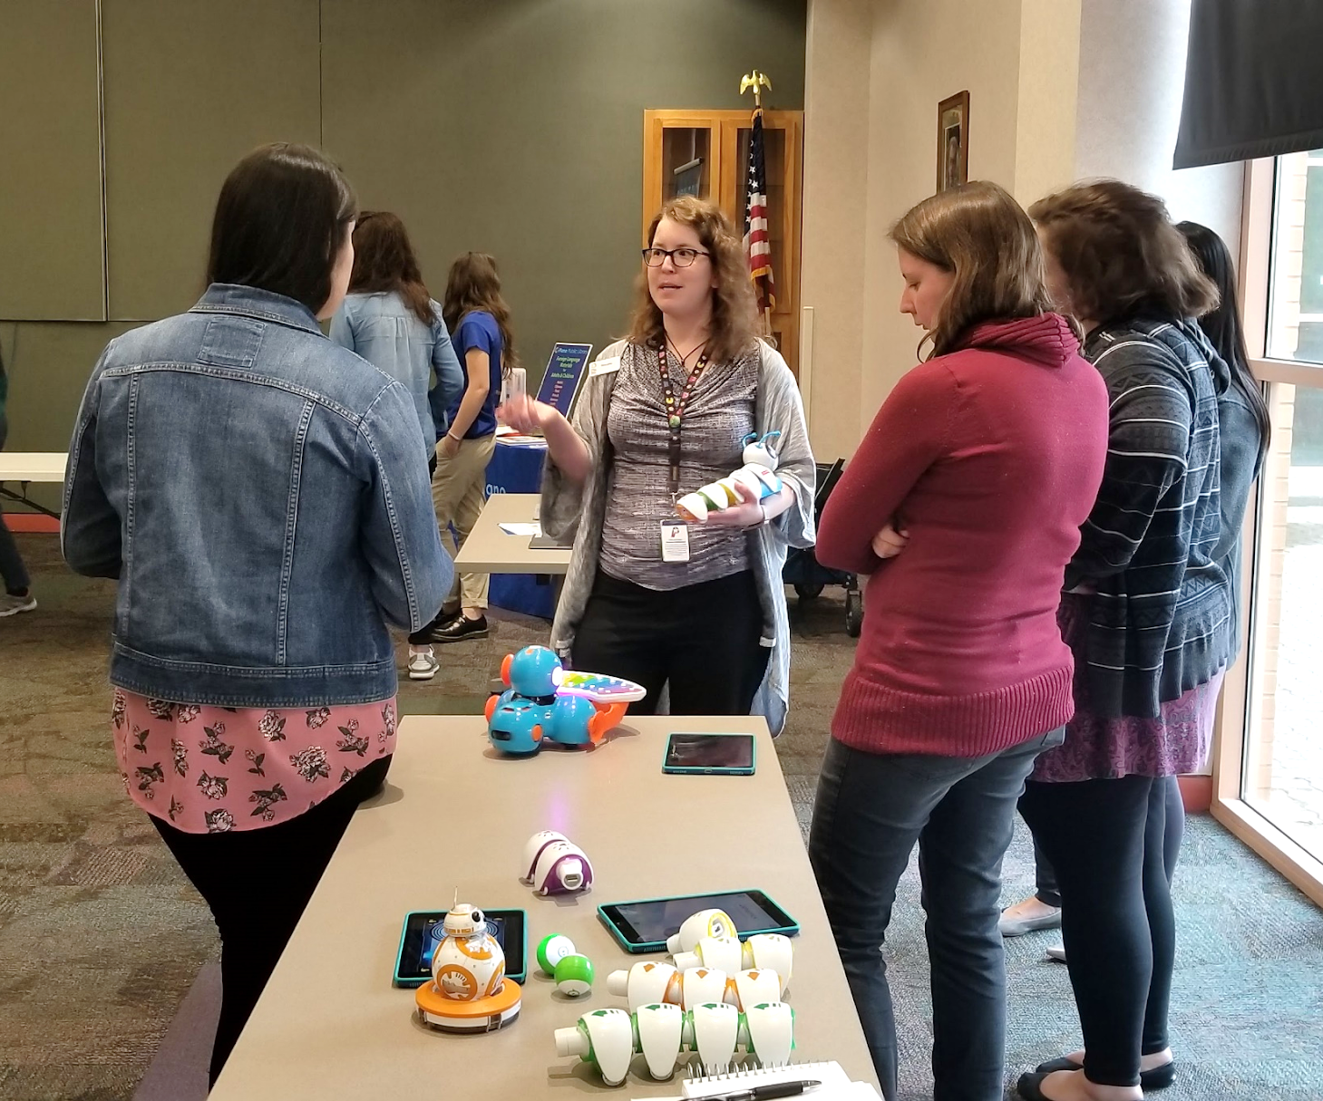
Empower staff to be flexible
Give as much information about the outreach event (if available) ahead of time
Outreach request form: location, audience type and estimated number in attendance, theme, etc.
Training specific to outreach and activity/class

Slide 4
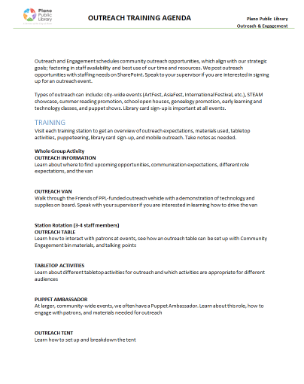
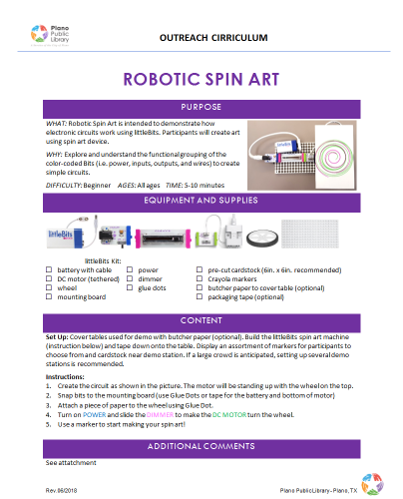
Empower staff to be flexible
Give as much information about the outreach event (if available) ahead of time
Technology failure options
At-event activity adaptations
Sharing built curriculum and/or successful activity resources

Slide 5
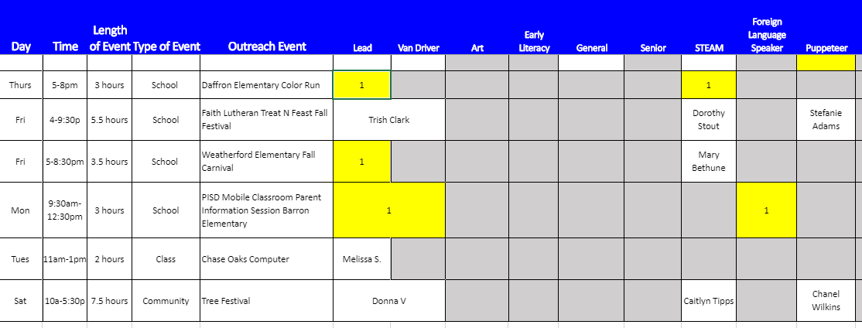
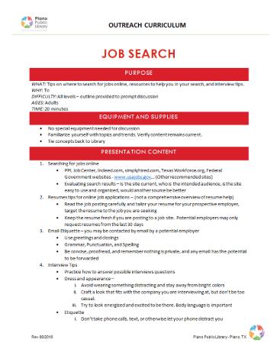
Capitalize on staff talents and interests
Outreach as sign-up, not assigned
Pool resources
Staff-built curriculum

Slide 6
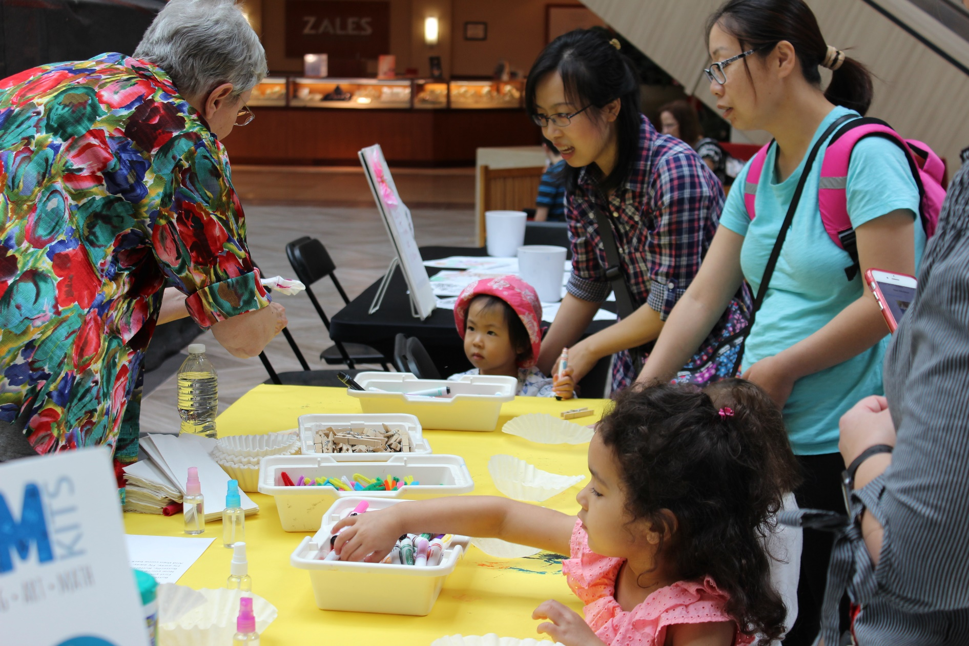
Utilize supplies you already own
Adapt programs for outreach
Spare or core supplies from previous programs
Shared, reusable supplies

Slide 7
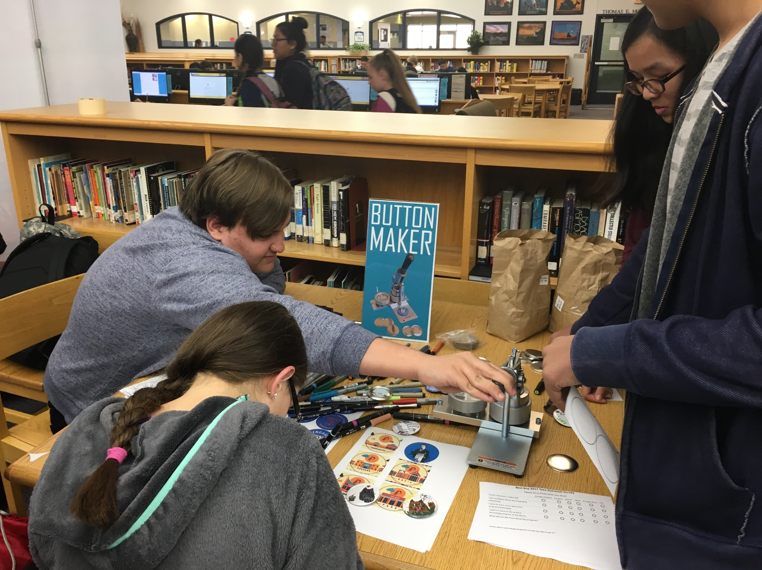
Successful Outreach Programs
Button Making
Button maker
Button supplies
Paper
Markers or pencils

Slide 8
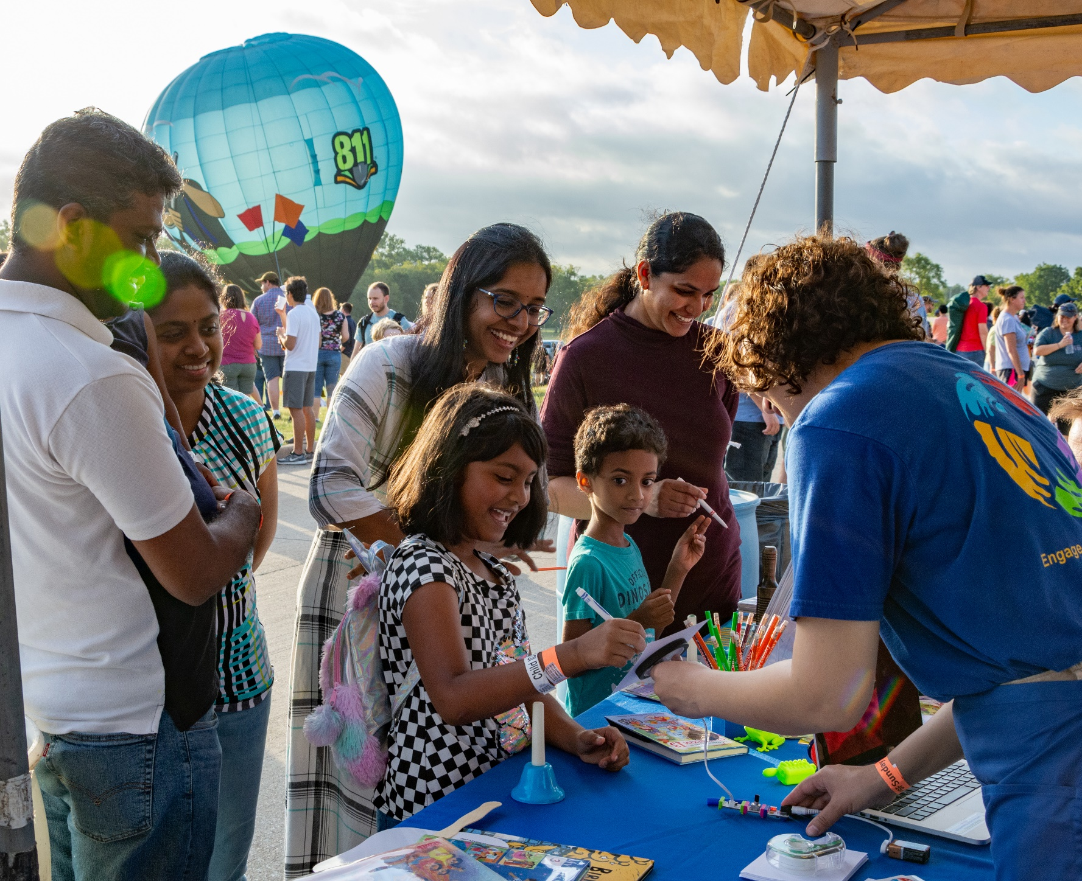
Successful Outreach Programs
Spin Art
littleBits or Lego WeDo
Paper
Markers or pencils

Slide 9
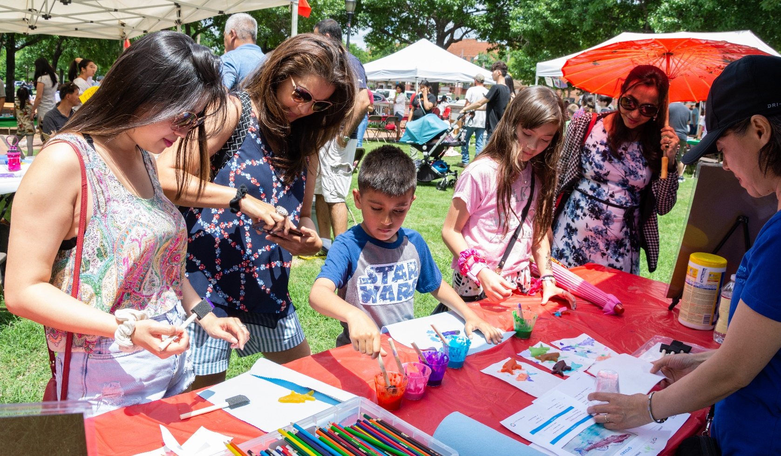
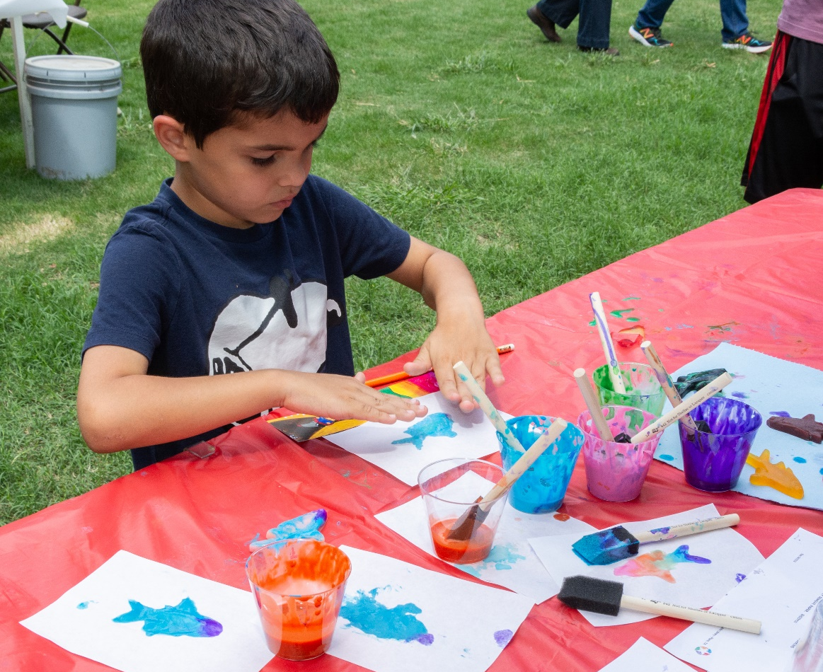
Successful Outreach Programs
Gyotaku
Gyotaku fish
Tempura paint
Paint brushes
Rice paper

Slide 10
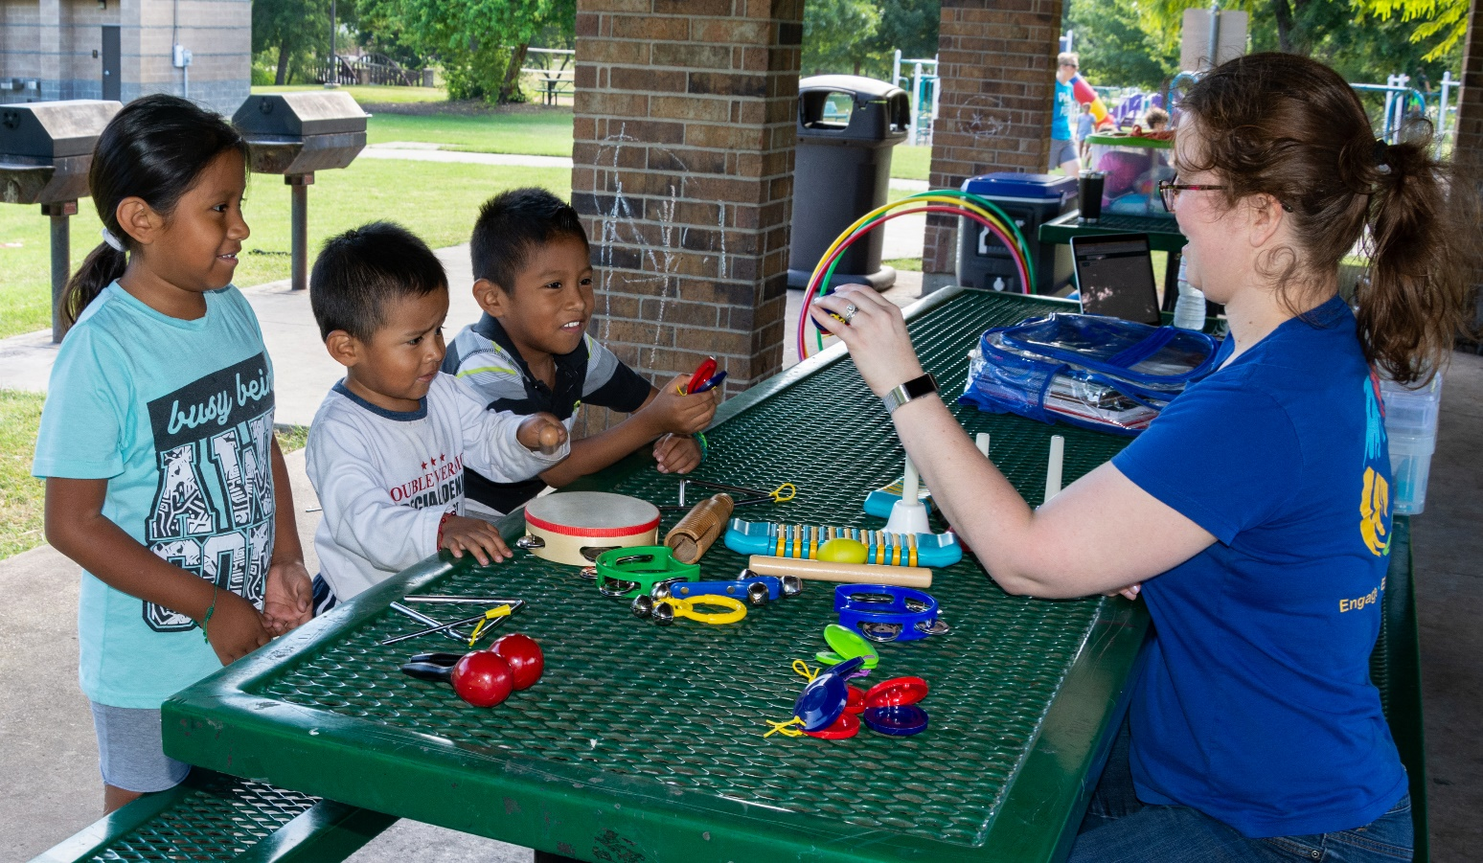
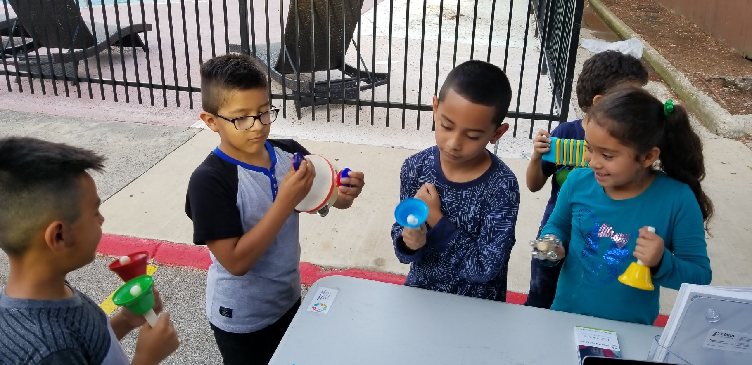
Successful Outreach Programs
Music
Variety of musical instruments: hand bells, egg shakers, tambourines, castanets, drums, guiro with mallet, triangle, keyboard

Slide 11
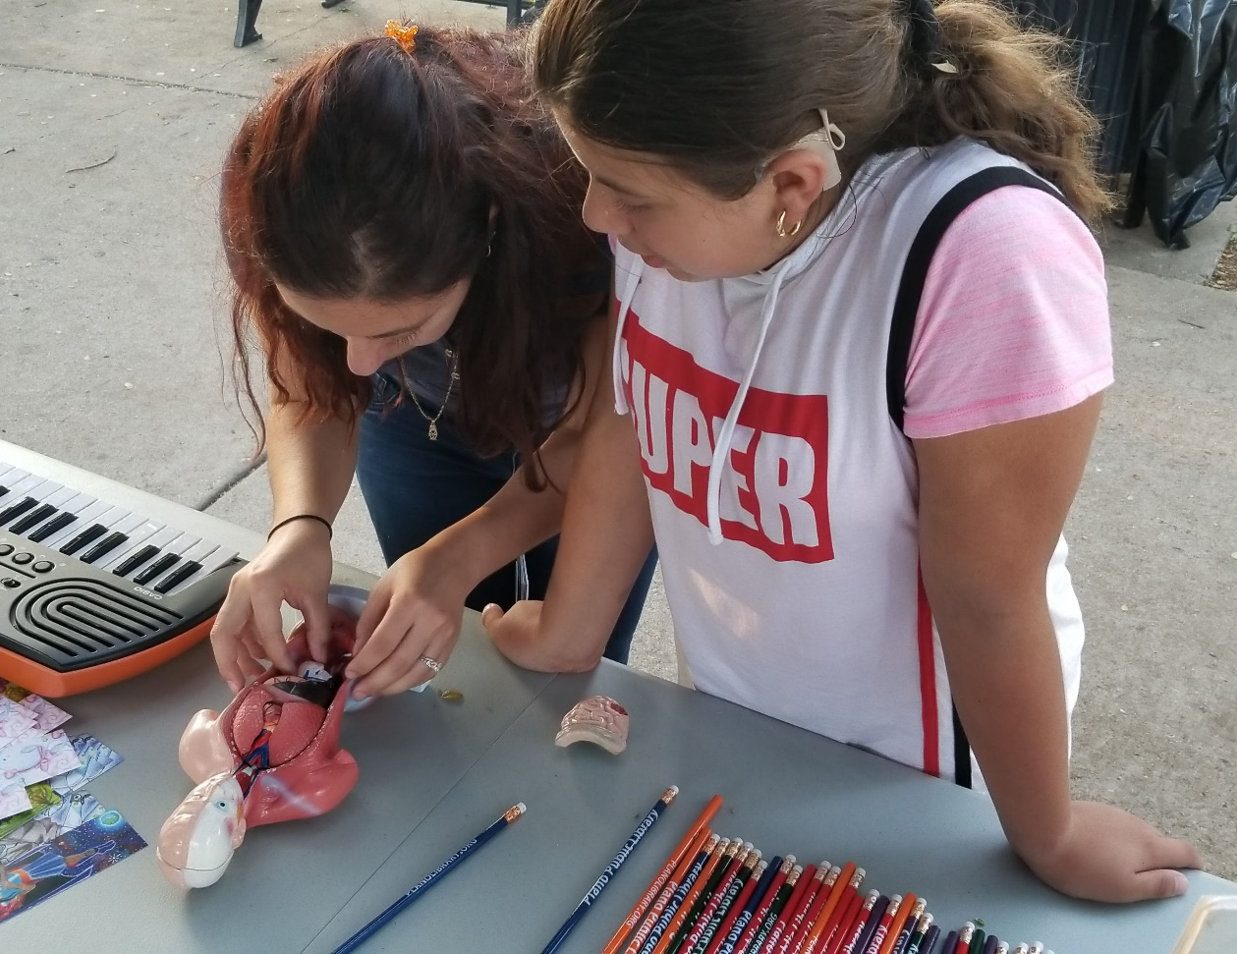
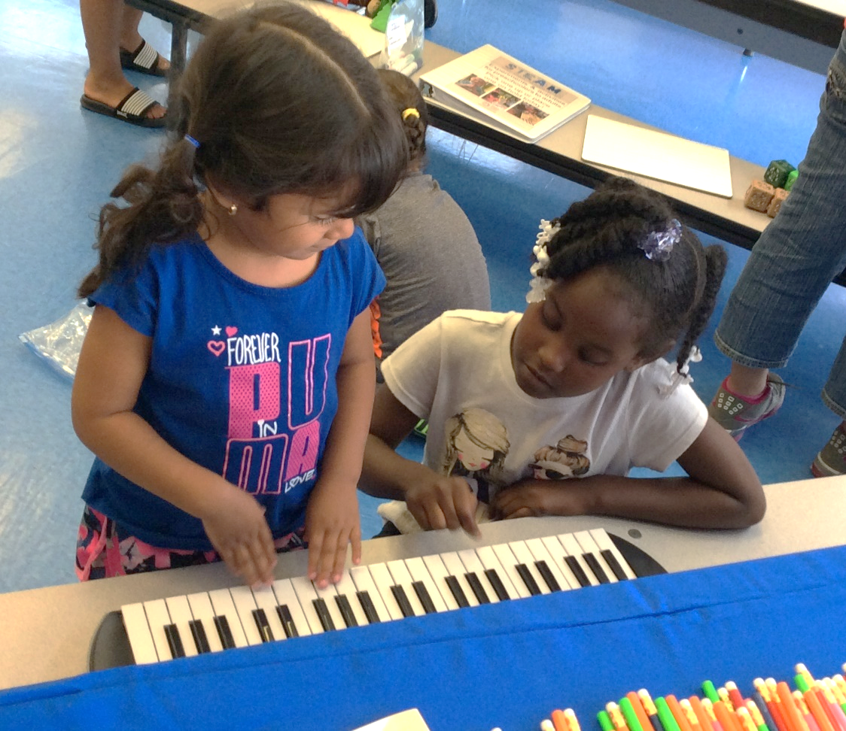
Successful Outreach Programs
STEAM Kits
Take Apart Torso
Water thing
Straw Rocket Launcher
Marble Maze

Slide 12
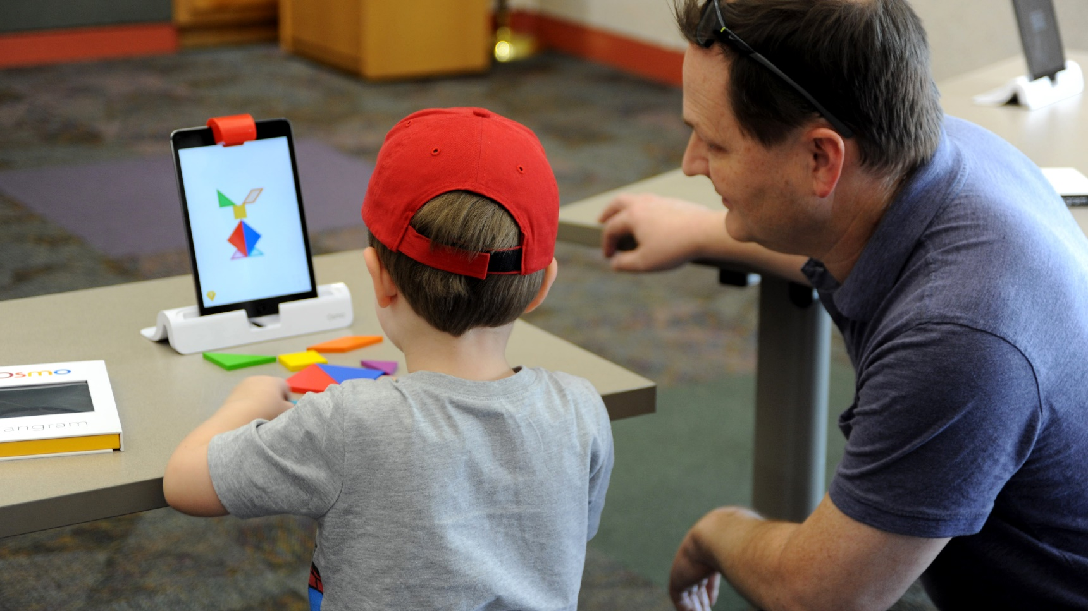
Successful Outreach Programs
Robots/Tech
Dash
Code-a-Pillar
Bee Bots
Sphero
Lego WeDo
Ozobots
littleBits
3D printer

Slide 13
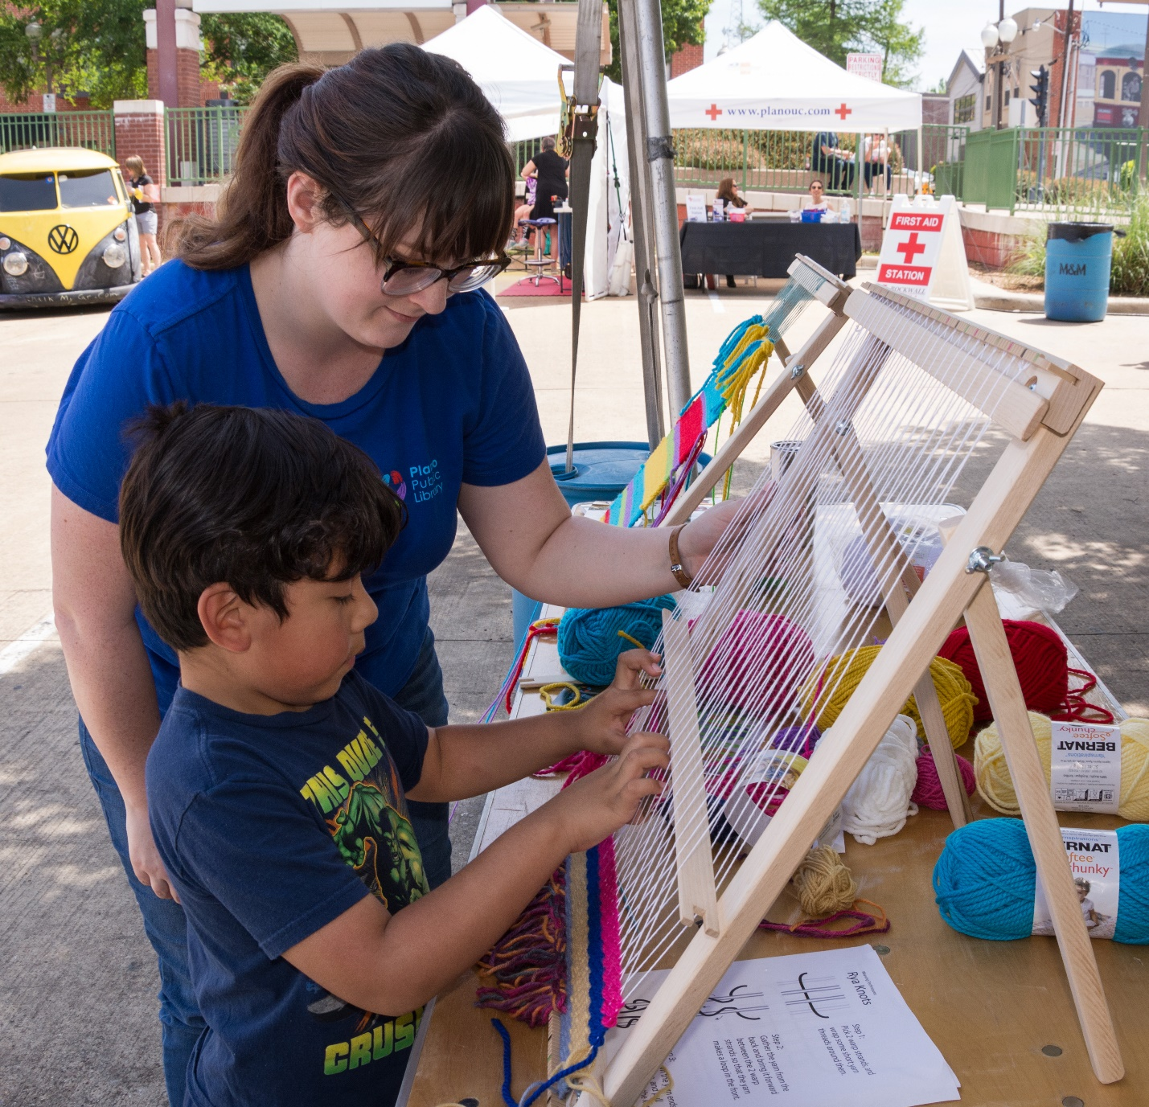
Successful Outreach Programs
Weaving
Loom
Yarn
Weaving supplies

Slide 14
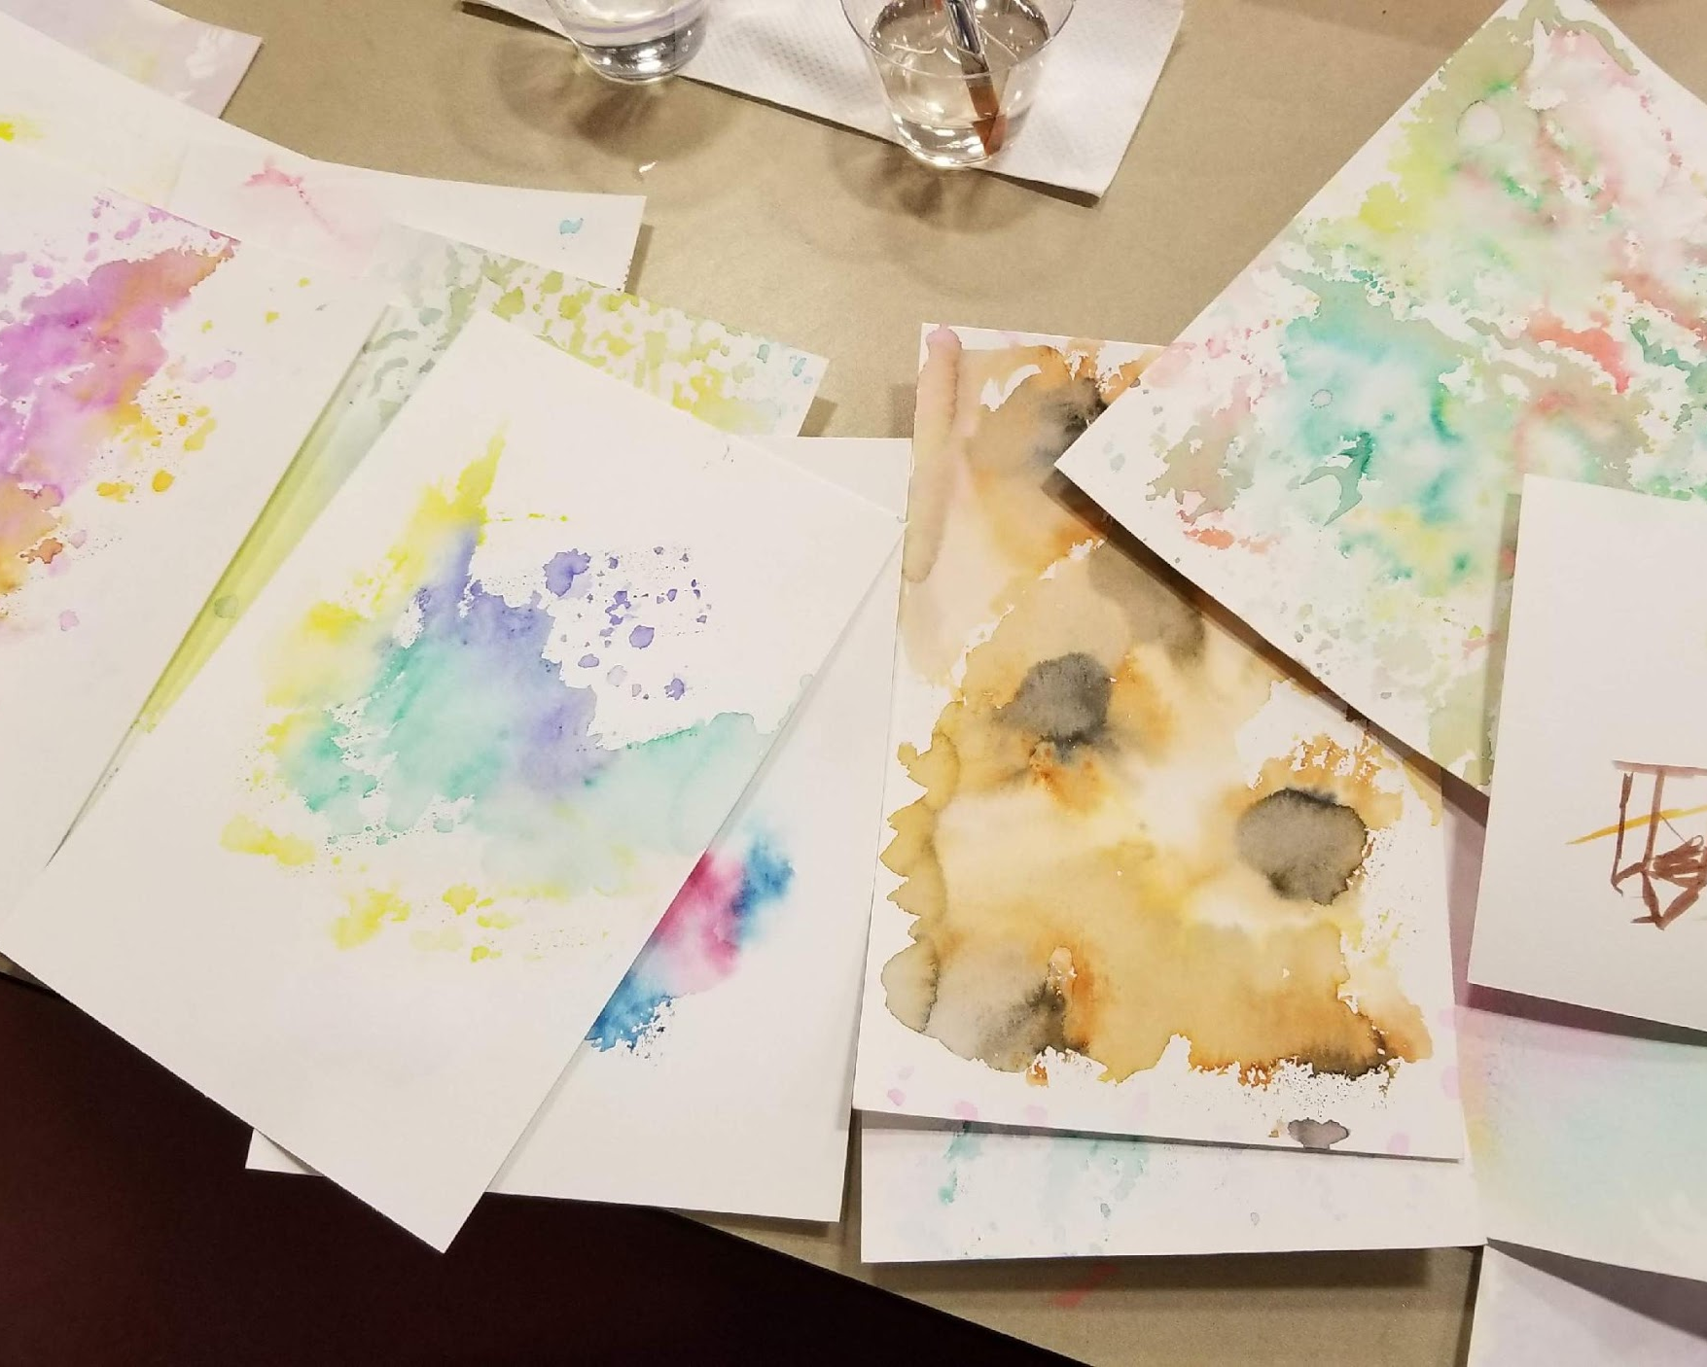
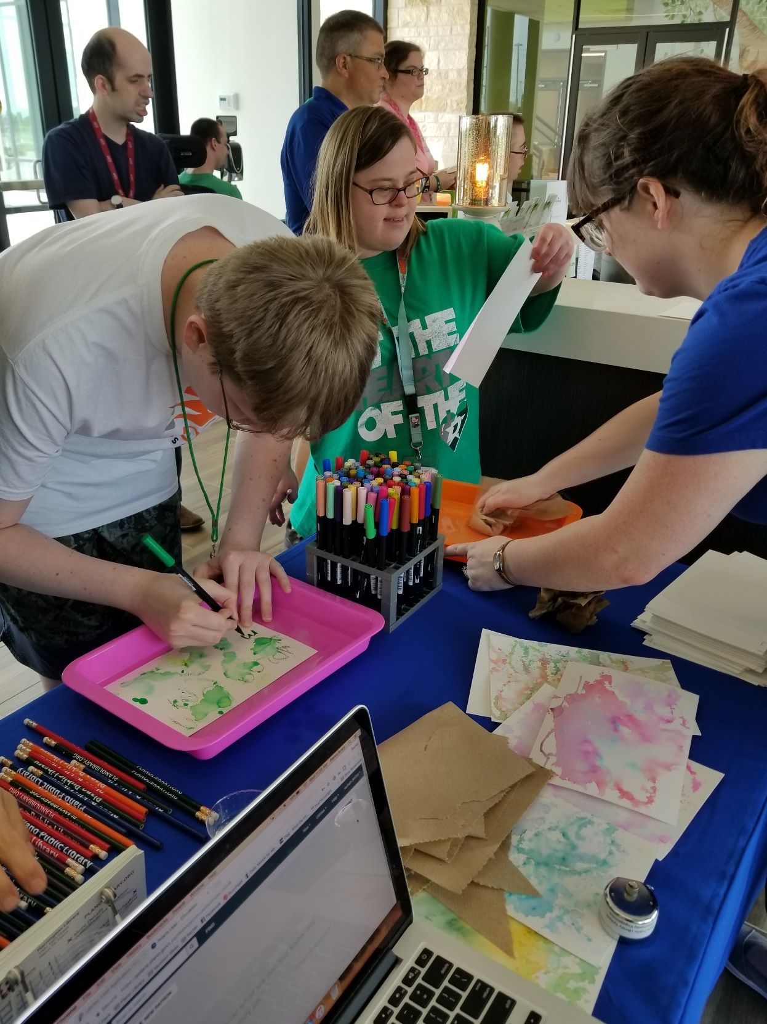
Successful Outreach Programs
Watercolor
Water-based markers (Crayola, Tombow)
Spray bottle with water
Plastic sheet
Watercolor paper
Tray

Slide 15
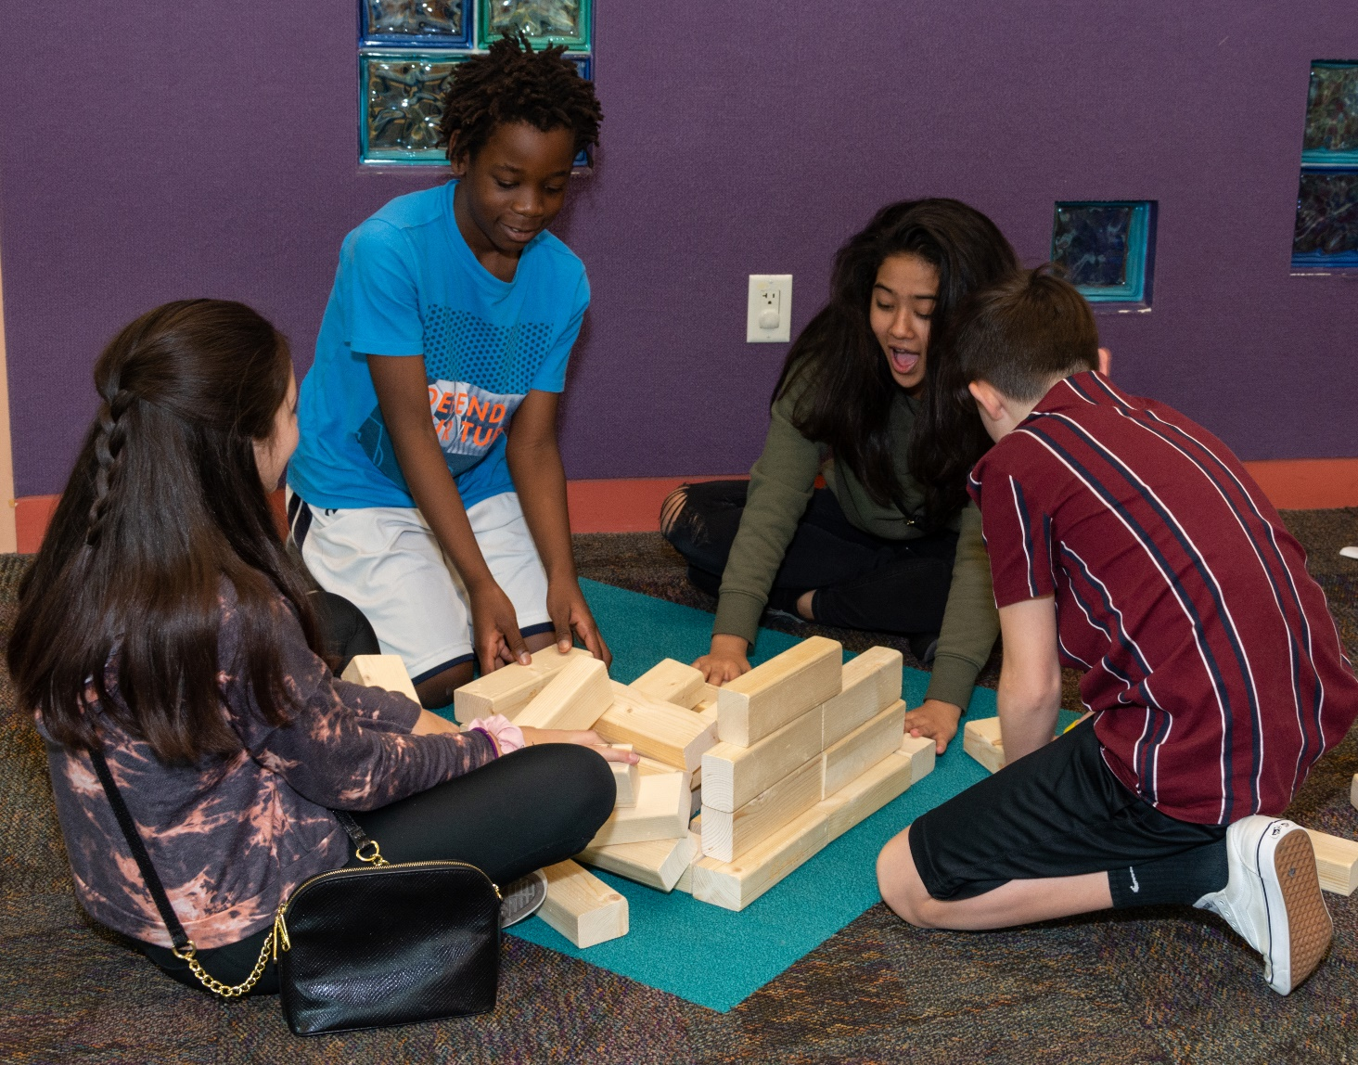
Successful Outreach Programs
Big Games
Big Blue Blocks
Chess
Checkers
Connect Four
Jenga

Slide 16
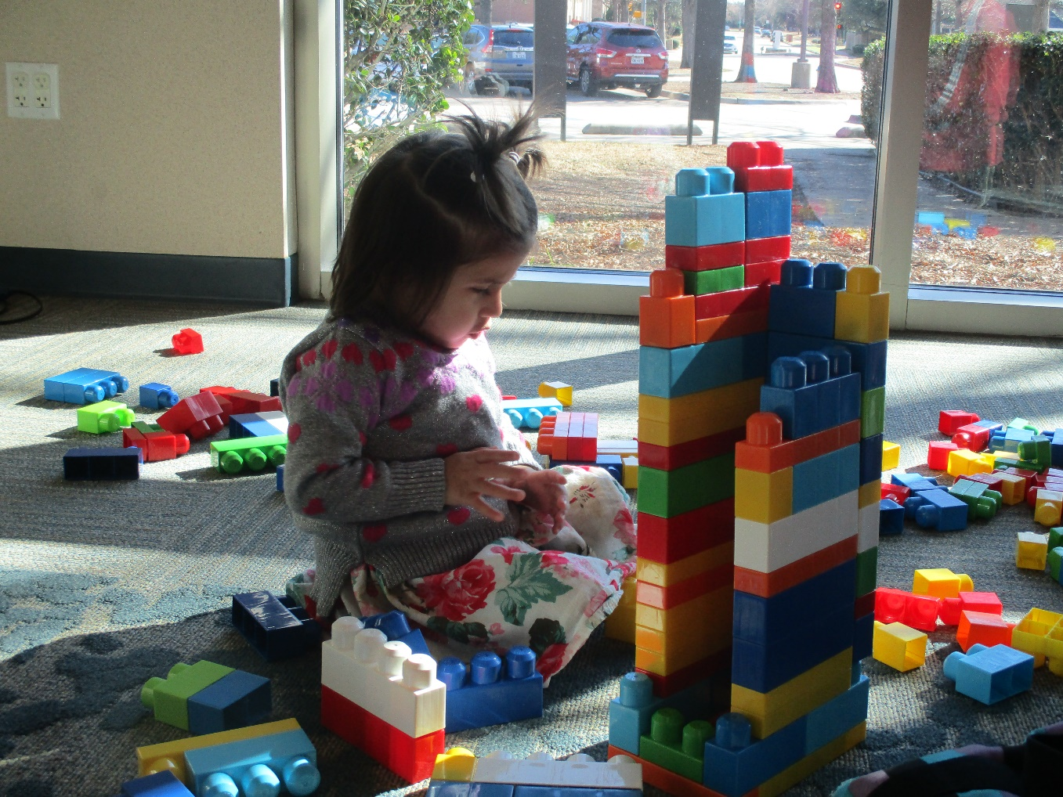
Successful Outreach Programs
Legos
Lego WeDo coding
Duplo blocks

Slide 17
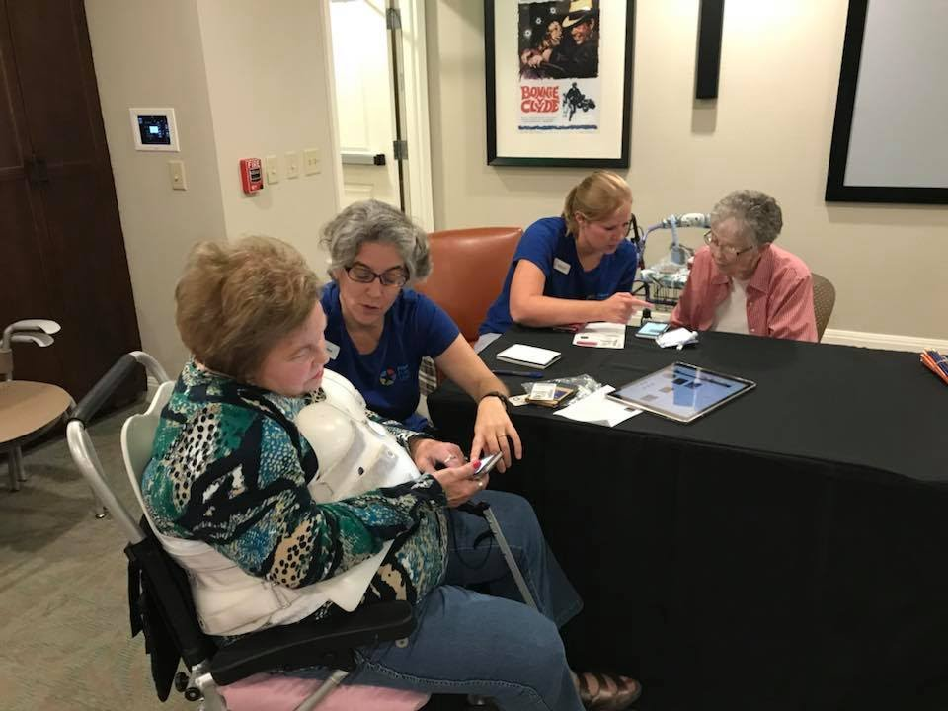
Successful Classes
Technology classes and demonstrations at senior living facilities
eBooks and More
Sharing library resources like Libby, Flipster, Rbdigital and Kanopy to residents of senior living facilities
Bring-Your-Own-Device or demonstrating on our own
Library card sign up

Slide 18
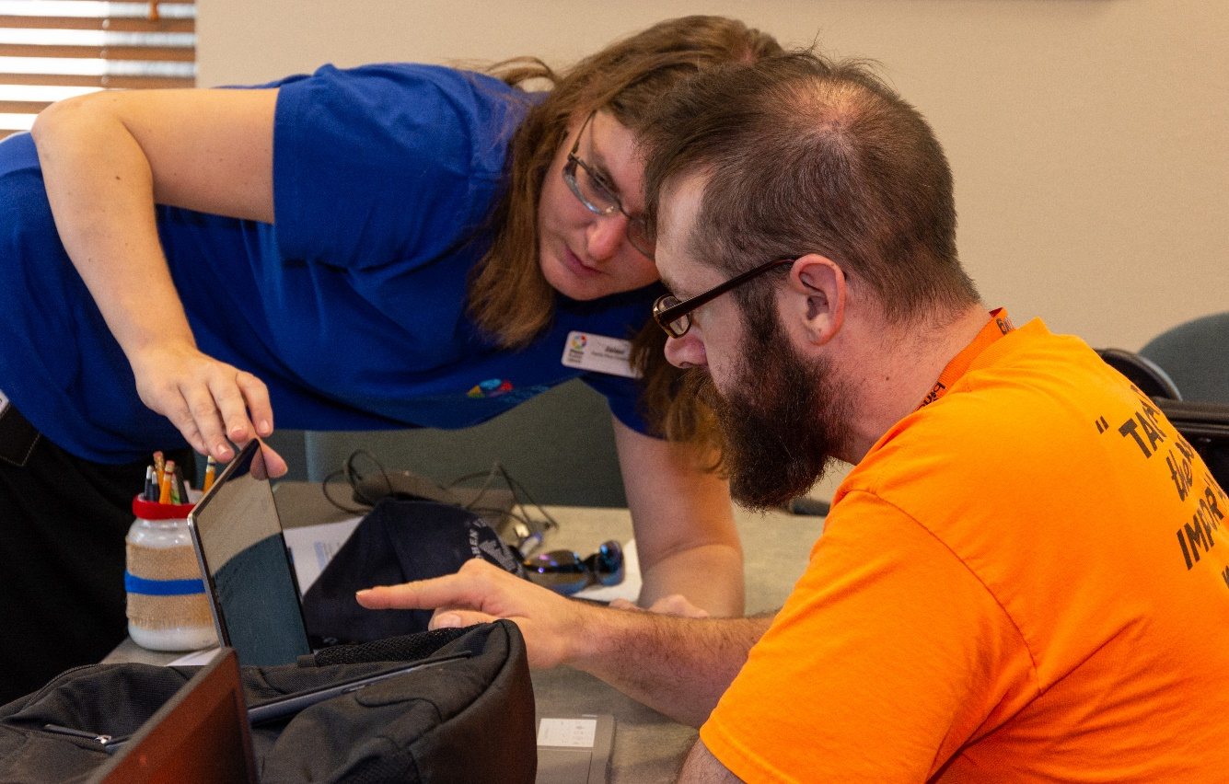
Successful Classes
Digital literacy and computer basics at community centers and senior living facilities
Computer Basics
Often bilingual in Spanish and Chinese
Computer basics, Internet search, email and using school forms
Bring-Your-Own-Device or demonstrating on our own
Library card sign up

Slide 19
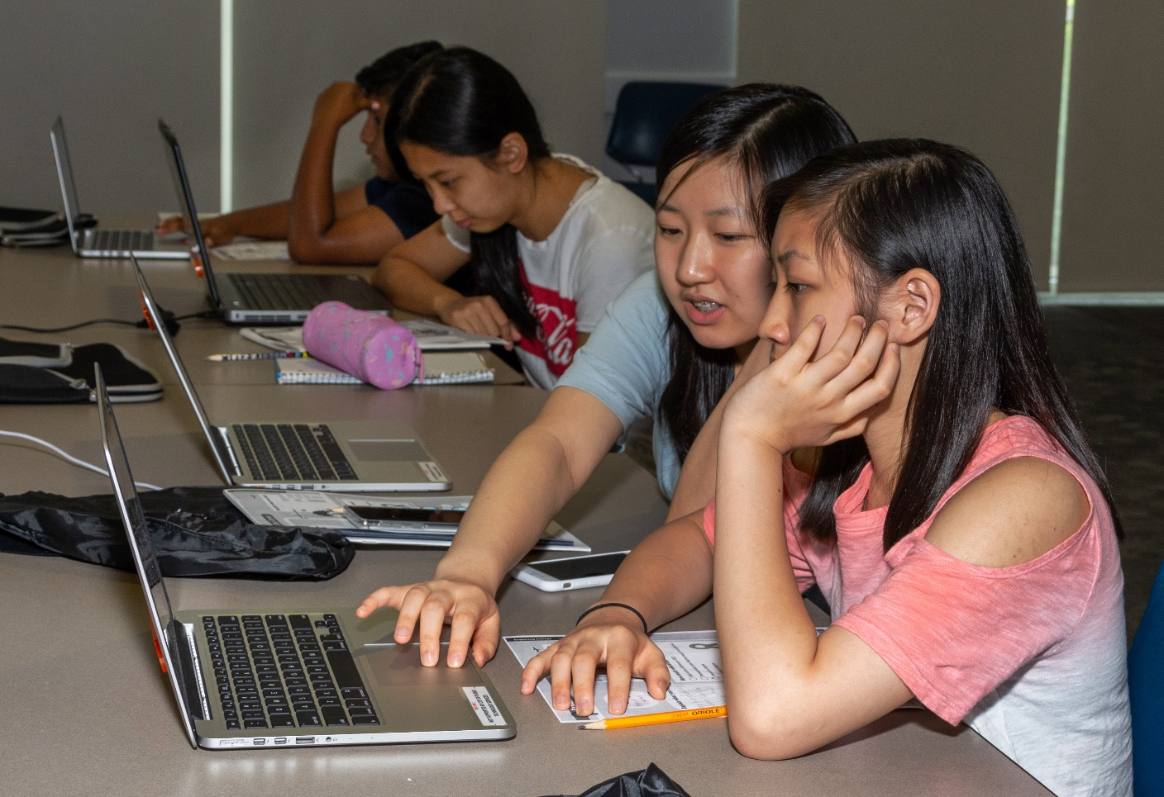
Successful Classes
Career training for adults
Navigate
Staff trained on career exploration database by the Federal Reserve Bank of Dallas
Laptops from library or facility devices
City House
Library card sign up

Slide 20
Successful Classes
Financial education with students and employees
Building Wealth
Staff trained on money basics (scenarios, strategies) by the Federal Reserve Bank of Dallas
Laptops from library or facility devices
College students, City employees
Library card sign up

Slide 21
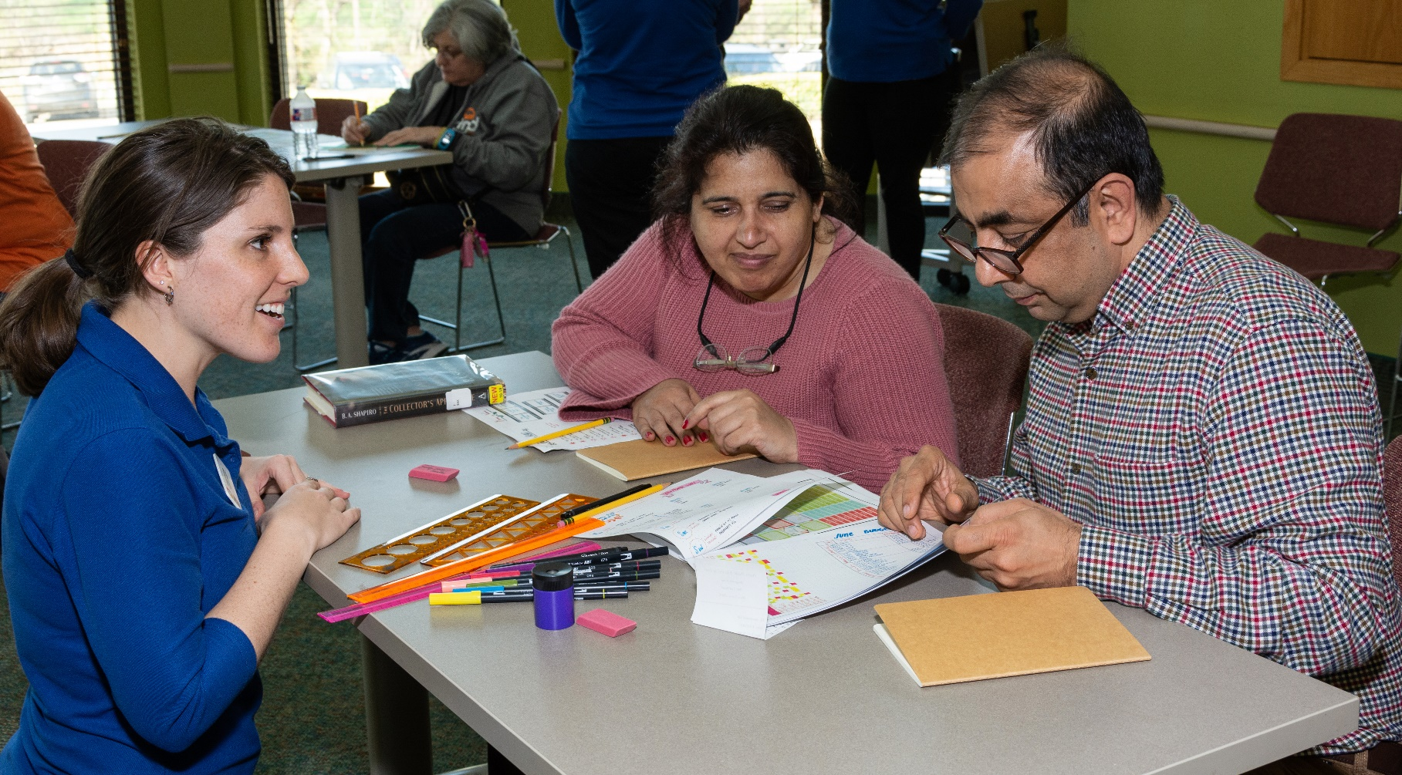
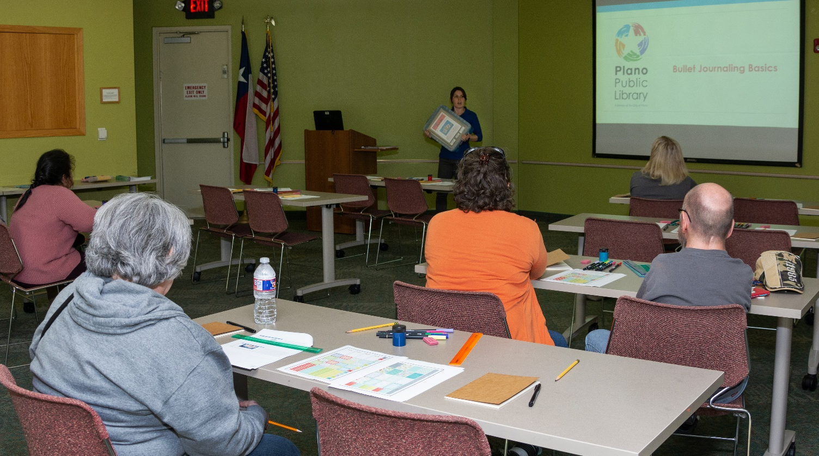
Successful Classes
Life planning and habit tracking
Bullet Journaling
Journal, markers, stickers, stencils, rulers, etc.
History and use of BUJO
Basic layout making
Share library resources
Library card sign up

Slide 22
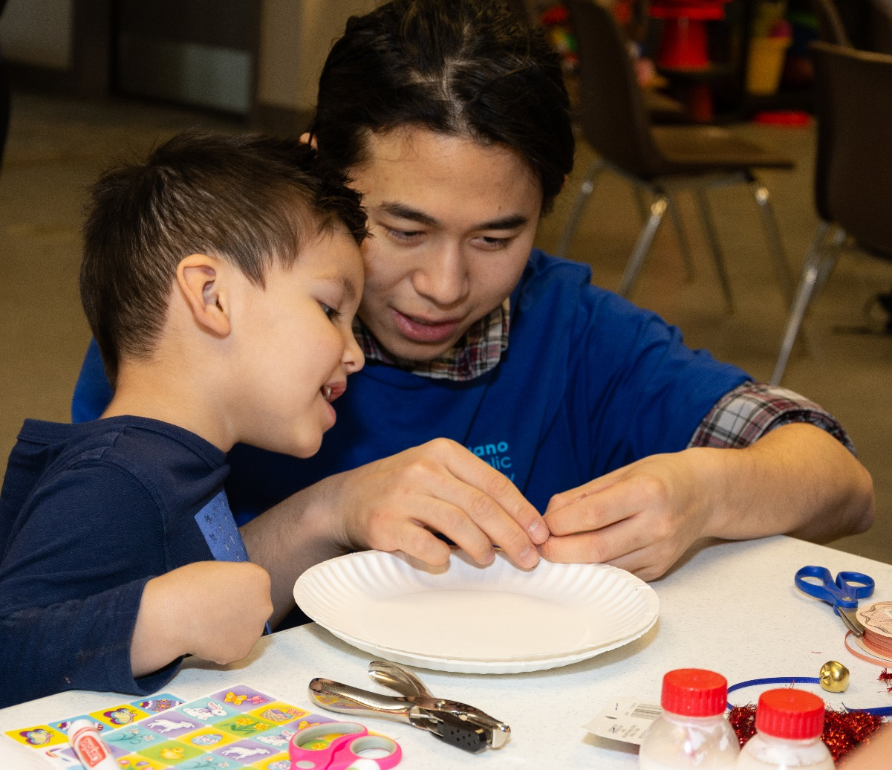
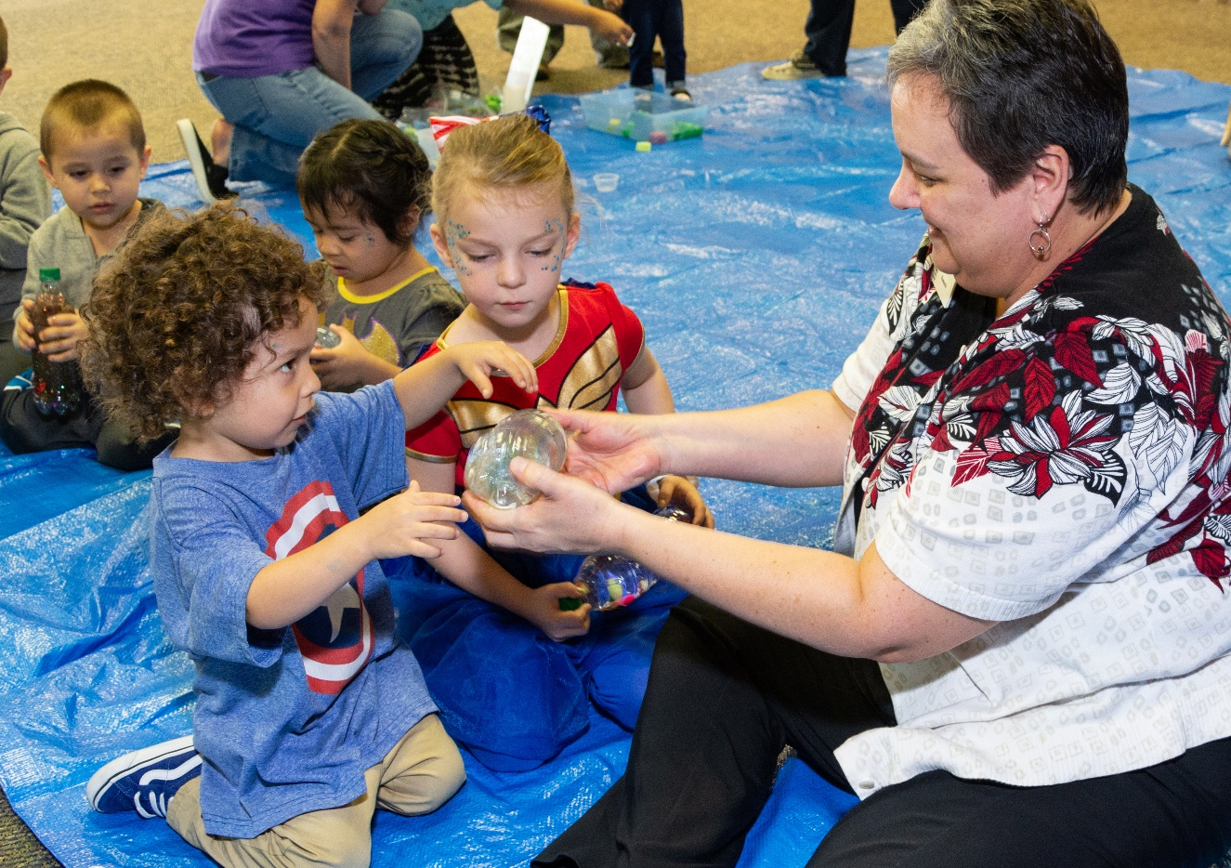
Successful Classes
Early learning with preschoolers and caregivers
STEAM and Stories
Sink/float, music, motion
Storytime
Related activity
Share library resources
Library card sign up

Slide 23
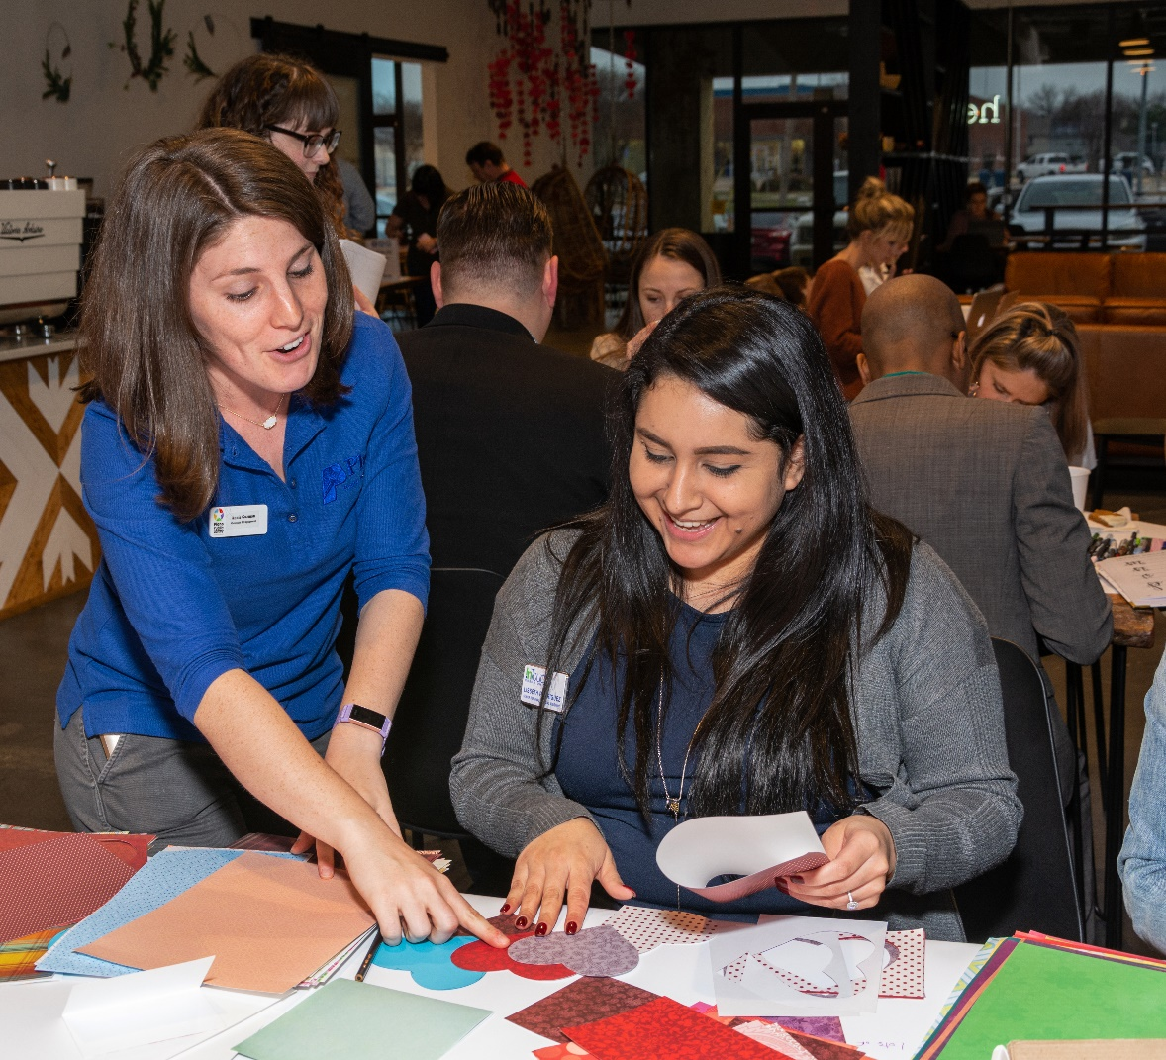
Successful Classes
Connecting with local businesses and young professionals
Valentine’s Day
Create Valentine’s Day cards with Young Professionals of Plano to distribute at memory care facility
Share library resources
Library card sign up

Slide 24
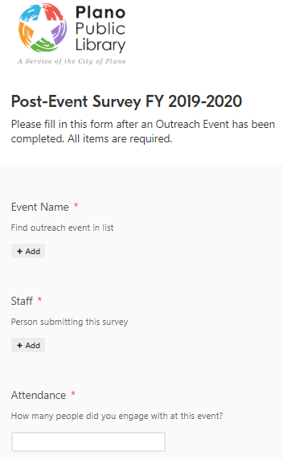
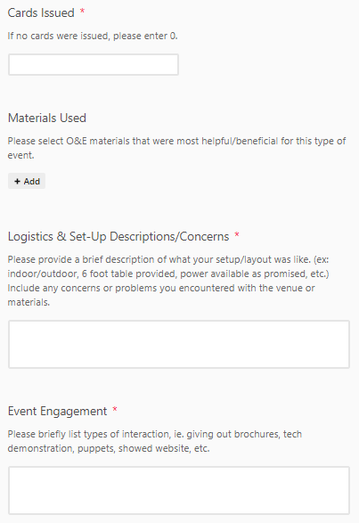
Post-event Survey
Gather quantitative and qualitative data for future outreach efforts and repeat events
Staff required
What worked, what did not
Common talking points
Resources shared

Slide 25
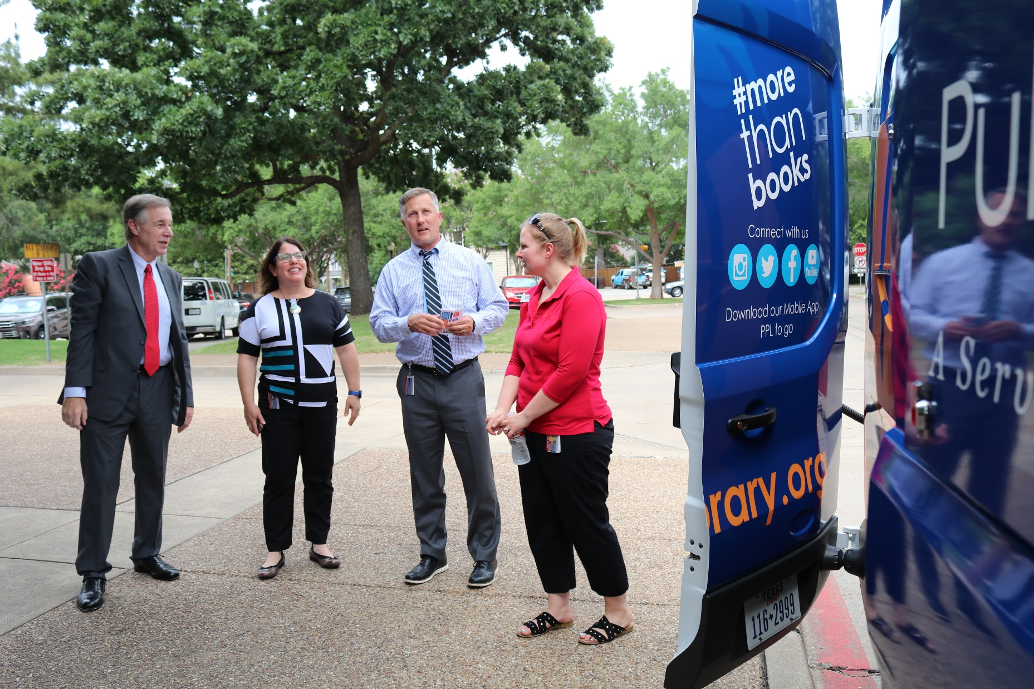
Resources
Plano Public Library: Partnerships and Outreach
Outreach curriculum & training documents

Slide 26
Questions?
Rachel Yzaguirre Community Outreach Librarian rachelyz@plano.gov 972-769-4472

