Slide 1
Working with Multi-Needs Children: An Introduction to Inclusion
Erin Linsenmeyer
Downers Grove Public Library
Downers Grove, Illinois

Slide 2
Areas of Focus
--Services
--Programs
--Collections

Slide 3
Why is this important?
2017 CDC report estimates that 1 in 6 children have one or more developmental disabilities
Attention-deficit/hyperactivity disorder
Autism spectrum disorder Blindness Cerebral palsy Moderate-to-profound hearing loss Learning disability Intellectual disability Seizure in the past 12 months Stuttering or stammering in the past 12 months Any other developmental delay
The percentage of children aged 3–17 years diagnosed with a developmental disability increased–from 16.2% in 2009–2011 to 17.8% in 2015–2017.
Libraries are for everyone.

Slide 4
Inclusive Services
--Speak directly to the patron
--Allow for processing and response time
--Use visual supports
--Offer choices
--Adjust delivery

Slide 5
Inclusivity in Programs/Outreach
Inclusive Programs and Targeted Programs
Sensory-Friendly Performances
Therapy Dog Programs
Early Intervention Play Groups
Special Needs Fair
Accessible Library Hour
Finding and working with community partners

Slide 6
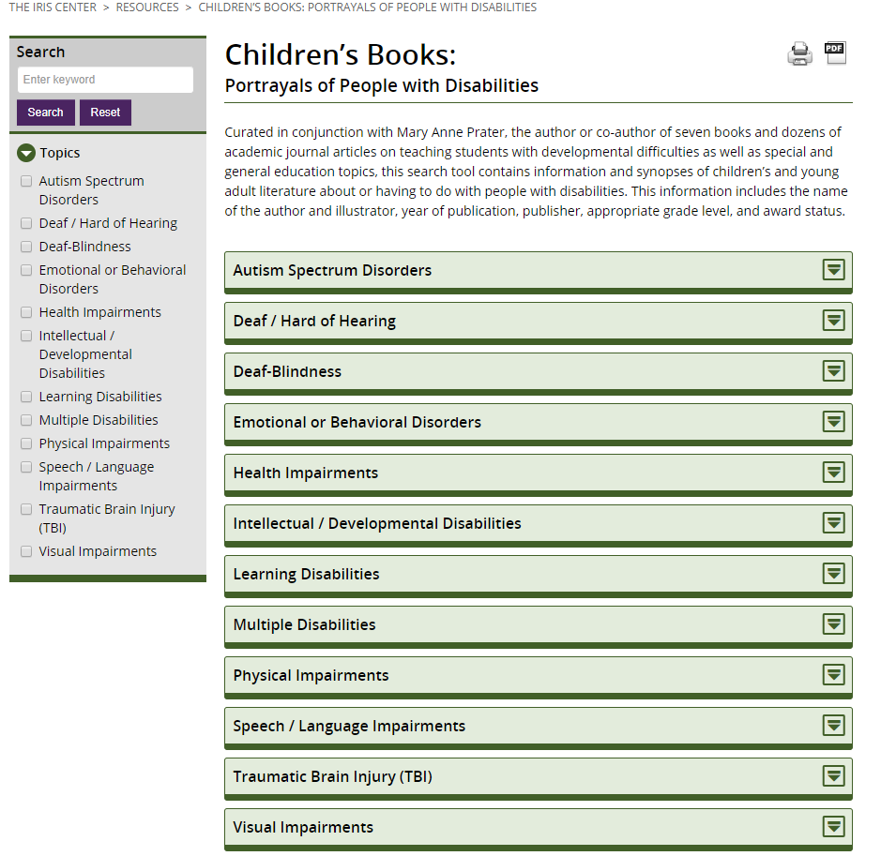
Collections
Iris Center at Vanderbilt University https://iris.peabody.vanderbilt.edu/resources/books/

Slide 7
Resources
Grassi, Renee. “Serving Children With Disabiltiies in Libraries: A Beginner’s Guide.” Association for Library Service to Children Blog. 7.2.2016. https://www.alsc.ala.org/blog/2016/07/serving-children-disabilities-libraries-beginners-guide/
Shelton, Anna. “Welcoming Children with Disabilities at Your Library.” WebJunction. 11.3.2014 https://www.webjunction.org/news/webjunction/welcoming-children-with-disabilities-at-your-library.html
Taggert, Jen. Adaptive Umbrella blog: https://adaptiveumbrella.blogspot.com/
Taggert, Jen. “A Spectrum on the Shelves: Building a Library Collection for People with Autism.” WebJunction Webinar.
Targeting Autism Forum YouTube Page: https://www.youtube.com/channel/UCzCcPYorVv2l7OcllfCgdVg

Slide 8
Questions?
Erin Linsenmeyer
Children’s Librarian--Outreach Coordinator
Downers Grove Public Library
elinsenmeyer@dglibrary.org

