Slide 1


Where Will We PopUp Next? Meeting Our Customers Where They Are
Kristen Sherry, Outreach Services Manager
Brittany Steck, Outreach Services Paraprofessional
St. Charles City-County Library

Slide 2
A Little Background...
We’re a baby department!
We’re growing VERY quickly!
Almost everything we do is new to our Library system!

Slide 3

Notes:
“Popping Up” at various different fairs, festivals, and other events throughout our county.
Talk about what a PopUp is here?

Slide 4
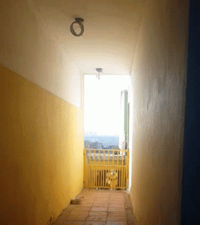
Why PopUp?
Decrease barriers!
Increase Access!
Make connections!

Slide 5
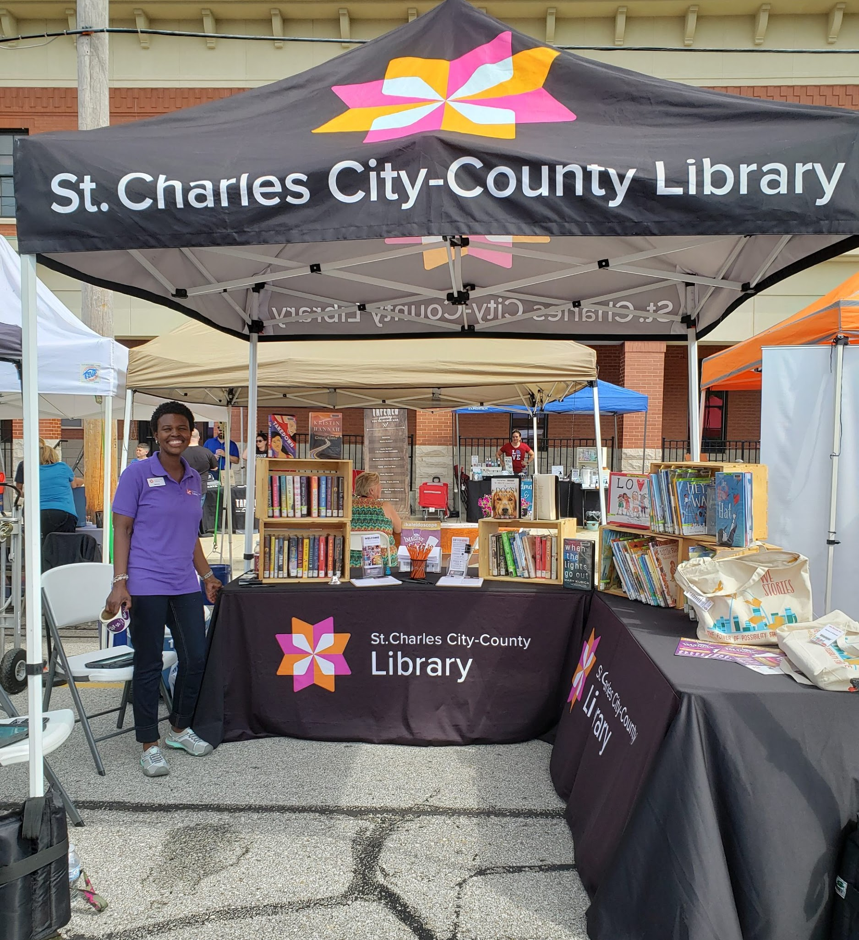
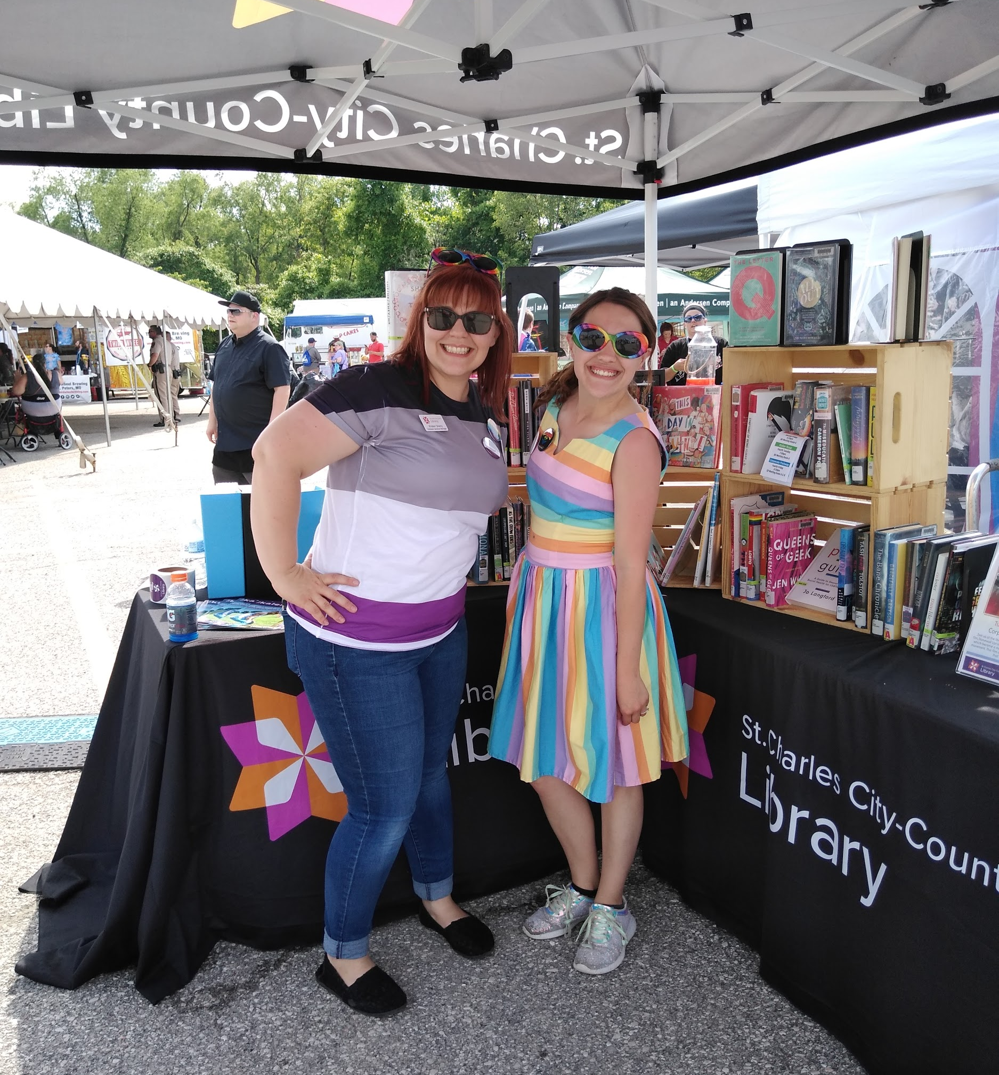
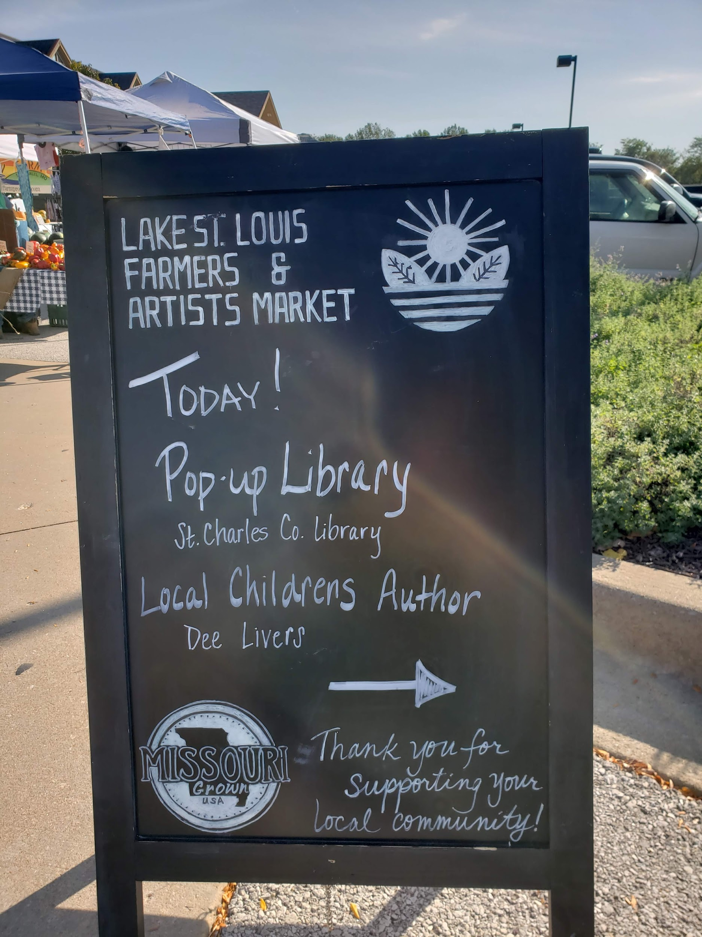
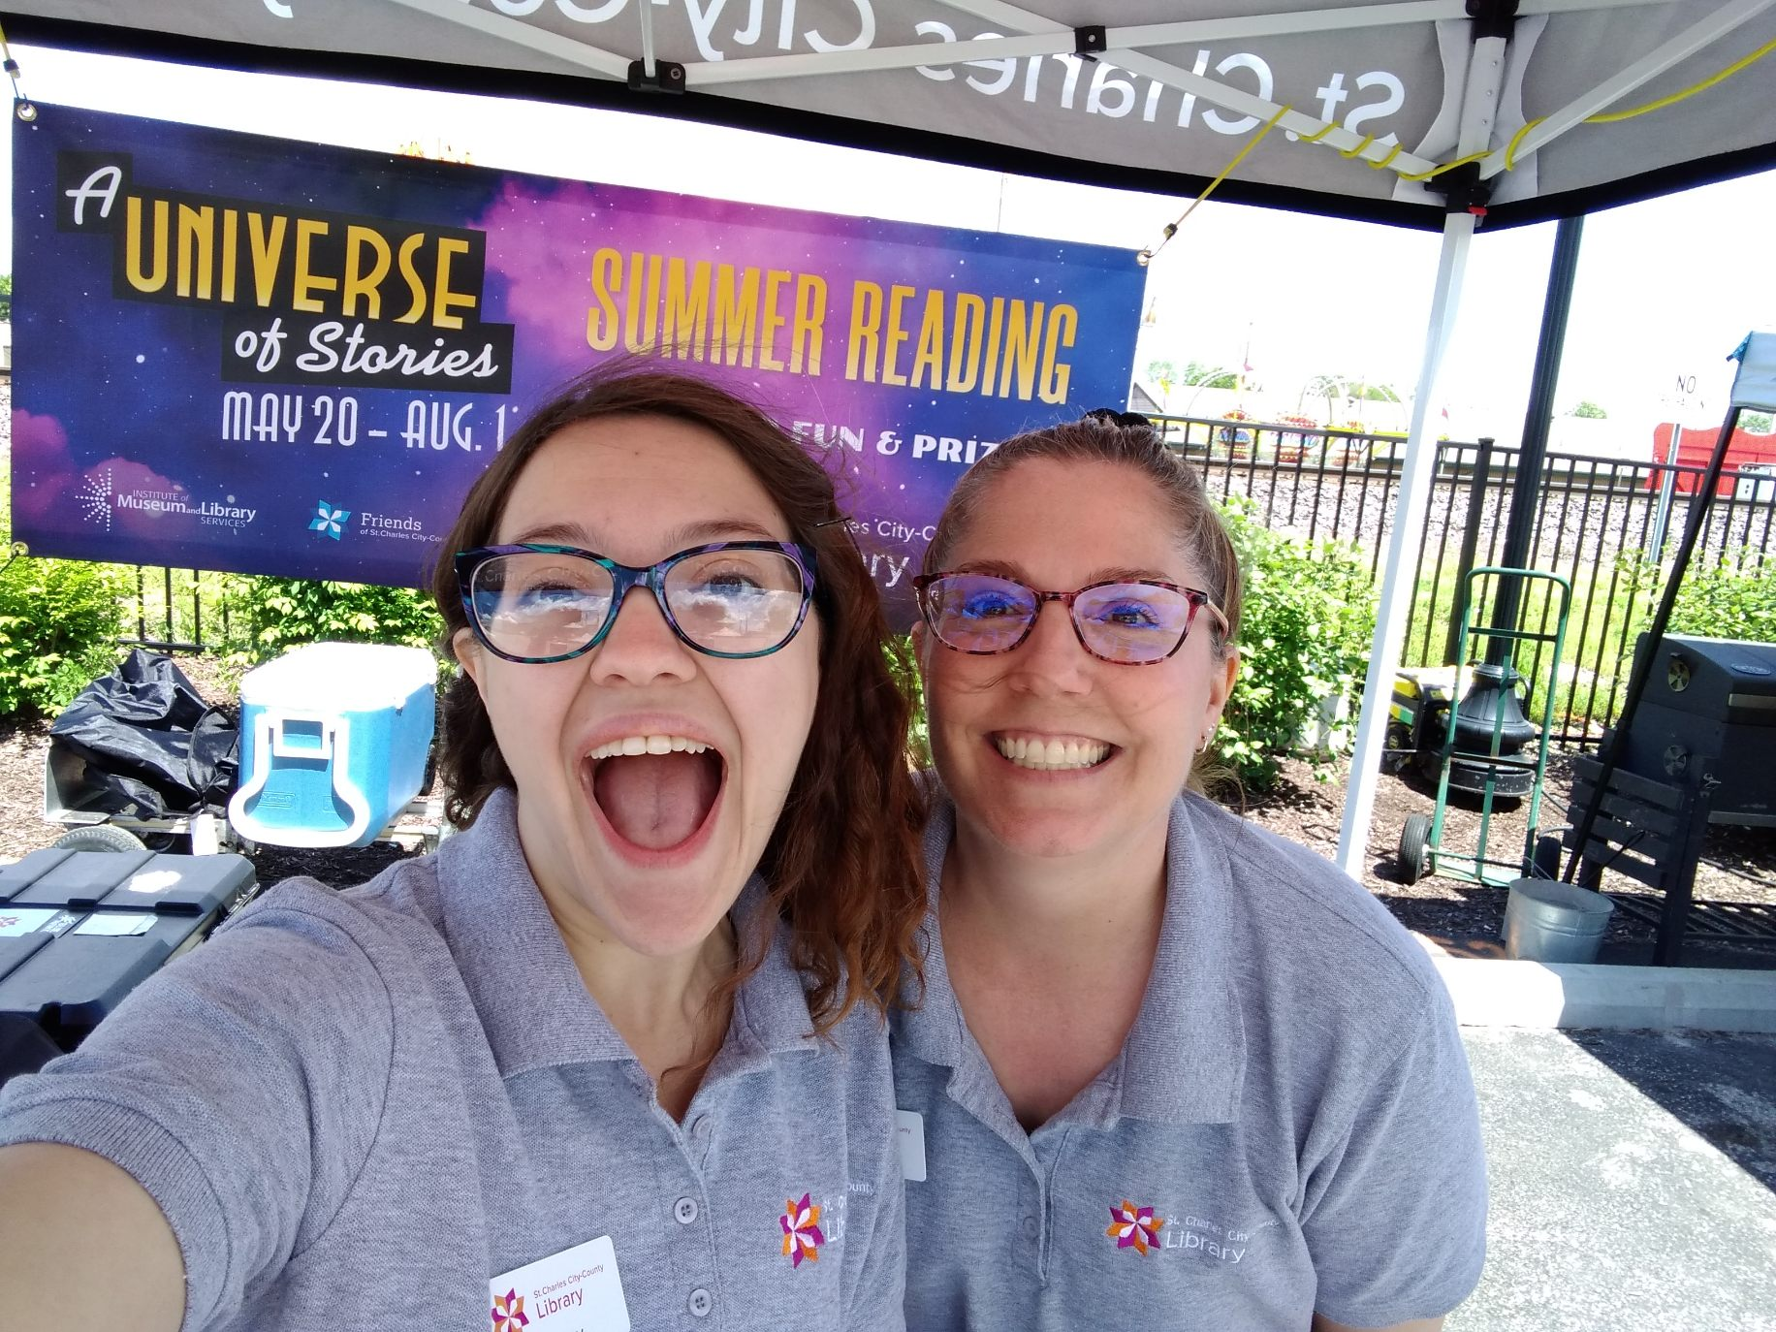
Where to PopUp?
Festivals
Fairs
Markets
Oh my!

Slide 6

Planning
How do I find events?
How do I staff it?
What should I bring?
  For customers and for staff!
Checklists!

Slide 7
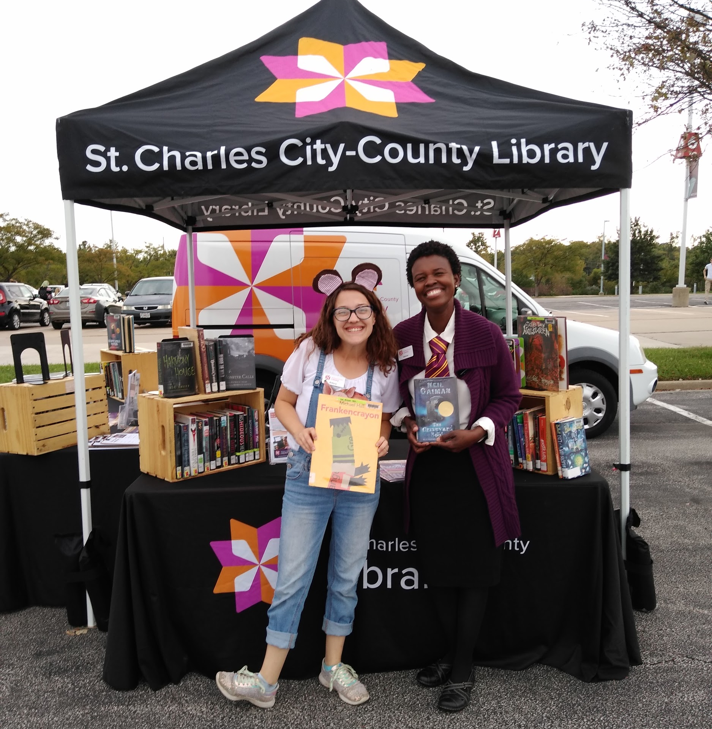
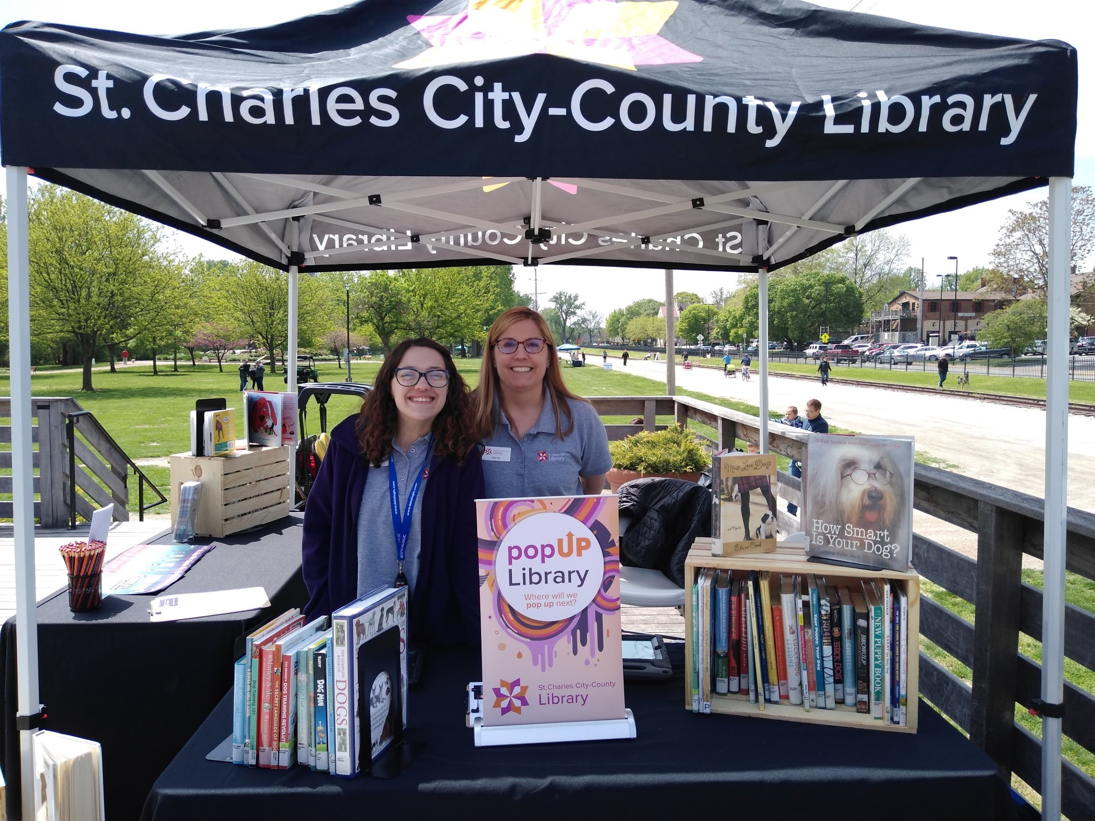
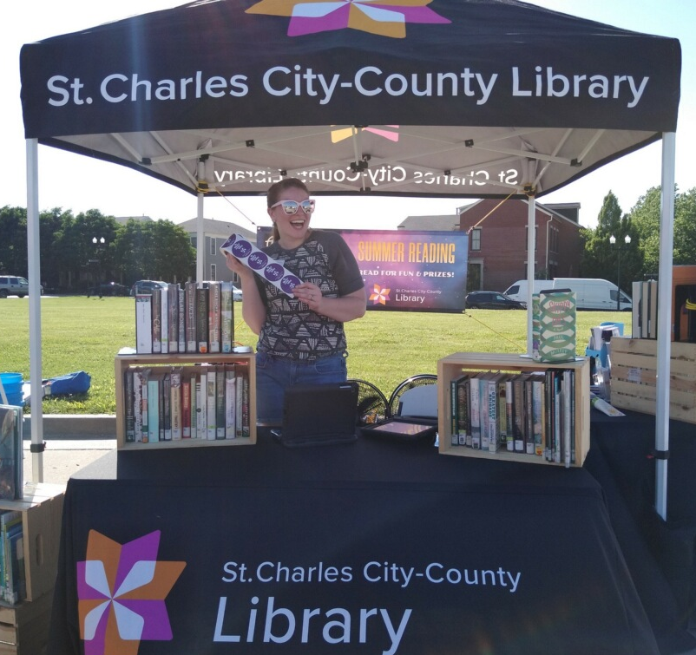
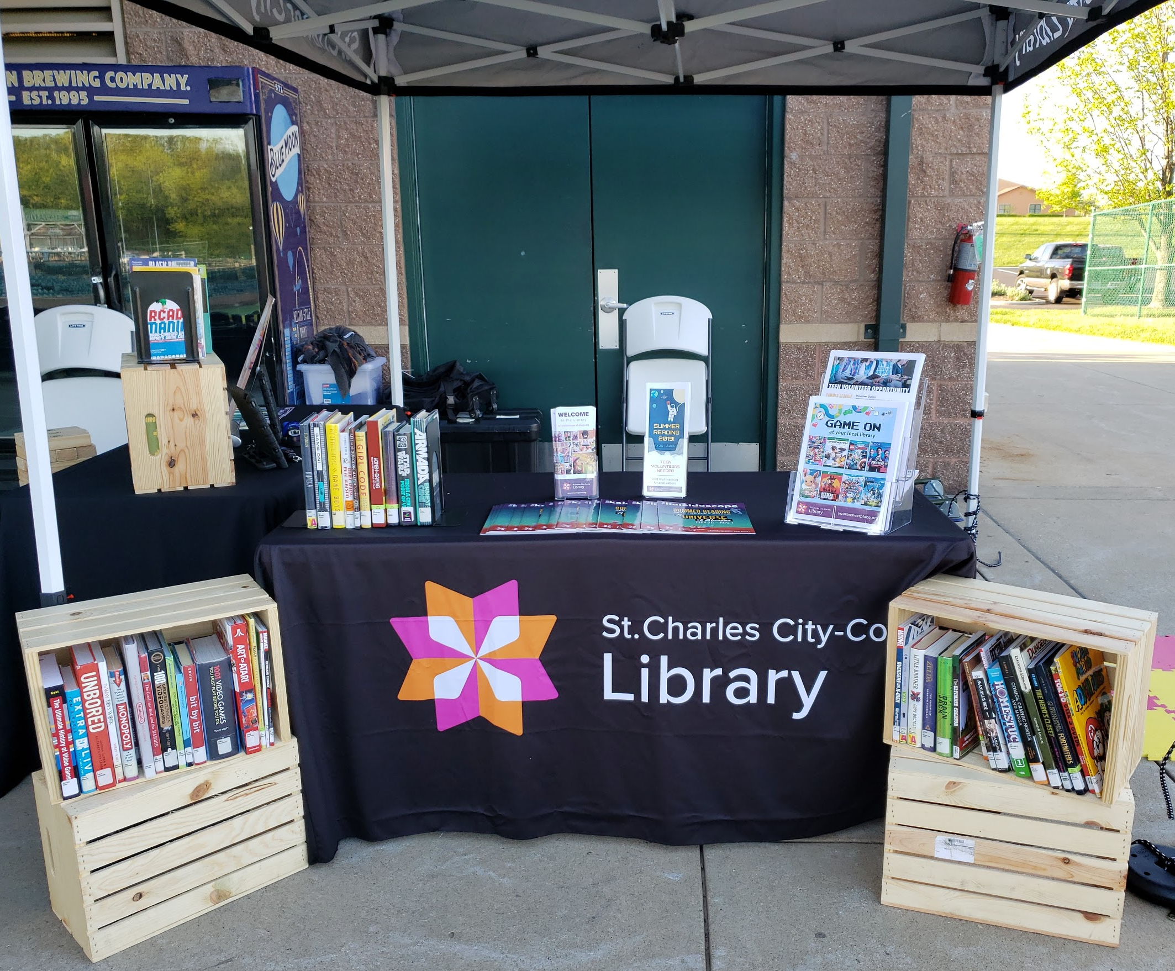
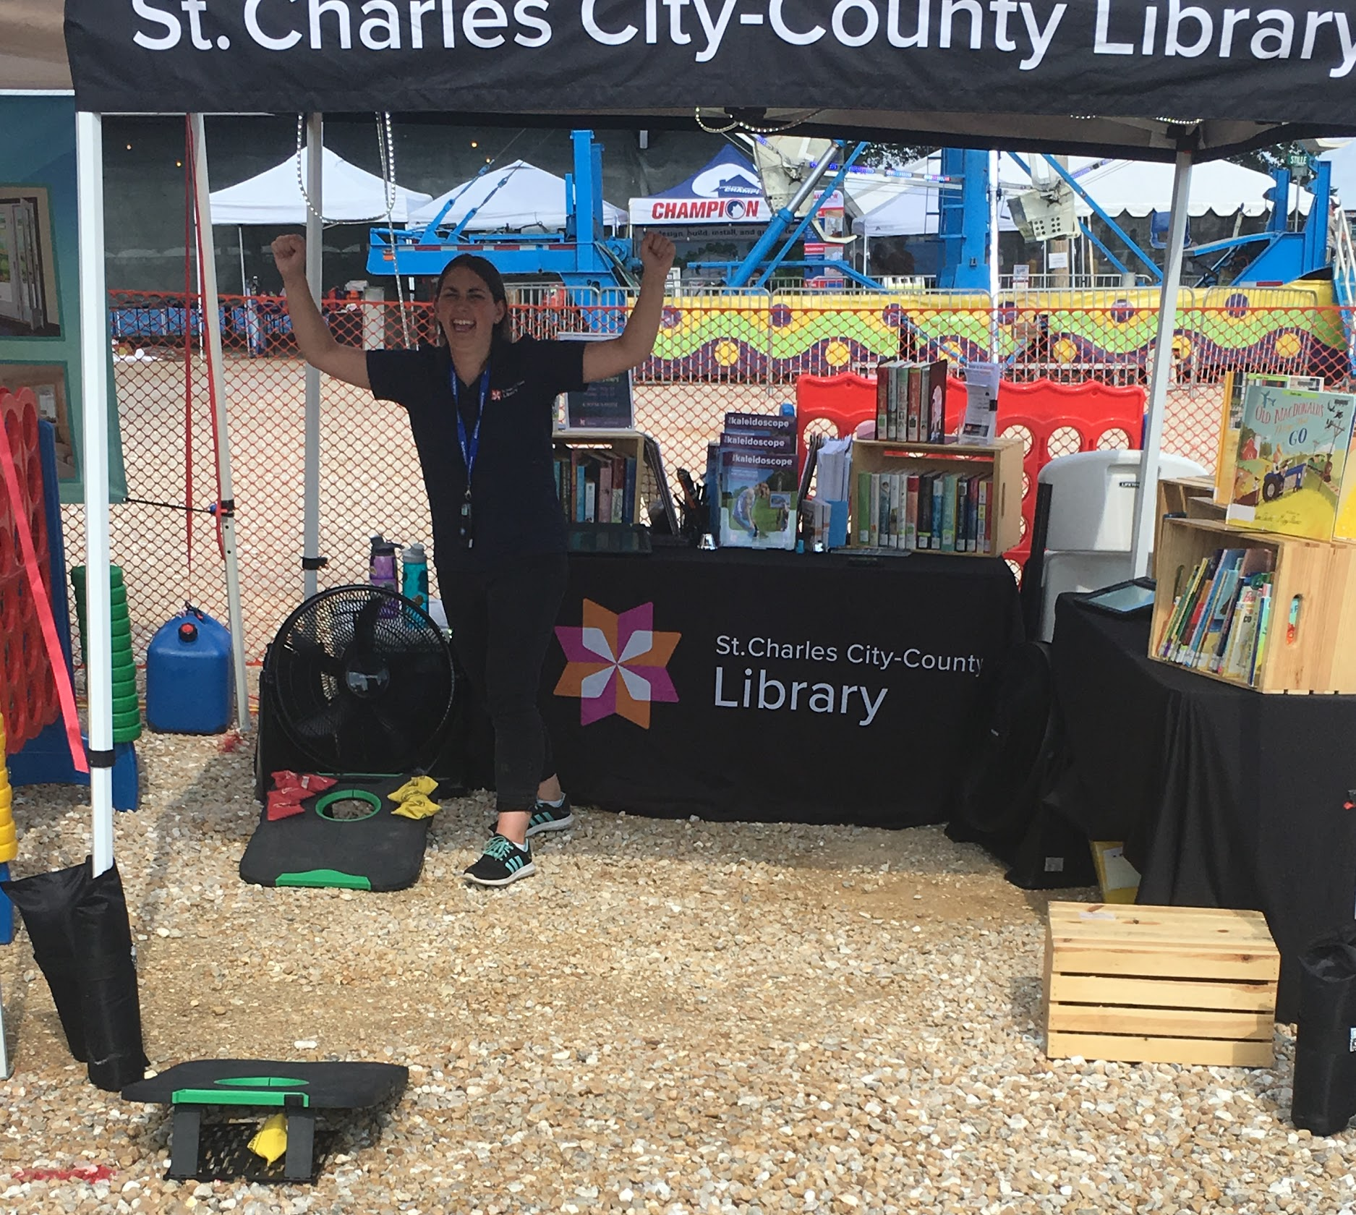
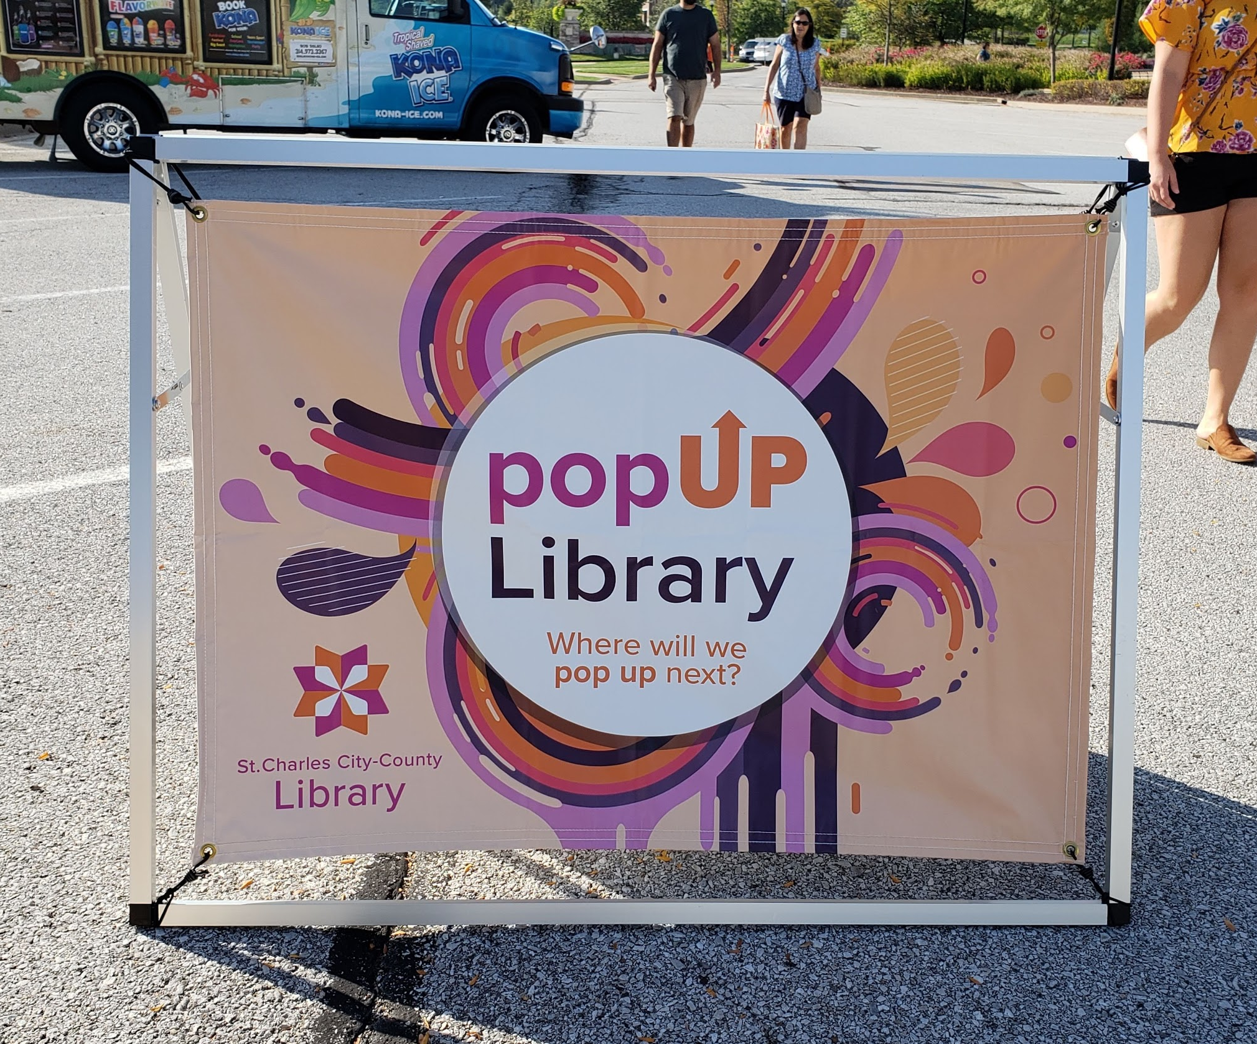
Execution
Branding!
Set-up!
Presentation!
Enthusiasm!
Did I say Enthusiasm?

Slide 8
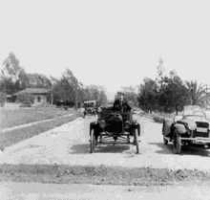
Troubleshooting
Weather woes!
  Wind, Rain, Heat
Technology tantrums!
Didn’t you say we had…?
  Something you’re expecting is not available

Slide 9
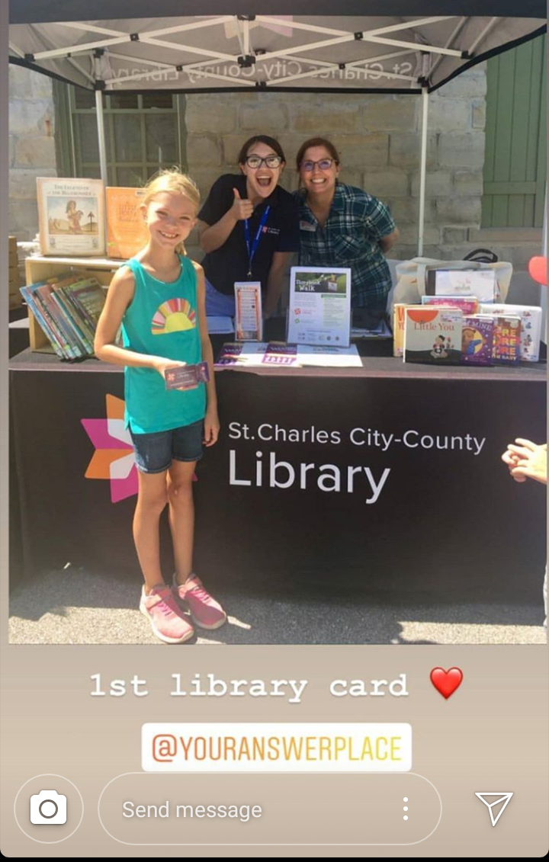
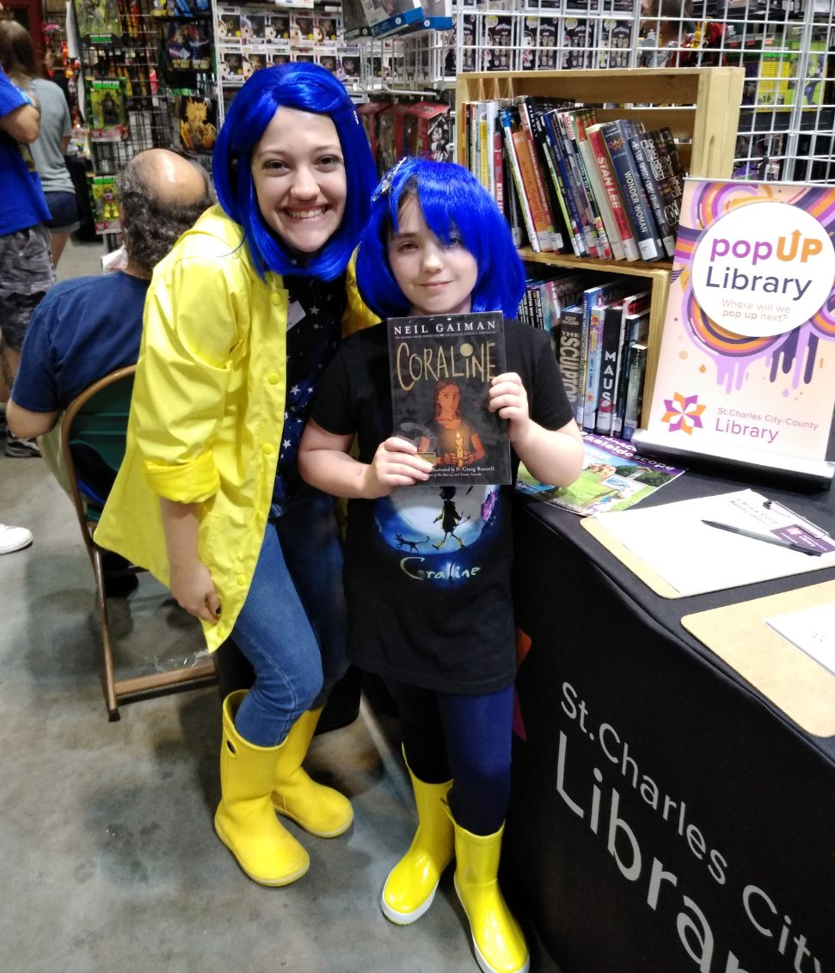
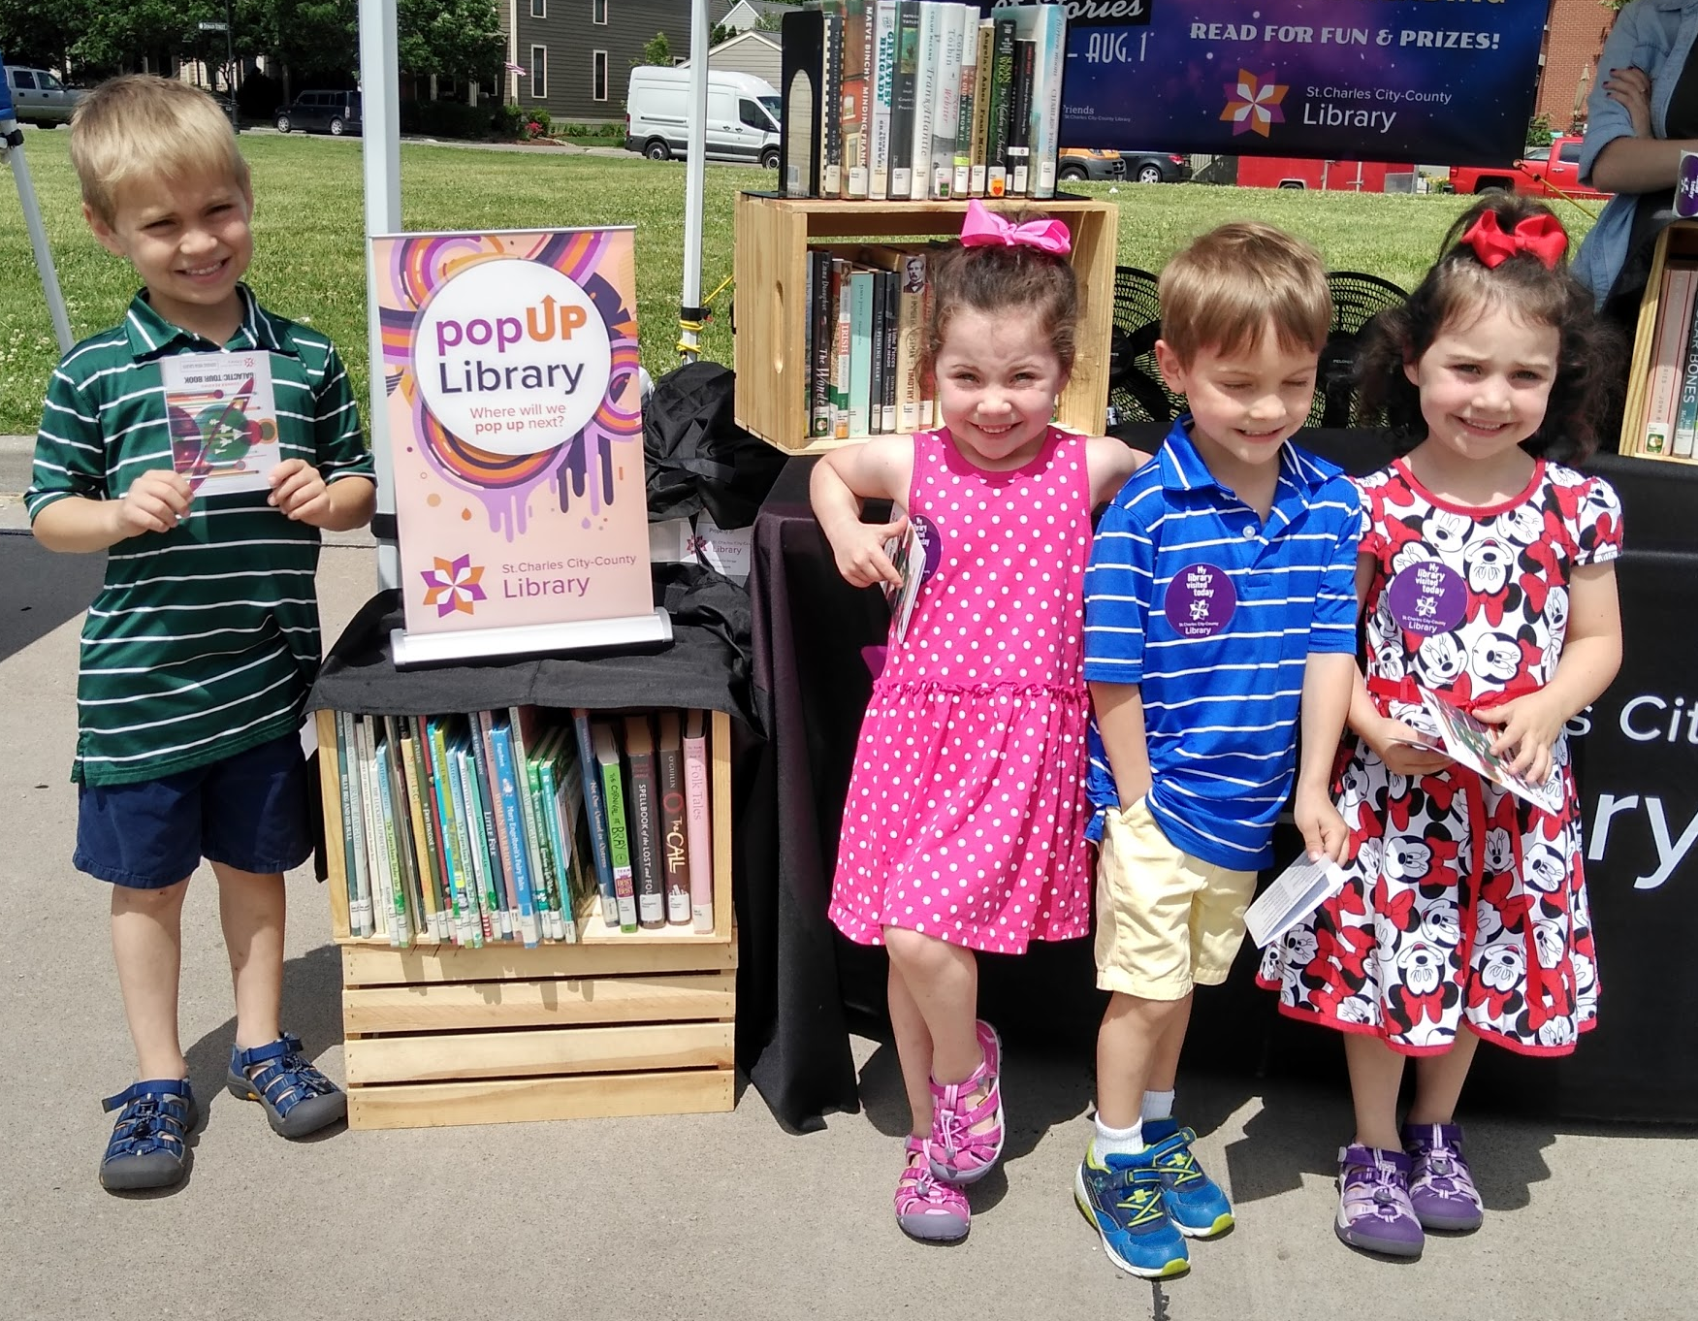
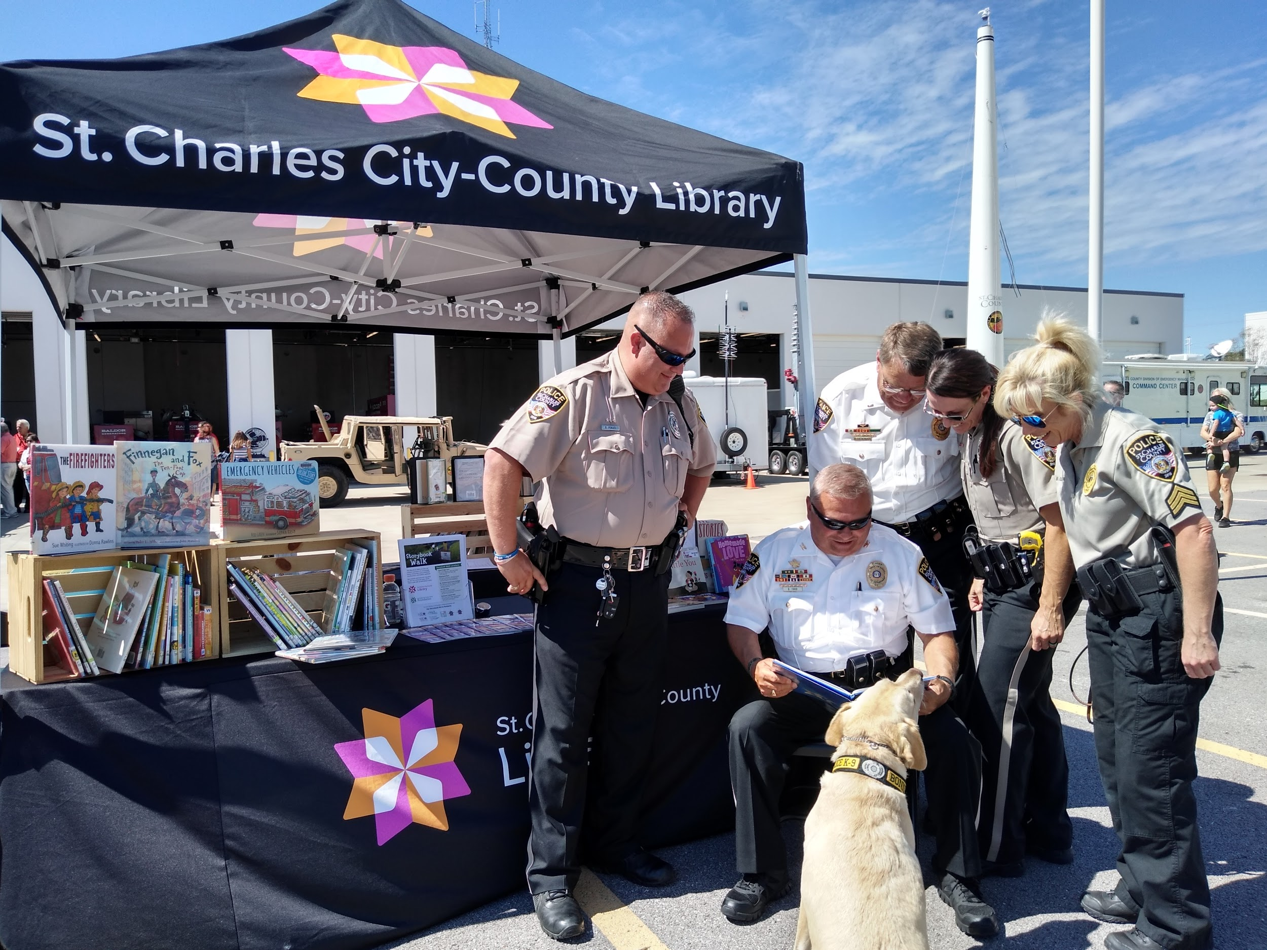
What Success Looks Like
Surface numbers and statistics
Customer connections and genuine interactions
Sometimes successes and busts happen in the most surprising places!

Slide 10

Measuring Impact
Surveys
Anecdotal evidence
Stories, stories, stories!
Statistics
Report out on all of it! It’s so important!

Slide 11




Funding: Shoe String Budget or Big Bucks
Leverage all your funding options
  Grants (local, state, national), Foundation or Friends group, etc
Make a case for the budget line
  Do your research, gather your numbers, WRITE IT UP!
Emphasize the community impact
Get creative!

Slide 12
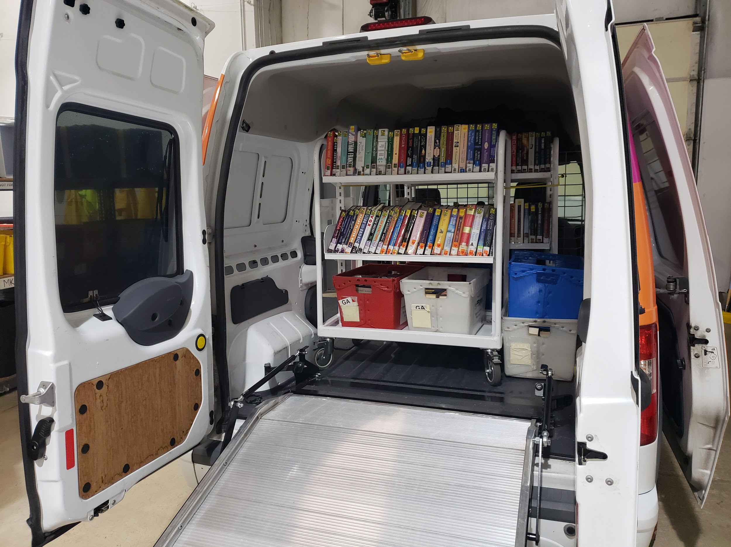
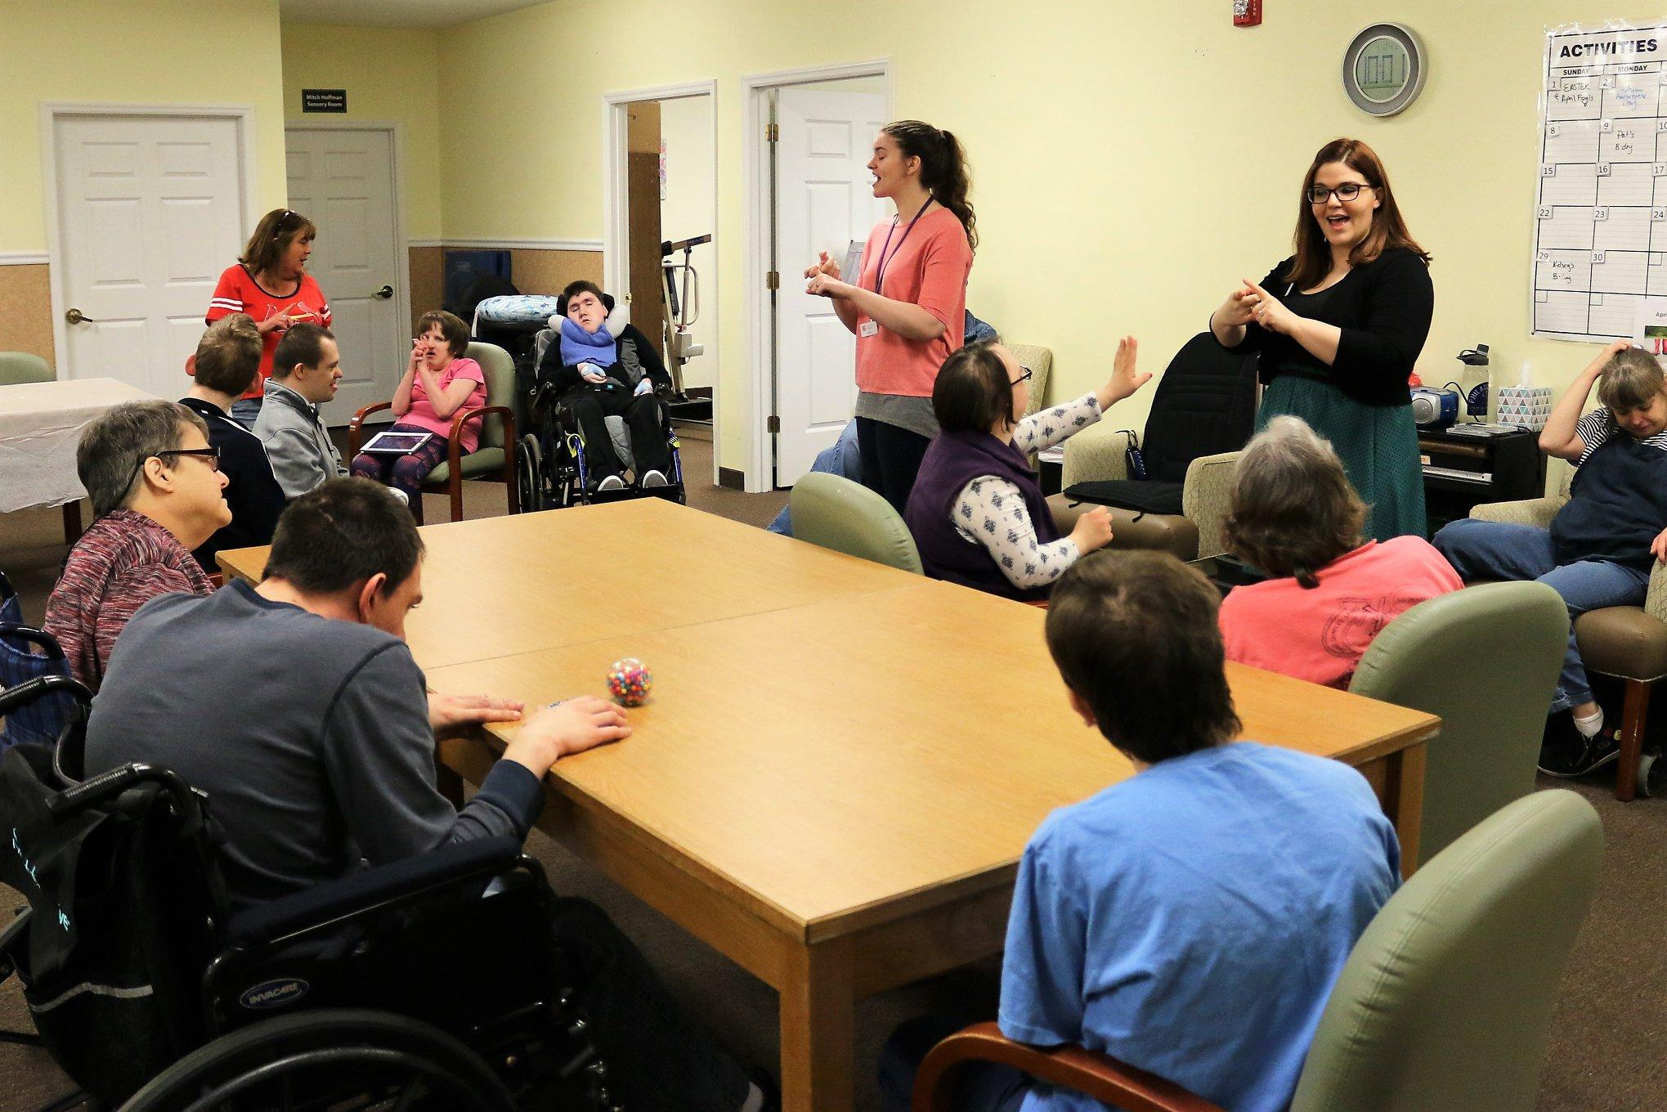
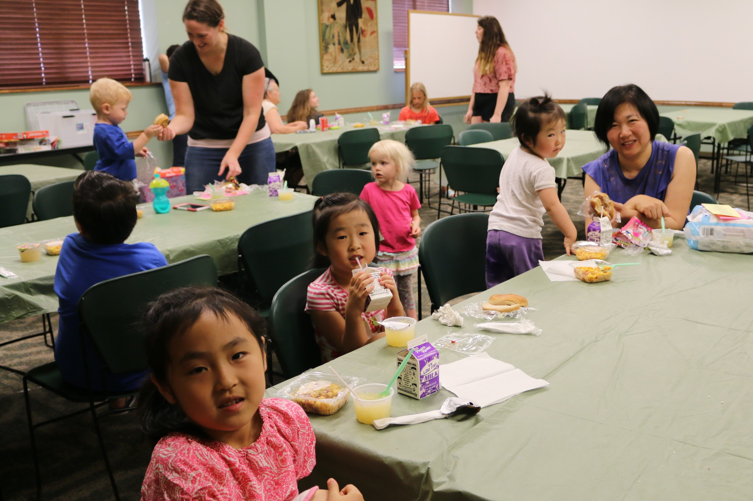
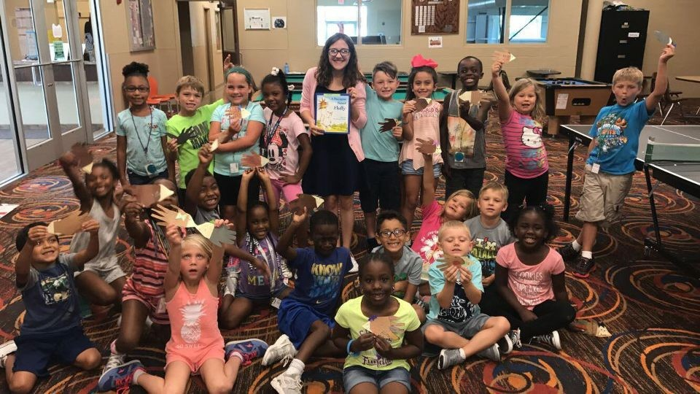
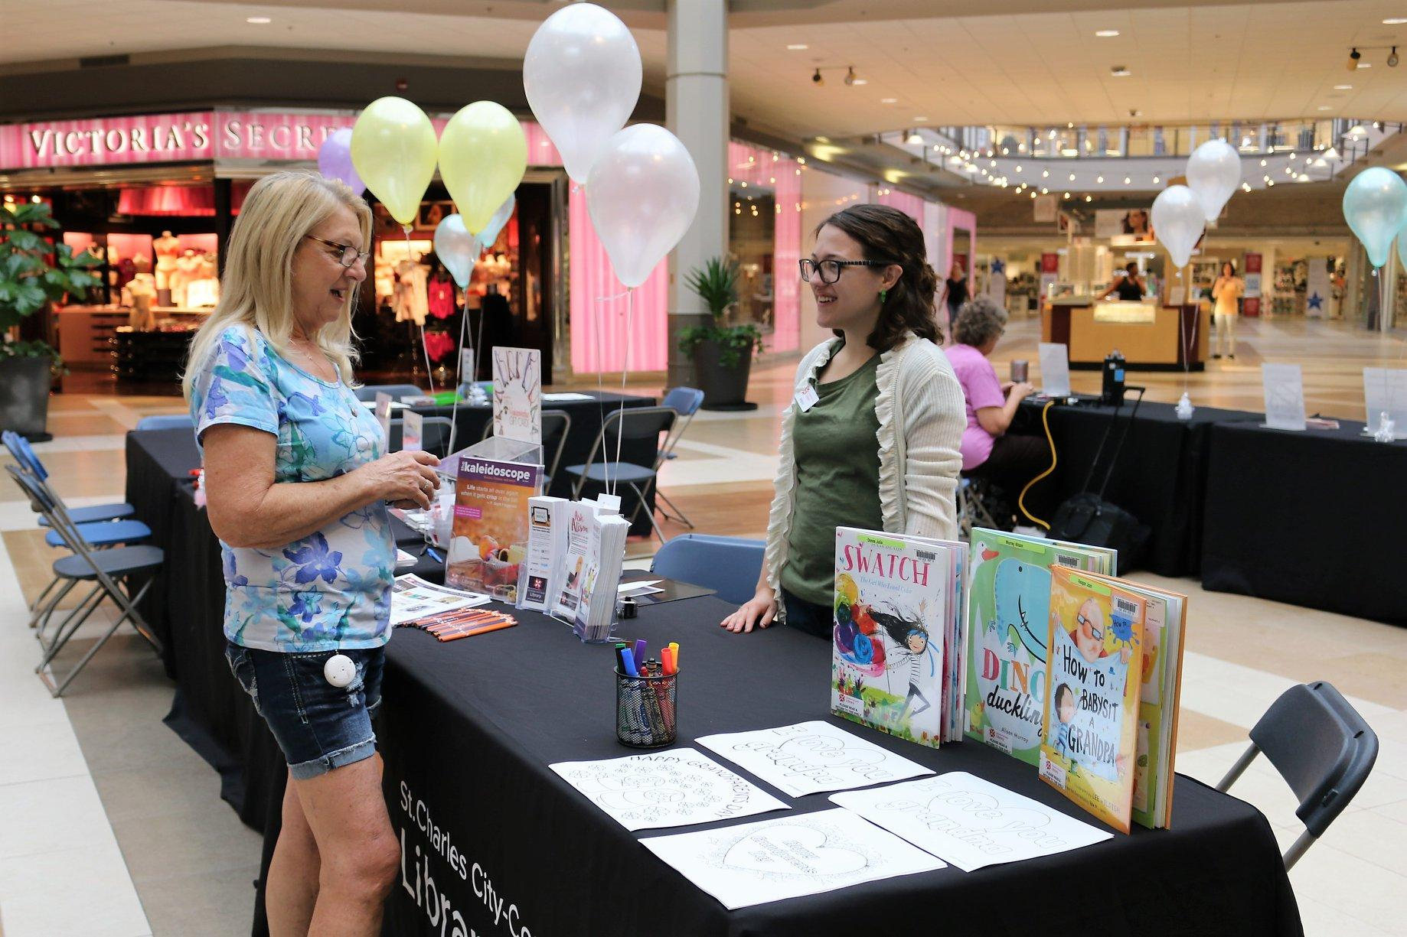
What Else in SCCCL Outreach? SO MUCH!
Homebound Services
Lunch @ the Library
Community Event Presence
School & Organization Visits
Reminisce & Ability Inclusive Programming
The sky is the limit!

Slide 13
Contact Information
Kristen Sherry, Outreach Services Manager Brittany Steck, Outreach Services Paraprofessional
636-441-2300 x1643 636-441-2300 x1645
ksherry@stchlibrary.org bsteck@stchlibrary.org
Outreach Services Department
outreach@stchlibrary.org
636-441-2300 x1640

Slide 14
a kaleidoscope of discovery

