Slide 1
Good Problems
to Have
...and how we worked through them

Slide 2
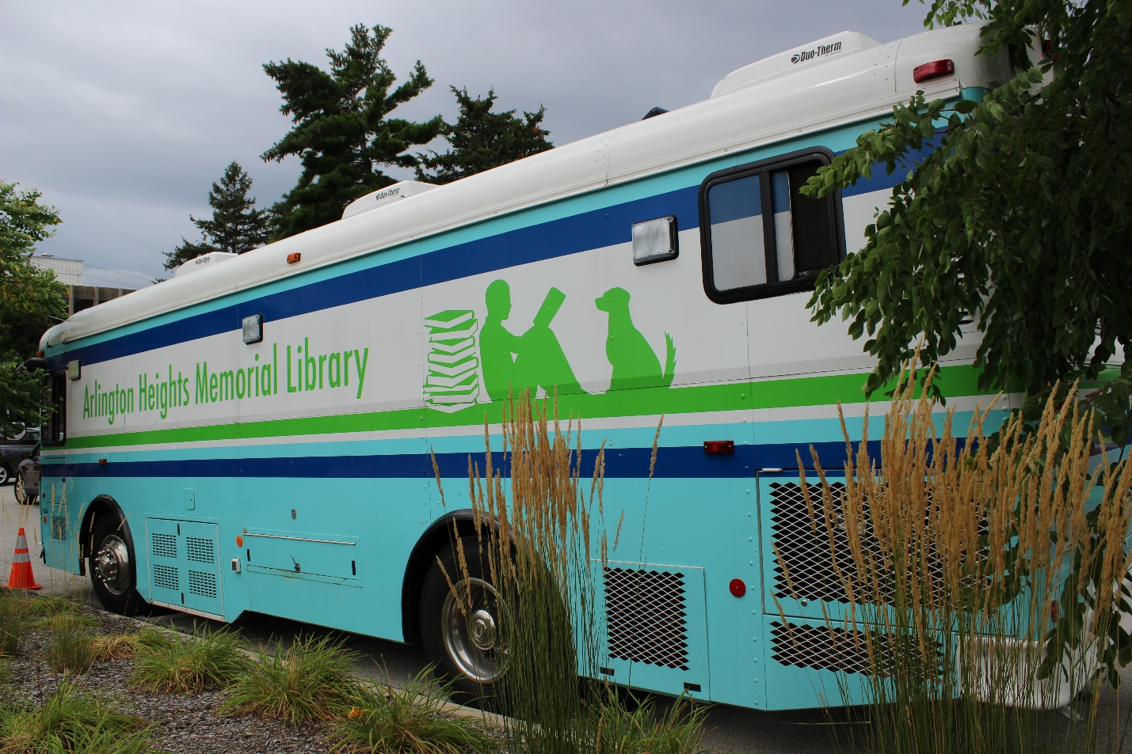
Arlington Heights
Memorial Library
Bookmobile
Services

Slide 3
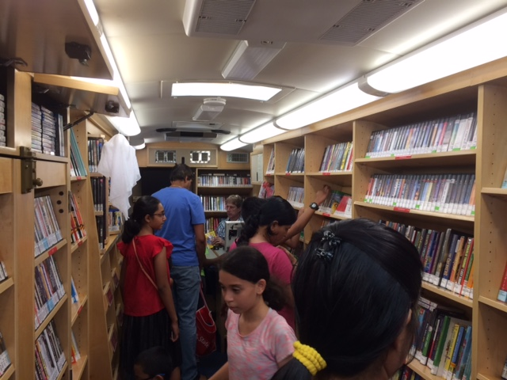
Over 100 Customers
an Hour

Slide 4
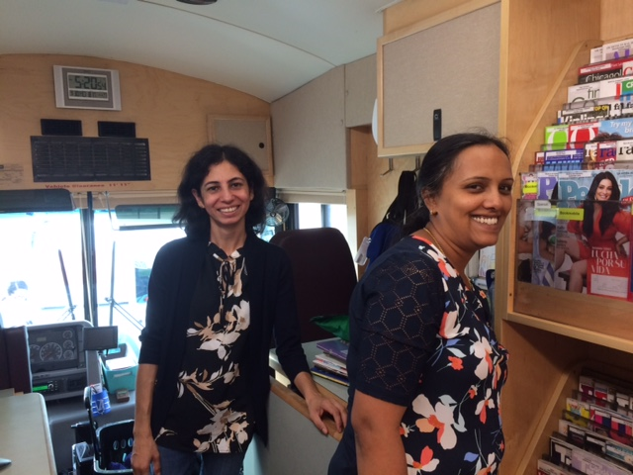
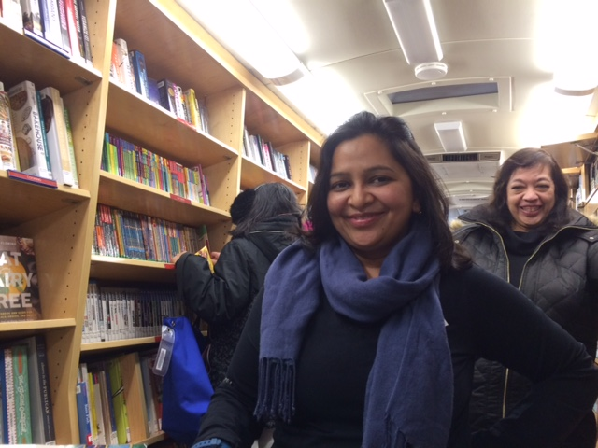
Volunteers

Slide 5
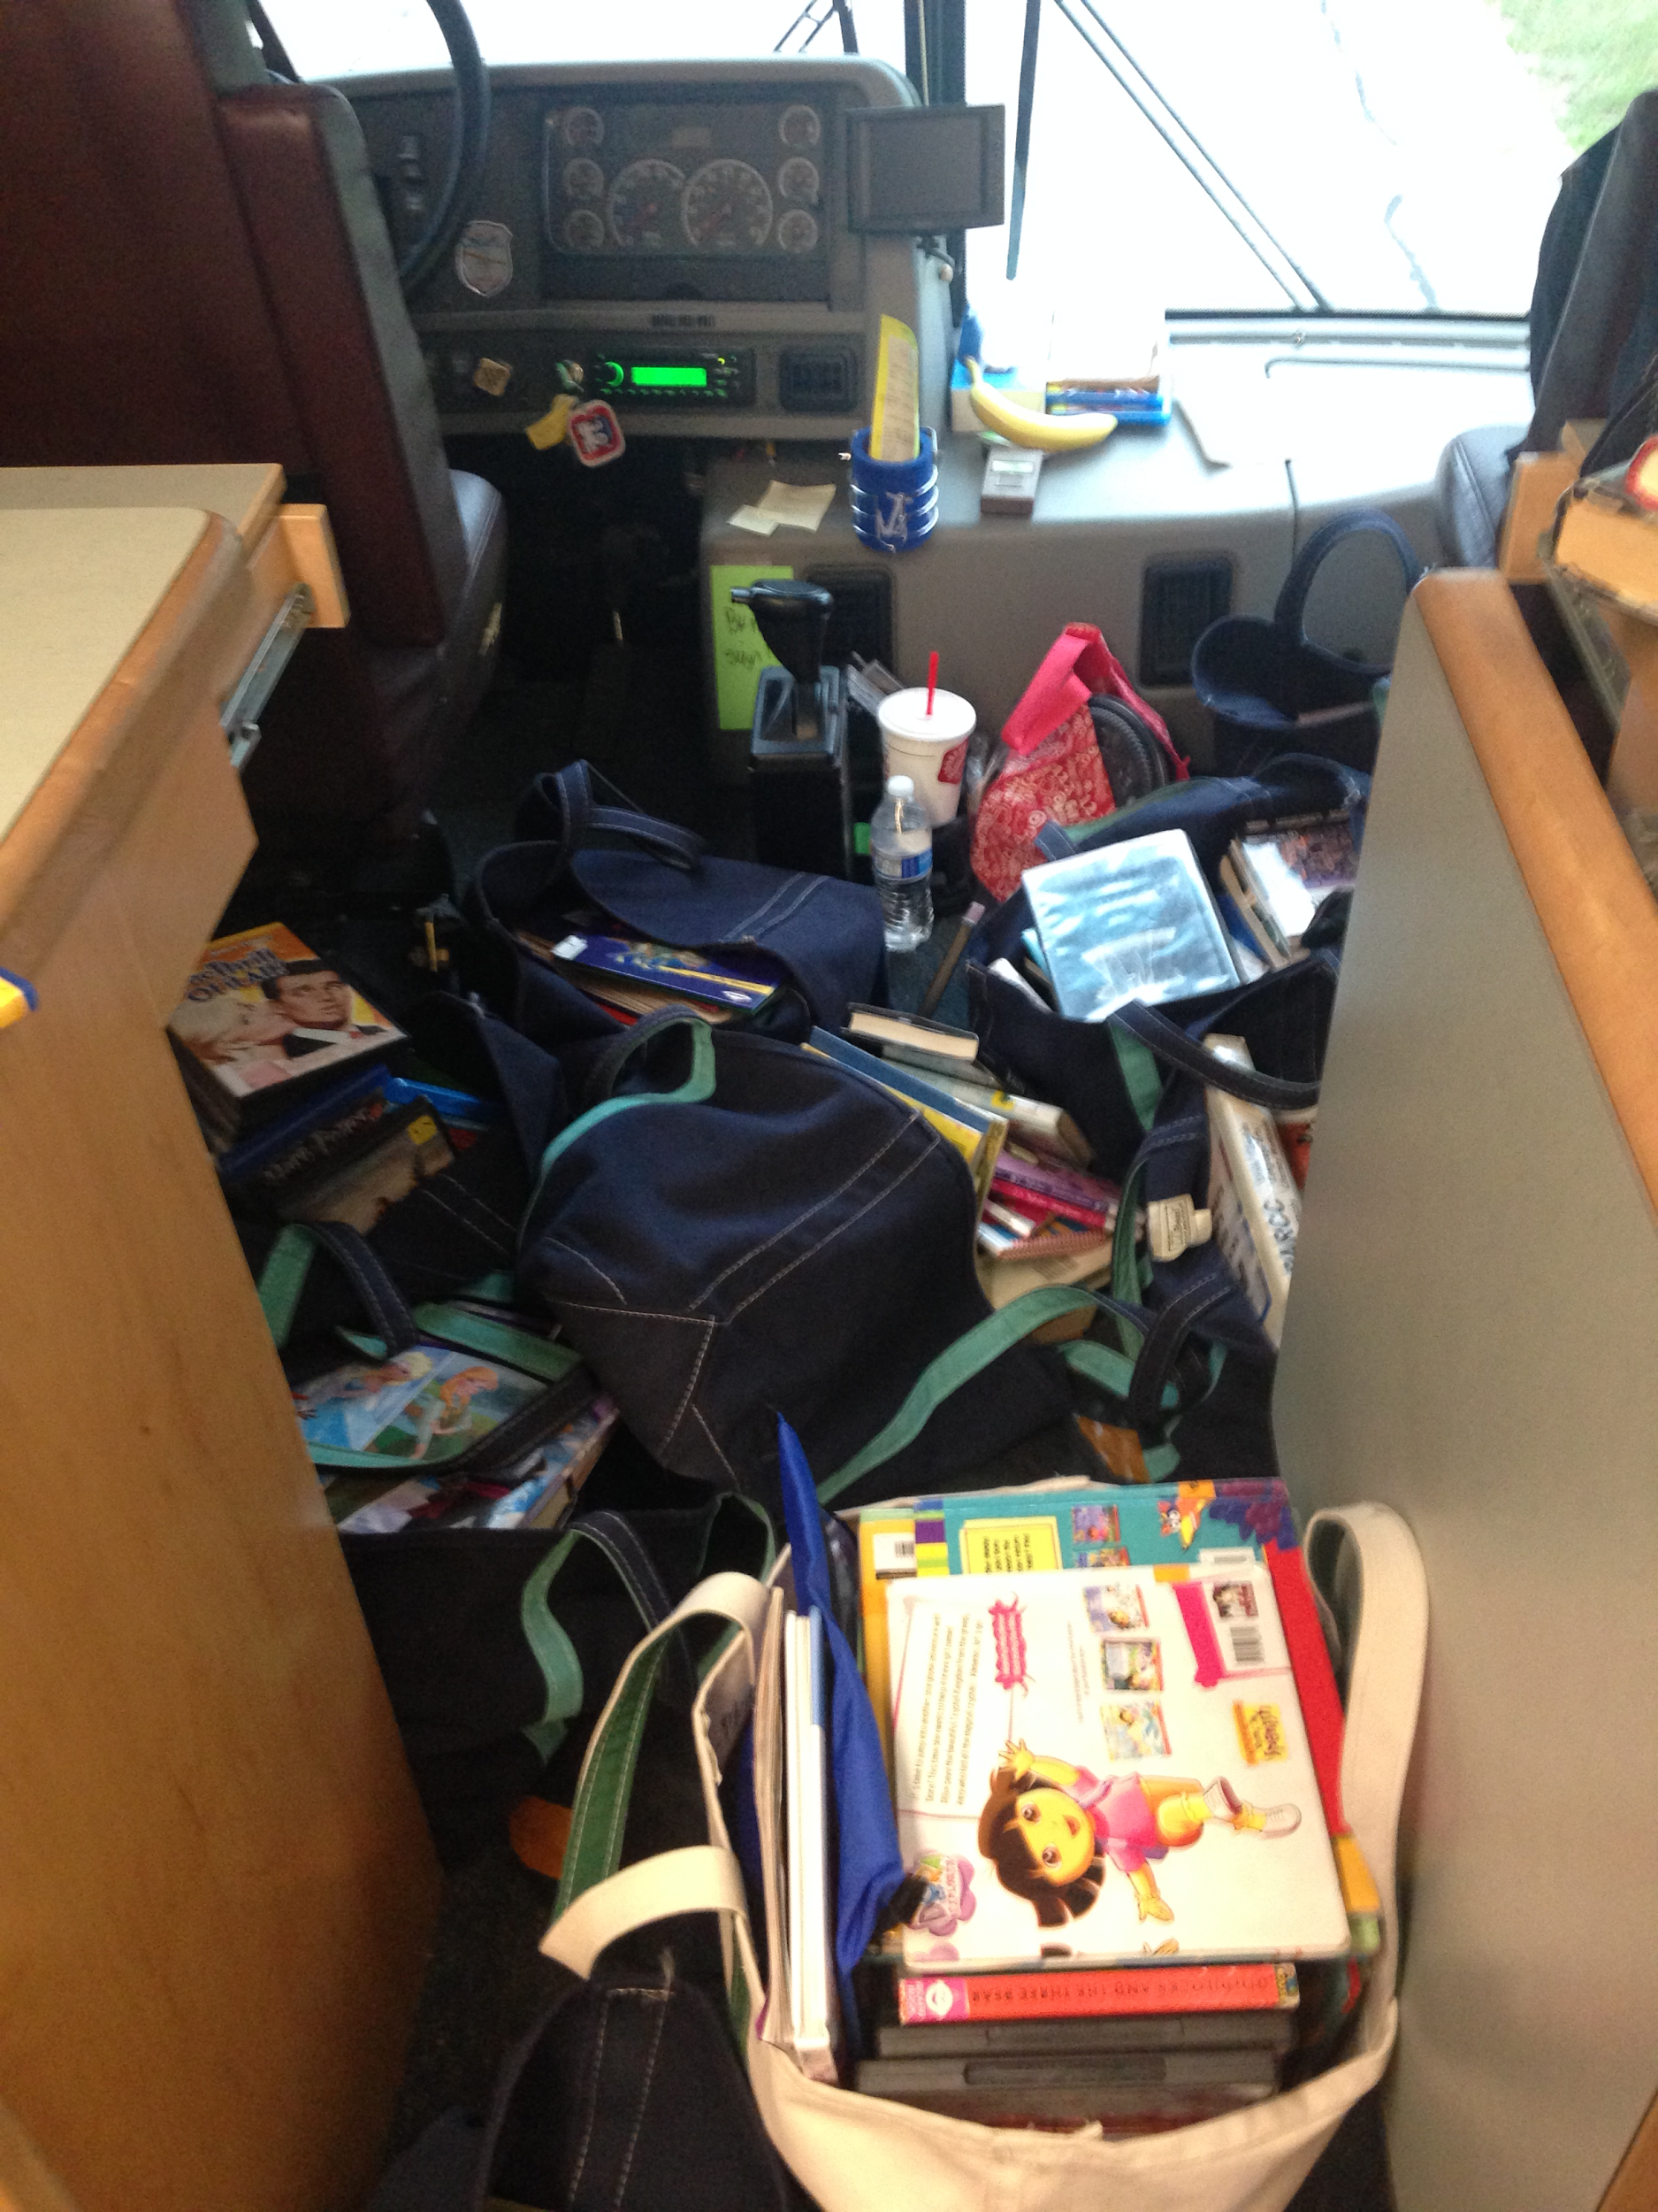
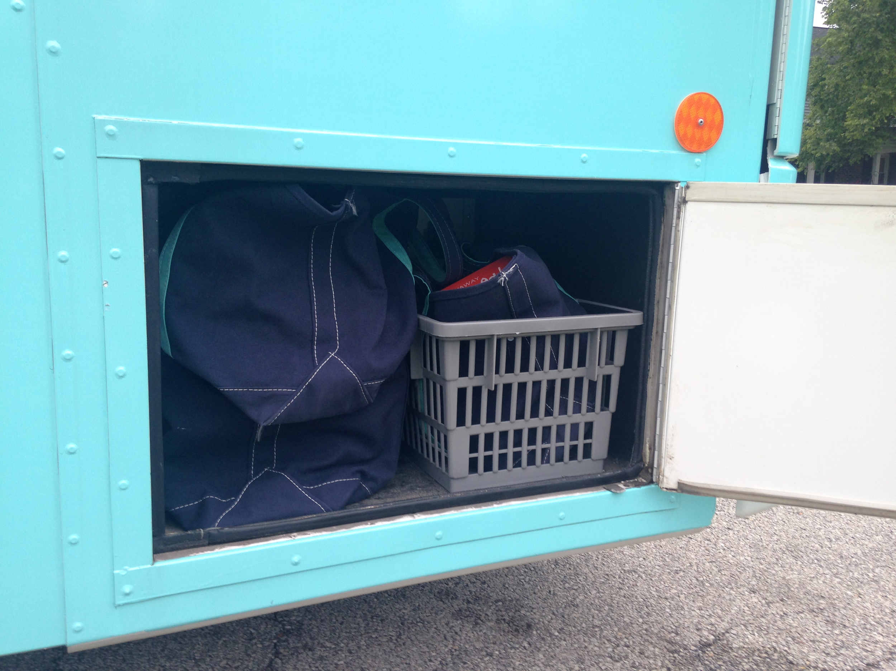
Bags

Slide 6
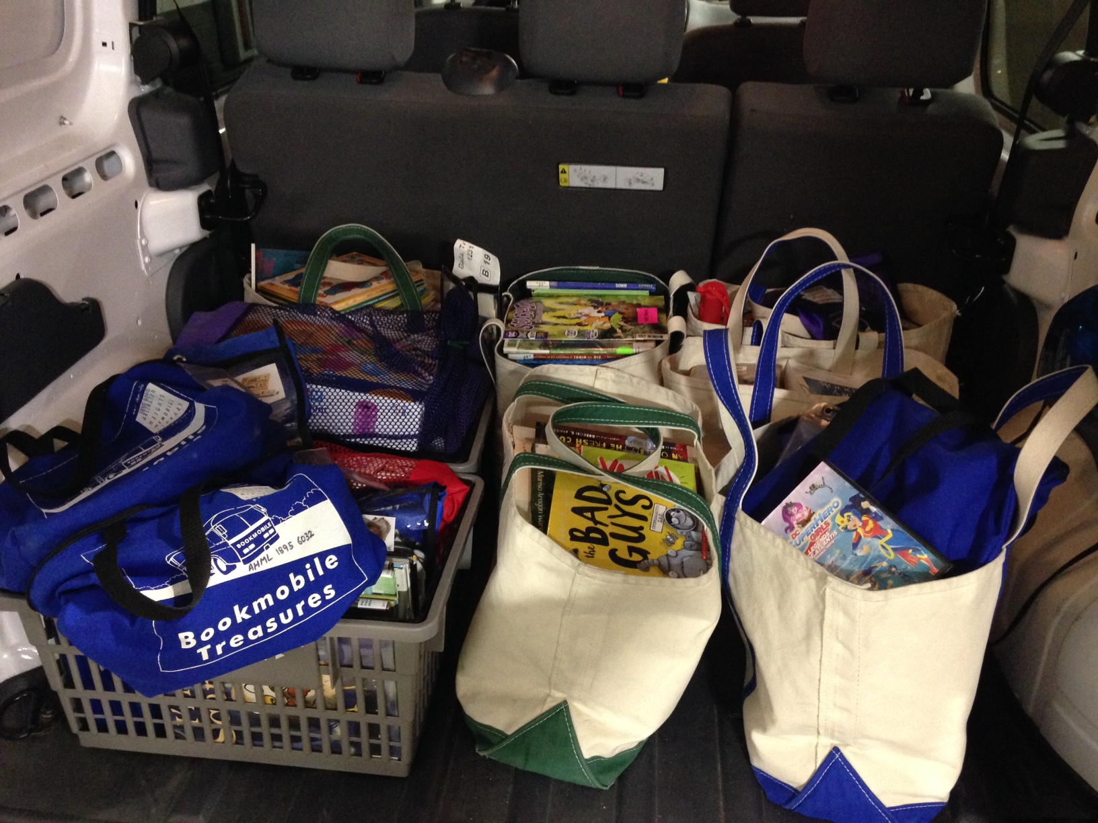
Van

Slide 7
Our Problem-
A very busy Bookmobile stop
Revised schedule
Volunteers
Van

Slide 8
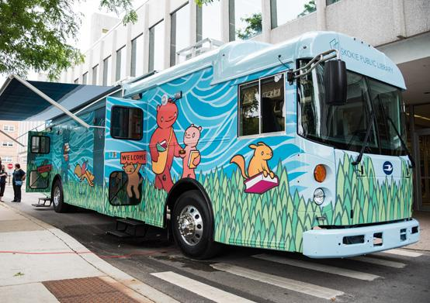
Skokie Public
Bookmobile
Library

Slide 9
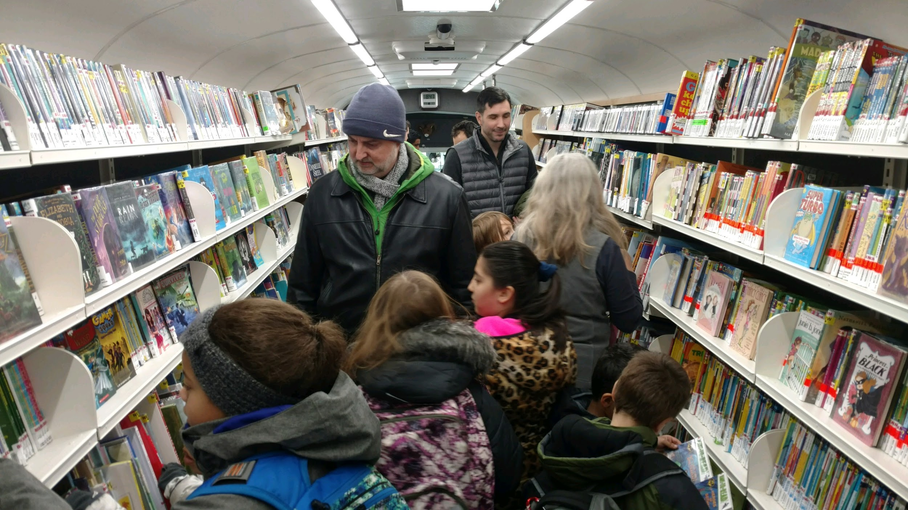
Too Many New Stop Requests/
Possibilities

Slide 10
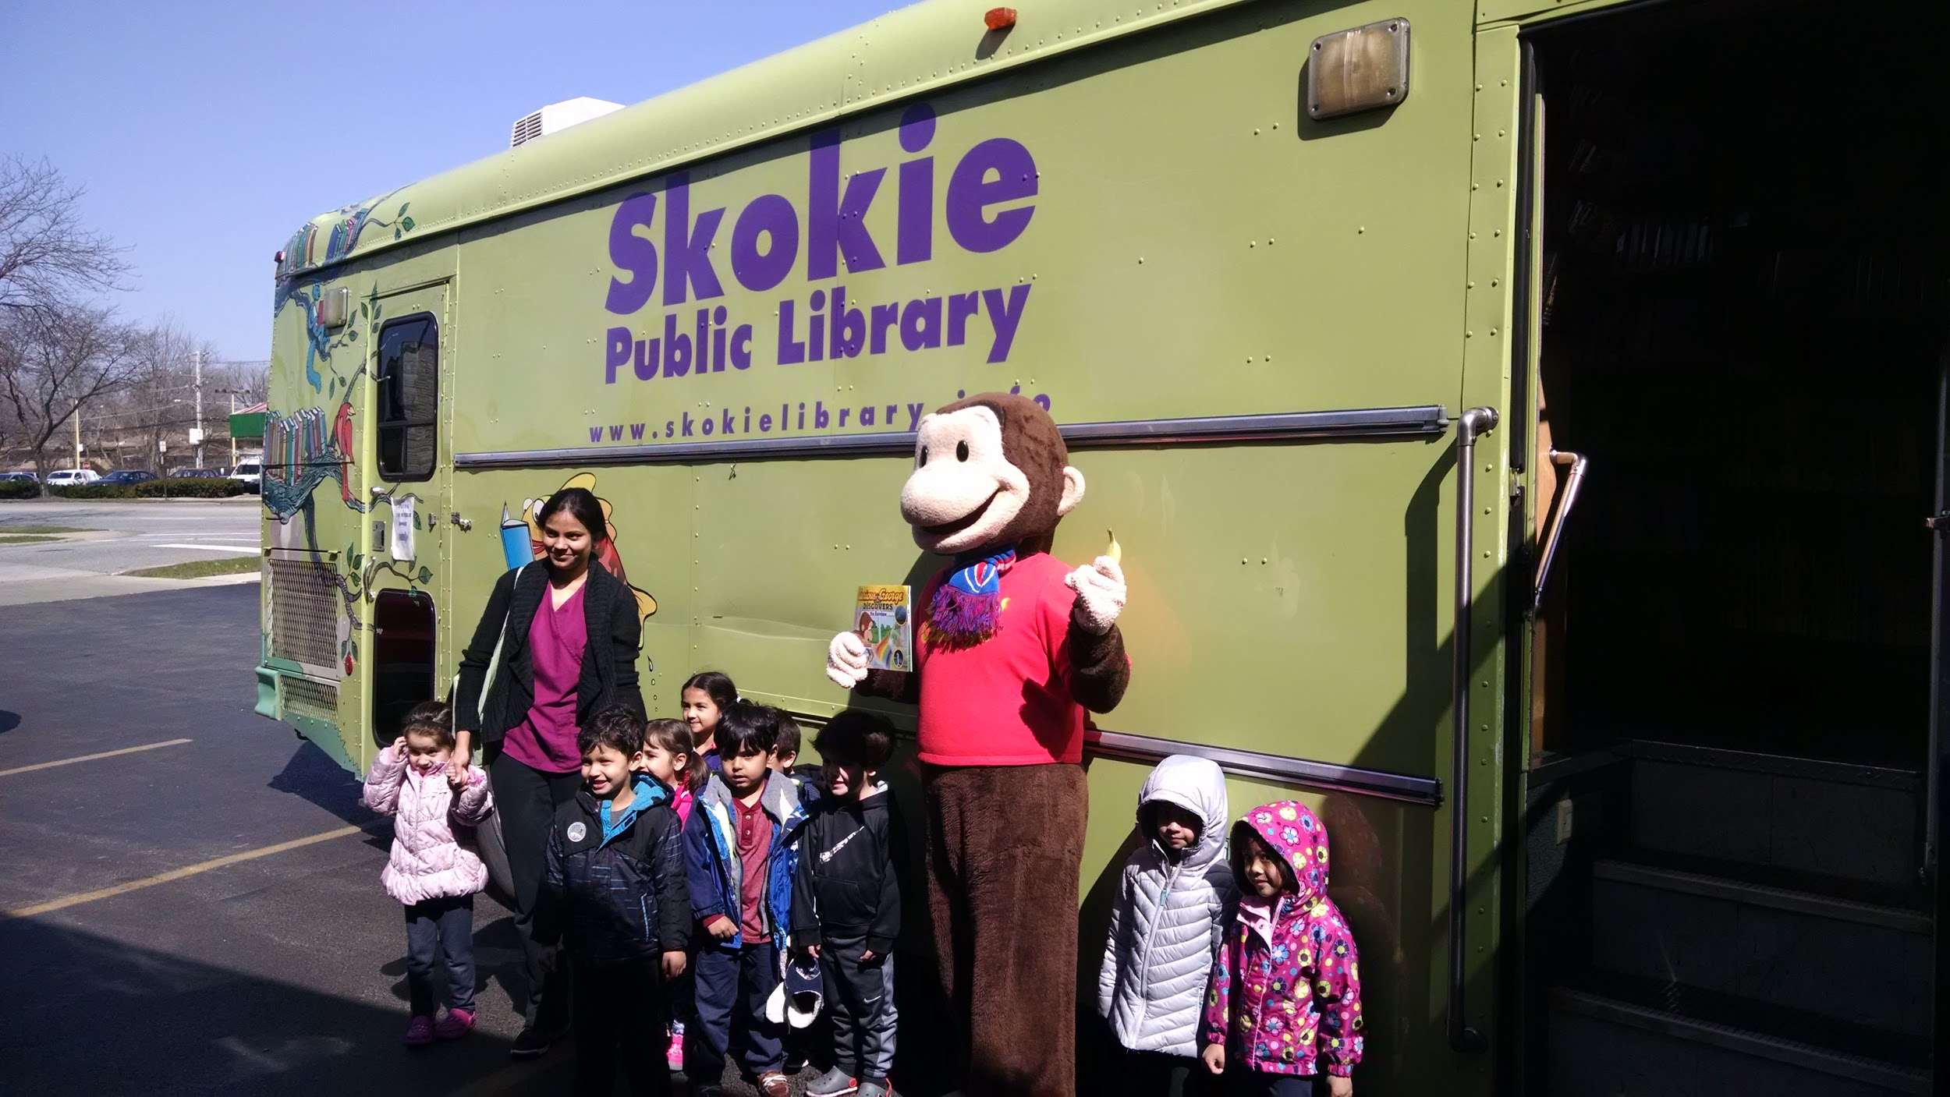
Looking Through an Equity Lens

Slide 11
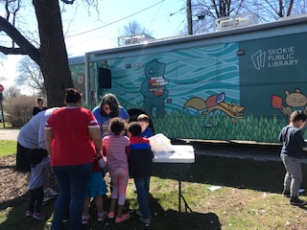
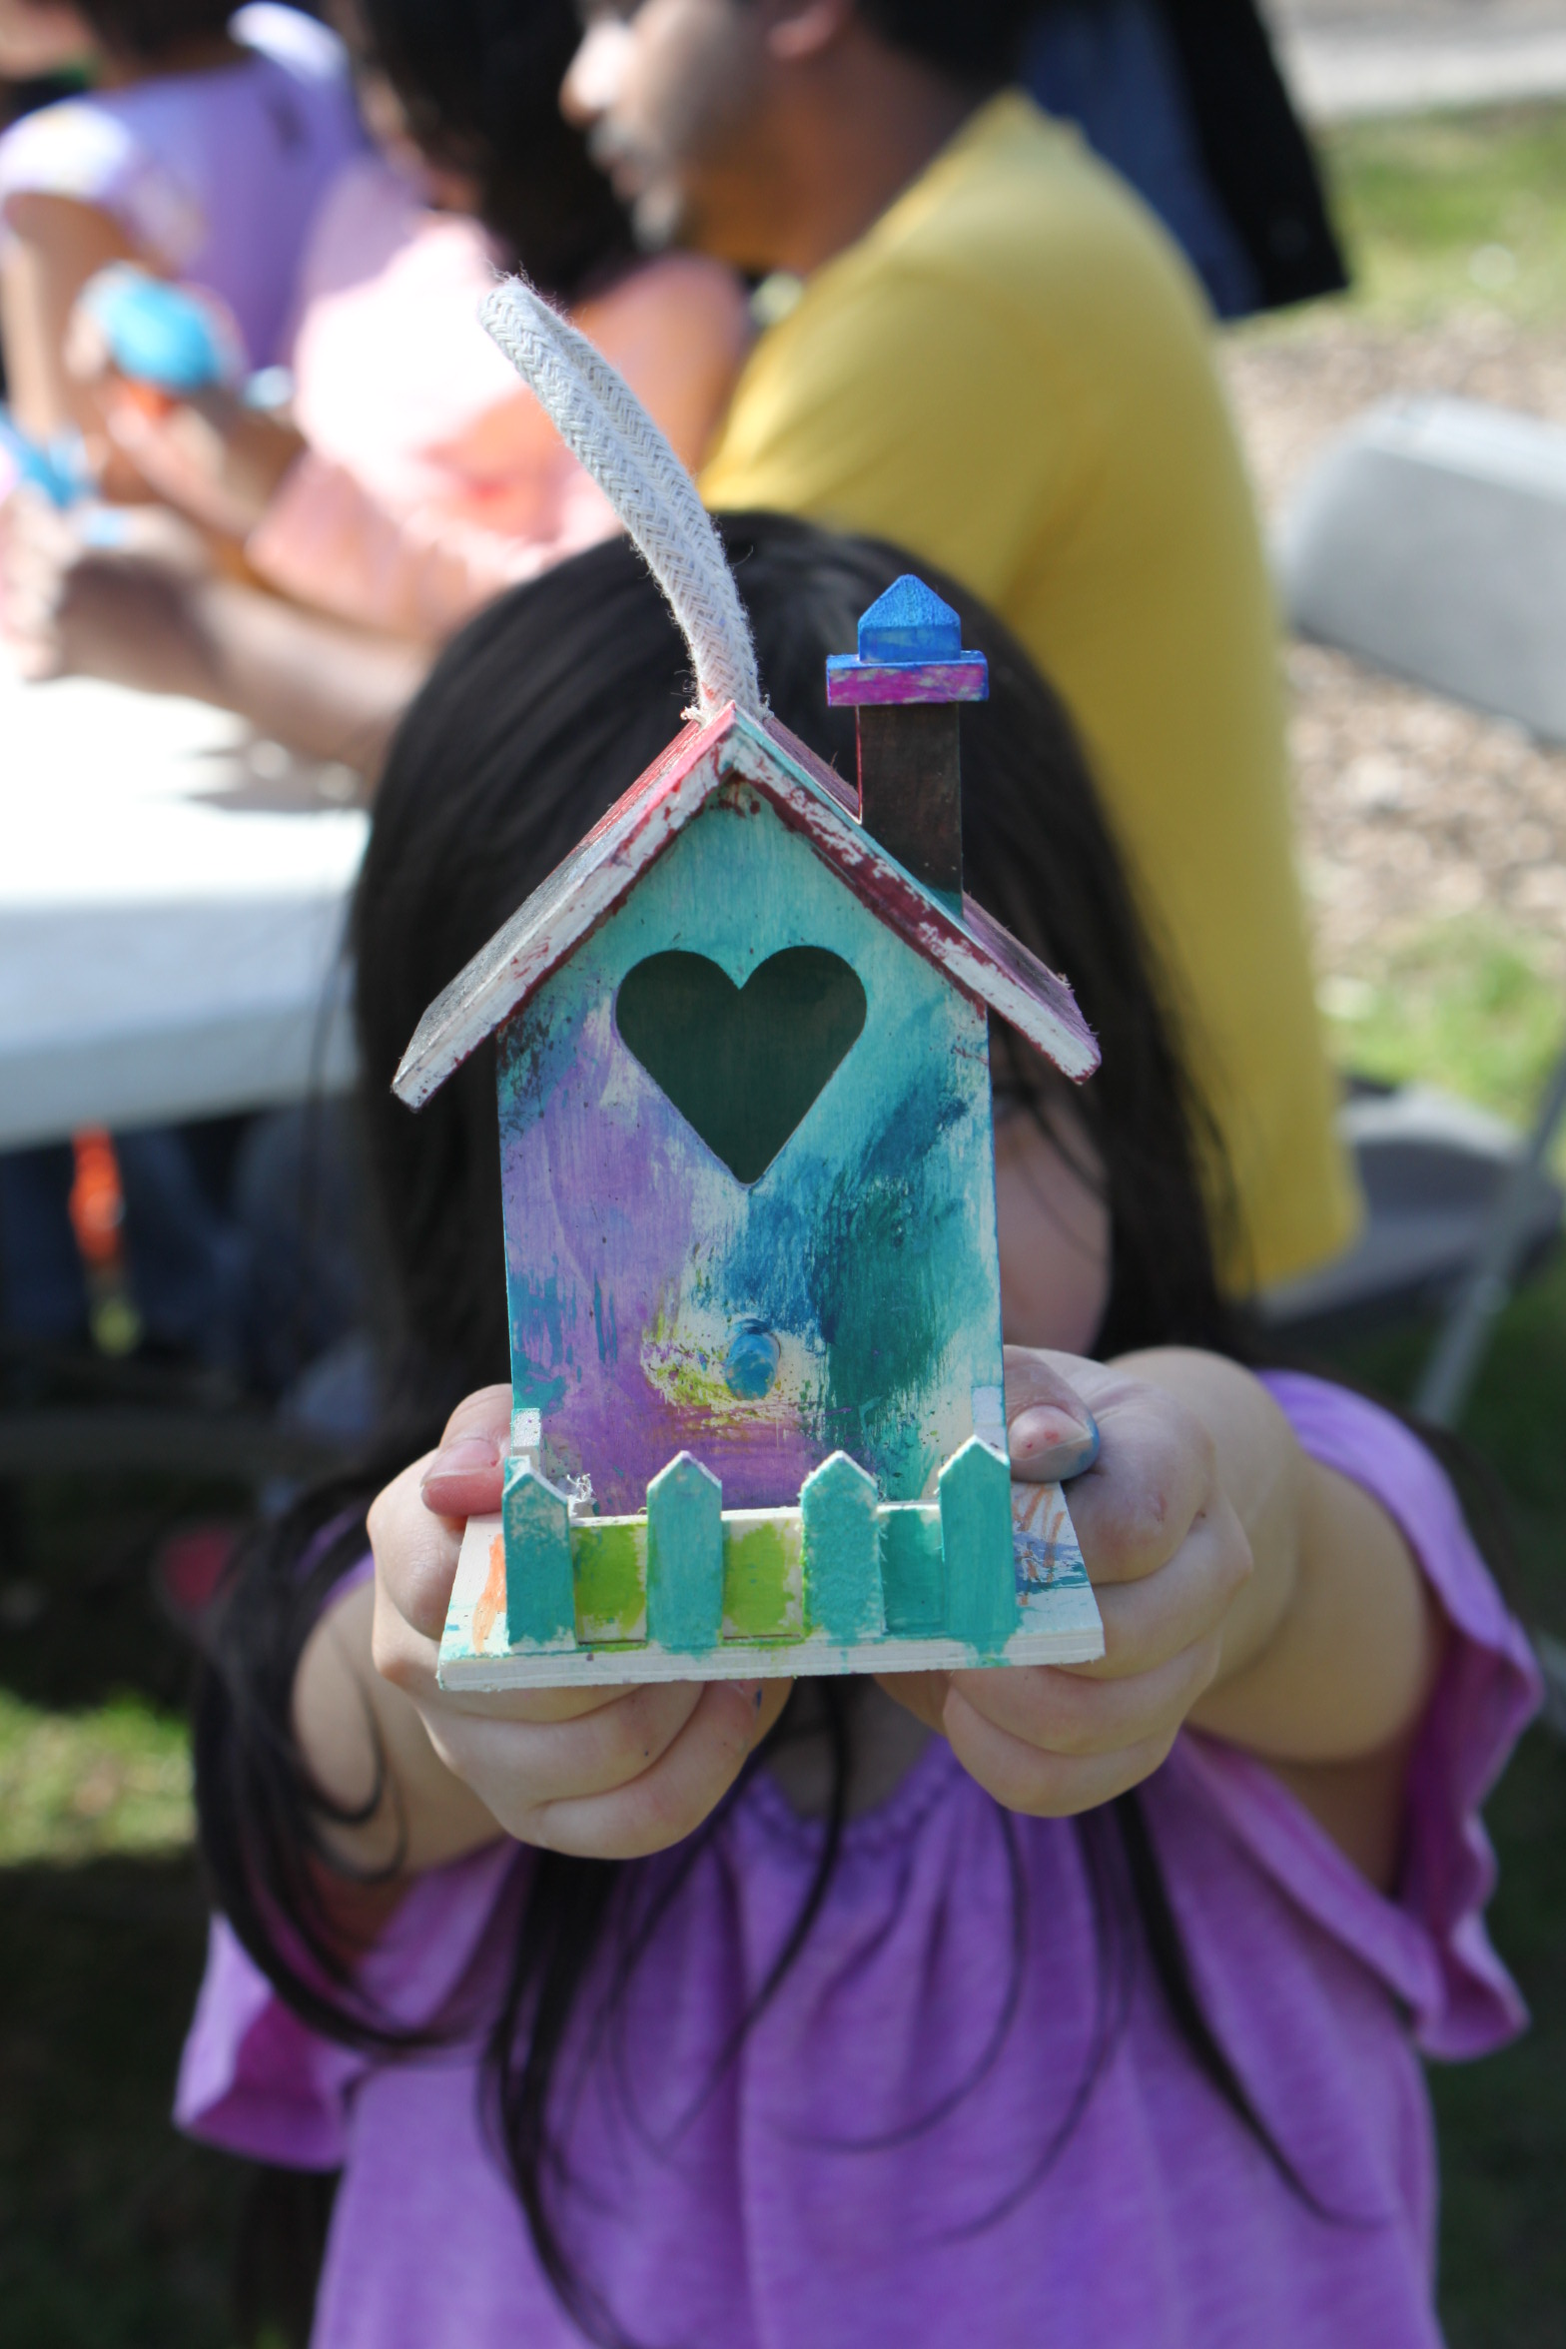
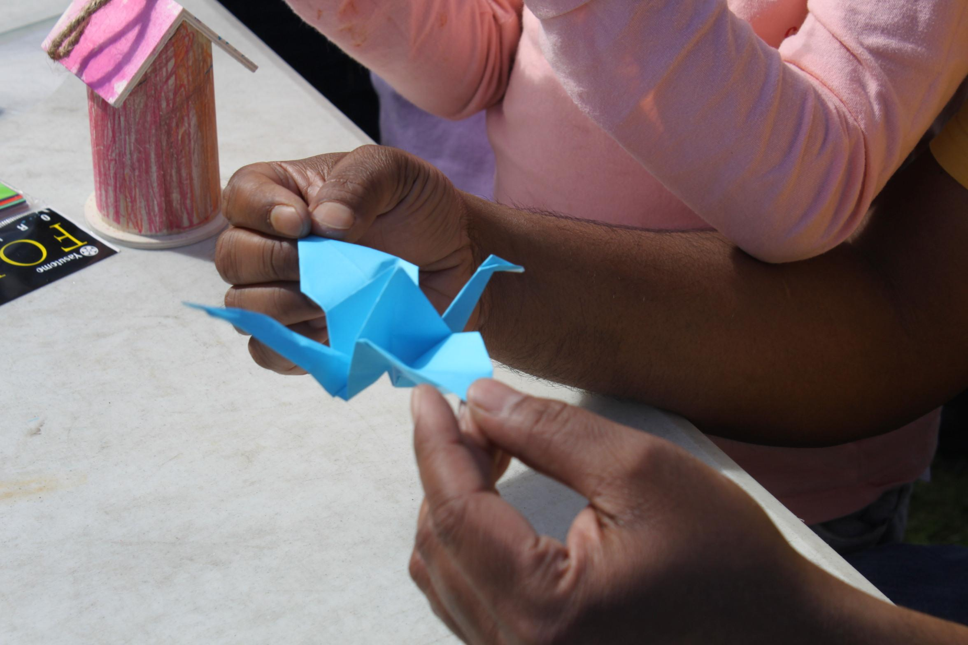
Being Proactive

Slide 12
Pop-ups

Slide 13
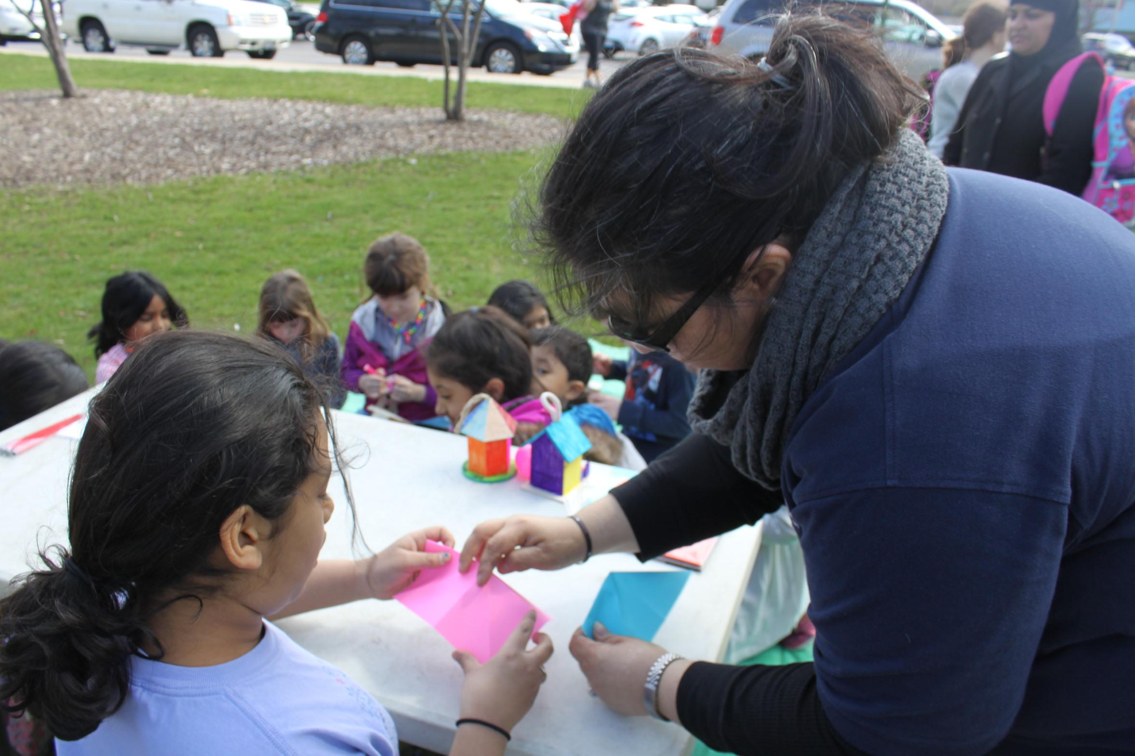
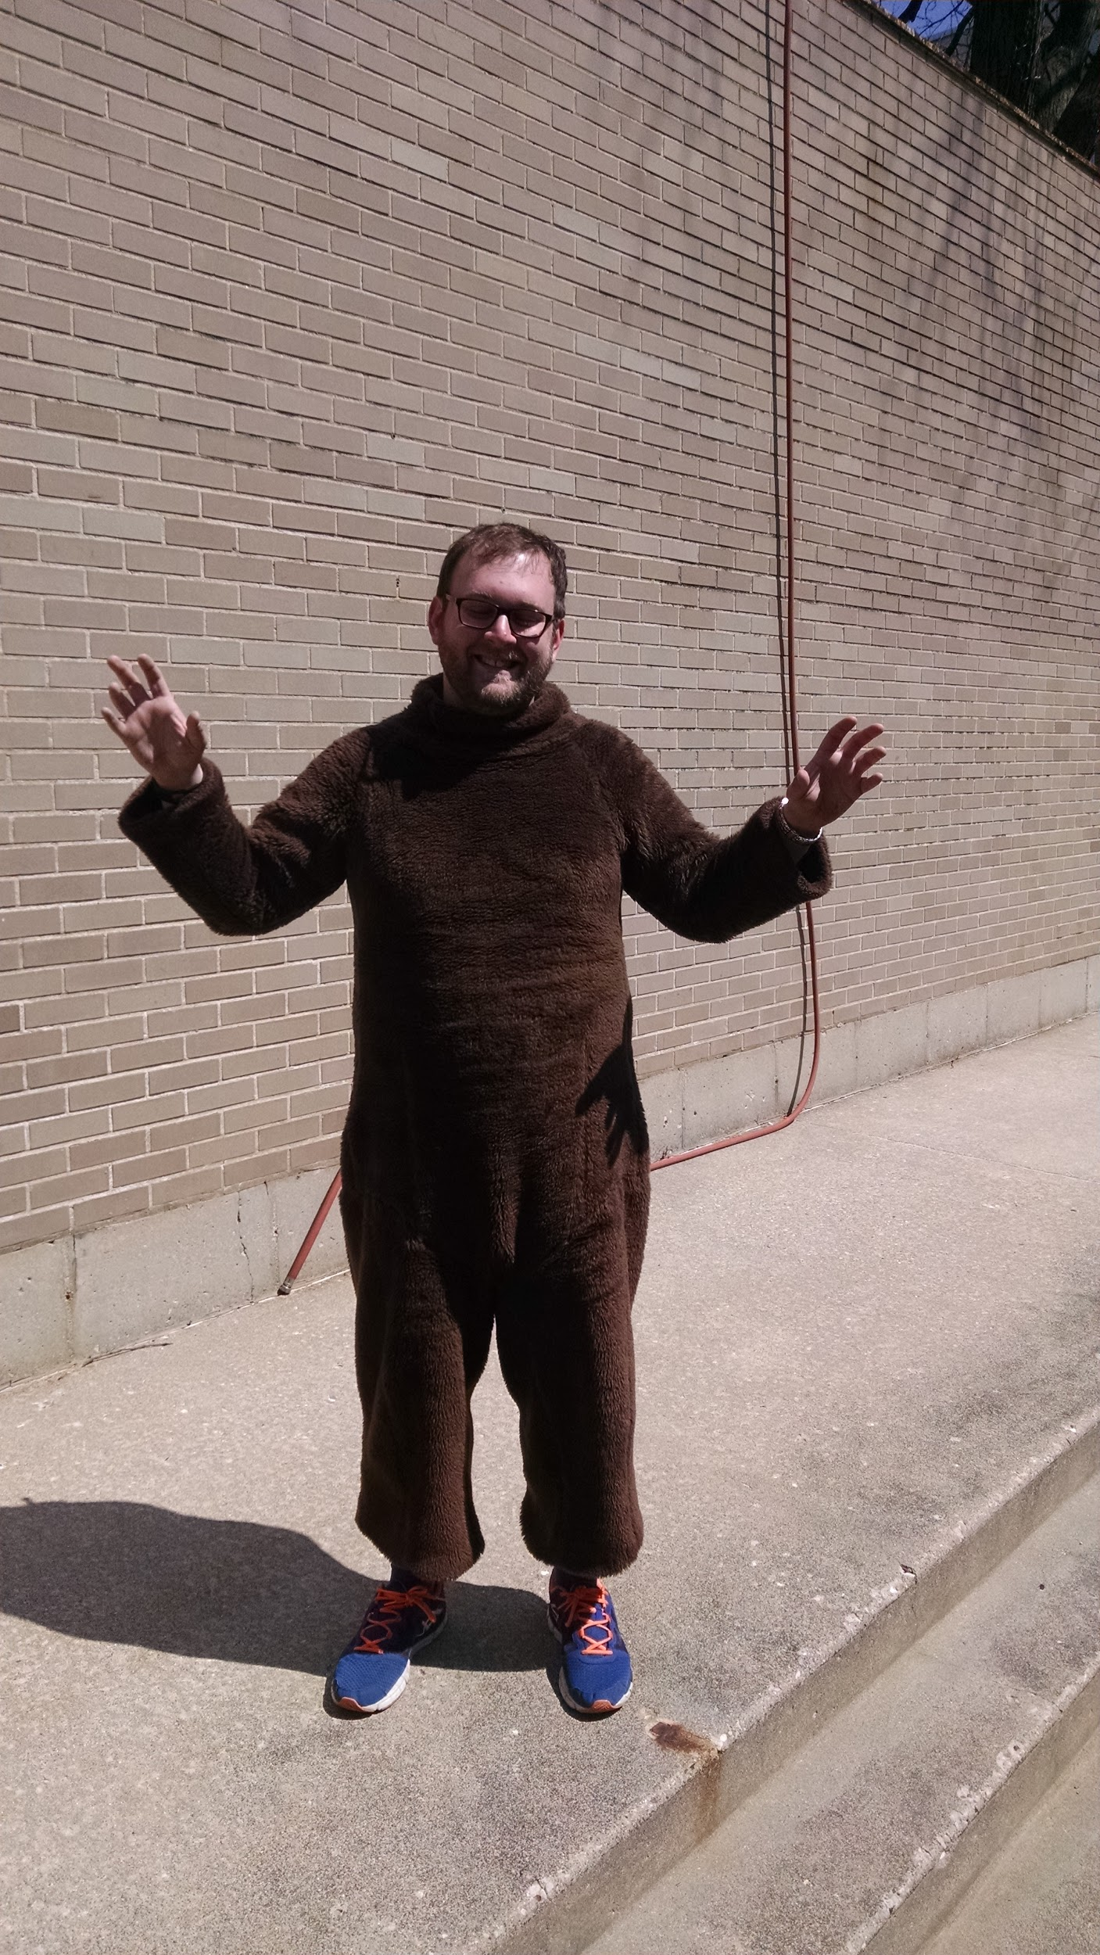
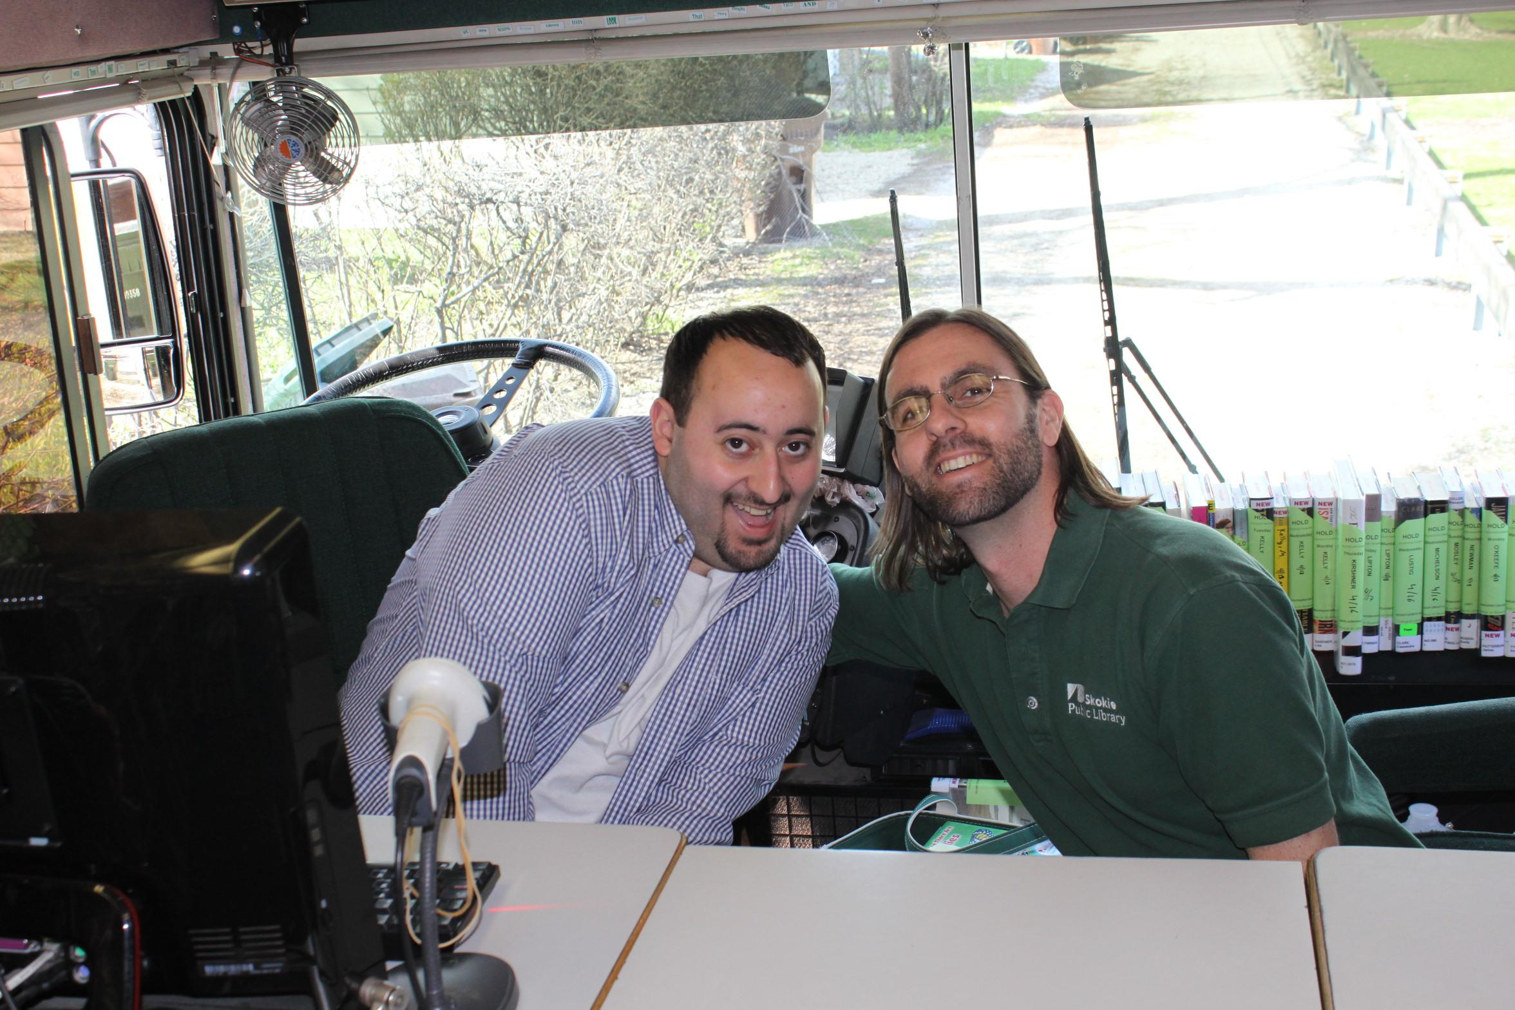
The Right Staff

Slide 14
Thanks! Teri Scallon tscallon@ahml.info
Carl Cutler
ccutler@skokielibrary.info

