Slide 1
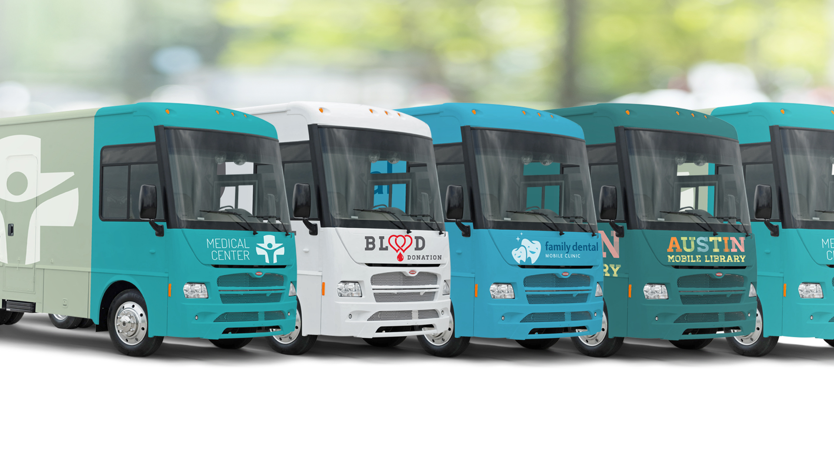

ABOS
October 17,2018

Slide 2





SUMMARY OF SPECIALTY VEHICLES
With a 30-year history at Winnebago, the Specialty Vehicles division partners with leading specialty vehicle upfitters to create custom mobile solutions for customers such as schools, universities, hospitals, clinics, libraries, art centers, sports teams, and broadcast media as well as state and federal government agencies.
60%
10%
10%
10%
10%
Mobile Medical
Blood Donation
Bookmobiles +
Library Outreach
Classrooms
Miscellaneous

Slide 3
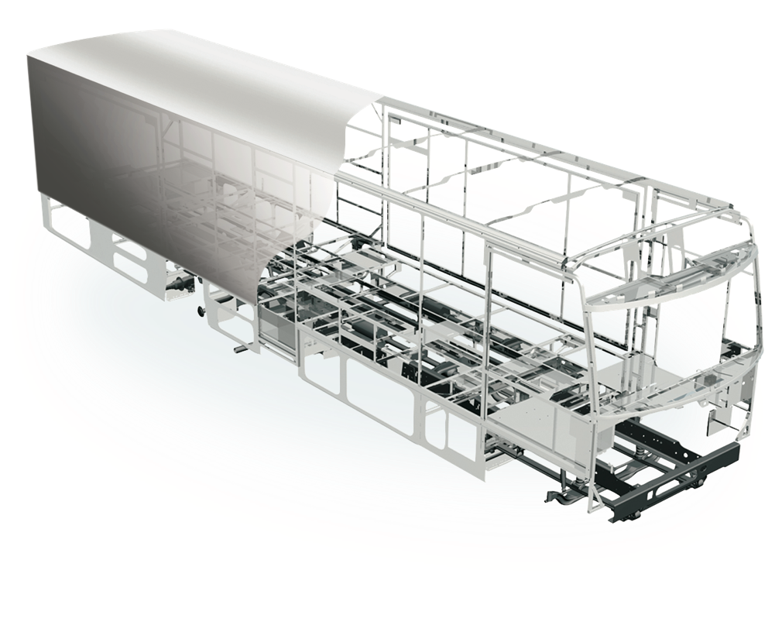
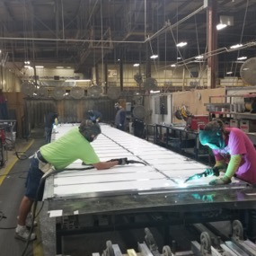
LEGENDARY CONSTRUCTION
Thermo-Panel® Sidewalls
One Piece Fiberglass Roof
Solid Framework
Laser-Cut Tubing
Interlocking Joints
Embedded Steel
E-Coating
Commercial Grade Floor

Slide 4
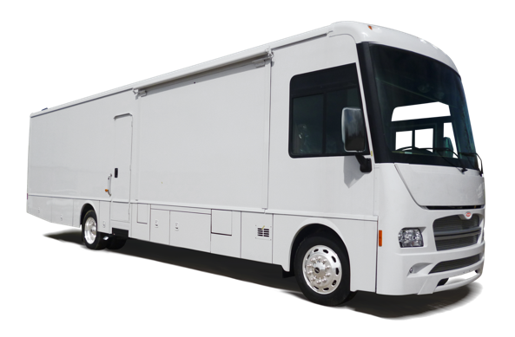
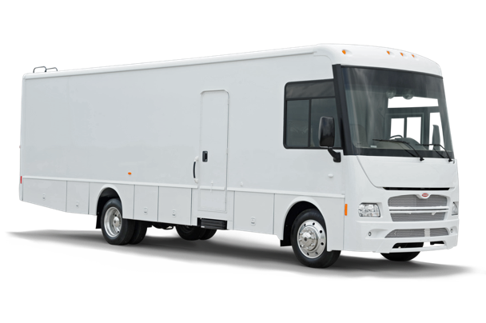
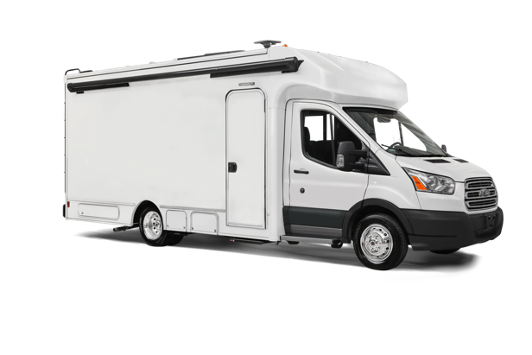


COMMERCIAL VEHICLE PLATFORM OFFERINGS
J38S
J33S
423S
3 Floorplans Available
2 Floorplans Available
2 Floorplans Available
Alternative fuel-ready options available
26,000 lbs. GVWR.
No CDL Required.
Available GVWR up to 26,000 lbs.
No CDL Required.

Slide 5

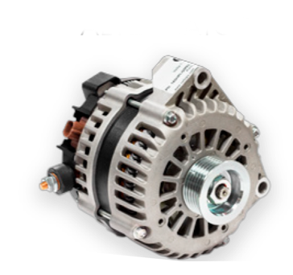
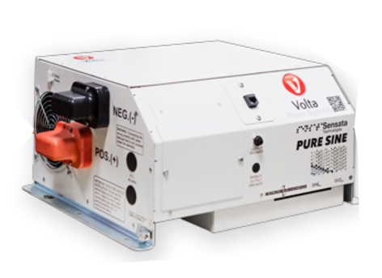
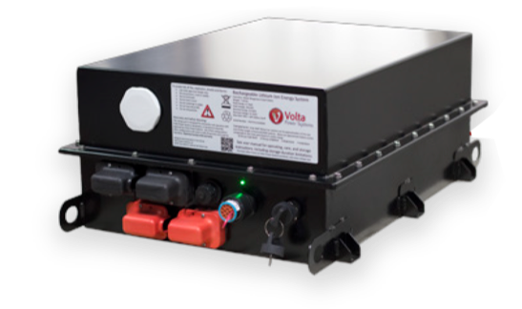
ALTERNATIVE ENERGY MANAGEMENT
Volta products offer the highest performance available on the market.
Replaces conventional generators
Competitively priced to commercial generators
Clean quiet power for all applications
Autostart feature ensures continuous power
STORAGE
GENERATION
DISTRIBUTION
Nickel Manganese Cobalt (NMC)
500 Wh/liter — 240 Wh/kg
20 million road miles on cells
High performance 58V alternators for all Winnebago applications
3,500 Watts — 22,000 Watts
Pure sine low frequency inverters
High current DC to DC converters
Multiple charging options

Slide 6
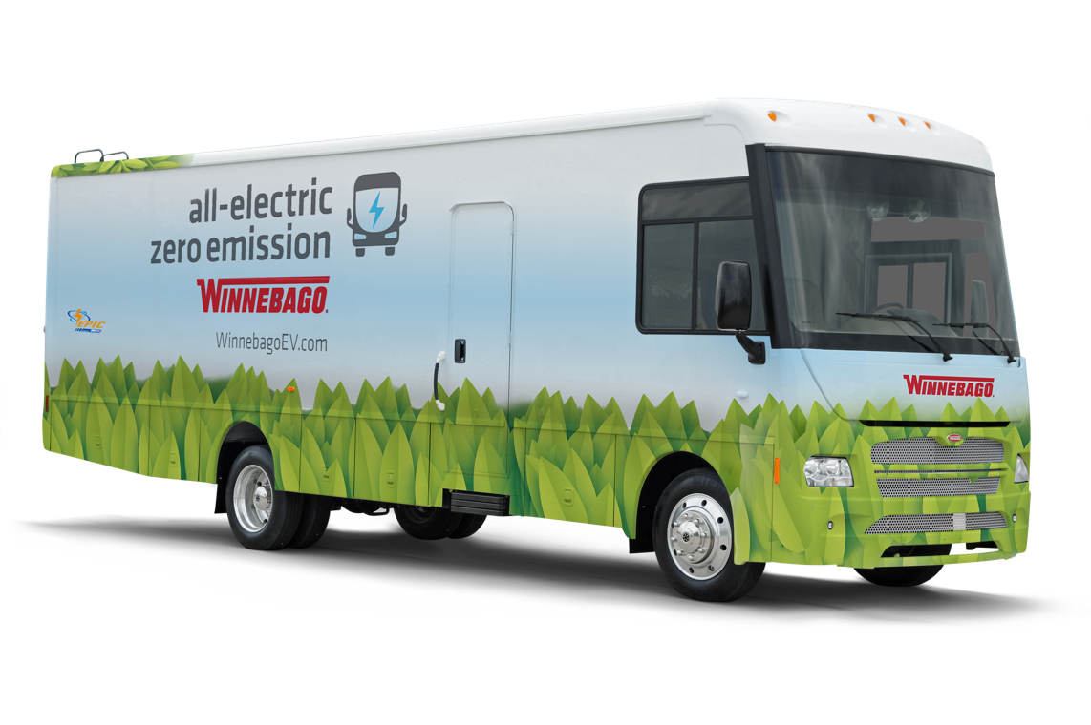
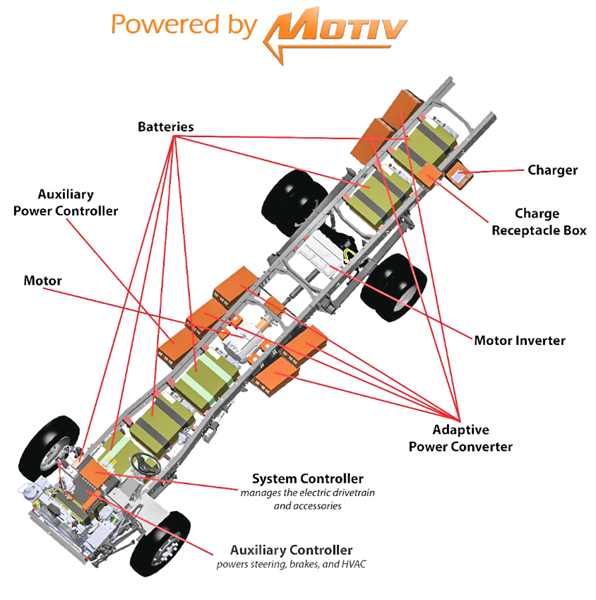
ZERO EMISSION VEHICLES
Winnebago is the first manufacturer to provide an all-electric vehicle based on a motorcoach chassis
Eligible for many incentives, federal, state, and local. California, New York, Colorado lead the nation in ZEV incentives
Expected range of 85-125 miles on a full charge
Available in an eight battery configuration (169 kWh) on 38’ commercial platforms and a six battery configuration (127 kWh) on 33’ commercial platforms
Fully meets Ford Electric Qualified Vehicle Modifier (eQVM) standards
Electric Ford F53 Chassis

Slide 7


Slide 8
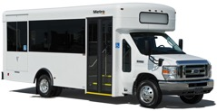






HISTORY OF RECENT INNOVATION
2010
Winnebago produces transit buses
2014
Custom CAN-based solutions
for chassis integration
2016
Connected coach for remote 360-degree
video capabilities
2017
Winnebago offers
lithium-ion battery systems as a generator replacement
2016
HWH hydraulic flat floor slide rooms
2016
True air-ride suspensions for Ford F-53 Class A gas
2017
Advanced solar installations move Winnebago closer to off-the-grid capabilities
2018
Winnebago is the first to develop an all-electric Ford F-53 chassis, exclusive to Winnebago
2018
Winnebago partners with medical OEMs for integrated vehicle solutions
Post-Recession Era

