Slide 1
2018 ABOS Conference
Raleigh, NC
October 17 – 19, 2018
Presented by:
Glenna Godinsky, Life Enrichment Liaison
Ana Devine, Director of Branch Services

Slide 2
Gail’s a la carte menu best for:
Seniors at home with caregivers
Senior living communities
Day Care Developmental Communities
Residential Developmental Communities
Staff who serve residents with dementia/varied abilities
Care Partners

Slide 3
Gail’s a la carte Menu Agenda
Carry Out - ideas to try at places you already serve
Side Dishes - ideas to support physical/occupational therapy
Big Kids’ Menu – collaborating with students
Little Kids’ Menu – utilizing children’s crafts
Pre-Packaged Kits – program kits
Starter Dough Recipes – special programming ideas
Secret Ingredients – share our secrets
Delivery Locations – go to these creative locations
Home Made – do these in the library
Desserts – building a dementia friendly community
– sharing your program photos & getting ideas
Door Prize Drawings
Questions
- Gail’s Favorites
- Low-cost
- Moderate
- Greater investment/
Greater impact
- Working together

Slide 4
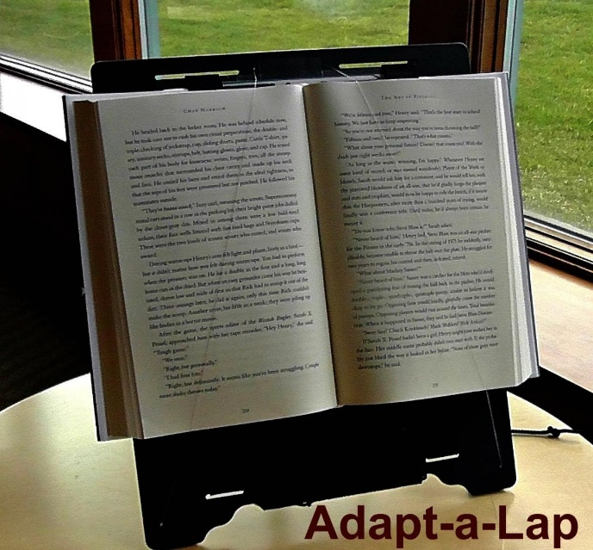
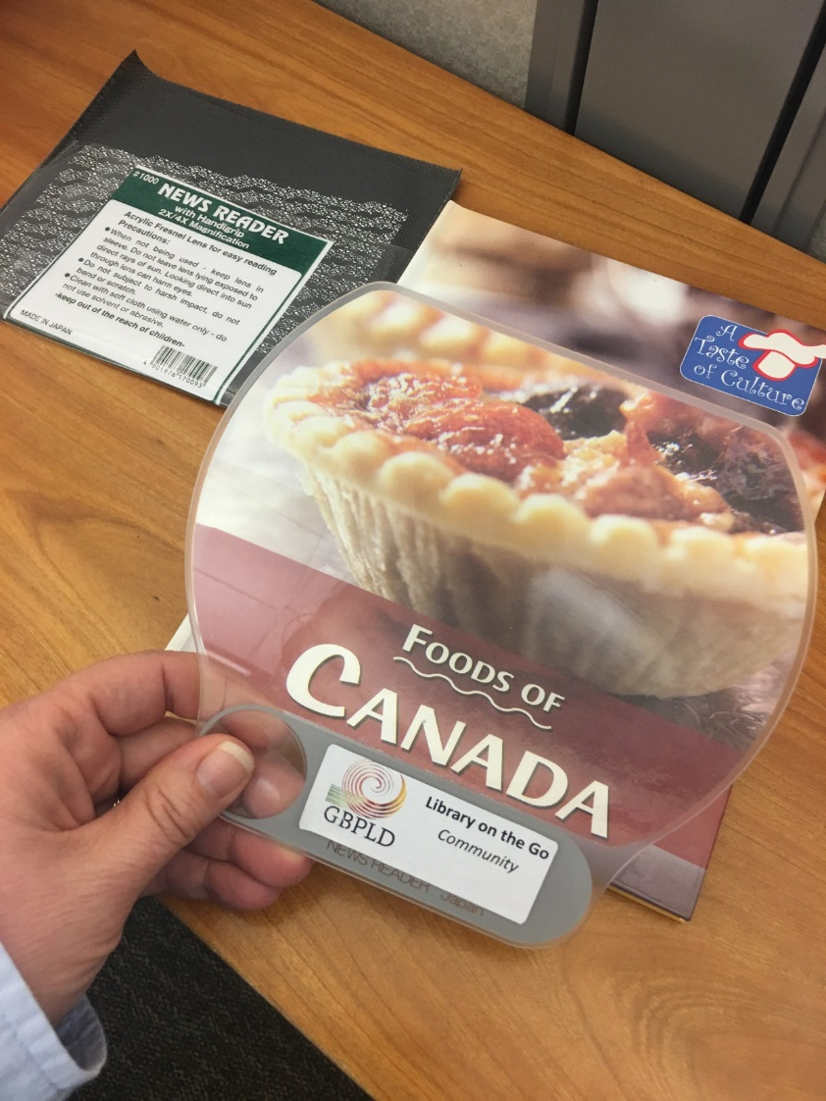
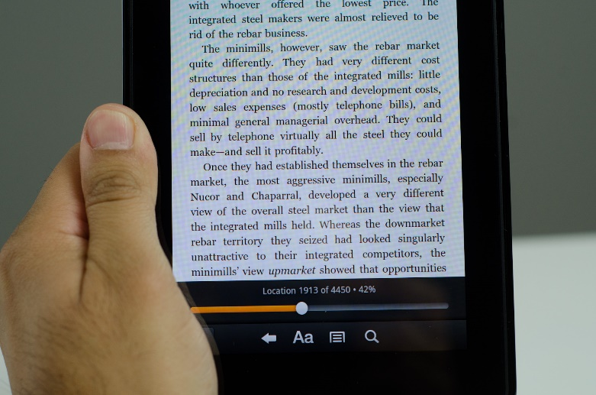
Carry Out
Take these materials to places you already visit:
Hand-held Magnifiers
Adapt-a-Lap
Kindles

Slide 5
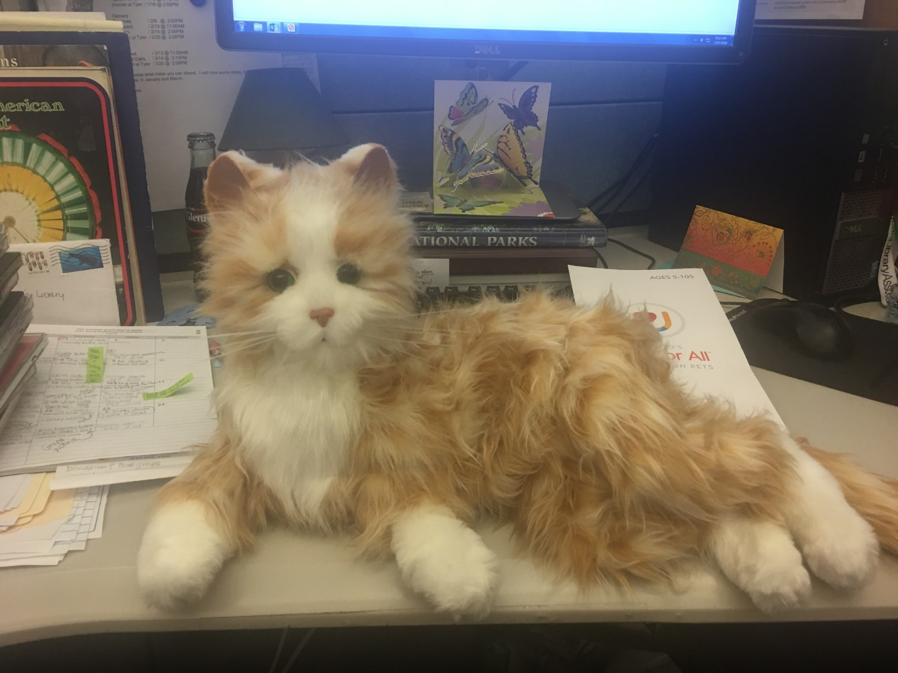
Carry Out
Animatronic Joy for All Pets
https://joyforall.com/

Slide 6
Carry Out
Talking Books - https://www.loc.gov/nls/
Tumble Books - https://www.tumblebooks.com/

Slide 7
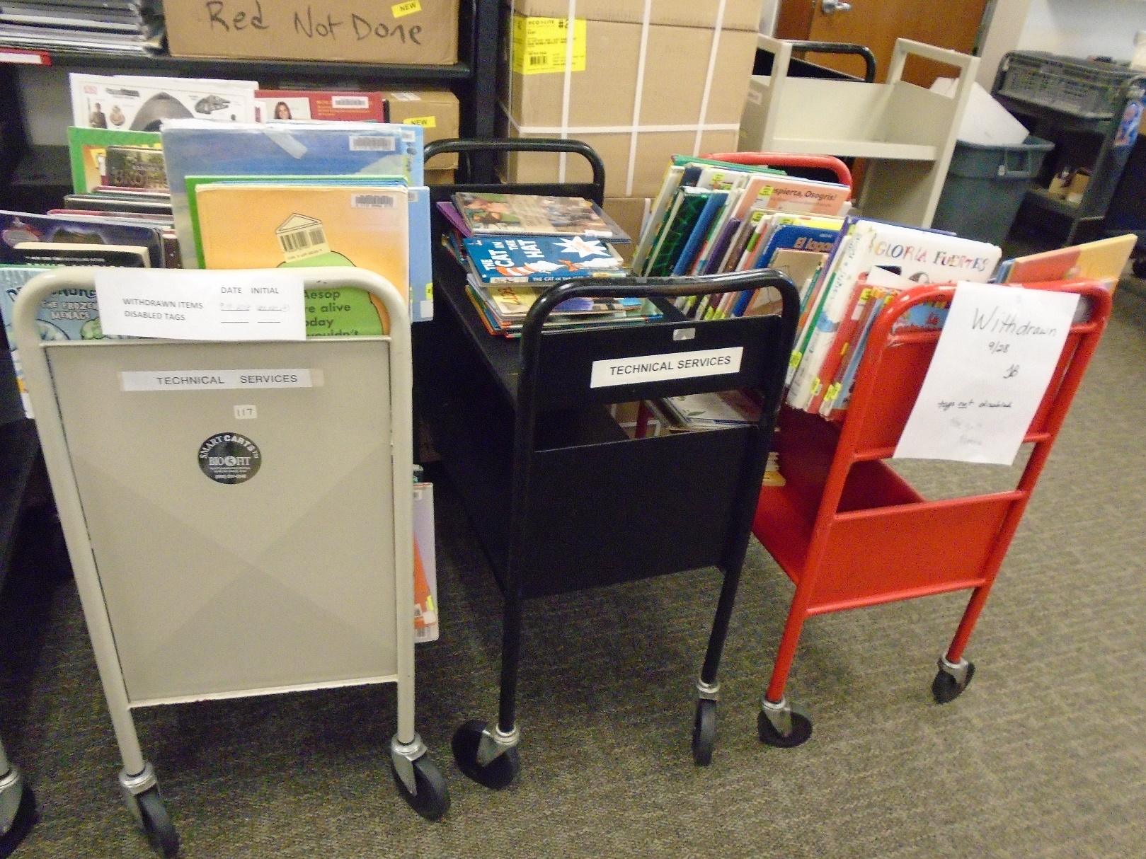
Carry Out
Donated and Weeded Materials

Slide 8
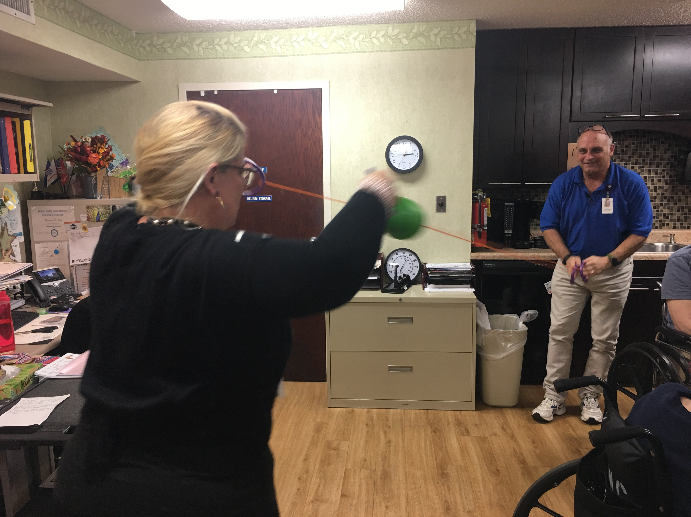
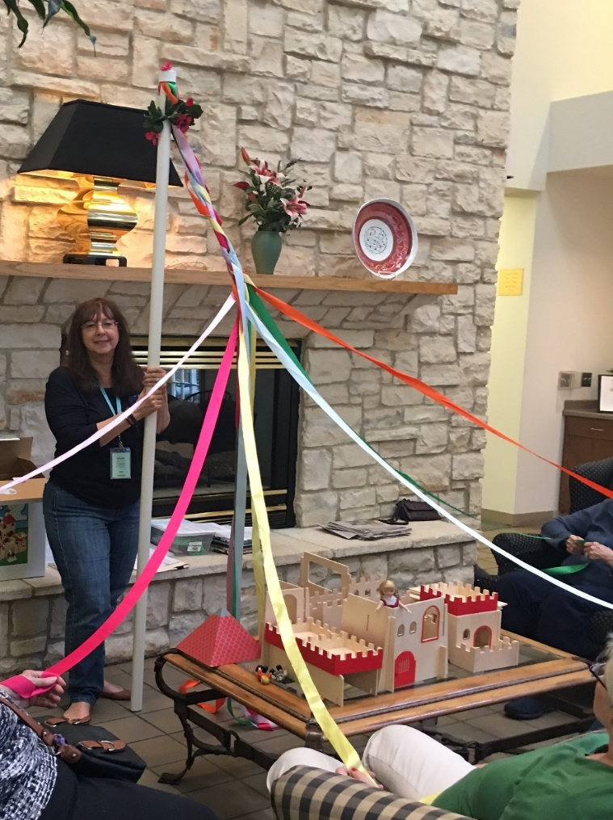
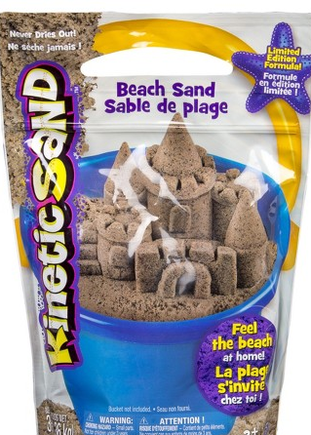
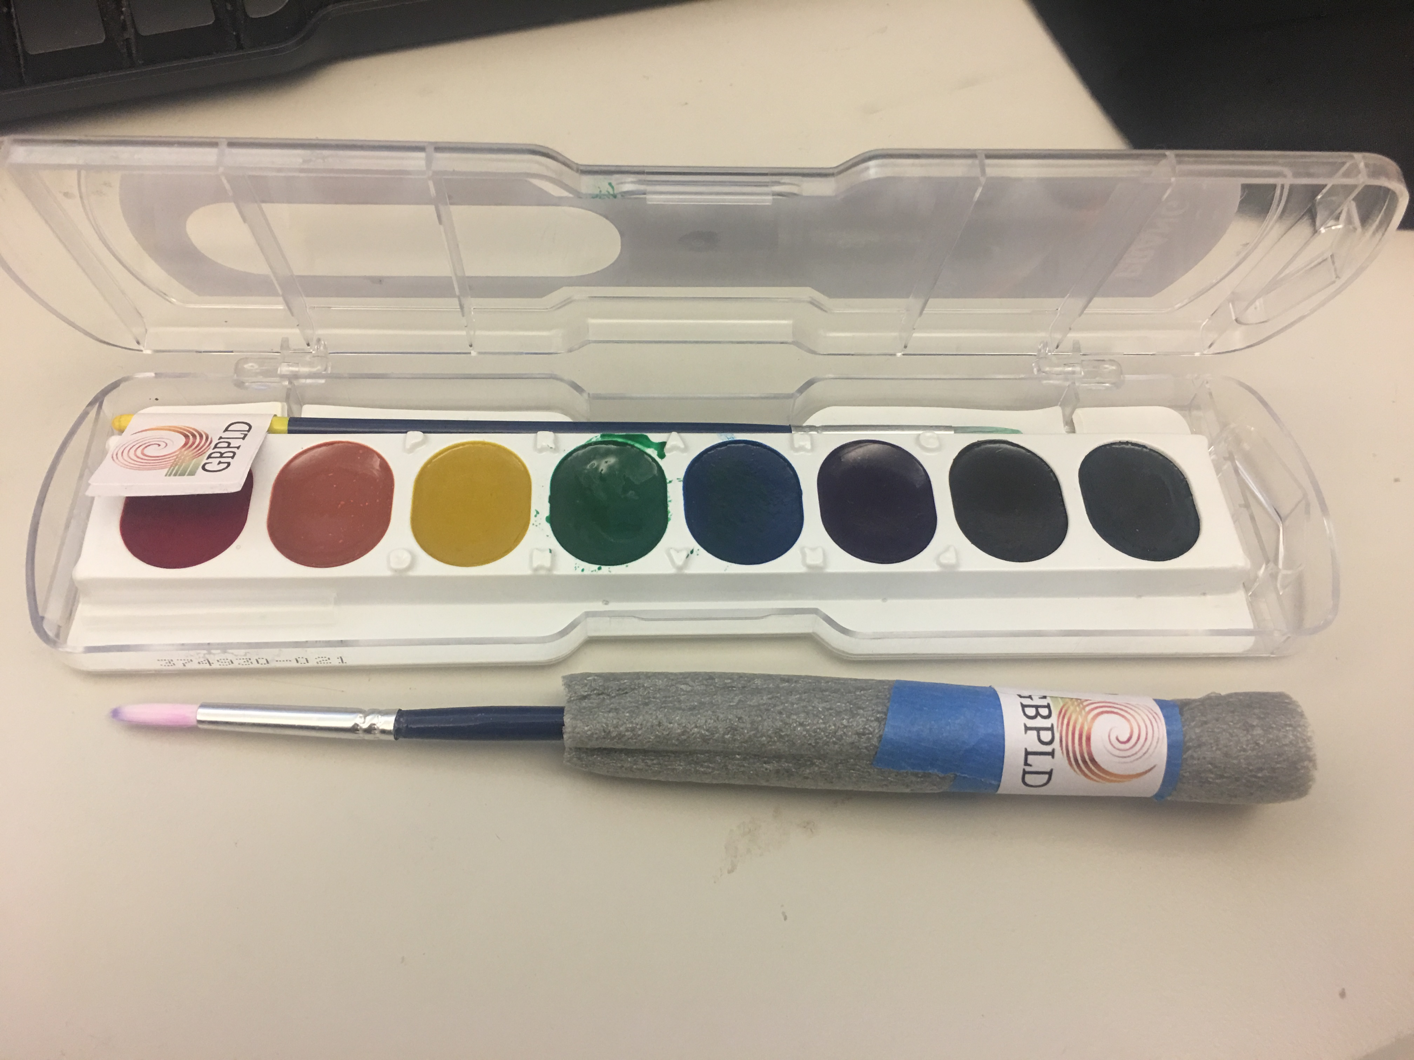
Side Dishes
Supporting physical/occupational therapy and offering innovation:
Swoosh Ball Exercise
Adaptive Paint Brushes
Puppets
Kinetic Sand
May Pole

Slide 9
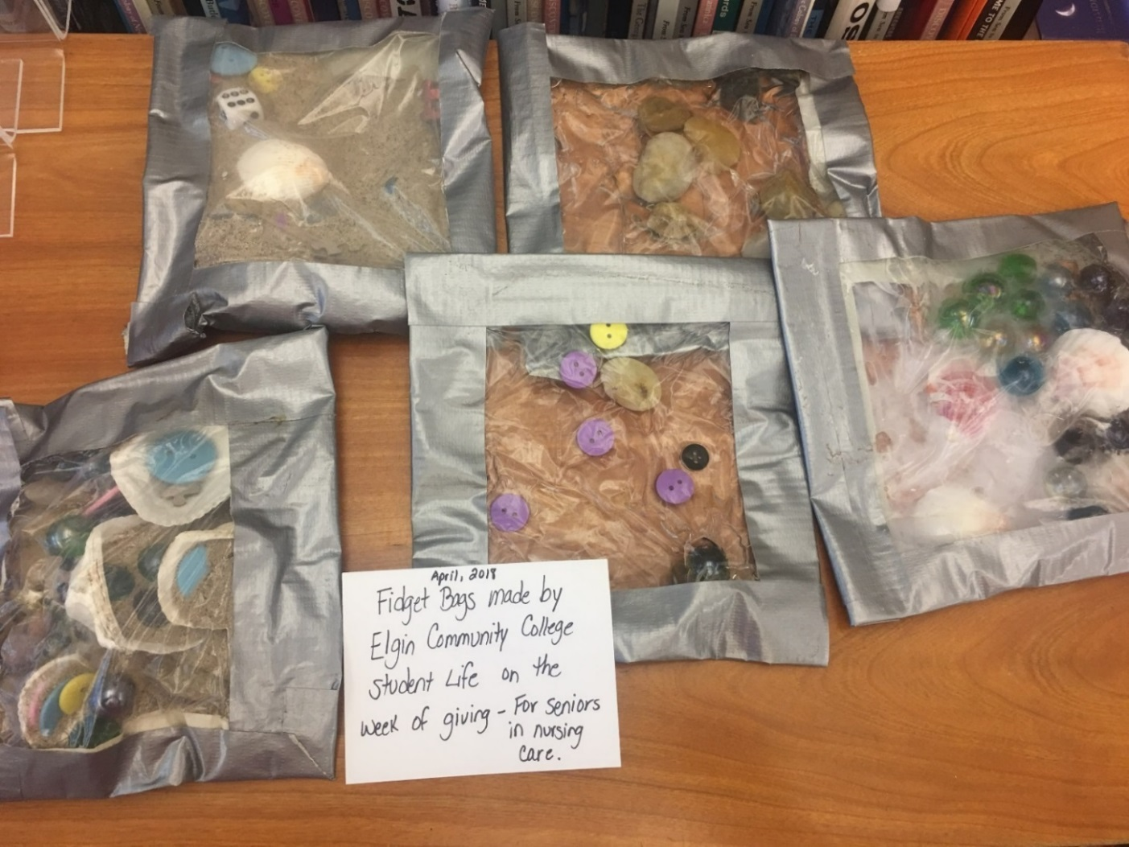
Big Kids’ Menu
Collaborate with student life volunteers in high school and college communities.
Fidget Bags - In one day, students made 38 Fidget Bags for memory care communities in our district.

Slide 10
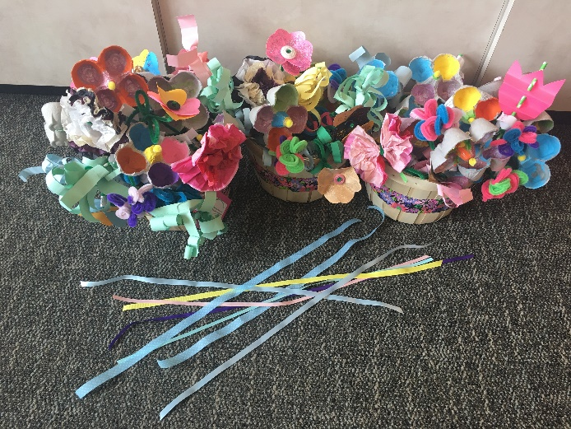
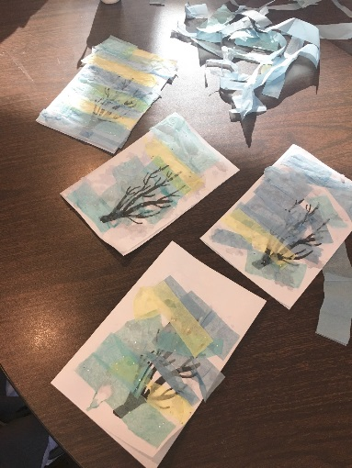
Little Kids’ Menu
Children love making crafts! Invite youth department visitors to make crafts as donations. Kids make one for themselves and one to donate.
Paper flowers – donate to memory care and developmental community activity directors for flower arranging
Holiday Cards – give to Home Service Delivery patrons with their monthly delivery of books
Multi-generational Pen Pal program (Planned for 2019)

Slide 11
Pre-Packaged Kits Tales and Travel Awards
Developed by Mary Beth Riedner and Gail Borden Public Library District.
Tales and Travel Memories is nationally recognized.
The Jean Williams Sayer Upstart Innovation Award through the Chapter of the Medical Library Association, 2014
The American Library Association
Carnegie-Whitney Grant, 2013
Featured in: American Libraries Magazine, April 11, 2016
http://americanlibrariesmagazine.org/2015/02/09/stimulating-minds/
Published in: Strategic Library, July 2014
http://cld.bz/L41Qhuo#8/z
2015-2016 Target Research Project Award
Through the National Network of Libraries of Medicine and the University of Illinois, Chicago

Slide 12
Pre-Packaged Kits
Tales and Travel www.TalesAndTravelMemories.com
Designed for those with dementia and their caregivers
Free downloadable for all public libraries
Take an imaginary trip to a foreign country through books and more
Exists as a program
Exists as a circulating kit

Slide 13
Pre-Packaged Kits Tales and Travel
5 Facts
Folktale
Books
Souvenirs
Sensory items
Music
Passive Programming
Evaluation Forms

Slide 14
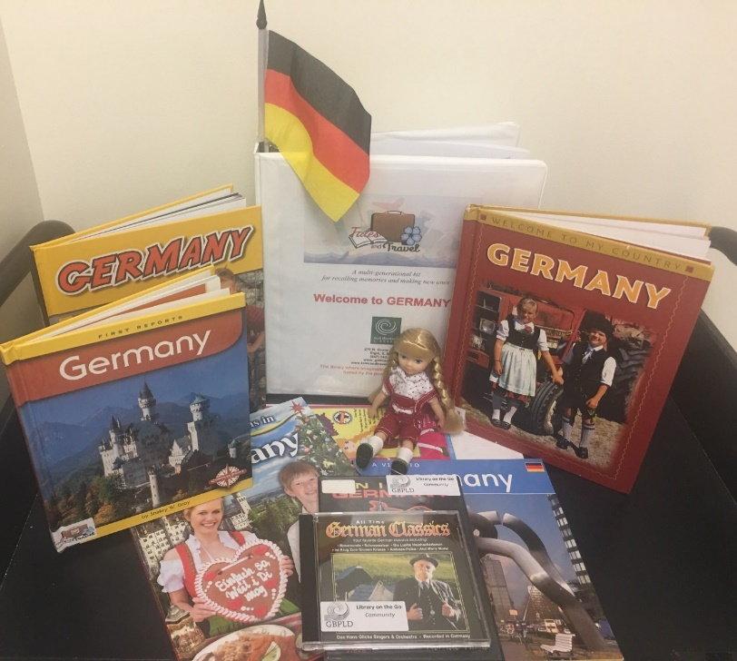
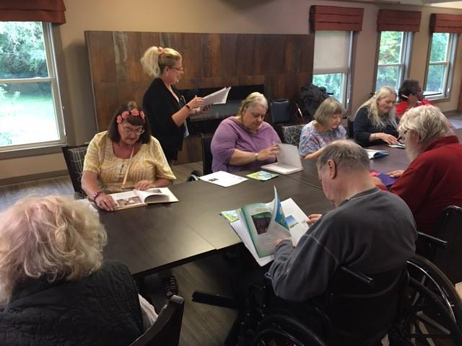
Tales and Travel: Evidence-based Research on patrons with dementia and their caregivers
Increases in:
Social & Cognitive Engagement
Quality of Satisfying Interactions
Patrons’ Relational Skills
Decrease in:
Stigma of Dementia
Isolation

Slide 15
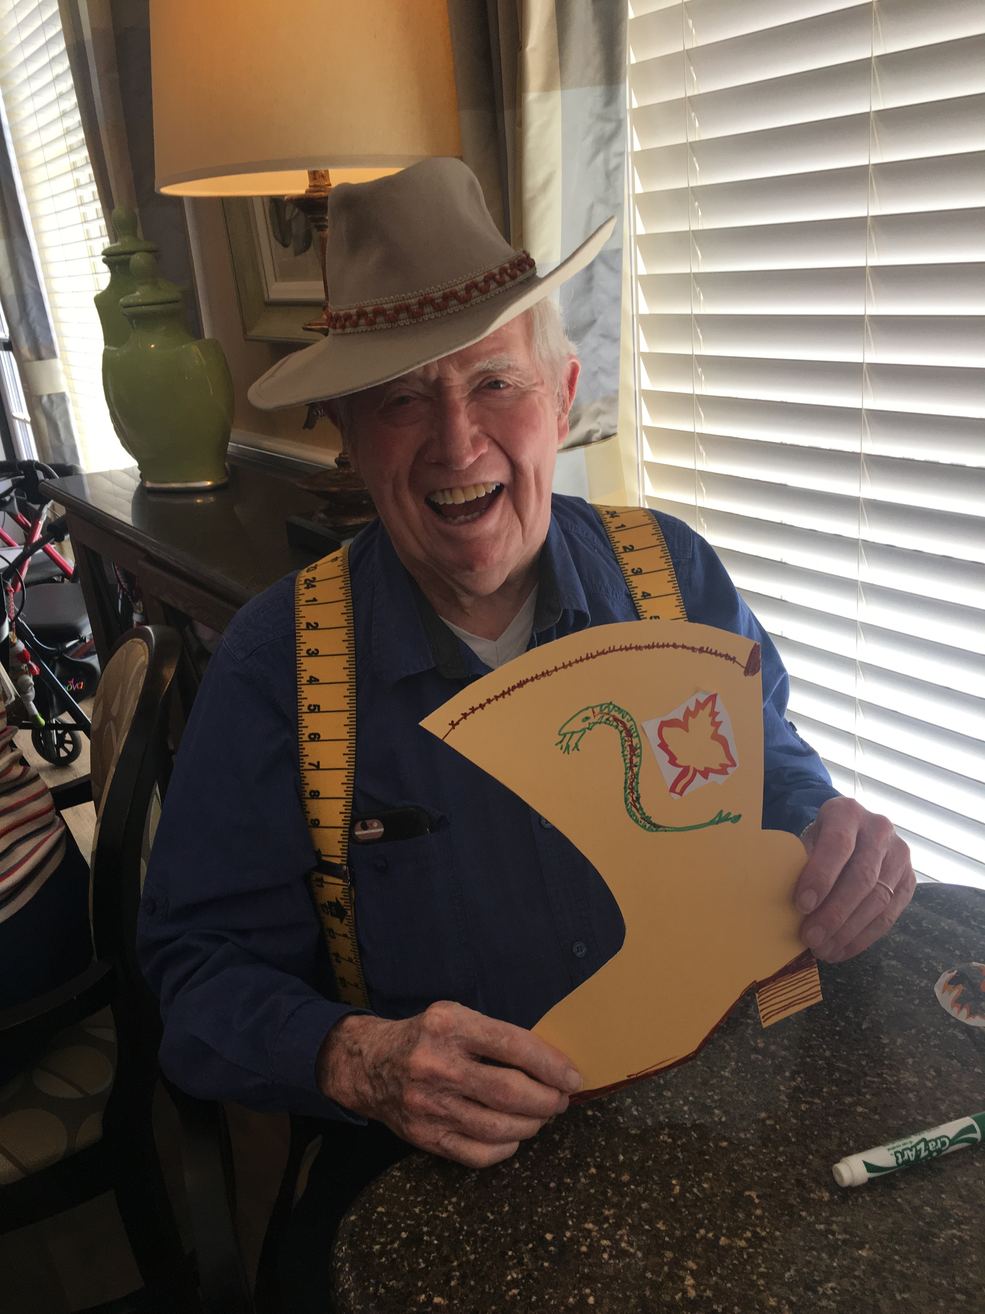
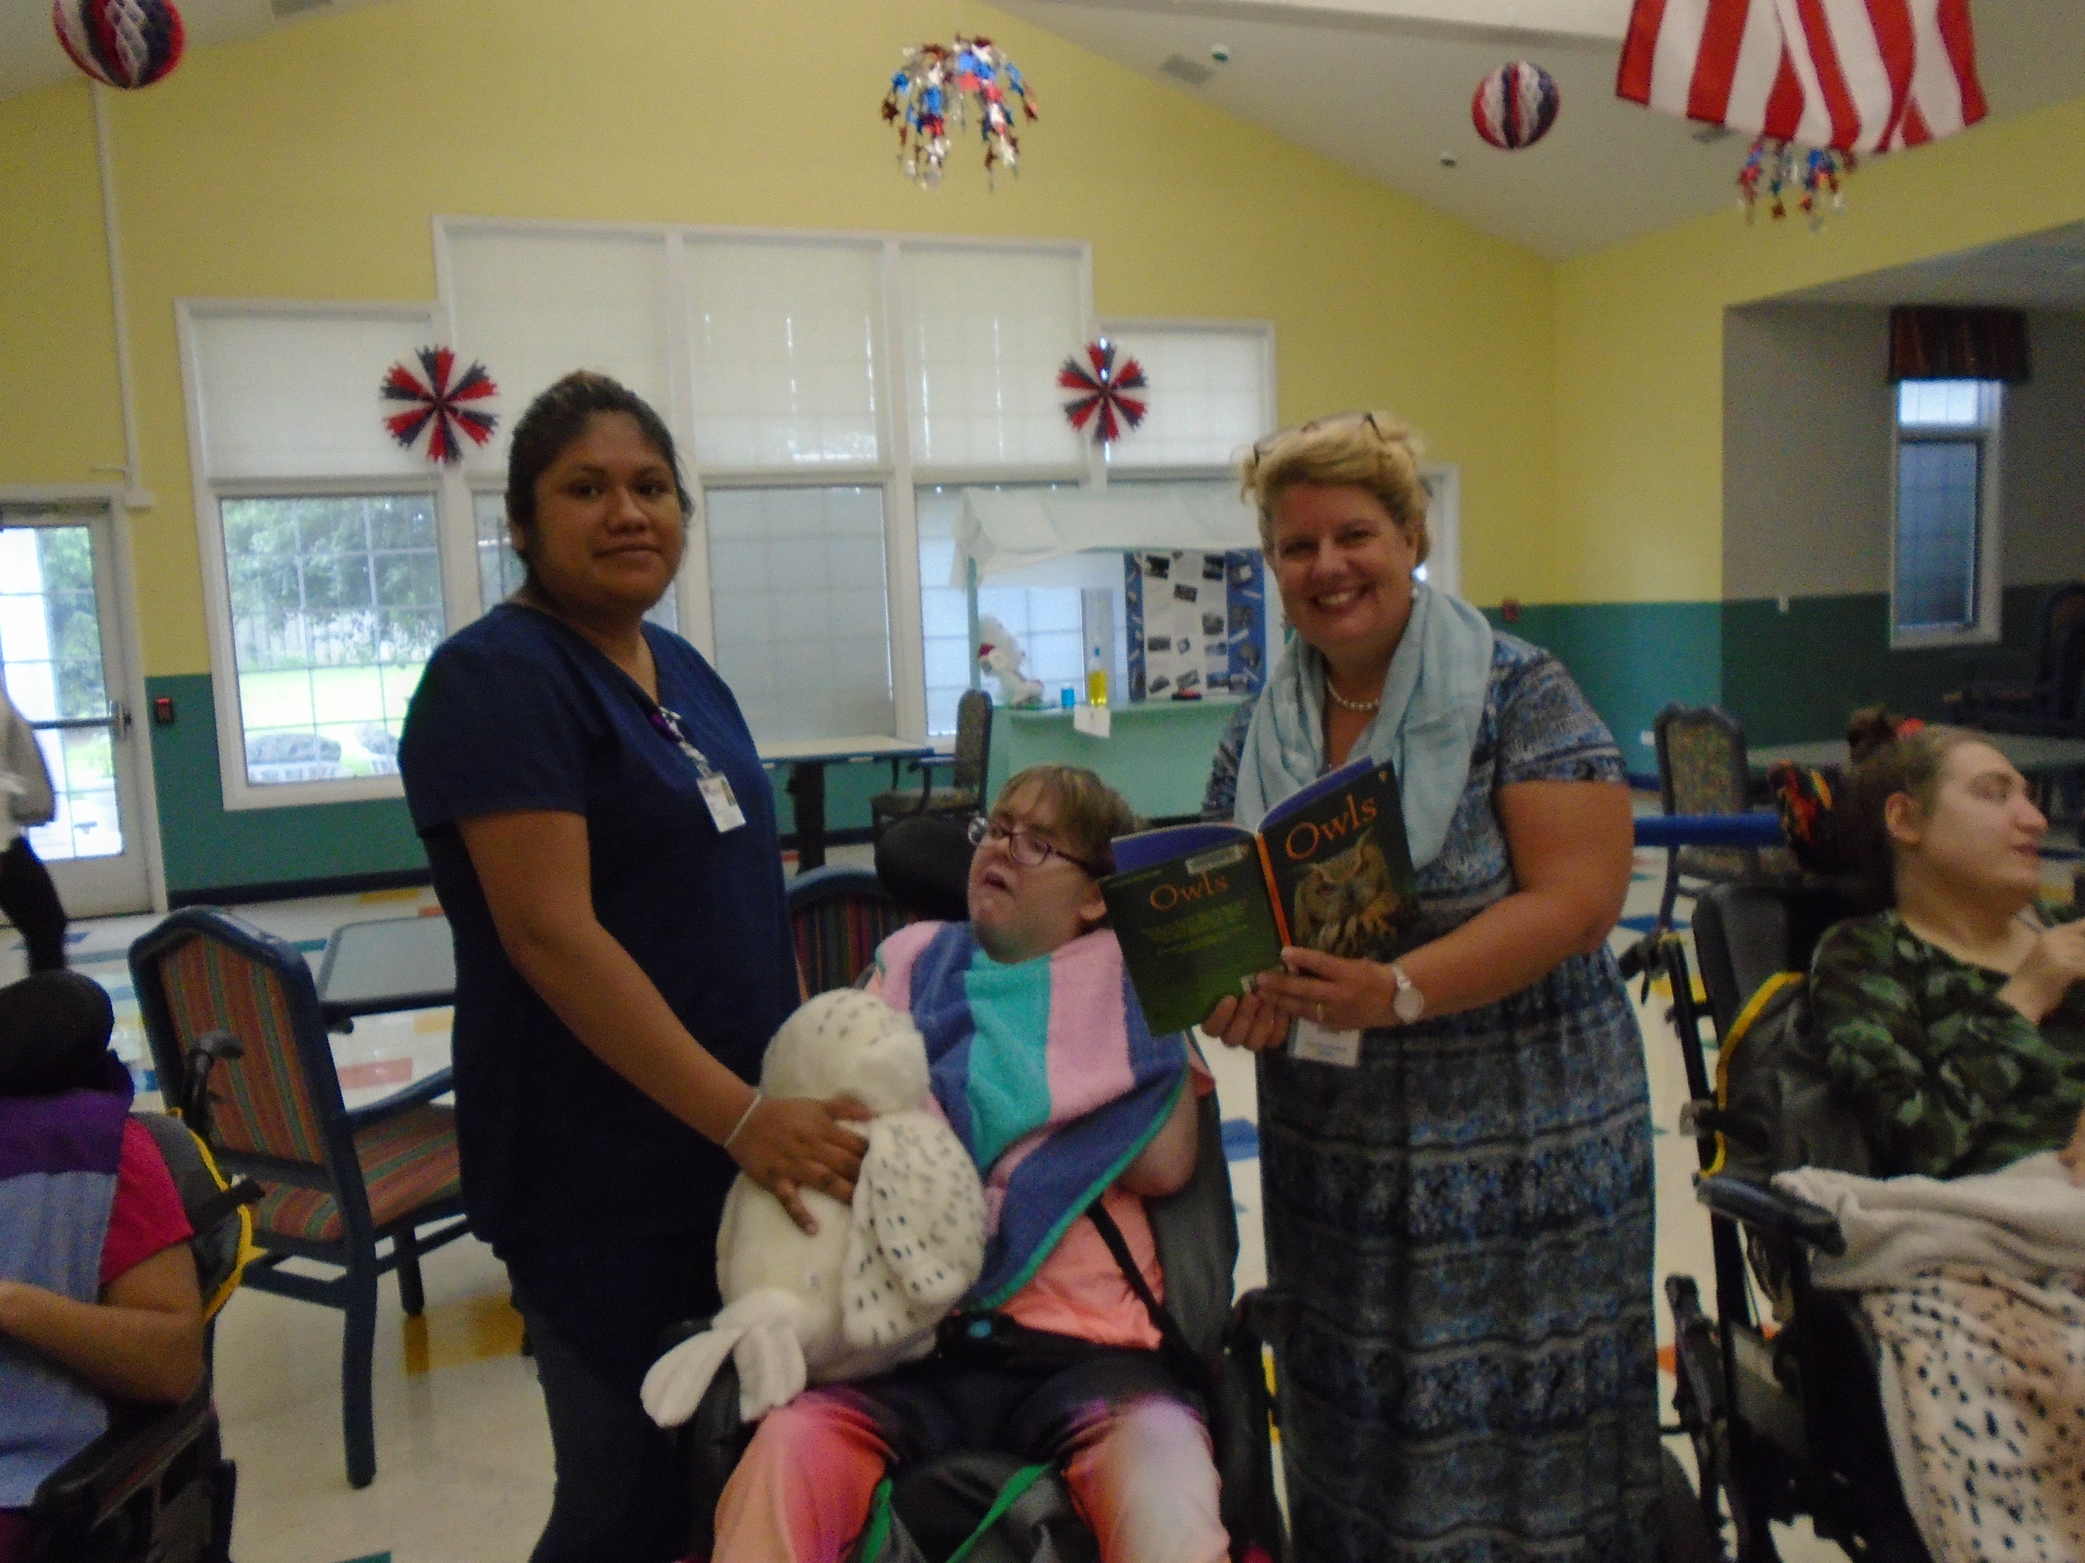
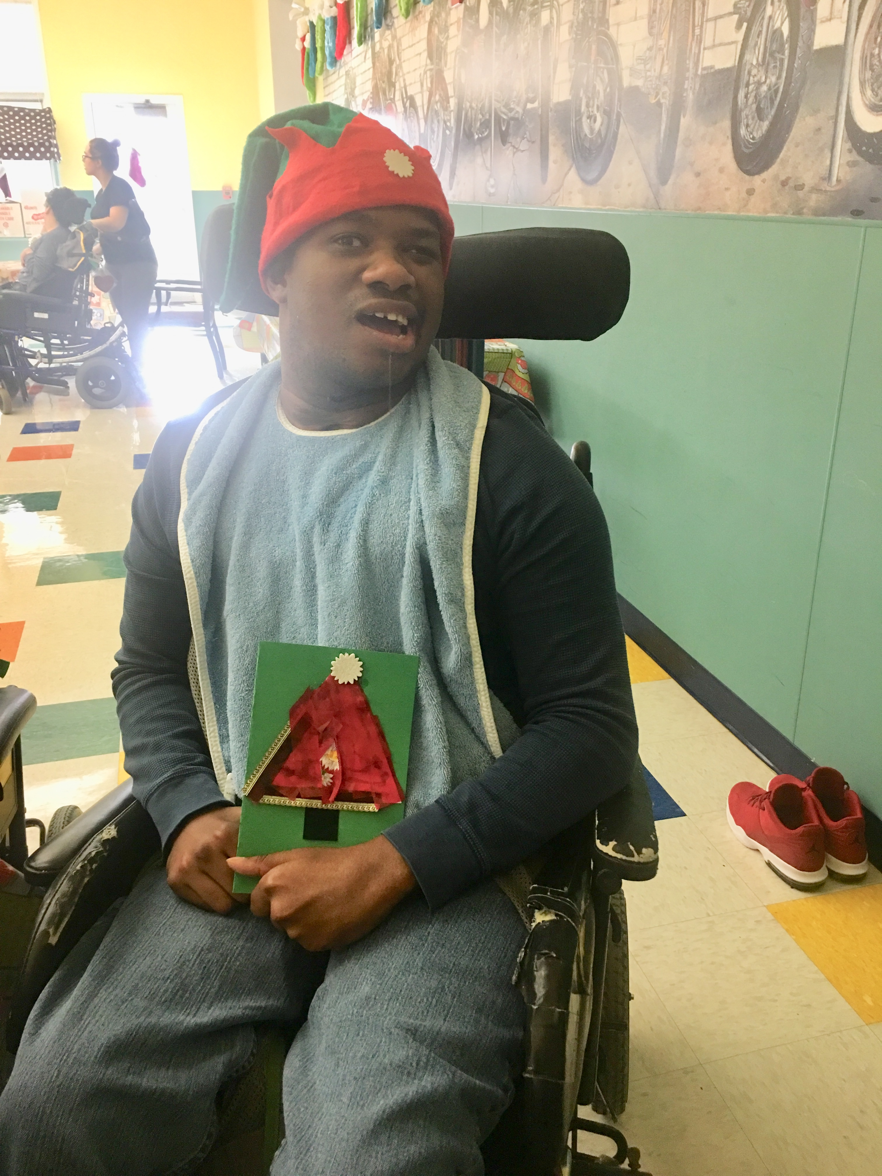
Starter Dough Recipes
Library Fun & Facts Program
Singing opening song
Reading 5 Facts Aloud
Listening to Story/Discussion
Viewing photos or books
Hands-on activity such as community art project
or interactive objects (swoosh ball)
Reflections on art project
Singing closing song

Slide 16
Library Fun & Facts Program Themes
Wassily Kandinsky, Father of Abstract Art
Take Me Out to the Ball Game
Visit the State Fair
Female Visual Artists
Cruise Ships to Subway Trips: Transportation in America
Wild West: Mountain Men & Women
Great American Amusement Parks
Beach Party: The Science Behind the Colors of the Beaches
Butterfly Migration

Slide 17
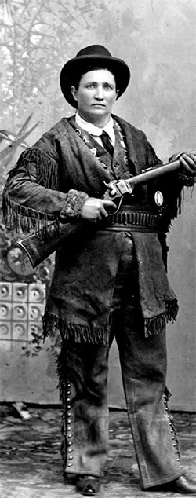
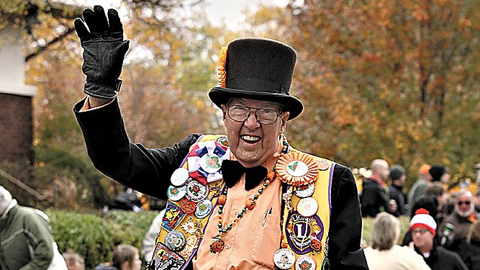
Secret Ingredients
Spice - add some spice to non-fiction information
Integrate biographies that include overcoming adversity, weird facts, and out of the ordinary situations.
Mountain Charley
Local celebrity – Mr. Pumpkin of Sycamore, IL
Sensitivity to Veterans – be sensitive to discuss the countries in which they spent their tours of duty .
Unless having discussions with groups designed
for veterans and led by veterans.

Slide 18
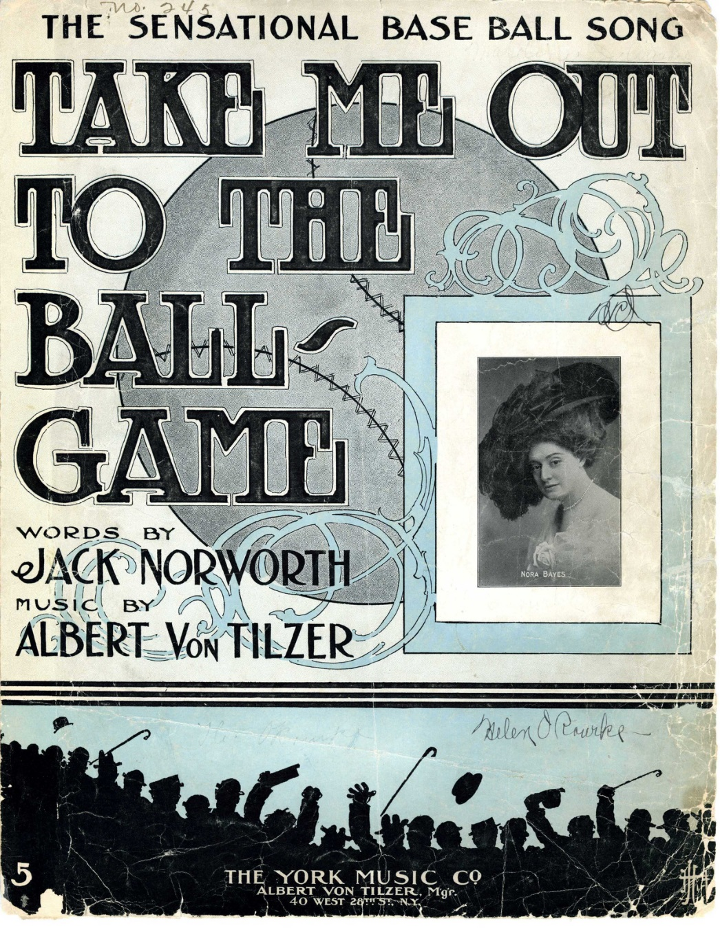
Secret Ingredients
Music - Seniors love to sing!
Some favorites include:
Take Me Out to the Ball Game
Happy Birthday
America the Beautiful and other patriotic songs
Home on the Range
For We are Jolly Good Fellows
Oh Susanna
I’ve Been Working on the Railroad
This Land is Your Land
Music Division, The New York Public Library. "Take me out to the ball game"The New York Public Library Digital Collections. 1908. http://digitalcollections.nypl.org/items/510d47e3-14d8-a3d9-e040-e00a18064a99

Slide 19
Secret Ingredients
Volunteerism - Engage memory care and developmental groups through volunteerism. Invite special needs groups to make crafts that can be used in other programs.
Association for Individual Development group made a circus train poster that helped to show the caste system that existed on circus trains in the late 1800s.
One memory care unit painted water color backgrounds. These were cut into postcards and another local group added African animal silhouettes. These lovely Savanna postcards were then placed at the dinner table for residents to enjoy.

Slide 20
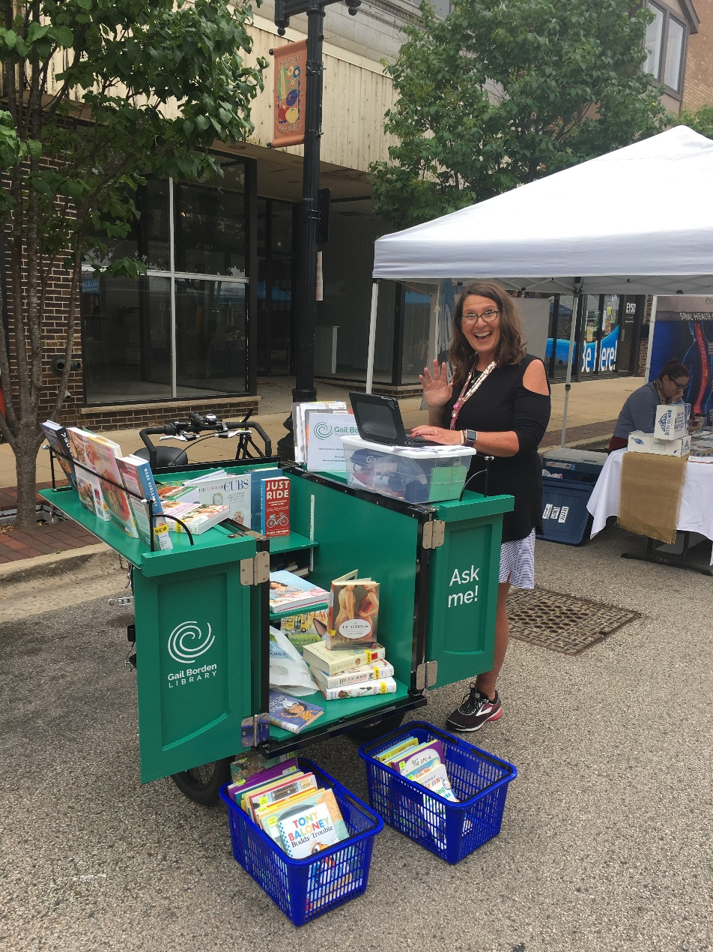
Delivery Locations
Consider expanding your services to these locations:
Barbershops
Crisis Centers
Food Pantries
Local Restaurant Storytimes
Park/Zoo Storytimes
Laundromats
Senior mobile home park communities
Farmers Markets
All of these locations can be paired with bookmobile and/or book bike services.

Slide 21
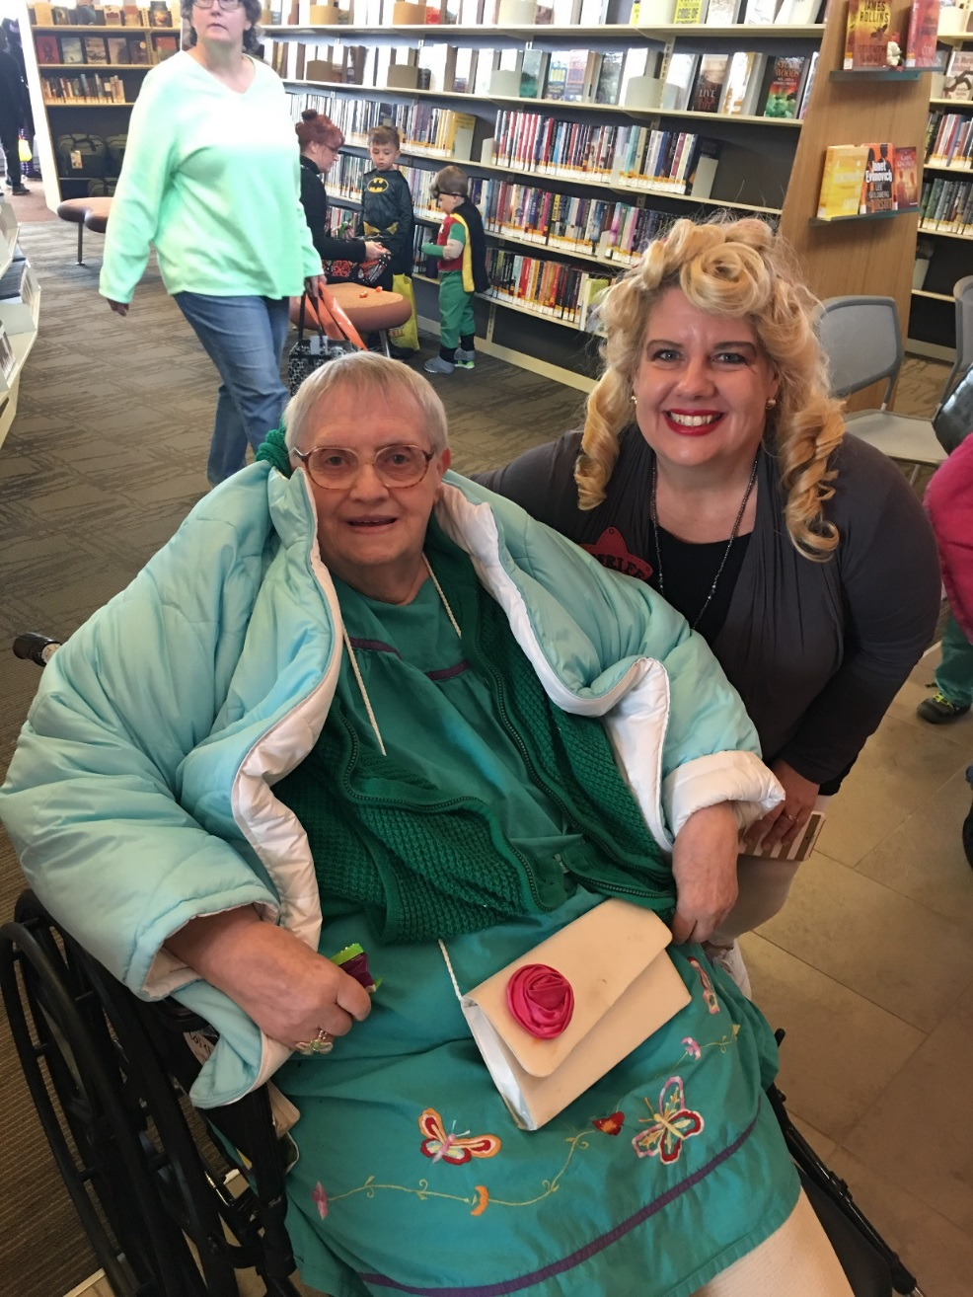
Home Made options
Can’t get away from your desk? Consider one of these ideas:
No-Shushing Movie
Memory Café
Halloween Costume Parade
Fall Fun Fair
Music in the Stacks

Slide 22
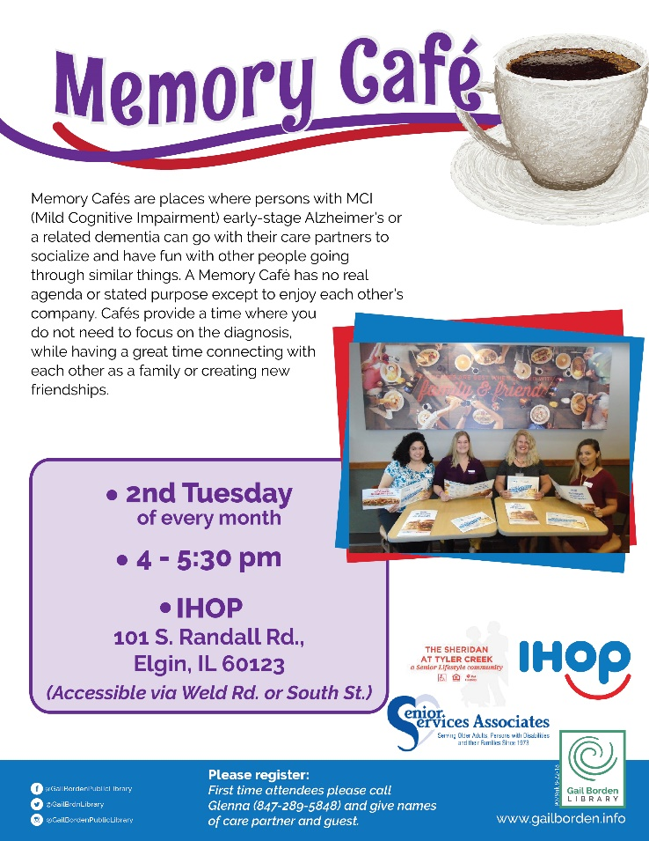
Desserts
Become a Dementia Friendly Community
Memory Café
Train community business partners to become Dementia Friendly
www.dementiafriendsusa.org
Share your program photos and get ideas from others on the Facebook group:
www.bit.ly./CGideahub

Slide 24
Door Prizes

Slide 25
Contact Information:
Glenna Godinsky Ana Devine
Life Enrichment Liaison Director of Branch Services
(847) 289-5848 (847) 931-2091
ggodinsky@gailborden.info adevine@gailborden.info

