Slide 2
TAKE YOUR LIBRARY
MOBILE

Slide 3
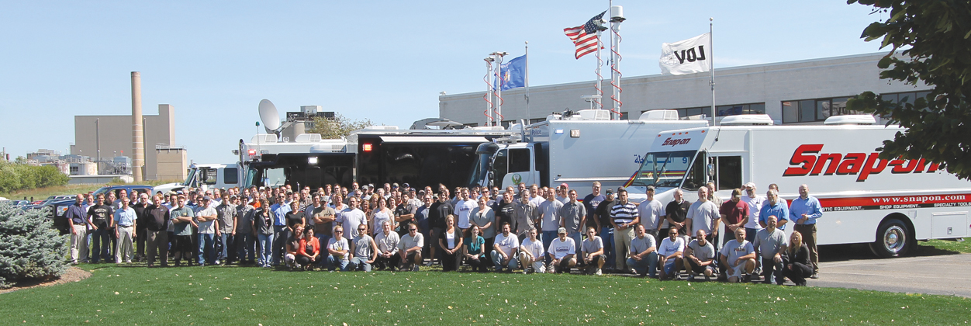
ABOUT US
Family owned and operated since 1977
256 employees
Over 30,000 vehicles in service
Over 110,000 sq feet of manufacturing space

Slide 4
DO’S AND DON’TS OF PURCHASING A VEHICLE
DO – Consider the platform. Many platforms are available to suit various needs. A commercial truck platform offers increased durability, longevity and safety…

Slide 5
DO’S AND DON’TS OF PURCHASING A VEHICLE
DON’T – Hire order-takers. Sales specialists and the design team should actively listen to your needs and wants in order to translate those items into a comprehensive vehicle strategy, suggesting alternatives and solutions that will result in the optimal product for your specific needs…

Slide 6
FIVE WAYS TO ENSURE YOU RECEIVE THE CUSTOMER SUPPORT YOU NEED
1. Ask questions up front.
2. Make sure there’s a service department.
3. Investigate responsiveness.
4. Learn about ongoing training opportunities.
5. Get references.

Slide 7
OUR PEOPLE – YOUR PROJECT
10 On-staff engineers
A Dedicated Project Manager
Average employee tenure of nearly 20 years
24/7 Parts and Service
15 Full-time service drivers on-site ALL over the world

Slide 8
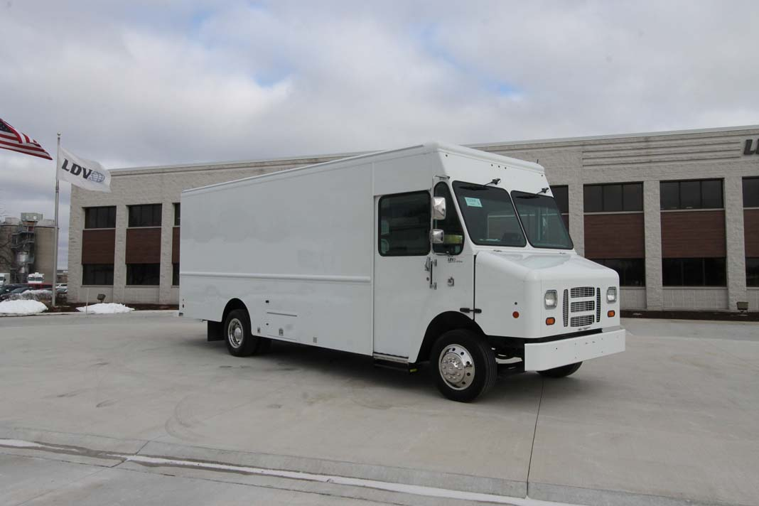
STOCK VEHICLE AVAILABLE!
Get your program off the ground for under $158,000.
Front Swivel seat with integrated check desk. Acore Shelves and Carts. Wheelchair lift option available.

