Slide 1
Get the Facts About CDLs
Michelle Stottlemire
Topeka & Shawnee County Public Library
Notes:
A little bit about our library…
Located in the heart of Shawnee County (county-wide service),
Mandate to serve 550 squared miles,169,871 people residing in the county. What does that mean?
The library serves more than 100,000 registered borrowers.
About 3,000 people walk through our doors daily, but outreach is very important to making sure all residents have access
Outreach
We provide services to 55 senior living facilities and 85 homebound individuals.
Our bookmobiles make 23 stops six days a week traveling across the county.
Two child-specific outreach services for kids
The Adventuremobile (currently serving over 4,000 students at schools in Shawnee County)
Learn and Play Bus – a mobile preschool for kids under 5 years of age.
In 2014 we began a multi-year program of replacing our 20+ year old bookmobiles and one of the biggest changes was the requirement for CDL – this information is fresh and some of it was learned the hard way. ☺

Slide 2
Why go the CDL route?
Drivers complete extensive training
Vehicle legally requires a CDL
26,001 lbs + GVWR
Towing 10,001 lbs+
16+ passengers
Hazardous materials
Restrictions
Must be at least 21 years of age
Driving experience and history
Proof of citizenship or permanent
residency
English proficiency
Medical and physical requirements
Criminal background restrictions
Notes:
CDL drivers will have more training and better understanding of vehicle operation than standard-licensed drivers
Vehicle legally requires a CDL
Any combination of vehicles (i.e. tractor-trailer/semi-trailer) with a gross combined weight rating (GCWR) of 26,001+pounds, providing the gross vehicle weight rating (GVWR) of the vehicle being towed is in excess of 10,000 pounds.
Any single vehicle (i.e. straight truck/bus) with a GVWR of 26,001 or more pounds
Any vehicle, regardless of size, designed to transport 16 or more persons, including the driver.
Any vehicle required by federal regulations to be placarded while transporting hazardous materials.
Some exceptions like fire trucks, farm equipment, RVs, etc.
Restrictions – most are Federal restrictions
Be at least 21 years old:
To drive a commercial motor vehicle across state lines (interstate).
To drive a commercial motor vehicle that contains hazardous materials.
In some states you can be 18 with a CDL if you do not cross state lines (but some insurance companies won’t insure CDL drivers under the age of 21)
Have a valid regular (non-commercial) driver’s license and have at least one or two years of driving experience (depending on the state)
An applicant “must provide to the State proof of citizenship or lawful permanent residency” per 49 CFR 383.71.
Social security card, or proof of the number.
Another document such as a birth certificate, Passport, or green card.
English Proficiency - Specifically, the statute reads: [A person is qualified if he/she] Can read and speak the English language sufficiently to converse with the general public, to understand highway traffic signs and signals in the English language, to respond to official inquiries, and to make entries on reports and records. By law, all manuals and exam materials must be in English.
Medical Card – DOT physical (not all physicians are qualified)
Most basic disqualifications include missing limbs, poor hearing test, high blood pressure, heart disease (history of heart attack), diabetes that requires insulin injections
May be exempt from this requirement due to local laws
Criminal Background: Some criminal felonies can disqualify someone from obtaining a CDL
If you have a warrant out for a felony, you are disqualified from earning a commercial driver's license until the warrant is released
If your license is suspended, then you first have to get driving privileges reinstated before getting a CDL
Difference types of CDLs –
Class A (combination vehicles like a tractor-trailer),
Class B (single vehicle like straight truck or bus), and Class C (passenger vehicles 16+ or hazardous materials).
Most bookmobile situations will require a Class B license with an air brakes endorsement.

Slide 3
How to train your driver
INTERNAL TRAINING
Pros
Budget-friendly
Individually tailored to organization
More control over content and quality
Cons
Affects staffing and vehicle availability
Only as good as your best trainer
Questions about trainer compensation
EXTERNAL TRAINING
Pros
Very experienced instructor
Less impact on staffing
Usually comes with a guarantee
Cons
Potential scheduling conflicts
Not available in all areas
Can be costly
Studying for permit test ≈ 8-14 hours
Training for practical test ≈ 15-22 hours
Test taking (permit and practical) ≈ 3-4 hours
TOTAL: 26 – 40 hours
Notes:
INTERNAL TRAINING - PROS
Budget friendly – not paying a contracted vendor to train your staff (professional training organizations often charge hundreds to thousands of dollars per individual for training and access to equipment).
Internal means you’re in charge of cost (most library staff hourly wage are under that charged by professional training organizations
In-house means the training, while aiming for the ultimate goal of getting CDL, can be tweaked and tailored to your specific organization and vehicles.
This means meaningful content, less sitting through information that only applies to “the other guys”
In-house gives more oversight to quality of the training (we had hit-and-miss experiences), and content
INTERNAL TRAINING – CONS
Pulling staff for training might affect your organization more, since you not only need to shuffle the schedule of the trainee but also the trainer
Additionally, vehicle access is required for the later portion of the CDL training process. This could affect service schedules and/or staffing schedules.
The training will only be as good as the program your organization and the person(s) facilitating that training. If you have limited staffing or sub-par candidates for this position then internal training may not be a good fit for your organization.
Because CDL training requires a different type of skill and knowledge set than is typical in a library setting trainers may seek a higher rate of pay for these services.
EXTERNAL TRAINING – PROS
With external instructors your instructor is typically coming to the training with considerable trucking, training, and testing experience
With external training you’ll typically only need to adjust the schedule of those staff going through the CDL process, since the trainer isn’t from your organization and they provide the equipment
Usually guaranteed
EXTERNAL TRAINING – CONS
At the merc of the trainer’s availability, not always convenient
Not available in all areas – we are luck in that there is a training school in our city; otherwise, next closest is 1.5 hours away
Costs – can be costly
Our experience: 2014 hybrid training with professional instructor and our bus…no charge…training was inconsistent and not a priority to the organization
Since then = internal training

Slide 4
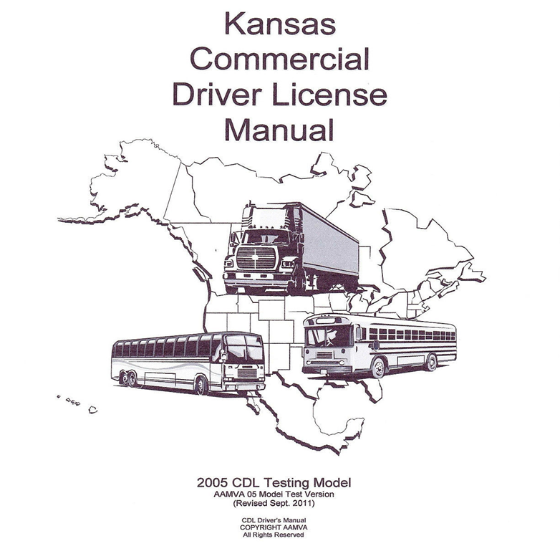
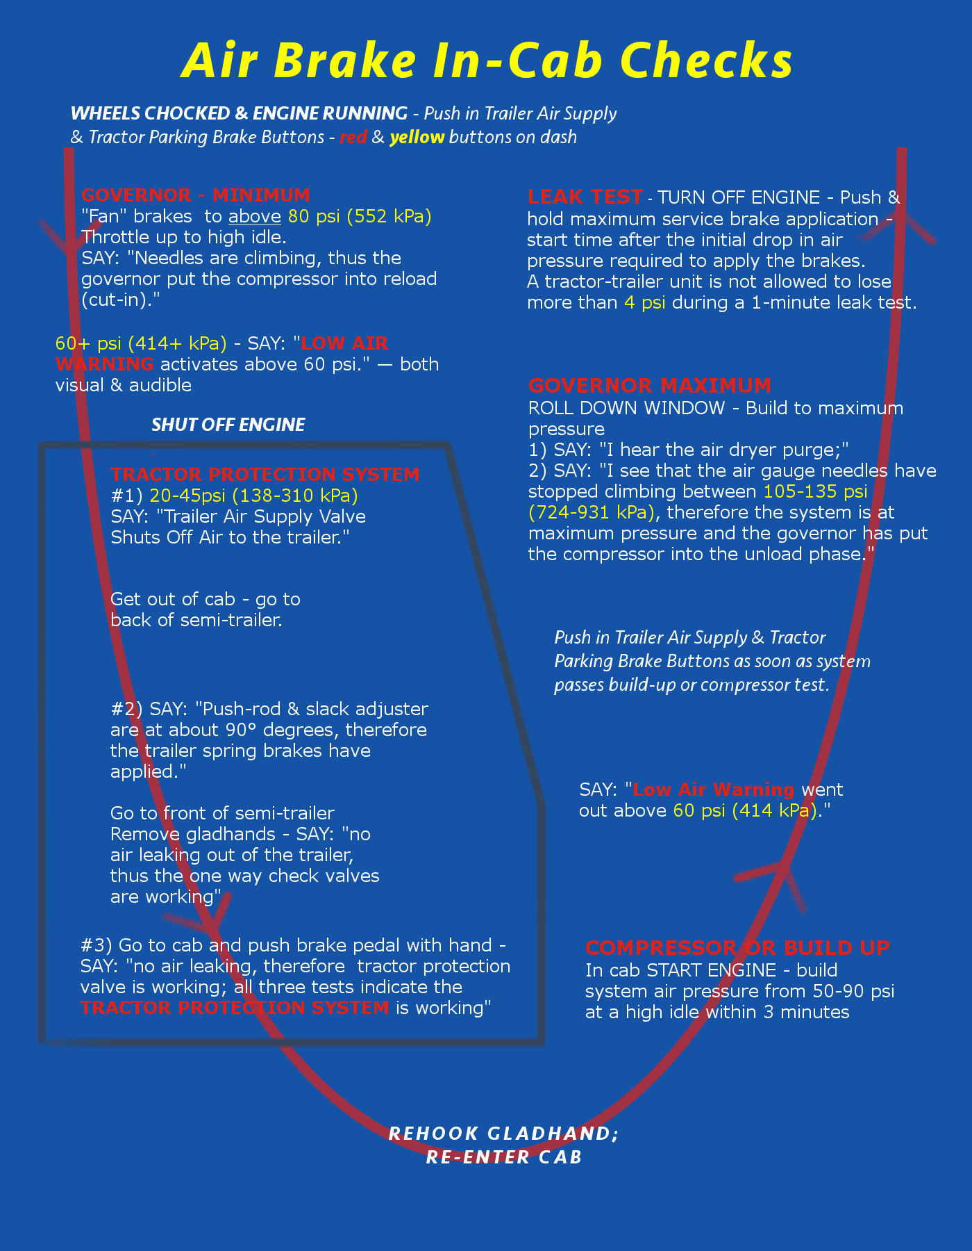
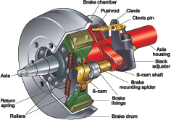
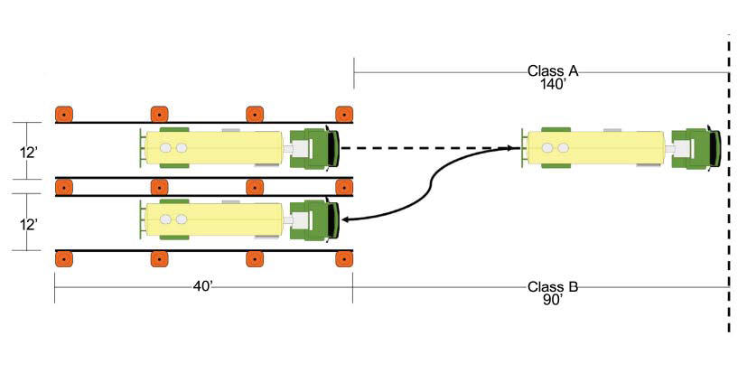
The (Class B) cdl training process
STEP 1: Study for the CDL permit + air brakes endorsement
Manual available online
Fees ≈ $5
STEP 2: Obtain the DOT Medical Card (if applicable)
May be exempt
Fees ≈ $100
STEP 3: Pass the CDL + air brakes endorsement knowledge tests
Computerized and written versions
Fees ≈ $25
STEP 4: Study for the CDL practical exam
Requires vehicle access and driving time
STEP 5: Pass the CDL practical exam
Vehicle pre-trip inspection/air brakes tests
Parking maneuvers
Driving observation
Fees ≈ $57
Allow a minimum of 3 weeks training for the process
Notes:
STEP 1: Manual available online or often paper version are available for a small fee at local DMV office.
The manuals are comprehensive, but in general when aiming for a Class B CDL there are sections you can ignore (for semi-trailers/combination vehicles).
Still, a comprehensive operational knowledge is required, including functional knowledge of air brake systems, vehicle suspension components, safety pratices, and rules of the road.
Lots of free online resources including videos and diagrams and practice tests. So fees for this step are pretty minimal, maybe $5
STEP 2 : DOT medical card requires a DOT physical, AKA Department of Transportation Medical Examinations.
Not all doctors are approved – check first.
Your organization may be exempt – in many states state and local governmental bodies are except from this requirement.
Prices range but average at about $100.
STEP 3: The permit test and air brakes endorsement are two separate tests – to pass must get at least 80% on each.
There are both computerized and paper versions available.
If you’ve practiced with several different online tests and consistently scored above 80% you should be in pretty good shape.
Tests usually around $20-$30 for everything
What happens if you don’t pass it on the first try? Waiting period – 24-hours to 2 weeks.
Retake with additional (usually reduced) fee.
Three strikes = must wait 30 days until attempting the next retake.
Additional rules apply if you don’t pass it on the 4th try.
Permits do come with a limited range of validity – 60-90 days seems common.
STEP 4: Permit in hand, time to start studying for the practical test.
This requires vehicle access and drive time.
Pre-trip inspections (all those components now have to be identified), parking maneuvers, and driving.
STEP 5: The actual test! Several different versions (random) – so will be variation.
In general, follows this pattern...
Fees range from $40-$65
In total, allow at least 3 weeks and roughly $65-$200
**Your state may have other requirements, like in KS Anti-trafficking training

Slide 5
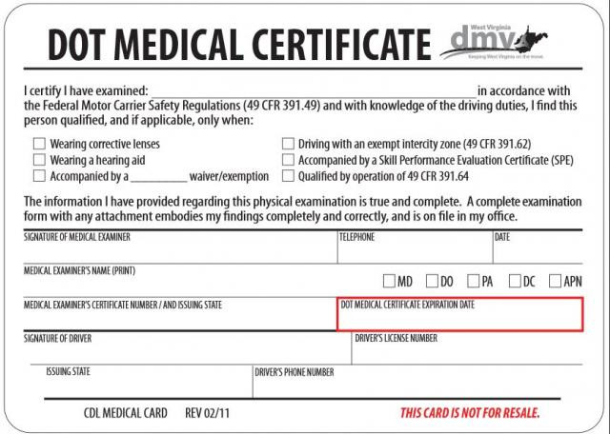
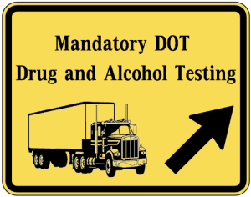
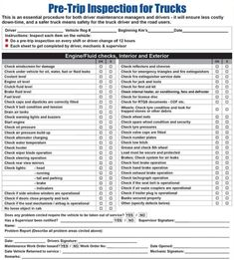
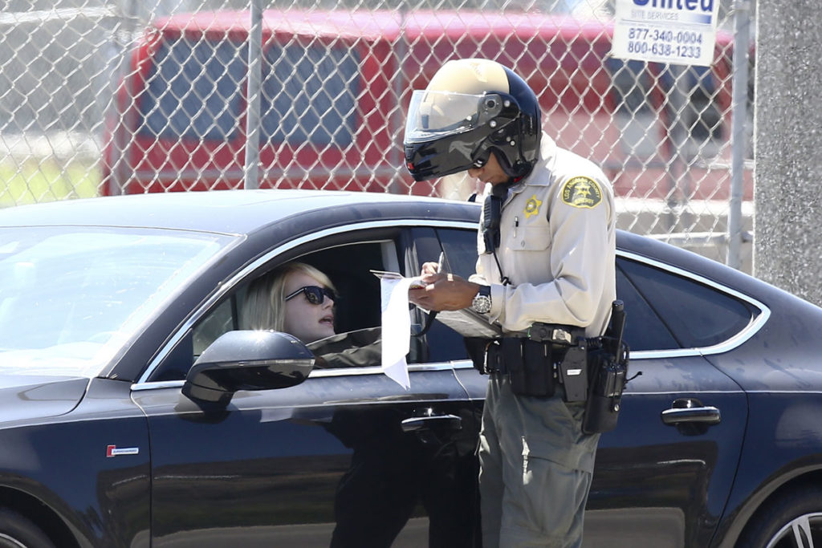
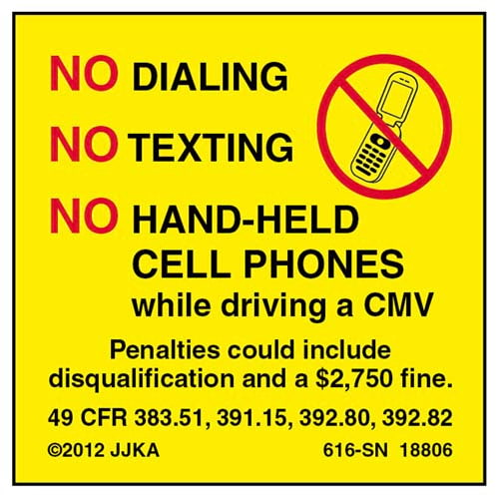
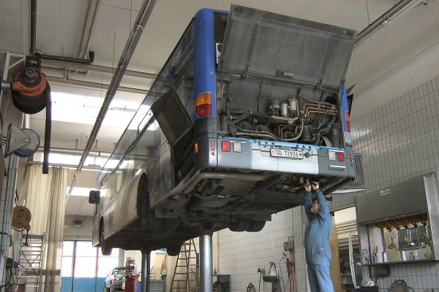
Federal regulations & compliance
Separate hiring paperwork/employee folder
Medical card
Mandatory drug and alcohol training and
testing
Accident and infraction reporting
Pre- and post-trip inspection forms
No hand-held cell phone use is permitted
Best Practices
Document driver training
Continued training and education
Vehicle maintenance log
Establish minimum medical requirements
Organizational membership
Notes:
FEDERAL REGULATIONS & COMPLIANCE
CDL drivers require oversight due to federal and state regulations
Library bookmobile drivers are sort of their own class – in between the more common scenarios for CDLs. Federal requirements vs. Best practices
May be exempt from some regulations, but not all (these are our examples which seems fairly common)
Hiring paperwork/employee folder: If they already have a CDL then asking information regarding previous motor carriers in previous 3 years employment history
Certification of Violations
Must include a MVR within 30 days of hire
Human Resources must keep a separate “accident file” and D&A testing file in personnel folders of CDL driving employees
Medical card – if applicable, copies of this must be kept on file with HR and guidelines followed for renewals.
Mandatory drug and alcohol training and testing - No organization is exempt!
There are federal protocols for this testing and not all D&A tests and D&A test facilities are in compliance.
Part of the D&A regulations pertain to random testing of CDL drivers – annual targets of 25% of CDL drivers for drug testing, and 10% for alcohol (potential $1,000 civil penalty per missed occurrence
Refusal to take a drug/alcohol test is considered/treated as a positive result. There are federal guidelines to follow should an employee refuse a D&A test and/or if their test result is positive.
ADDITIONALLY, there are certain accident situations which require D&A testing within 2 hours of the incident.
Training component to D&A testing – required to have a comprehensive D&A policy that specifically addresses CDL drivers, consequences, etc. and must show documentation of this training.
Also, those who supervise and/or directly manage CDL drivers must take a mandatory one-time 2 hour training and D&A and determining reasonable suspicion.
Best advice: consortium!
Accident/infraction reporting - The driver must notify his/her employer within 30 days of the date of conviction.
Required to inform supervisors (or Human Resources, if supervisor is not available) of any tickets/vehicular infractions, or of any changes in driving status (specifically a suspension, cancellation, or revocation of a license) within 24 hours or the next business day from the date of the action.
Pre- and Post-Trip Inspection Documentation - Under Federal laws (49 CFR 392.7 and 49 CFR 392.8) CDL drivers must inspect their vehicle daily (as assigned) and complete the proper pre/post inspection forms.
Any vehicle maintenance concerns should be reported to the property authorities immediately, documenting repairs, etc. (CYA)
Federal law prohibits the use of hand-held cell phones (either for calls, texting, or internet service) by a CDL driver while driving a CMV, except in the case of emergency.
Penalties for doing so include the possibility of a $2,750 fine on the individual and possible license suspension.
This rulemaking restricts a CMV driver from holding a mobile device to make a call, or dialing by pressing more than a single button.
CMV drivers who use a mobile phone while driving can only use a hands-free phone located in close proximity. Some hands-free options such as one-touch dialing and dialing by voice are allowed.
BEST PRACTICES
Although the following are typically not required of libraries due to governmental exemption, they are required of private motor carriers (regardless of size) and are considered industry standards. KCC staff made it clear that they highly recommended our library consider adopting these practices since, in the event of an accident/mishap, our organization would be a target for inspection and a focus for predatory attorneys. As they pointed out, libraries aren’t the kind of big business that can simply raise the prices of our goods to off-set a million dollar settlement resulting from negligence. Putting the following practices in to place would, in their words, “reduce the chinks in our liability armor.”
Document Driver Training – internal or external
We document number of hours each driver spends in training once they acquire their permit, as well as what instruction was given.
For our driving and maneuvering training we have a very thorough form that allows for documentation of a number of driving behaviors (examples available).
Additionally, document any continued training and education – at the least an annual review of basic operational information, plus the federal requirement to instruct drivers on the Whistleblower Protection law
CDL drivers have the legal right to decline operating any vehicle should they have reasonable evidence that it would not be safe (either by themselves or others) to do so. Per federal law, 40 U.S.C. 31105, drivers who refuse to violate safety regulations, including the operation of an unsafe vehicle, are protected against retaliatory action by their employers.
Vehicle Maintenance Log – Important for general operations, but also in cases of accident investigation (and in multi-vehicle fleets)
Minimum Medical Requirements – Even if your organization is exempt from the medical card requirement it will benefit your org if you set a minimum requirements.
Sometimes, your organization insurance will set limits.
For example, in Kansas local school districts that own and operate their own bus fleet are exempt from the medical requirement because they are considered a local governmental entity. However, there are requirements put in place by the KDHE that mirrors the DOT physical criteria.
Organizational Membership - Finally, it’s important that you stay abreast of any changes to CDL training and/or operational requirements. Consider joining a state or national organization that monitors and educates about the industry.
EX: Truckers Against Trafficking training.

Slide 6
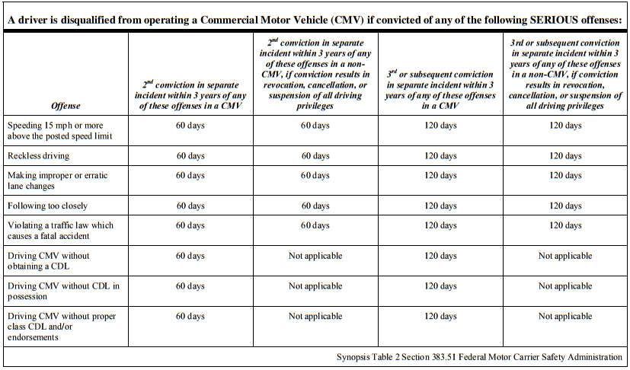
Personal Liabilities and Limits
Cost of exams, license and renewals
Higher fines for vehicular infractions and moving violations
Loss of license for multiple moving violations within a 3 year period
No diversions allowed
State-specific restrictions
Notes:
Cost of Exam/license/renewal
Potentially higher fines for vehicular infractions and moving violations in commercial or personal vehicle (at discretion of responding officer).
Loss of license for multiple moving violations within a 3 year period.
The severity of your consequence depends a lot on which type of traffic ticket you receive. Some offenses disqualify you from keeping your CDL and from ever applying for one again. This includes serious offenses like operating a motor vehicle with a blood-alcohol level above the accepted limit, committing manslaughter with a vehicle, leaving the scene of an accident, and using a commercial vehicle in the commission of a felony. In fact, many felonies are grounds for loss of a commercial driver’s license.
However, other tickets may not have such serious consequences. For example, speeding a little bit or parking incorrectly may not be an issue unless you get multiple tickets for the same offense over a period of time.
Multiple Tickets
Even if you never get driving tickets that are considered serious on their own, receiving multiple tickets can eventually spell bad news for your commercial driver’s license. This is legislated on a statewide level, so you may wish to consult your CDL handbook to find out how many tickets in what period of time may result in your license getting revoked.
In some states, for example, getting two or more tickets in a six-month time period may result in the temporary suspension of your commercial driver’s license. Getting more tickets in a shorter time frame may result in your CDL being permanently revoked.
No diversions allowed
State specific restrictions – Kansas CDL holders should also be advised that blood alcohol concentration (BAC) limits are much lower for them when they are driving their commercial vehicle. Operating a commercial vehicle with a BAC of 0.04 —the rough equivalent of 8 ounces of beer or one ounce of liquor consumed within an hour for someone weighing 200 pounds — is enough to be charged with a crime. But there are limits for CDL drivers even if they are driving personal vehicles – in Kansas if a CDL driver is driving a non-commercial vehicle and is stopped/tested and found to have ANY measurable amount of alcohol in their bloodstream they will be legally put out of service for the next 24 hours (can’t drive). It isn’t an arrest, per se, but it is a legal order not to drive and could result in missed work time/service.

Slide 7
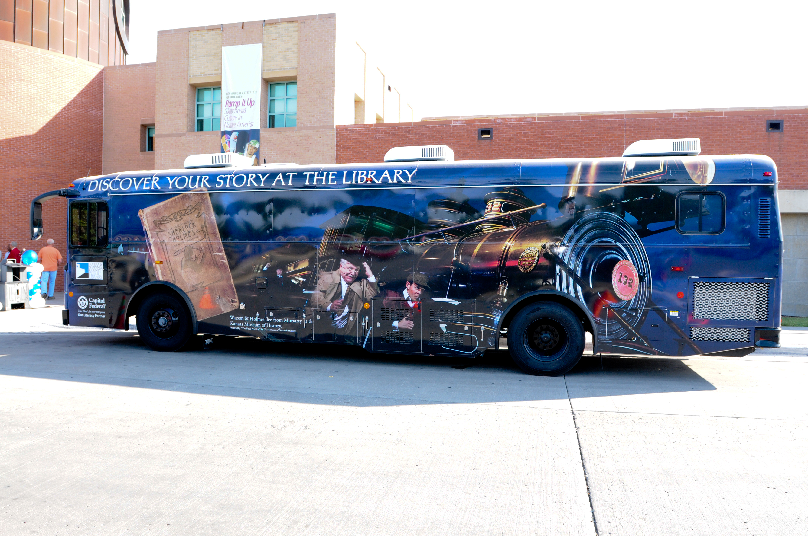
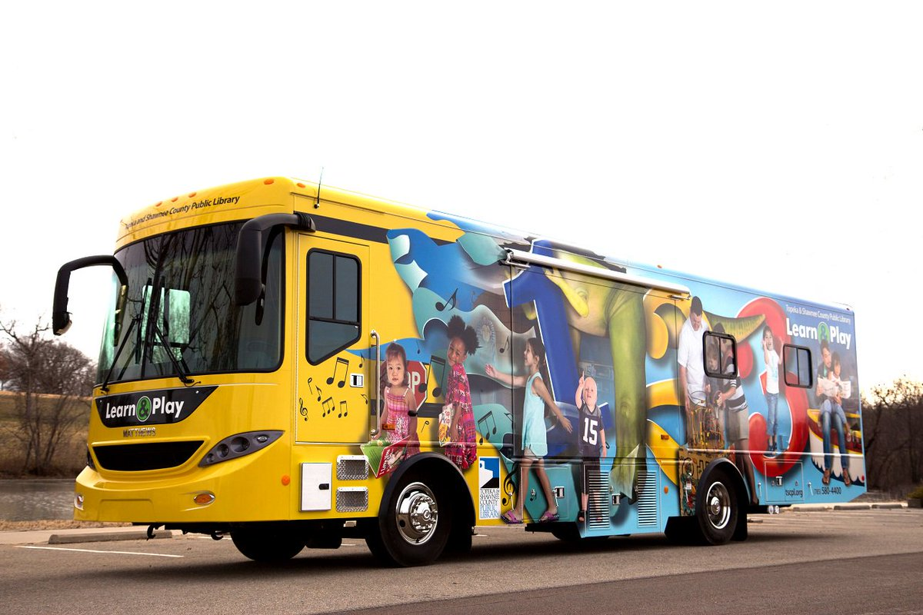
CDL-Requiring Outreach Vehicles
Bigger on the inside (and outside)!
Allow for new service models
Parking and storage
Vehicle operation
More complex
Generators
Vehicle maintenance
Notes:
New service models – more materials/better selection. Plus people like the brighter lighting and more space (not bumping in to each other). LAP bus…mobile preschool.
Parking and storage – many of these new, larger vehicles are…larger – wider, longer and taller. Pre-existing library garages may not be of sufficient size, require outside the box thinking (LAP bus – offsite at Forbes)/compromises (no A/C).
Vehicle operation – Diesel, more complex than older vehicles and both mechanics and drivers need to have a good working knowledge (DEF/DPF, air brakes, pre/post inspection sheet (driver’s expected by law to have a solid working knowledge of vehicle components and operation
Generators – preferred energy source – flexible parking, but more noise and fumes
Vehicle maintenance – specialized, staff may need extra training to perform service in –house. Also, options may be limited when it comes to warranty work. Ask for this info in your RFP – where does it have to go to get service while under warranty (can be close or hundreds of miles away)

Slide 8
Driver Compensation
Options
No extra compensation
Extra compensation for time spent driving
Shift differential for CDLs
Classification and Compensation Study
Third-party analysis
Offers suggestions to help your organization be more in-line with others in the industry
Notes:
Third-party analysis of work and current classification and compensation
Offers suggestions for any shifting to help your organization be more in-line with others in the industry.

Slide 9
Organizations to Contact
Department of Revenue
Federal Motor Carrier Safety Administration
Great tools, forms, regulations, layman’s terms
Local DMV
State regulatory agency for commercial vehicles
Kansas Corporation Commission
Department of Transportation
Local CDL training academies
Local bus systems (municipal and schools)
Other CDL libraries
Vehicle vendors

Slide 10
Questions?
Notes:
Copies Available:
Drivers Agreement
Training Checklist
Copy of RFP
Pre-Post Trip forms
CDL Handbook

