Slide 1
BRINGING OUTREACH DATA TO A NEW LEVEL
Presented By: Tina Williams, ABOS 2018 President, White Oak Library District Cathy Zimmerman, ABOS 2018 Board Member, Scott County Library

Slide 2
Association of Bookmobile & Outreach Services
What is Outreach Services?
What is ABOS?
What is the BOIR Project?
BOIR

Slide 3
What do we do?
Bookmobiles & Mobile Services
Vans & Book Bikes
Lobby Stops
Pop-Up Libraries, Parks, & Community Events
Home Deliveries & Books By Mail
Community, Preschools/Daycares, Schools, Older Adults, Memory Care, etc.
Programming: Storytime, Crafts, Book Clubs, Reading Programs, Reminiscing, etc.
BOIR

Slide 4
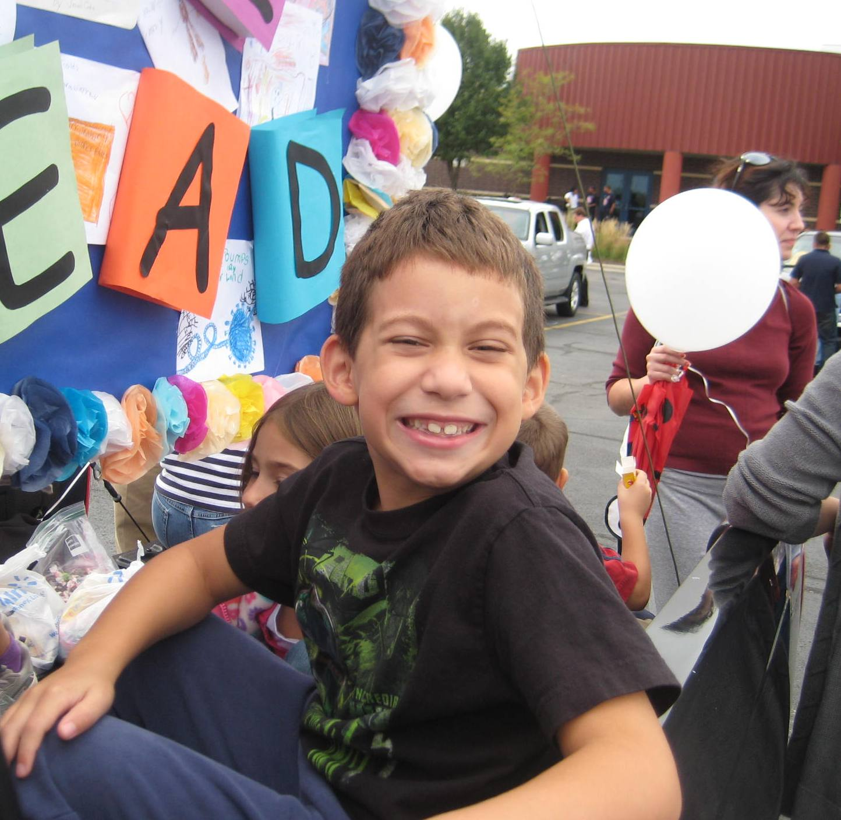
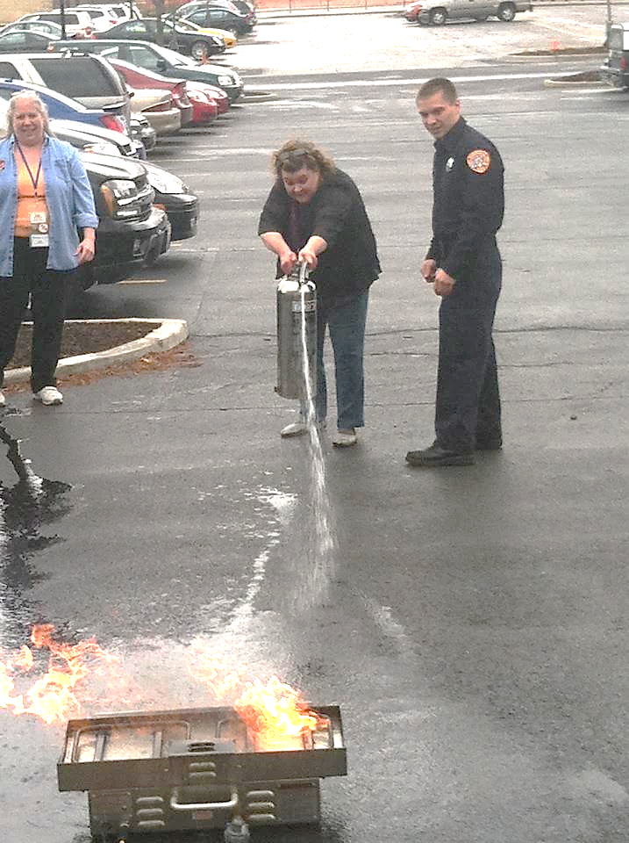
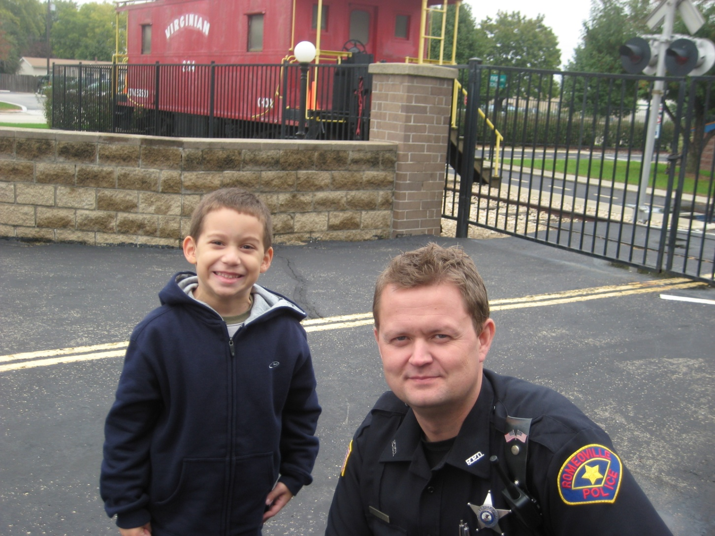
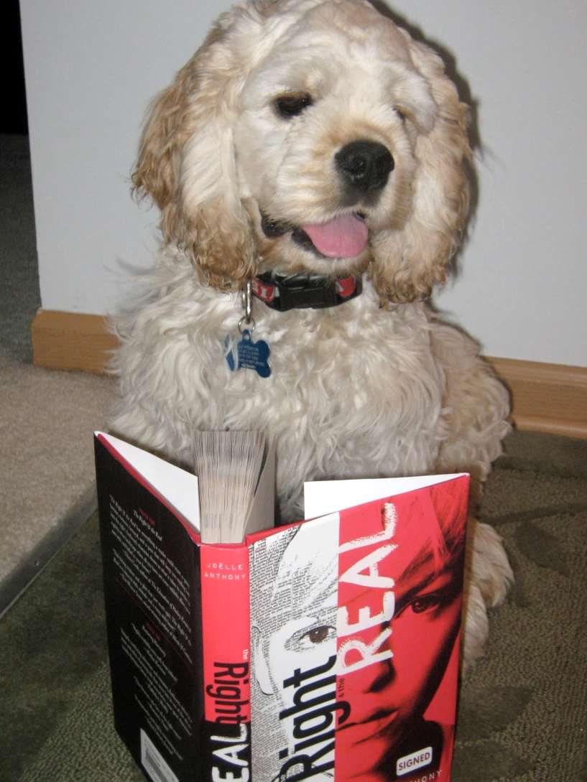
Libraries: Part of the Community
BOIR

Slide 5
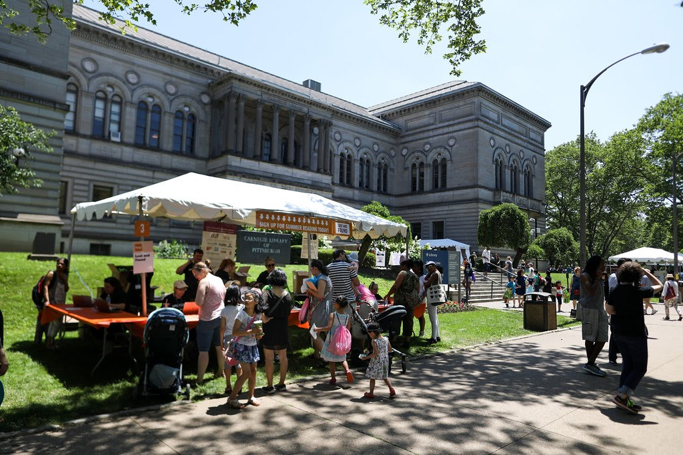
Summer Reading Extravaganza
BOIR

Slide 6
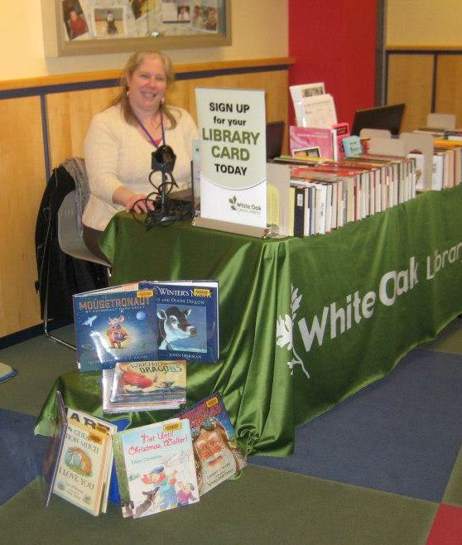
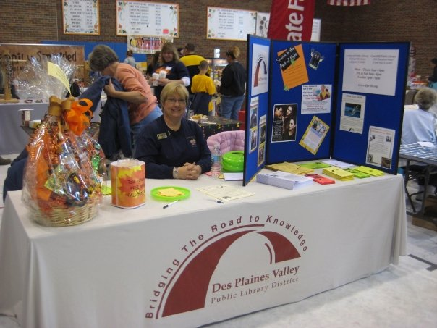
We Bring the Library To You
Library Cards
Book Mobiles
Lobby Stops
Book Fairs
Touch A Truck
Business Expositions
Senior Fairs
Resource Information
eReader Demonstrations
Reminisce with the Library Programs
BOIR

Slide 7
ALA: ODLOS http://www.ala.org/offices/diversity
The ALA Office for Diversity, Literacy, and Outreach Services supports library and information science workers in creating safe, responsible, and all-inclusive spaces that serve and represent the entire community.
BOIR

Slide 8
ABOS HISTORY
For many years, Professor Bernard (Bernie) Vavrek from Clarion University sponsored two organizations, the Association for Rural and Small Libraries (ARSL) and the Association of Bookmobile and Outreach Services (ABOS). They would have a joint conference in Columbus, Ohio each year. Clarion University hosted a listserv for each organization.
In 2006, Professor Vavrek retired and the two groups decided to separate.
More information on our website!

Slide 9
JOIN A COMMITTEE
SHARE YOUR STORIES
ASK YOUR QUESTIONS
SPREAD THE WORD
RENEW YOUR MEMBERSHIP
ATTEND THE ANNUAL CONFERENCE
VOTE
RUN FOR THE BOARD
PRESENT AT YOUR LOCAL CONFERENCES
BOIR

Slide 10
BOIR PROJECT
Bookmobile and Outreach Information Repository
BOIR

Slide 11
BOIR
User maintained online database
Collect information, statistics, photos and history
Provide data for planning, research and reporting

Slide 12
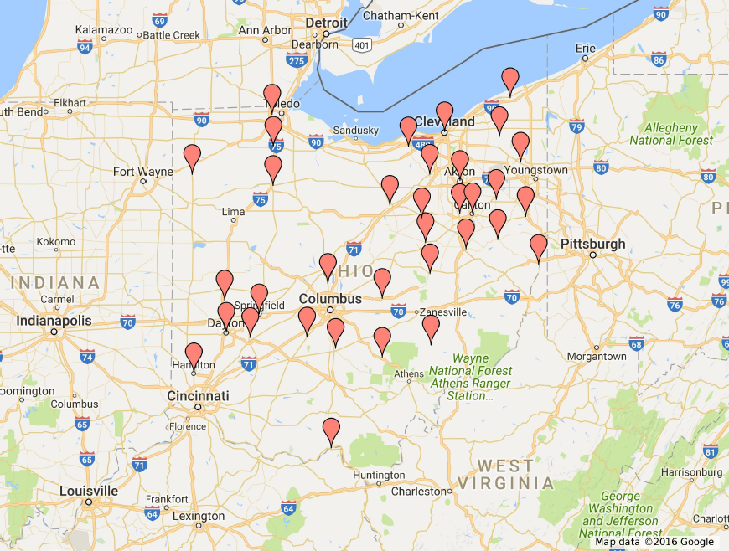
BOIR

Slide 13
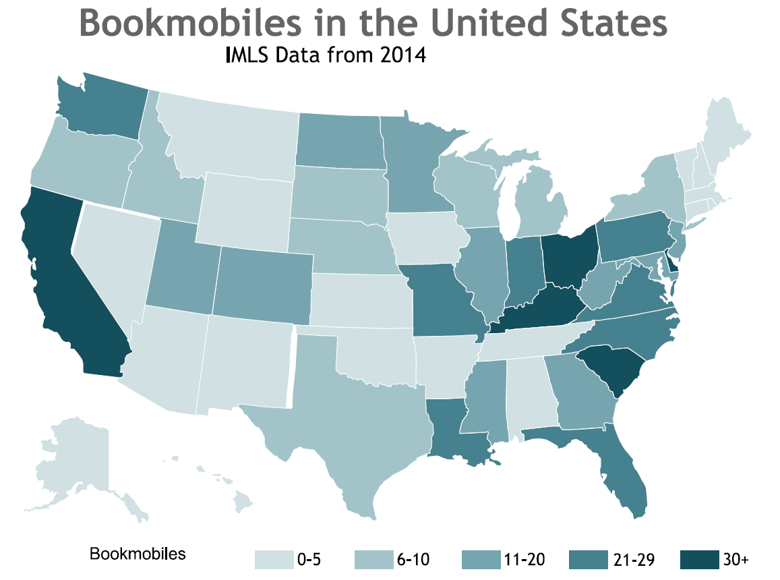
BOIR

Slide 14
BOIR DATA POINTS
Library Information
Library Name
Year Started
Library Website
Library Telephone
Library Funding Source
Number of Staff
Number of Branches
Circulation System
Annual Circulation
Annual Budget
Service Area
Population
Type (urban, rural, suburban)
Area (square miles)
BOIR

Slide 15
BOIR DATA POINTS
Outreach Department Information
Outreach Department Name
Formal
Informal
Year Started
Budget
Number of Staff
Staff Educational Requirements
Operating Days/Hours
Rotation Period
Weekly
Bi-Weekly
Monthly
Other
Annual Circulation
Average Number of Public Service Hours per week
Outreach Department Contact 1
Name
BOIR

Slide 16
BOIR

Slide 17
Partnership with library schools
Sponsors
Grants
Cooperation with IMLS and COSLA
BOIR

Slide 18
The BOIR Project has actively moved into the fundraising stage. As a member of ABOS, you can help us raise the needed funds by using one of the following sites when you are shopping.
GivingAssistant.org ‐ set up an account for yourself and designate ABOS as your recipient.
AmazonSmiles (smile.amazon.com) ‐ set up or use your current account and designate ABOS as your recipient.
Facebook donates (donations.fb.com) ‐ when you have a birthday, anniversary or a special event, you can go to the donations site and register, designate ABOS as your recipient and then ask friends to donate to your cause.
BOIR

Slide 19
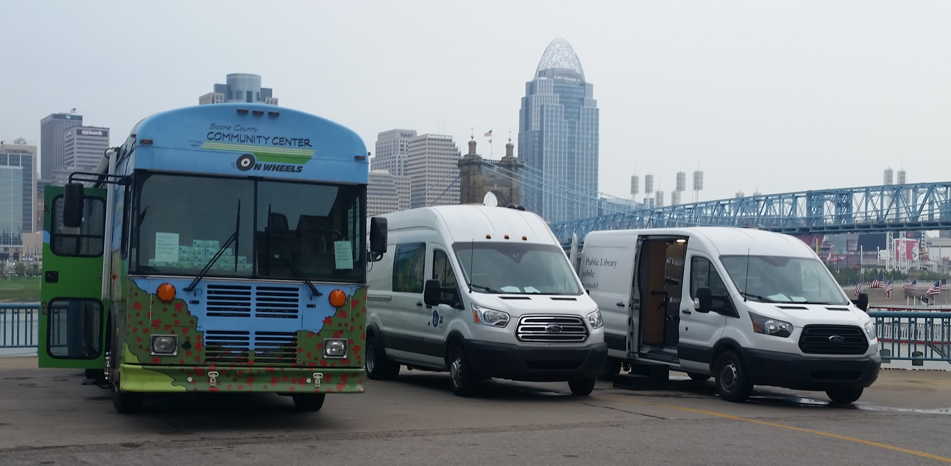
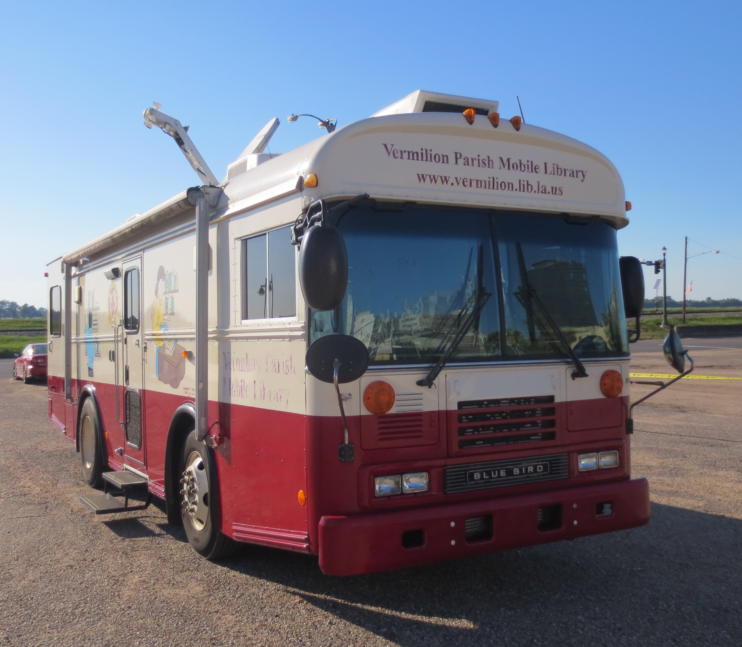
Suggestions for data points?
Feedback on user outputs?
Thoughts on overall concept or goals?
BOIR

