Slide 1

Bling my ride: Engage your patrons with passive programs and unique displays
Karen bradley & richard lyda – arapahoe libraries

Slide 2

Arapahoe Libraries serves more than 250,000 people at eight library locations, mobile library services and a detention center facility in the south metro area of Denver. Urban, suburban and rural service area
Notes:
Rich will talk about ALD facts here!!!! We’re a library district. 70 miles in length. Budget is approx. 30 million. Boundaries are confusing

Slide 3
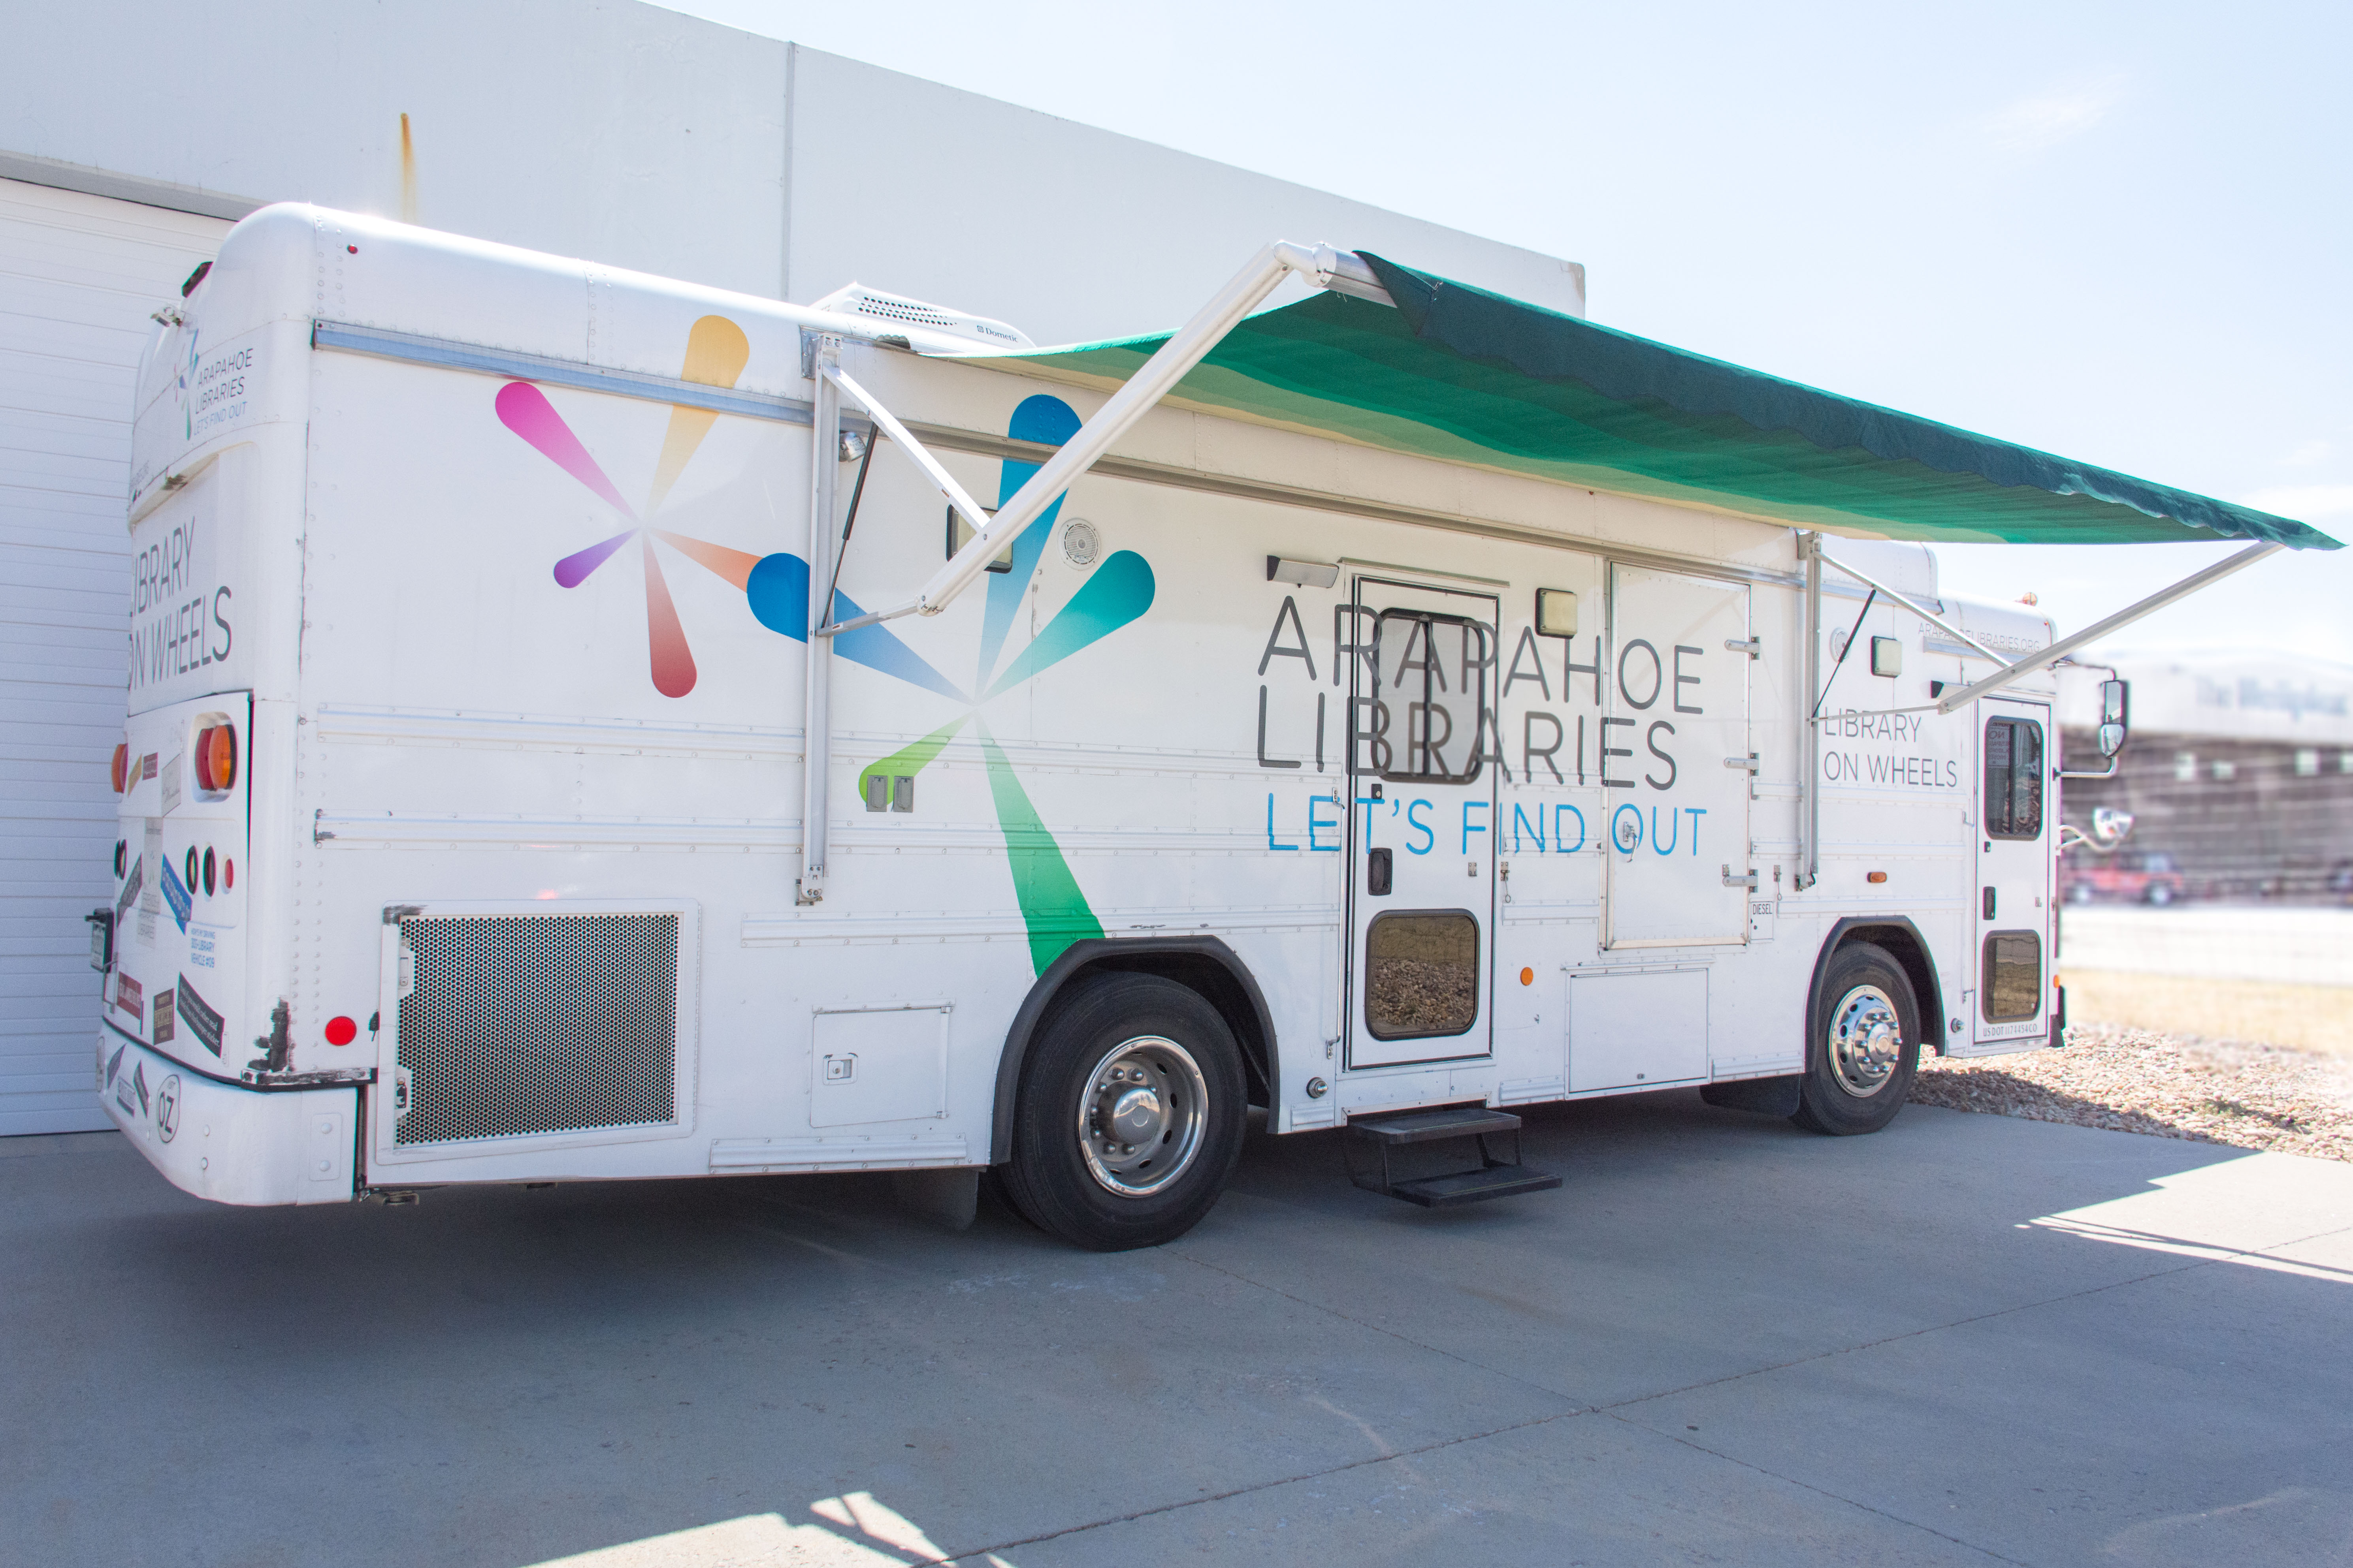
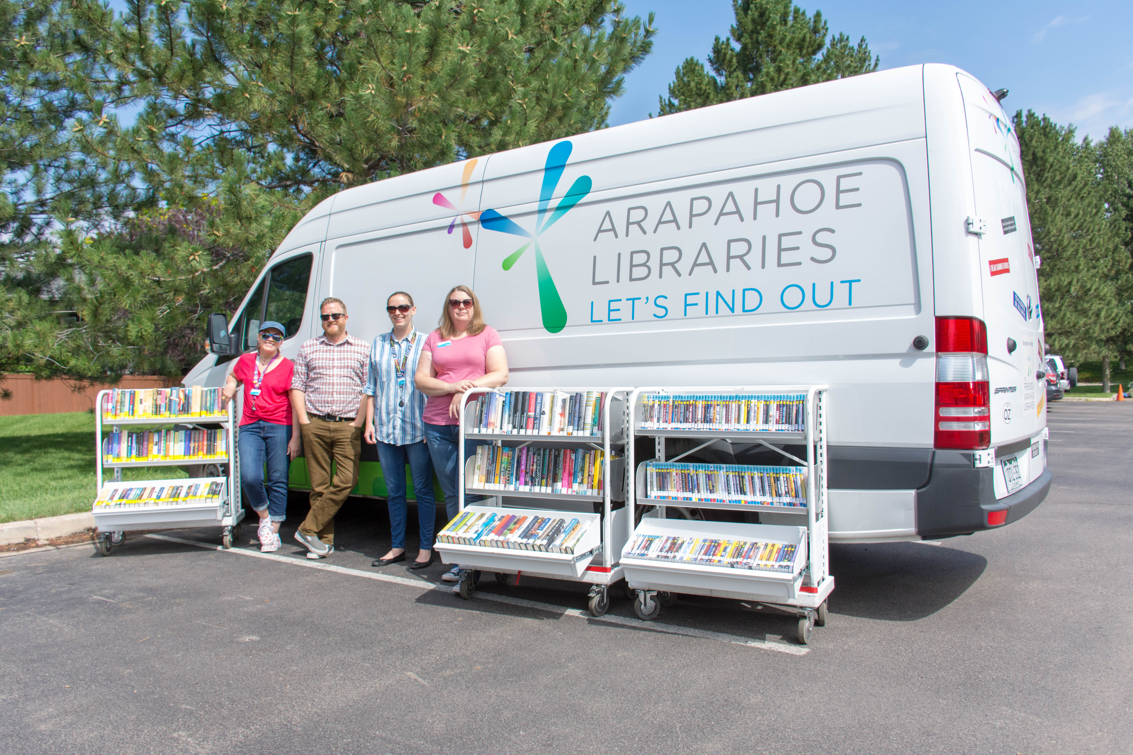
Mobile library services at arapahoe libraries
SENIOR SERVICES
Diversity and inclusivity
BOOKMOBILE
LOBBY STOPS
HOME DELIVERY
BOOKS BY MAIL
Deposit collections
Notes:
Rich: Senior services-created in 2016…serves as district wide resource for all things seniors. Provide programs in memory care units and in our branches for patrons with dementia.
D & I: Added in 2017 as part of strategic plan initiative. D&S specialist lives in MLS-presenting at ABOS – check it out!
Bookmobile, 34 foot bluebird, holding 3K items, out Monday through Friday
Lobby Stops: Sprinter van to lobbies
Home DeliveOverview of MLS!!!

Slide 4
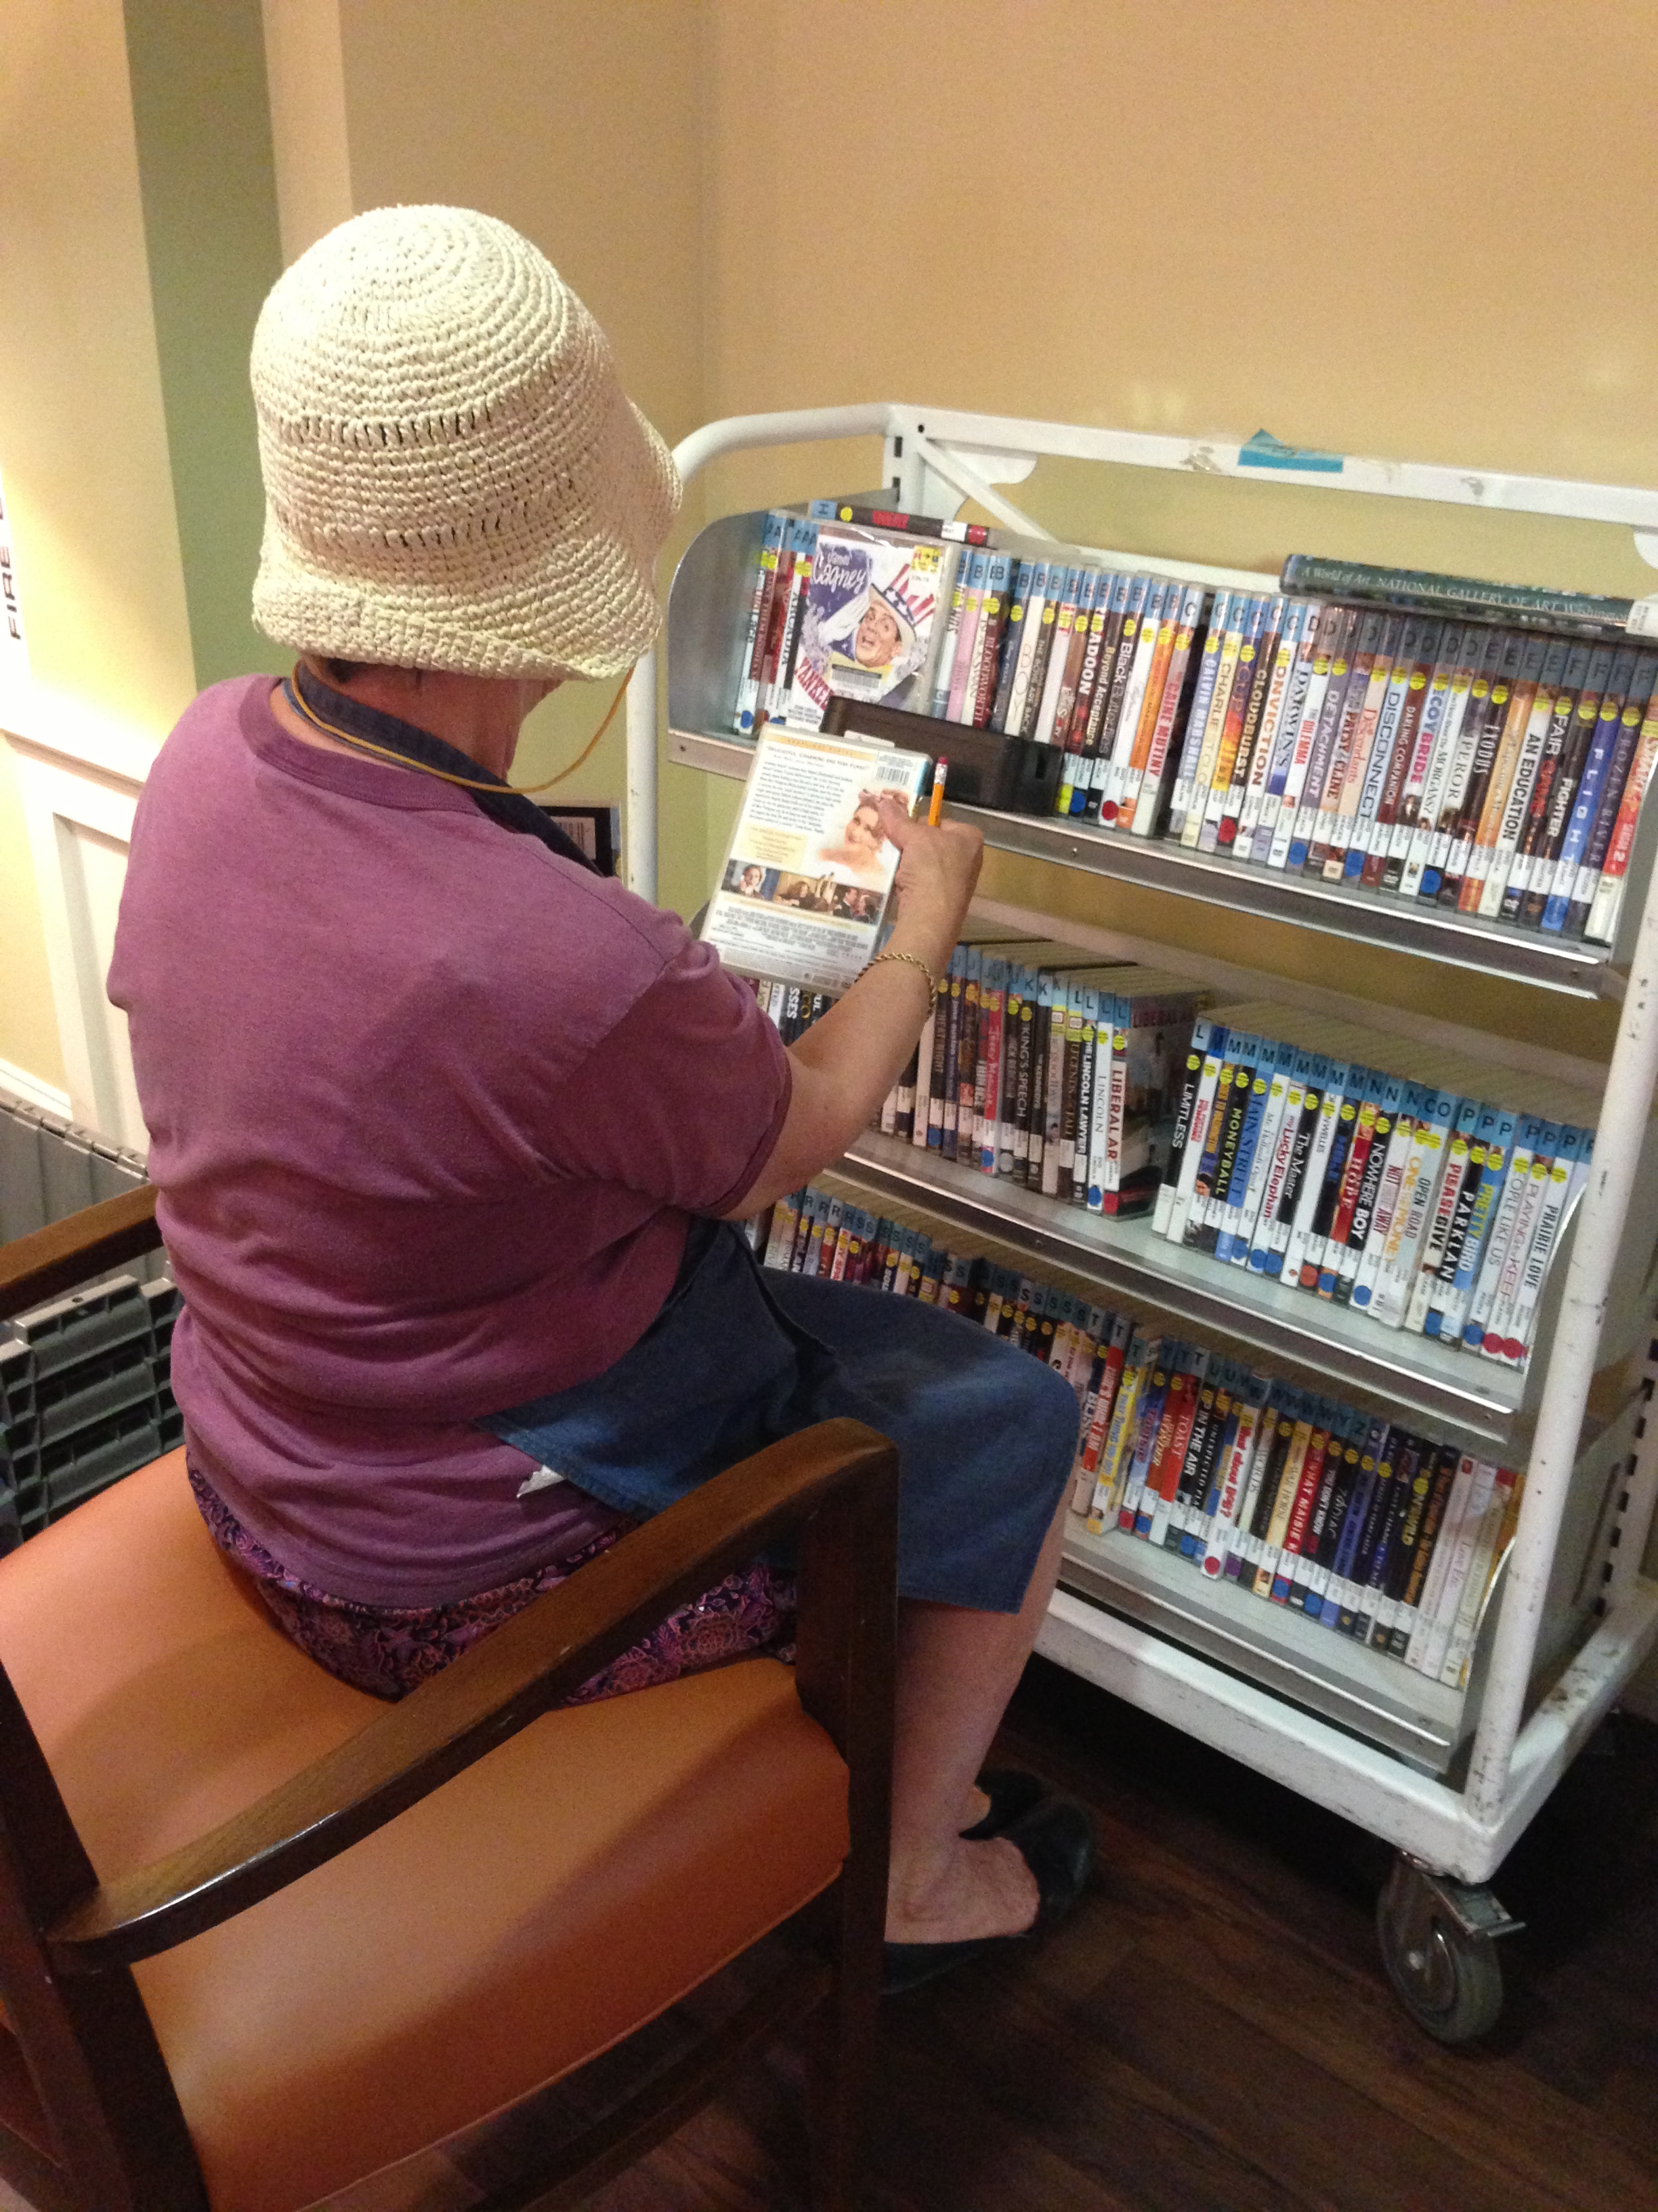
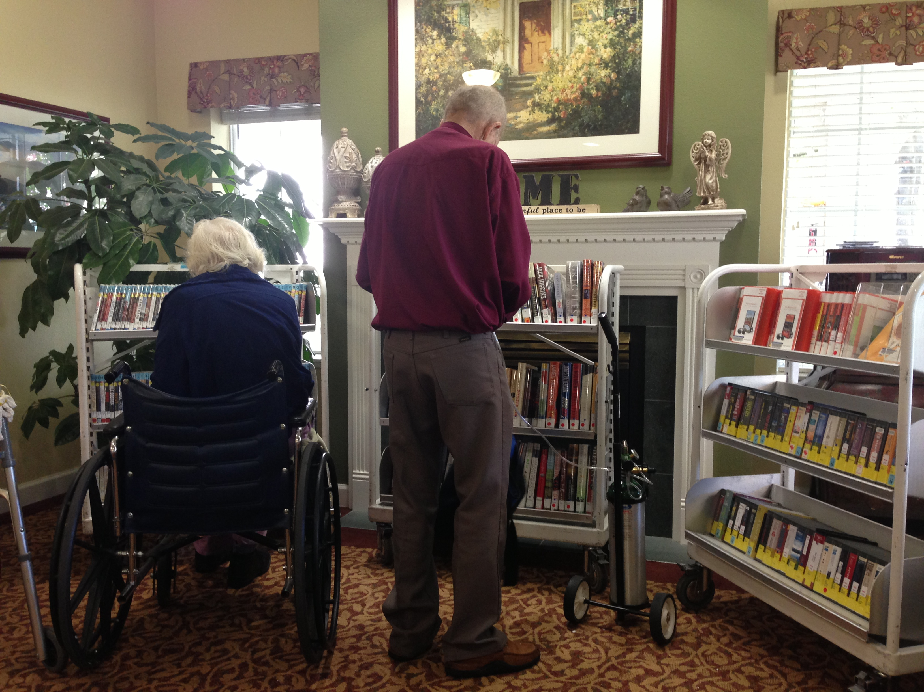
Creating an engaging lobby stop experience
Notes:
Rich: Lobby stops – what we do every day. Great for residents, simply the fact that we’re there and providing access. Needed some tweaks Seniors – pull out shelves on the bottom

Slide 5
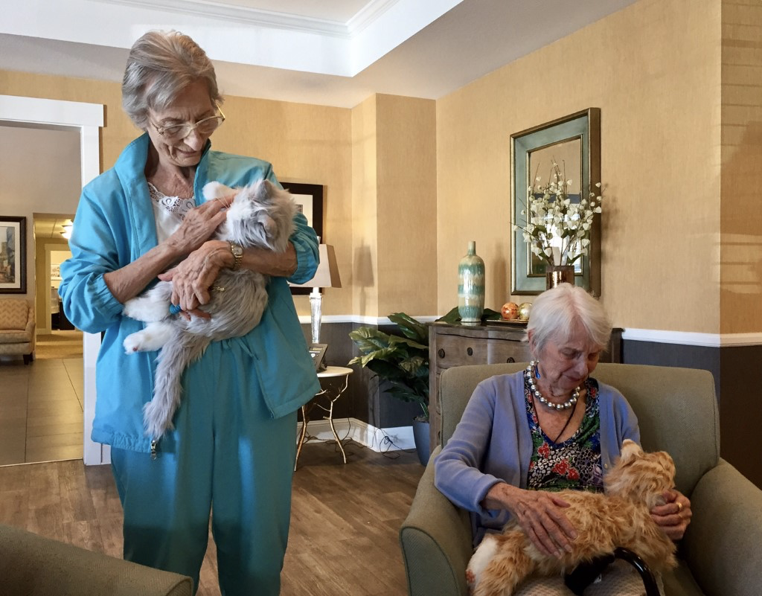
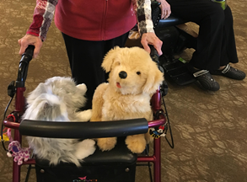
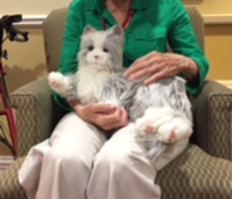
CATS (and sometimes Dogs)
Notes:
Rich – merchandising CATS!!!! Hasbro

Slide 6

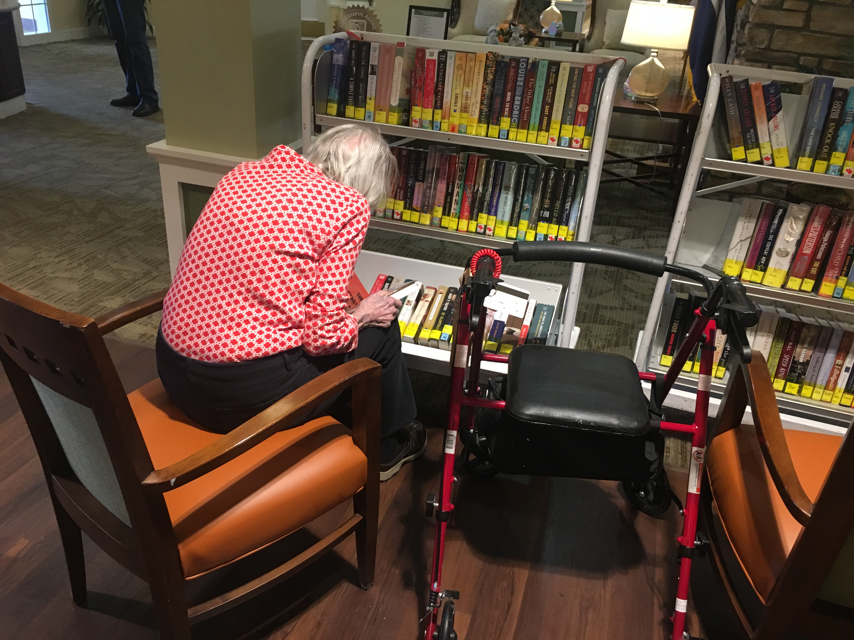
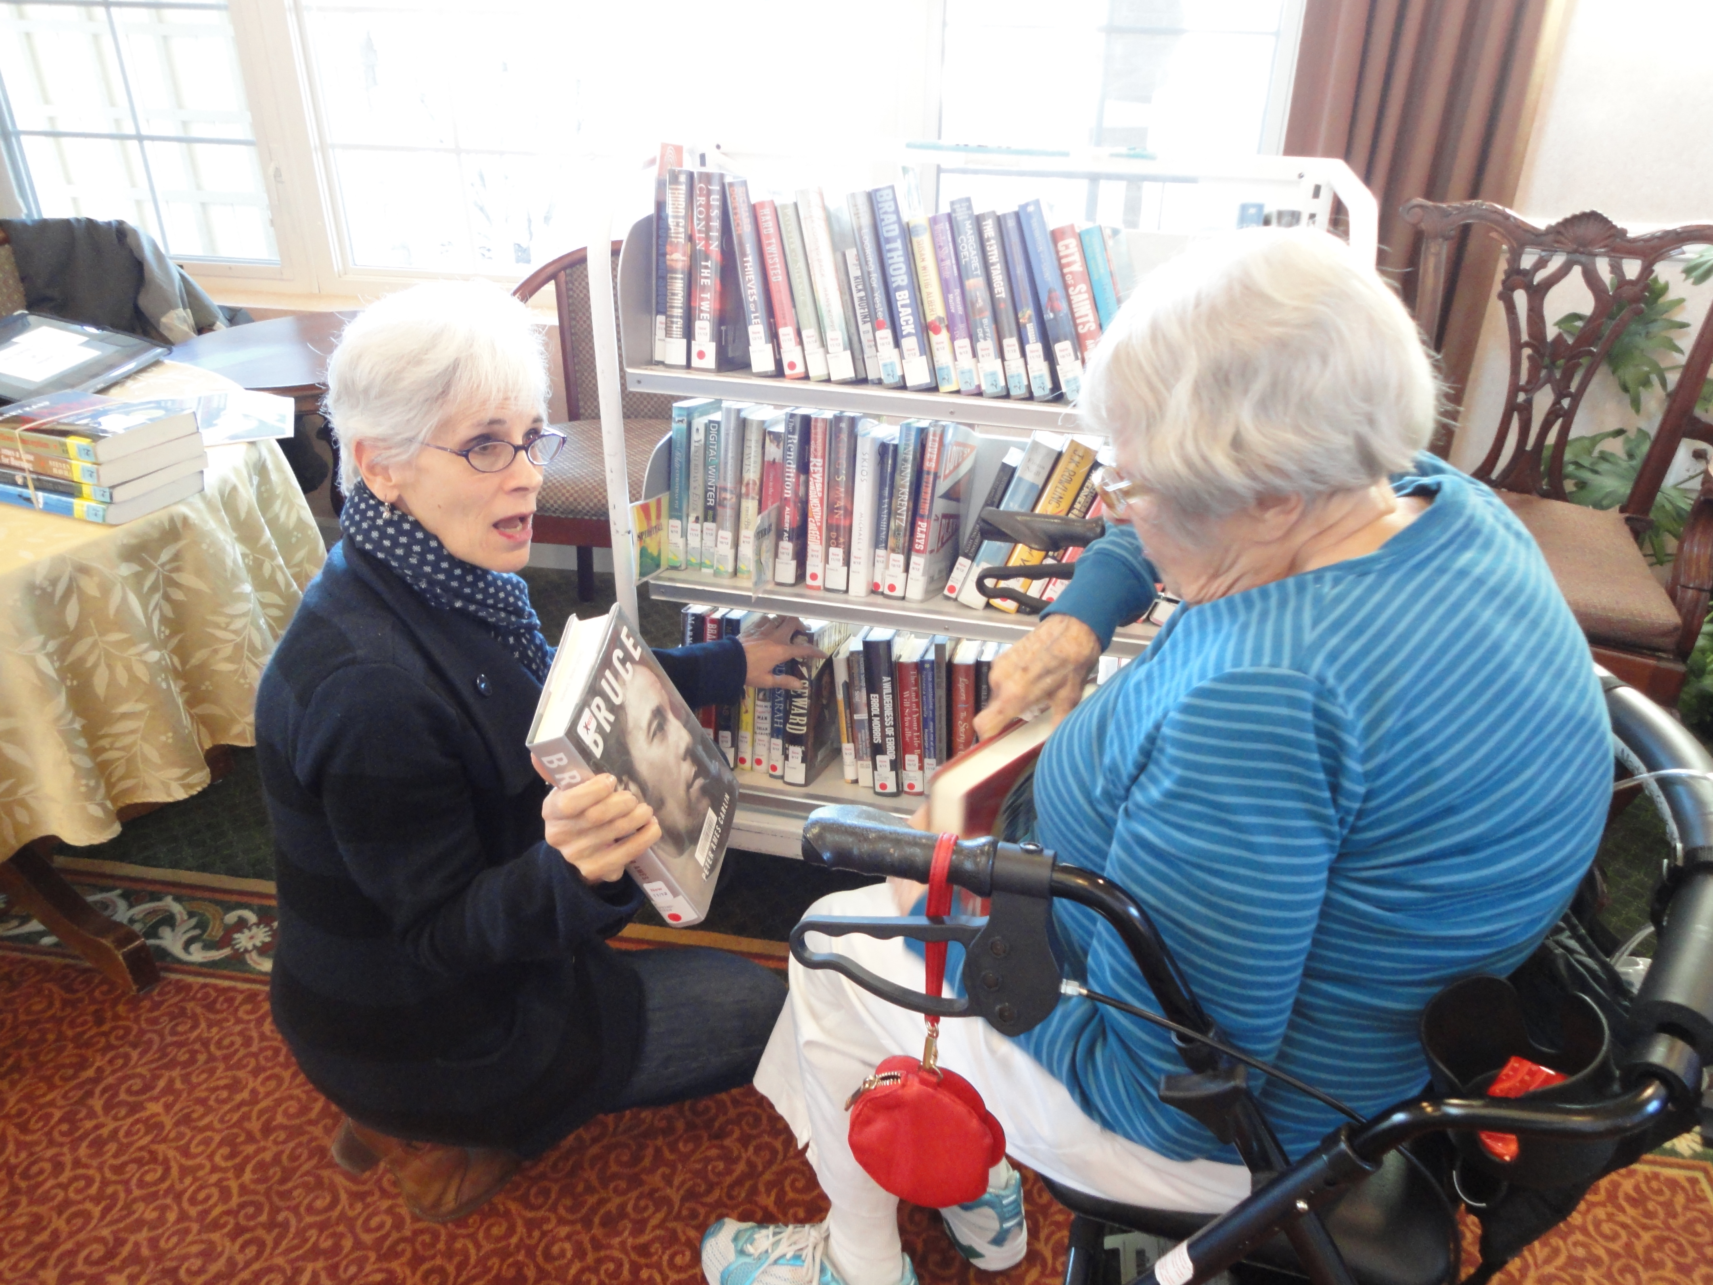
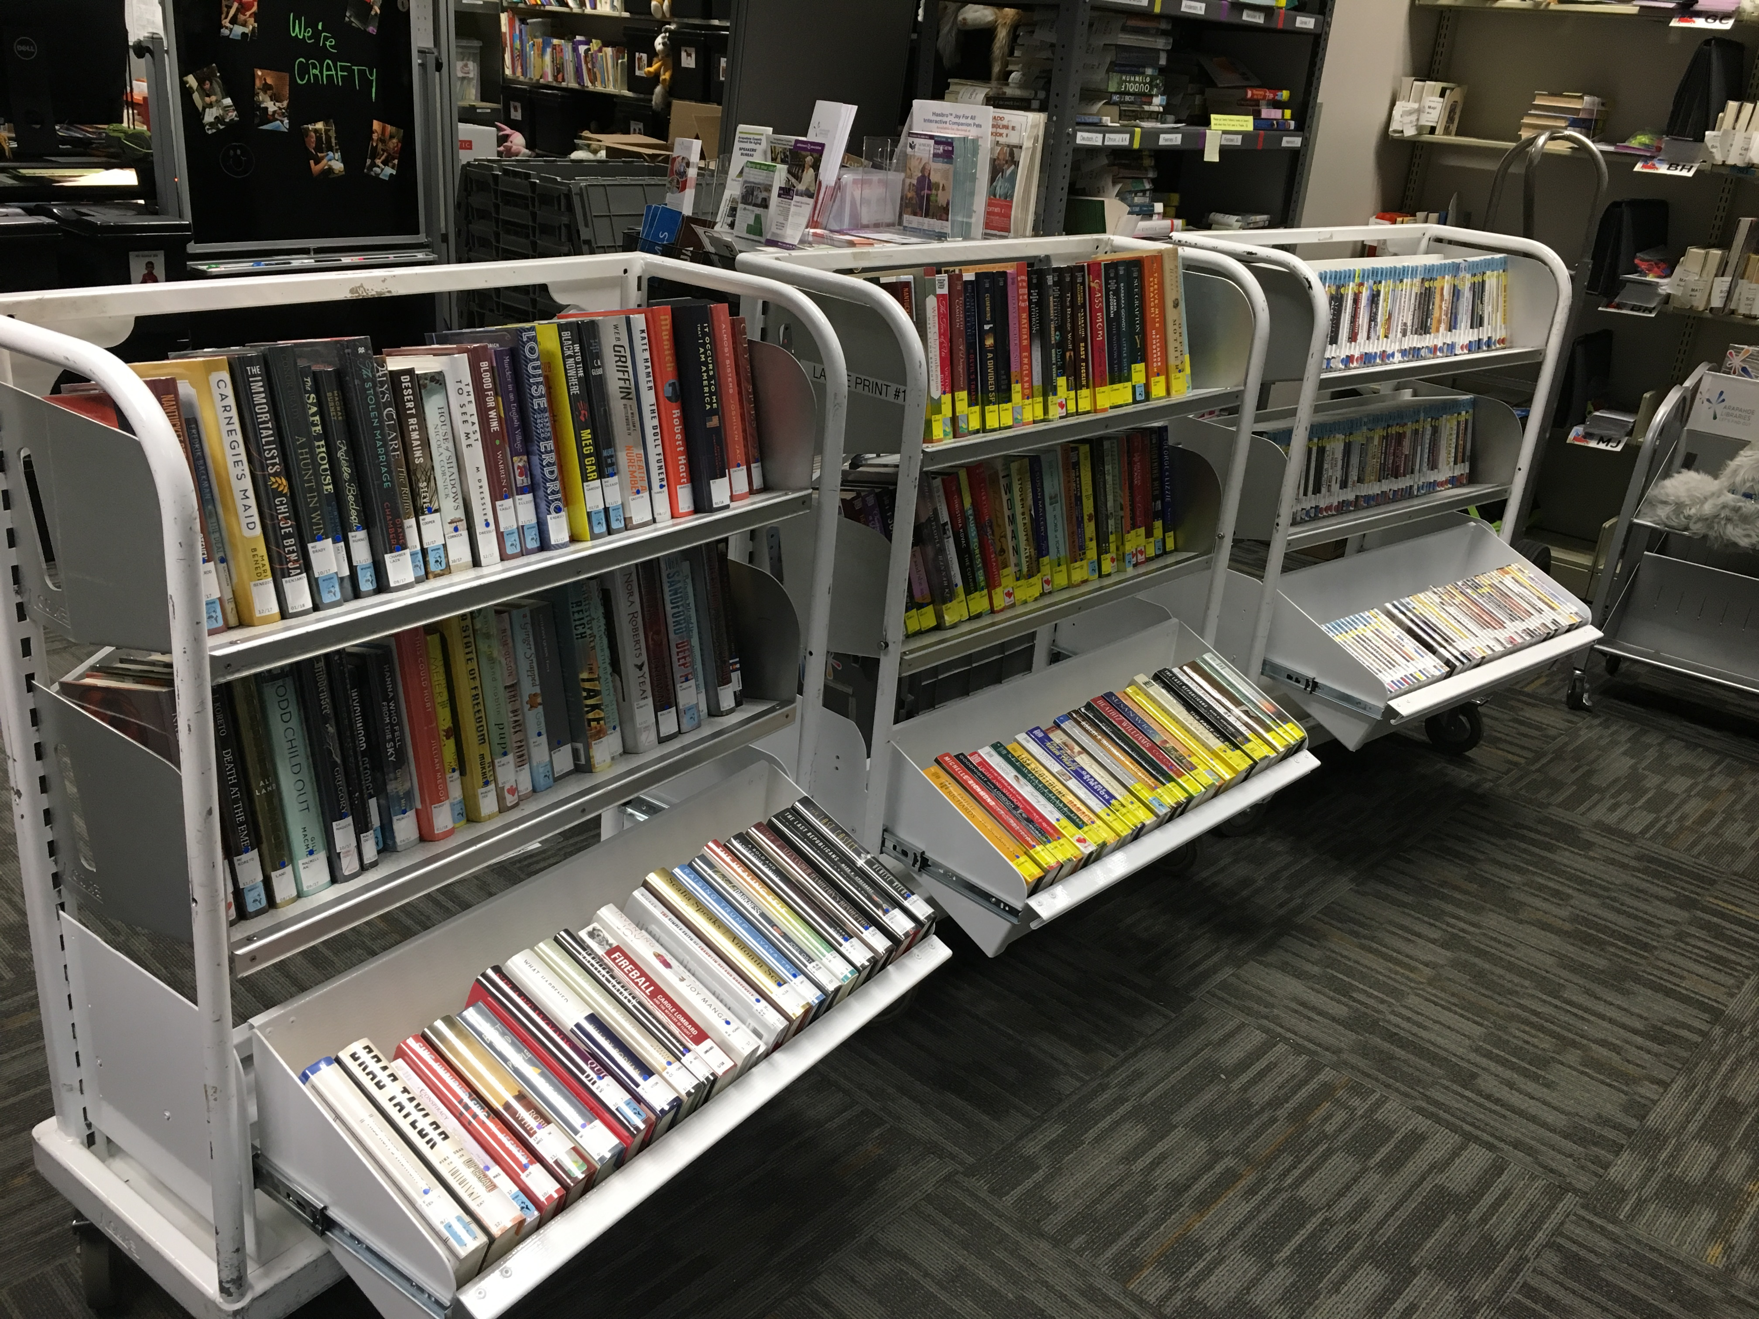
The bottom shelf!
Notes:
Rich: First…access to bottom shelves was a major issue – poor lighting, lack of mobility. Seniors – pull out shelves.

Slide 7

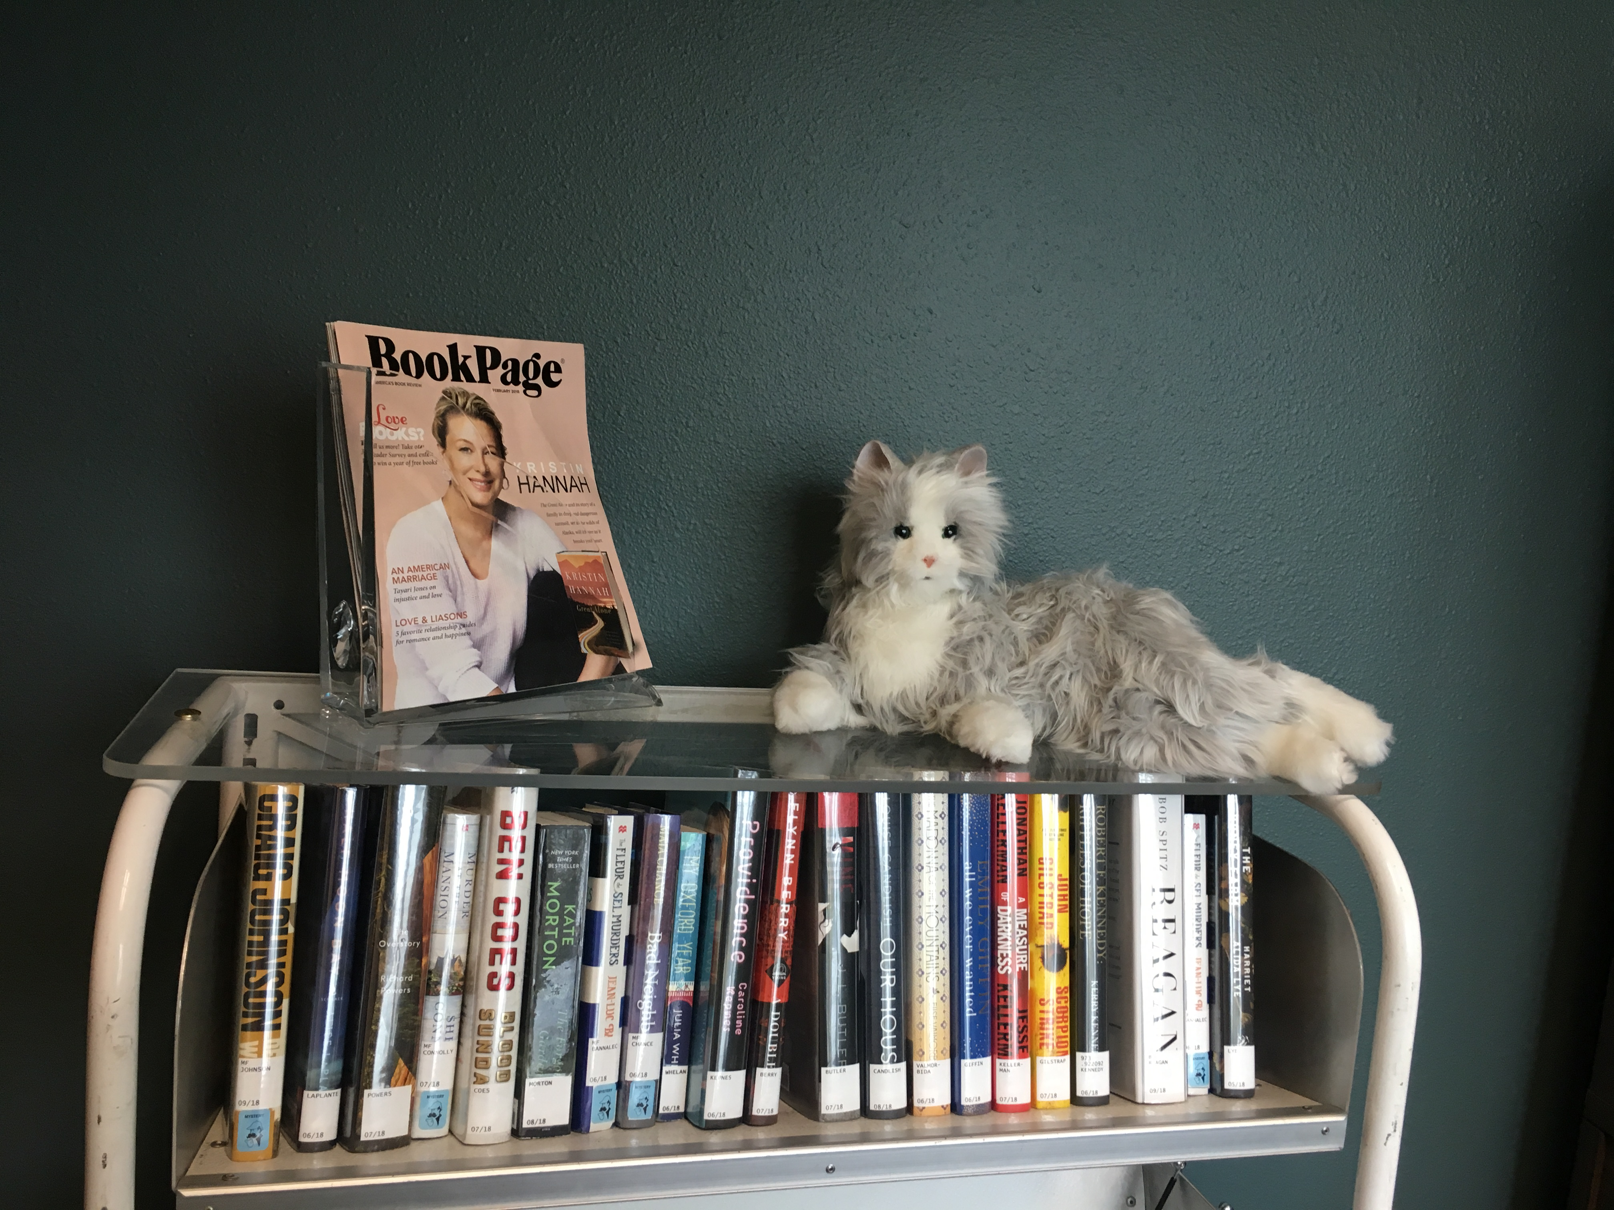
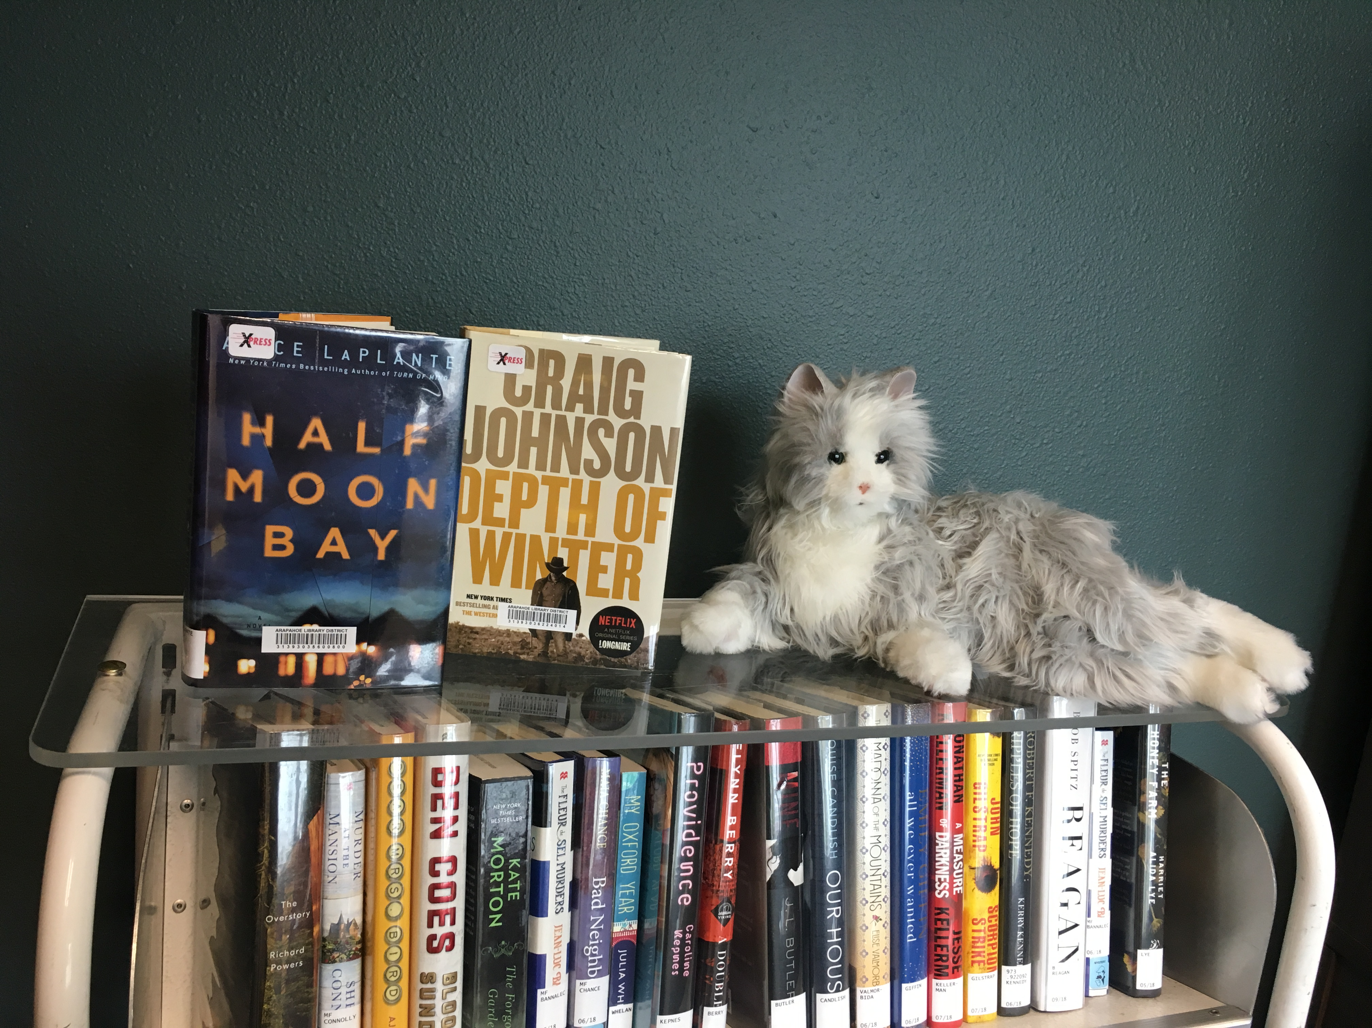
Merchandising in a small space
Notes:
Rich-merchandising Acrylic display. Not a lot of table space...often taken up by computers and holds

Slide 8
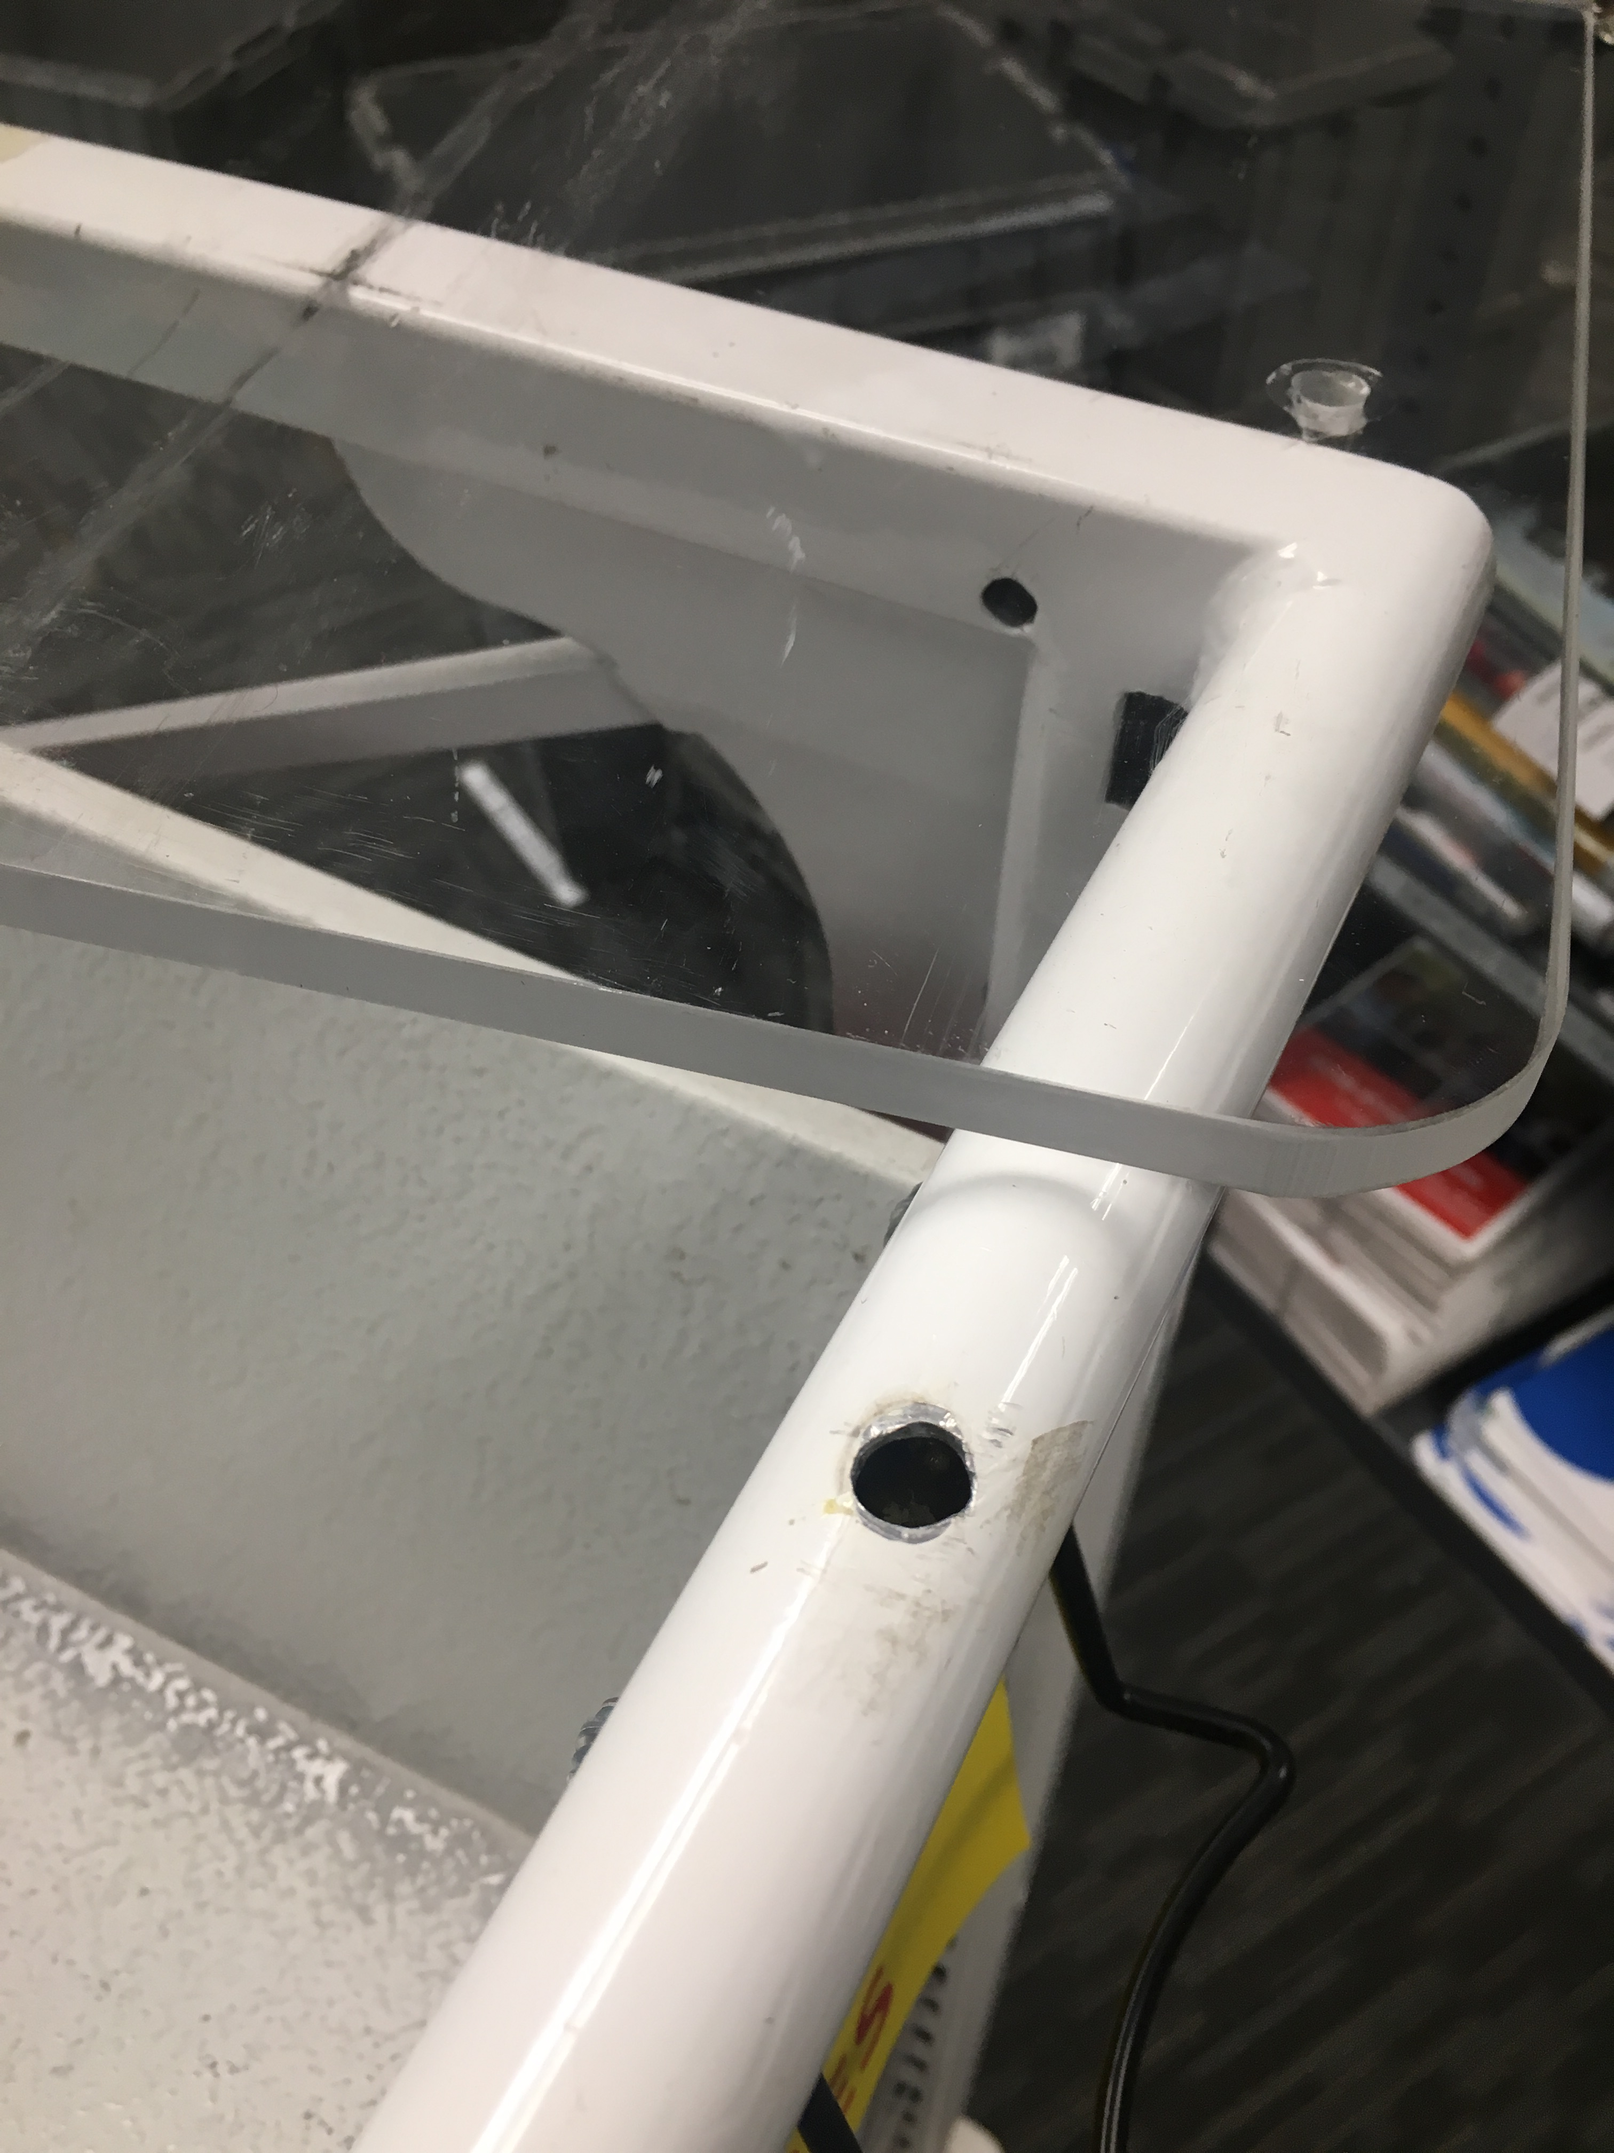
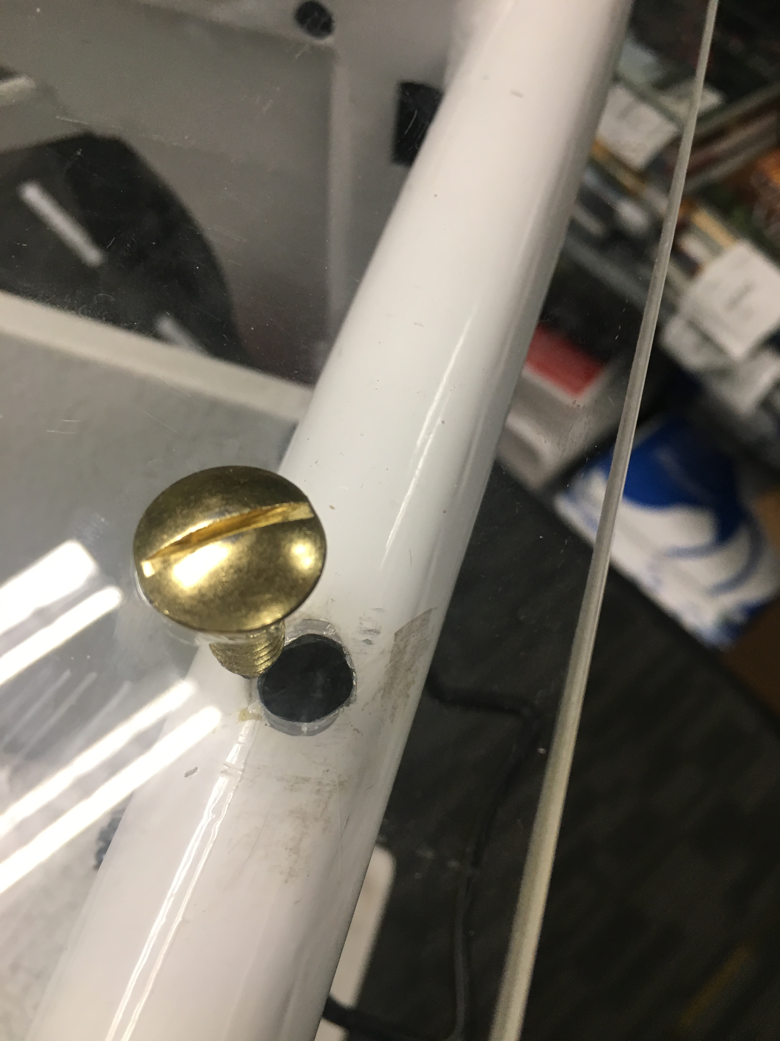
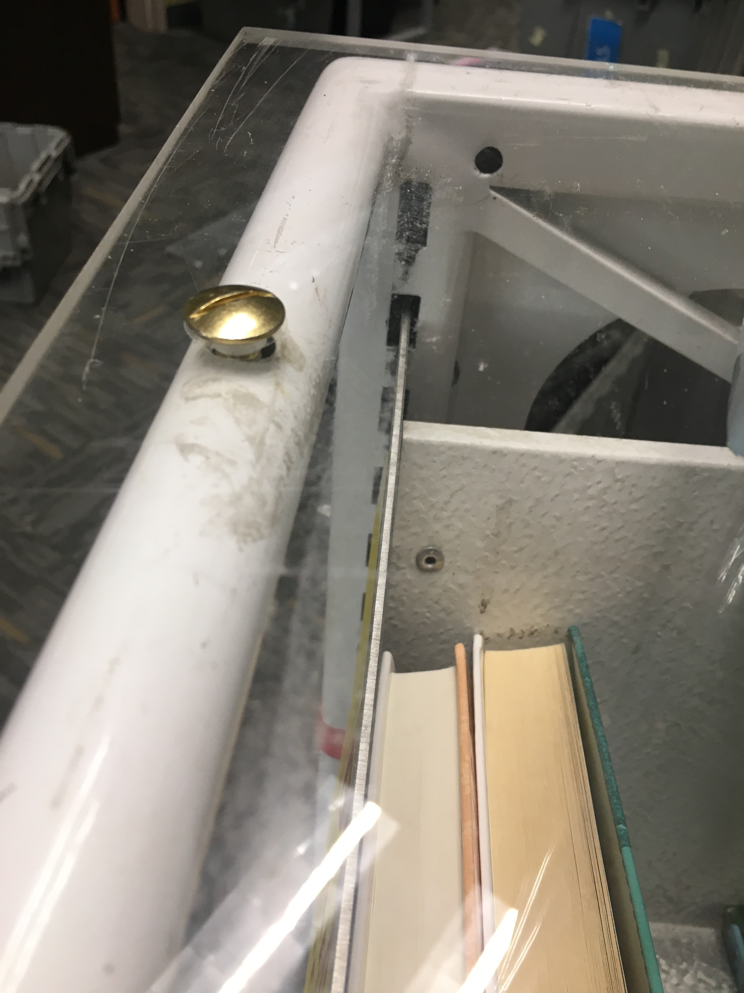
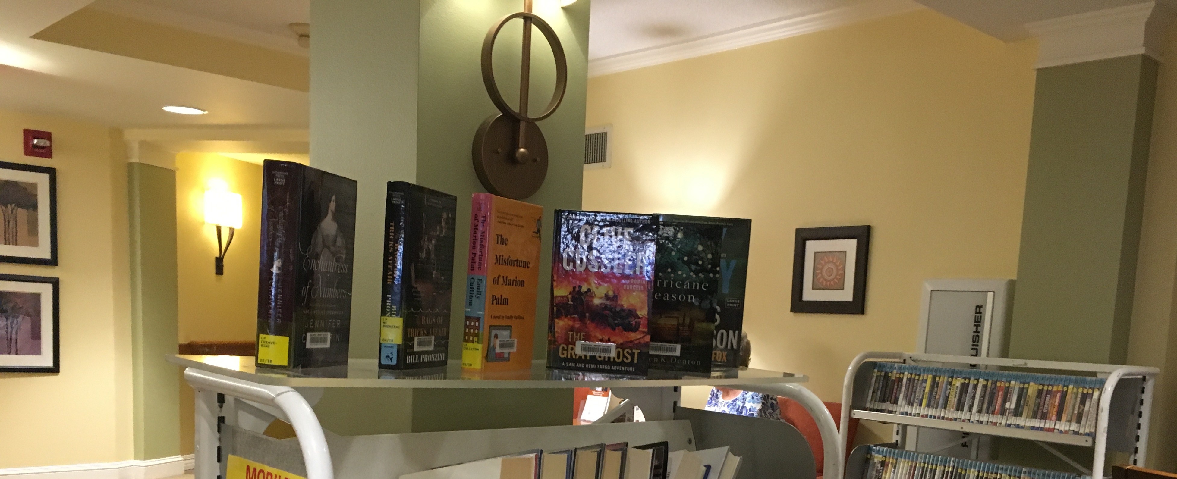
Notes:
Merchandising – Rich

Slide 9
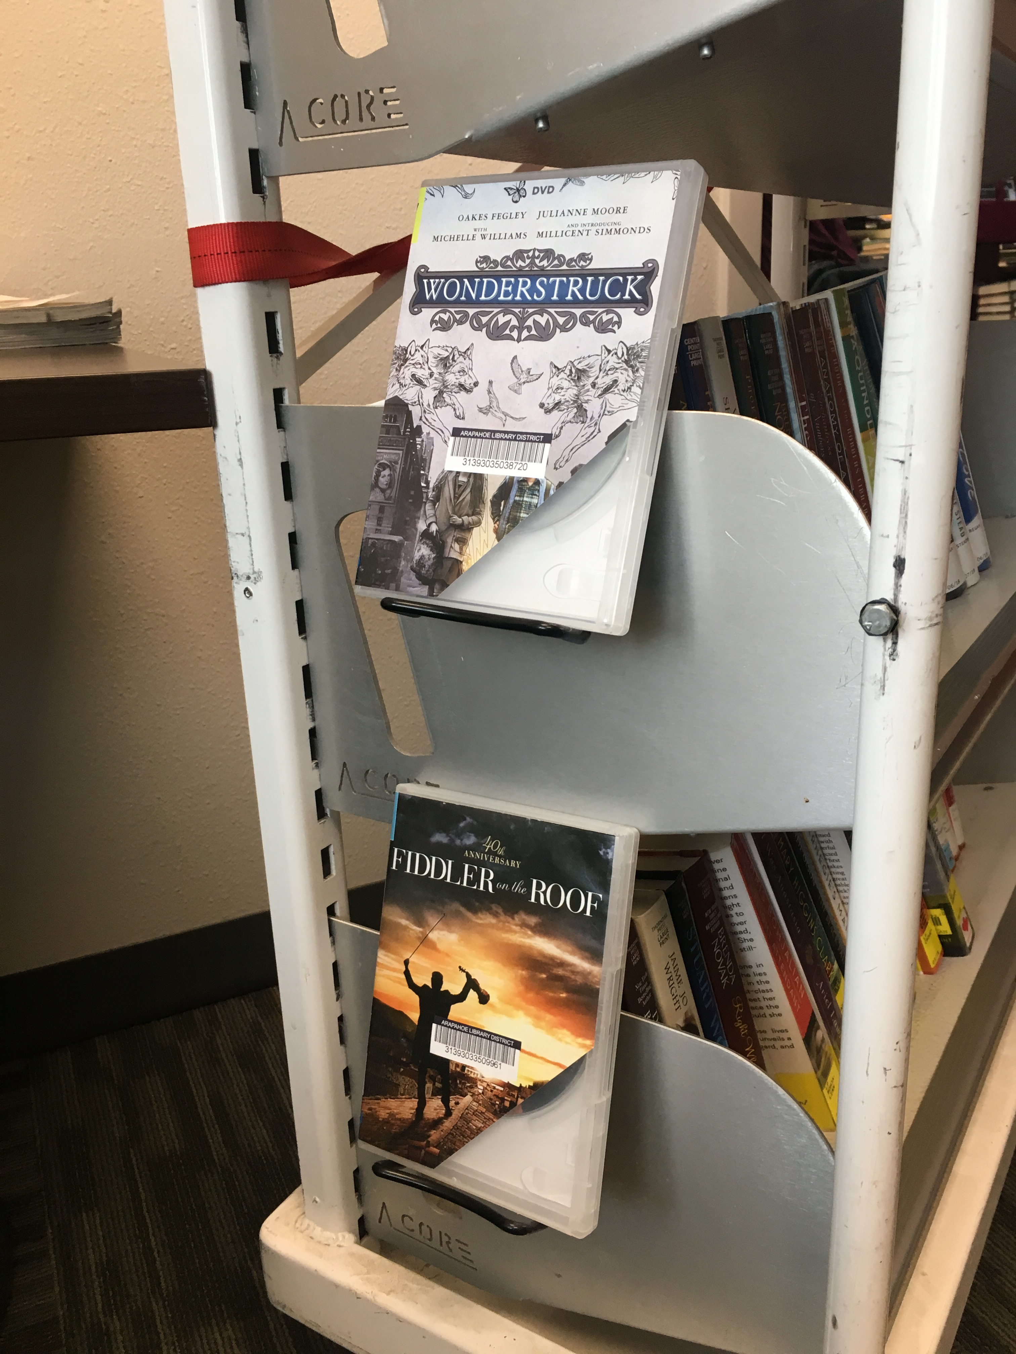
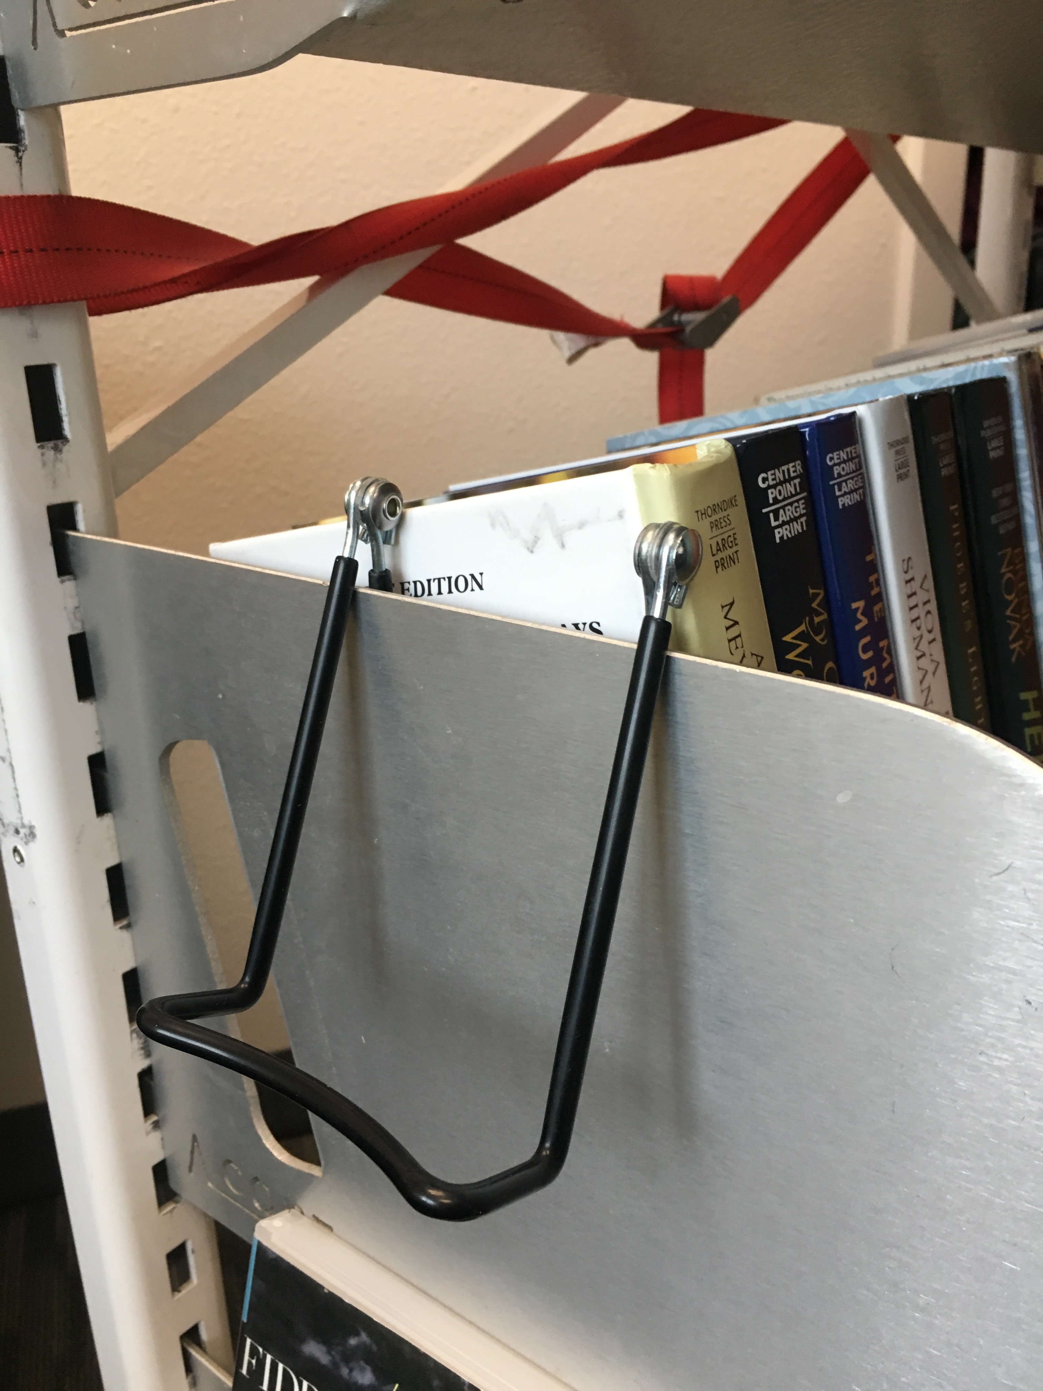
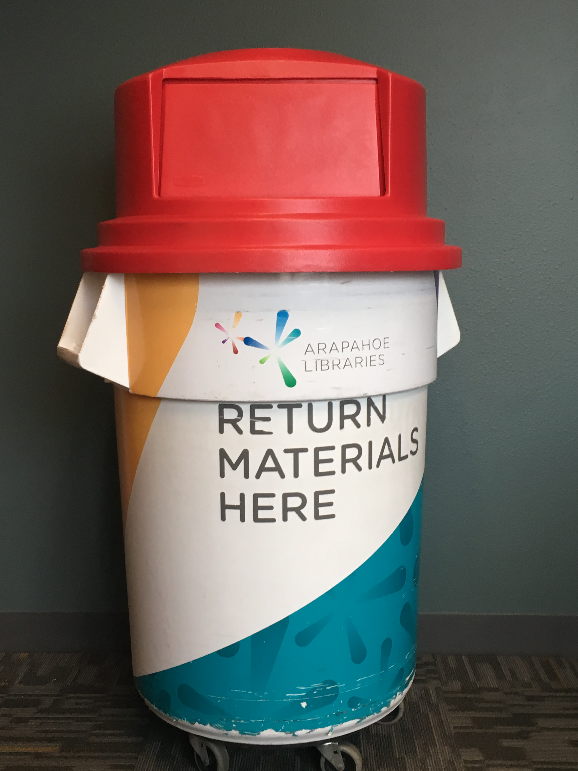
And more…
Notes:
We made sure to rebrand our trash can! It said “no trash!”. Add easels to do face-out displays on the side of carts too. Movies only with these

Slide 10
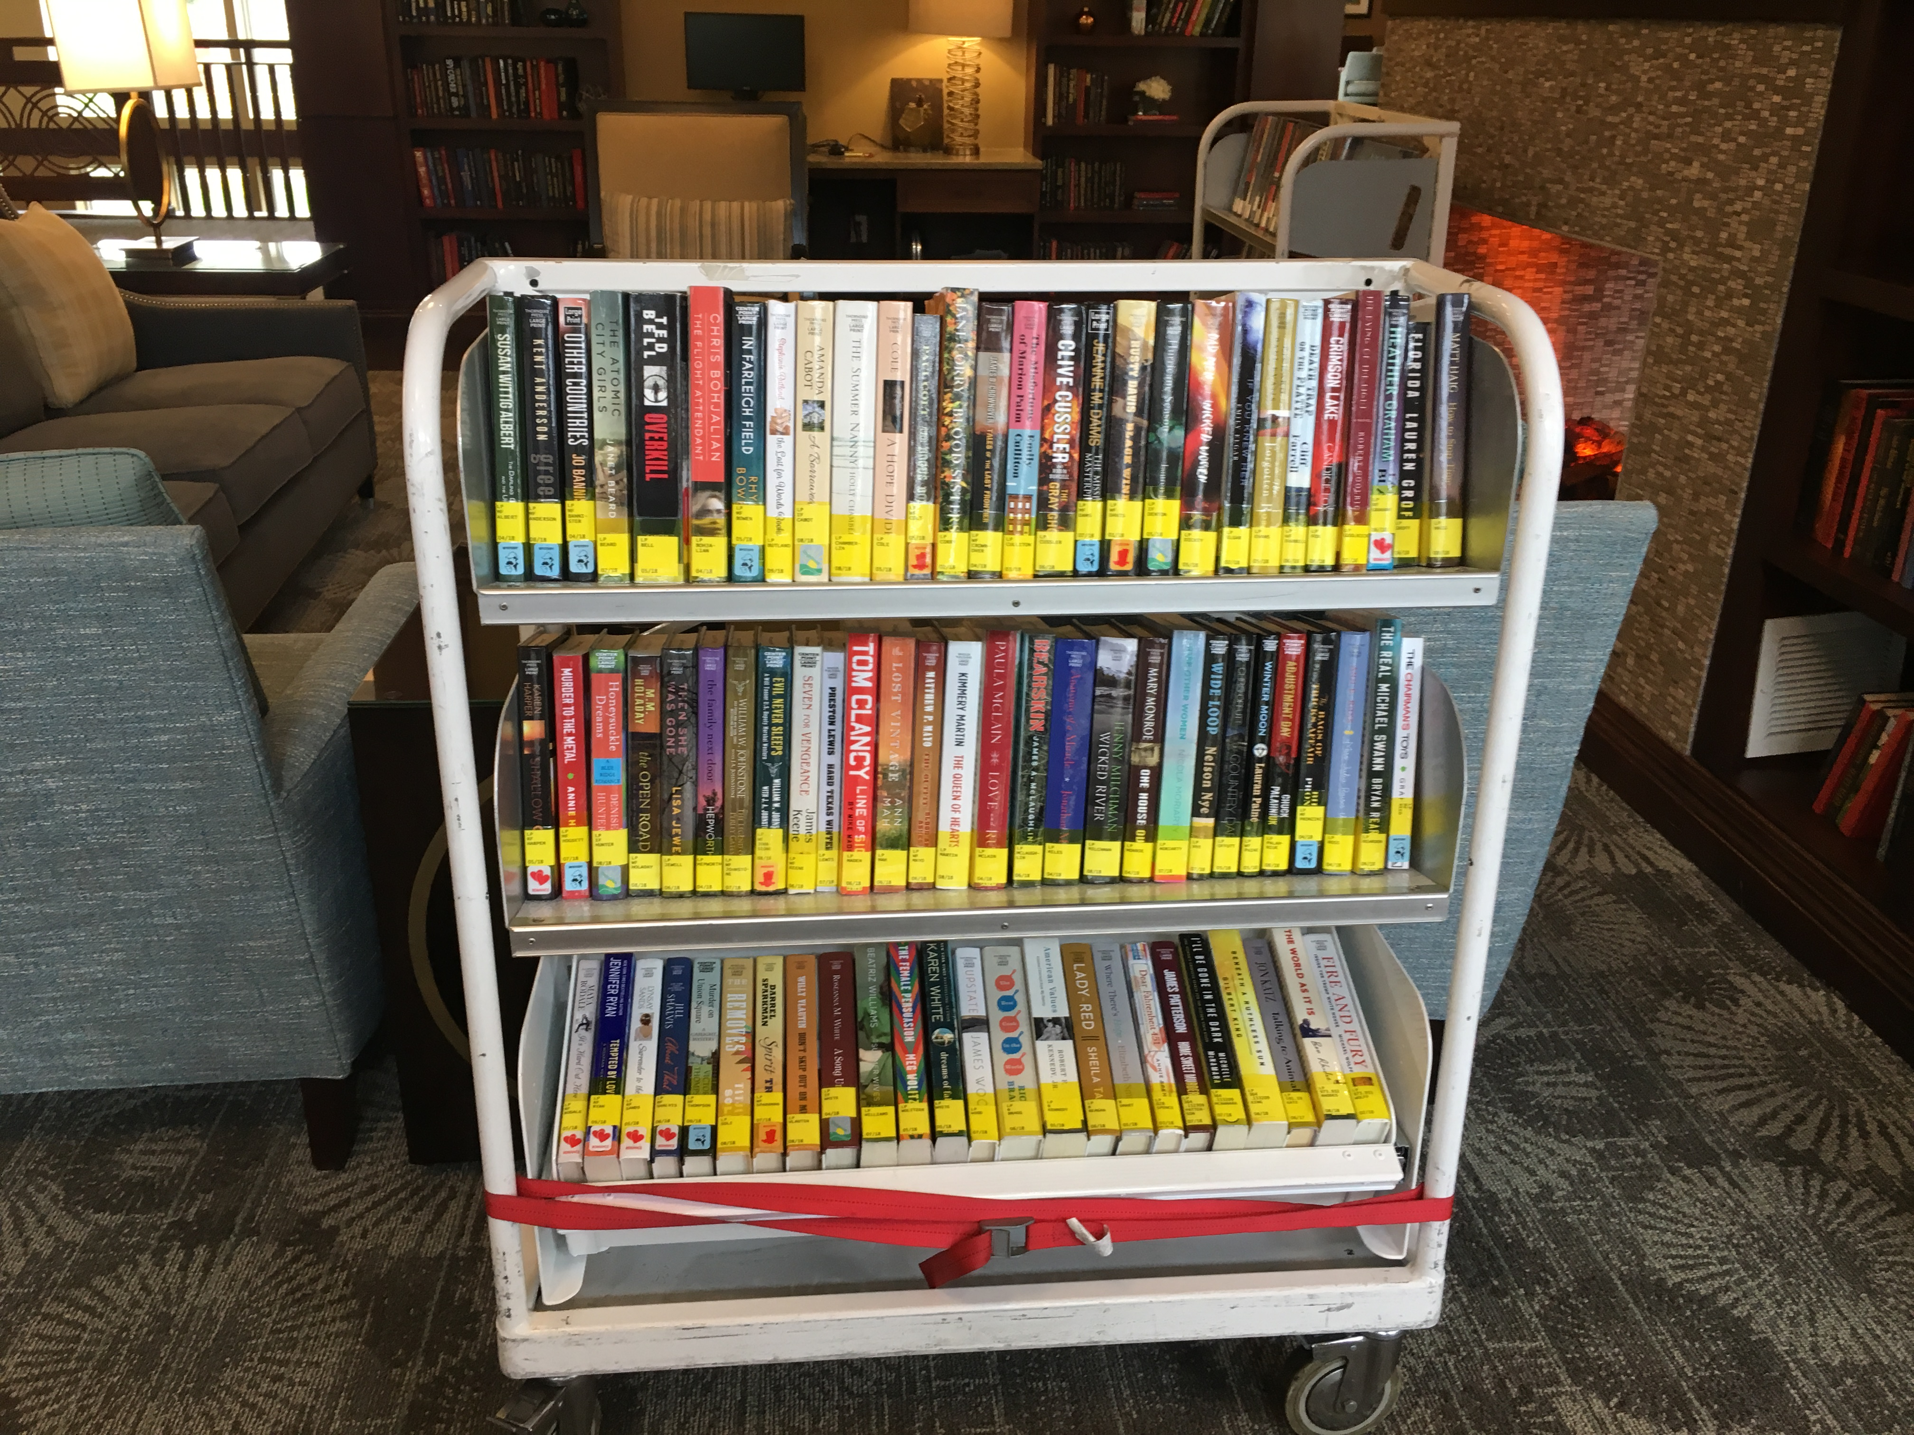
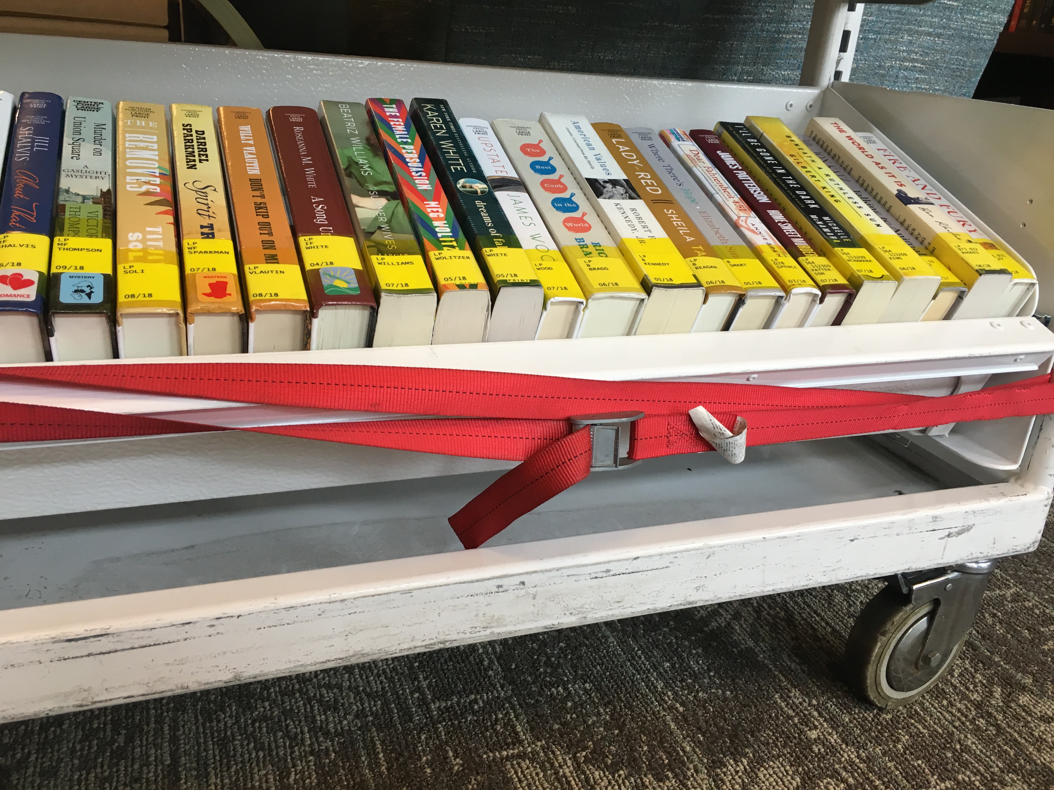
Costs and lessons learned
Notes:
Easels: $2
https://www.demco.com/goto?PRDWF13587730&s=WF13587730
$300 for pull out shelves (check with Don!)
$200 for return bin wrap
$90-$100 for cats (bring info in case residents want to purchase!)
$8 for red tie-downs
$60 for acrylic plastic
Straps for pull out shelves
Lock the wheels if you’re displaying items on top!
Patrons might try to take the cats

Slide 11

Passive Programming
Quick, easy activities to keep your patrons engaged.
Notes:
Rich: Seniors – Cats!!!!

Slide 12
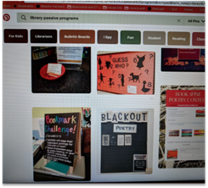
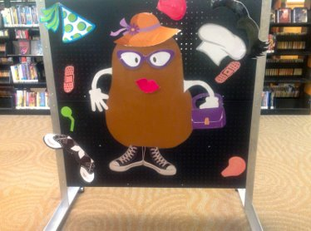
GENIUS WAY TO REACH PATRONS!​
Quick
Easy
Fun
Interactive

Slide 13

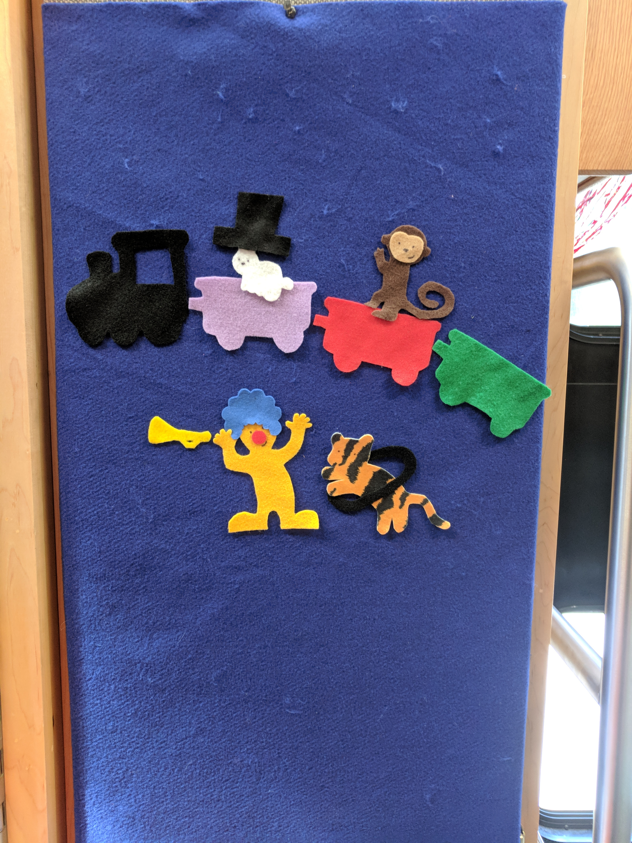
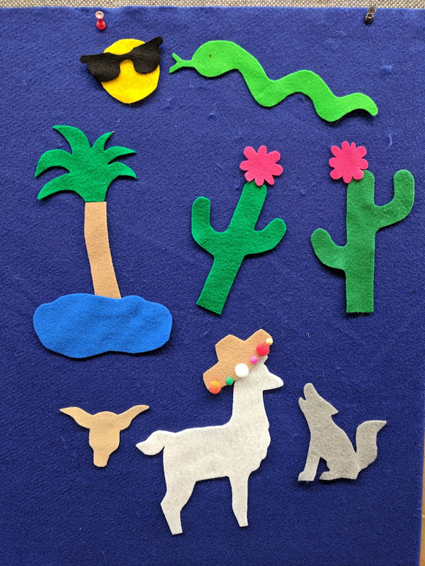
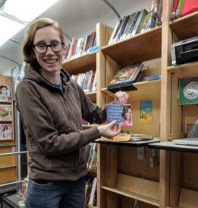
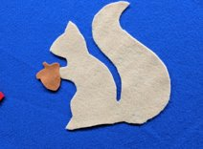
Teamwork and crafts

Slide 14

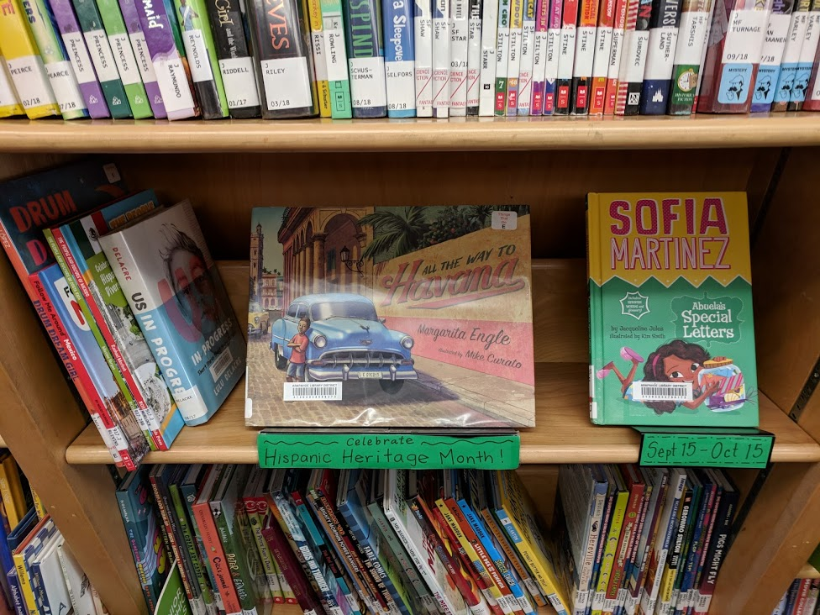
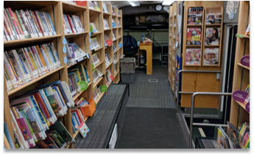
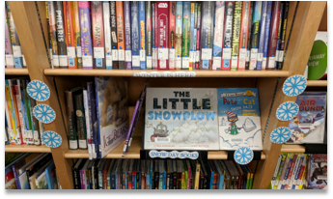
Book Displays
Line of Sight​
Change Monthly ​
Books from bookmobile & branches

Slide 15

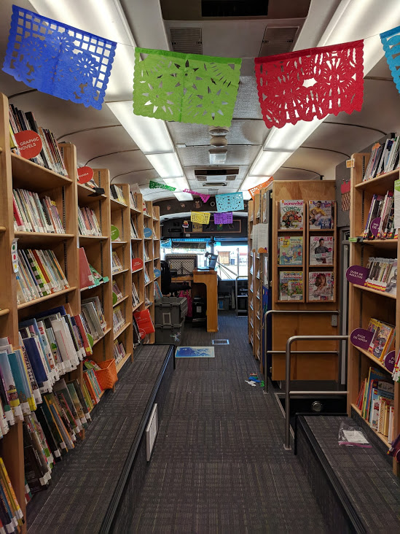
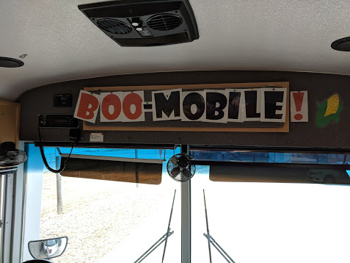
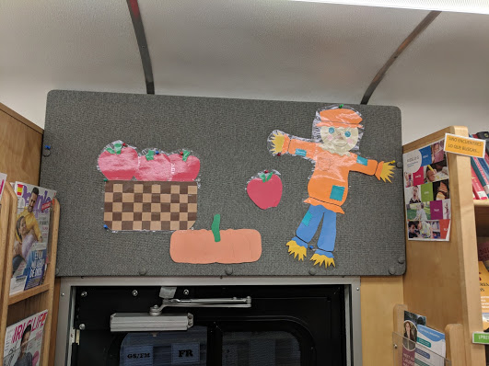
Inexpensive Décor is uplifting and makes for a fun space
DeCORations

Slide 16

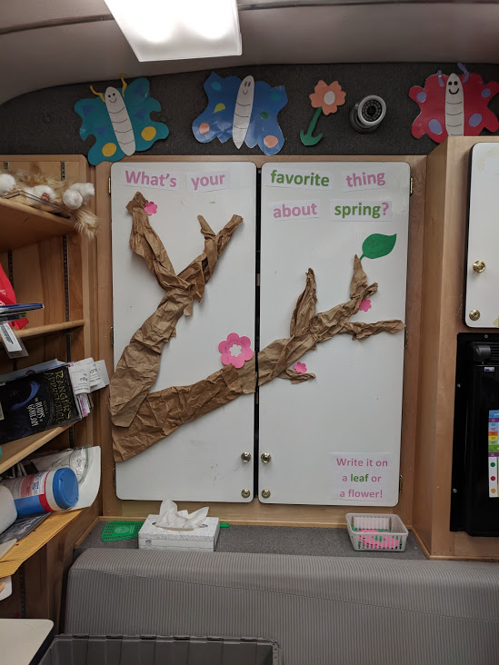
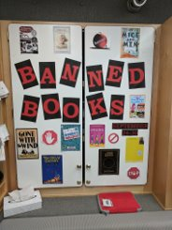
WhiteBoard
Banned Books
Favorite Halloween Candy
Winter Break Activity
Favorite Book
Black History Month
Women’s History Month
Hispanic Heritage Month
Literary Cats

Slide 17
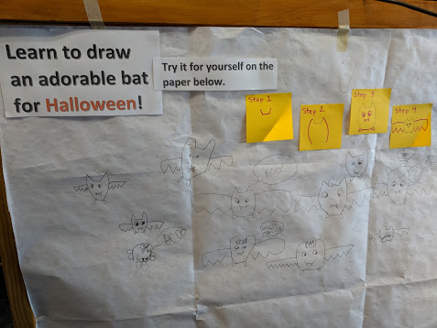
Front Desk
NEW!
Draw a Dog with the Word Dog
Draw a Bat

Slide 18

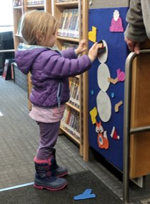
Felty Fun

Slide 19

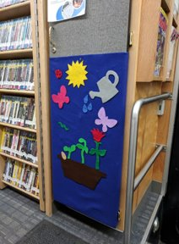
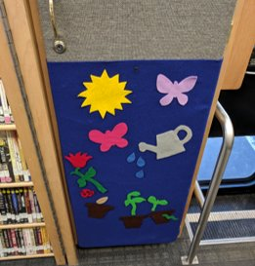
Size & Weight

Slide 20
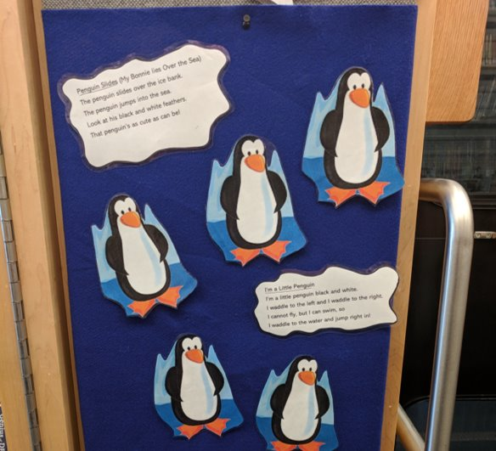
Velcro & Rhymes

Slide 21

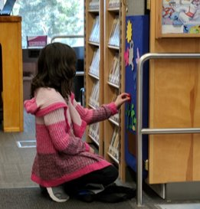
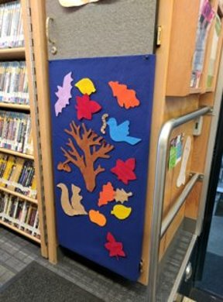
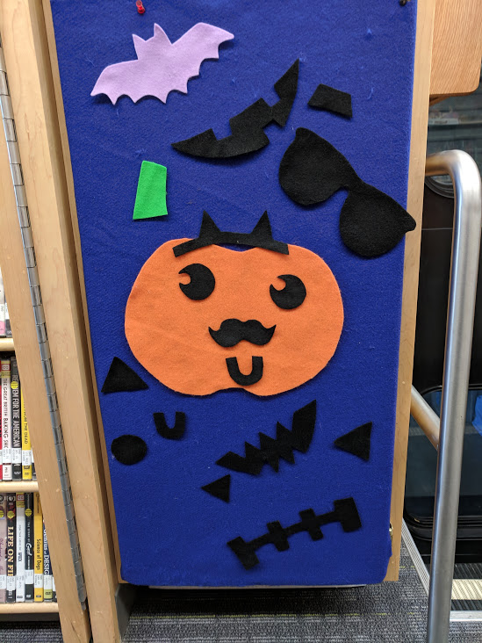
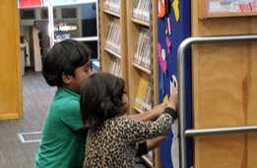
Interactive themes
Notes:
Jack o’ Lantern
Apple Sorting
Snow Man dress up
Plant Growth
Tortoise & the Hare
Circus & Trains

Slide 22

Scavenger hunts
Notes:
* HALLOWEEN
* BABY ANIMALS

Slide 23

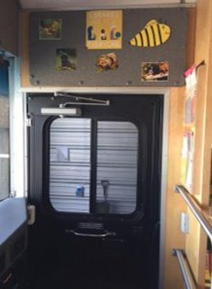
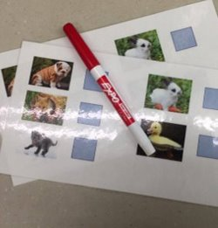

Slide 24

What's next?

Slide 25

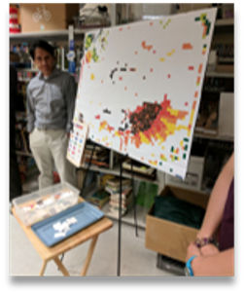
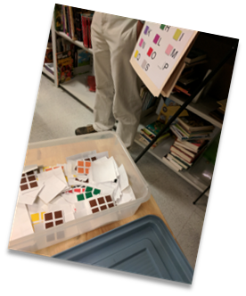
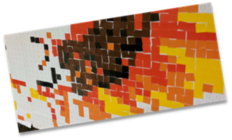
Sheridan Library – Giant Coloring Sheet
Denver Public Library – Pixel Project
Pizza building
Mr. Potato Head
Math Based - counting

Slide 26


Questions?

Slide 27
Contact Us!
Richard Lyda
Supervisor, Mobile Library Services
303-220-8934
Rlyda@arapahoelibraries.org
Karen Bradley
Librarian, Mobile Library Services
303-792-8999 ext. 12615
Kbradley@arapahoelibraries.org

