Slide 1
An Introduction to the Office for Diversity, Literacy and Outreach Services and its Resources
By Amber Hayes

Slide 2
What we’re talking about today
The American Dream Literacy Initiative
2
National Bookmobile Day
3
Outreach Toolkits
1

Slide 3
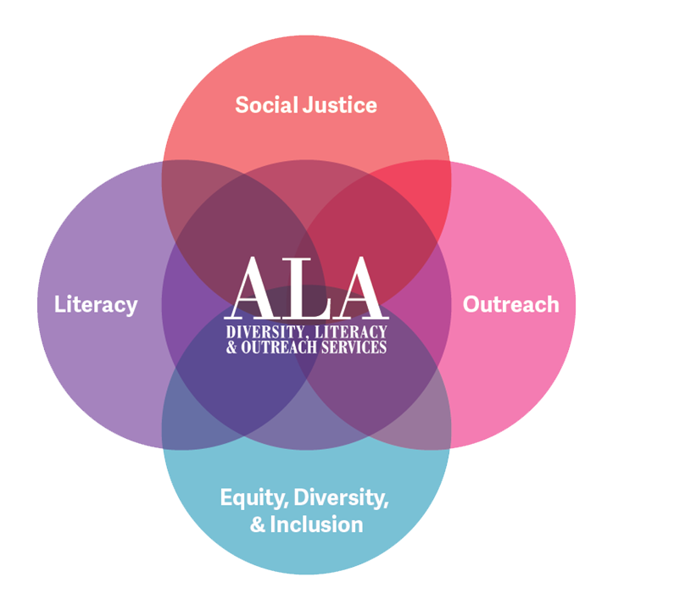
An Introduction to ODLOS
The ALA Office for Diversity, Literacy, and Outreach Services supports library and information science workers in creating responsible and all-inclusive spaces that serve and represent the entire community. To accomplish this, we decenter power and privilege by facilitating conversations around access and identity as they impact the profession and those we serve. We use a social justice framework to inform library and information science workers' development of resources. We strive to create an association culture where these concerns are incorporated into everybody's everyday work.

Slide 4
What we do
Roundtables
Diversity Literacy Grant
American Dream Literacy Initiative
Book Awards
Spectrum Scholarship program
Outreach toolkits
Consultations
Webinars
Workshops

Slide 5
Affiliates
Notes:
There are 27 affiliates associated with ALA. 8 associated with ODLOS (6 are ethnic).
Programming at ALA conferences
Opportunities for collaboration

Slide 6
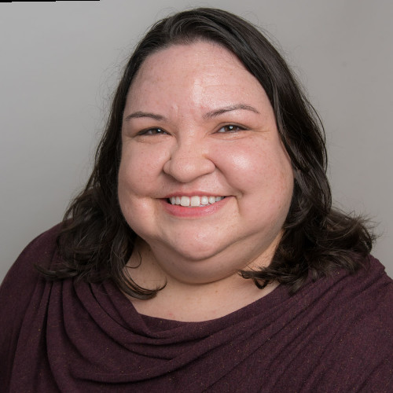
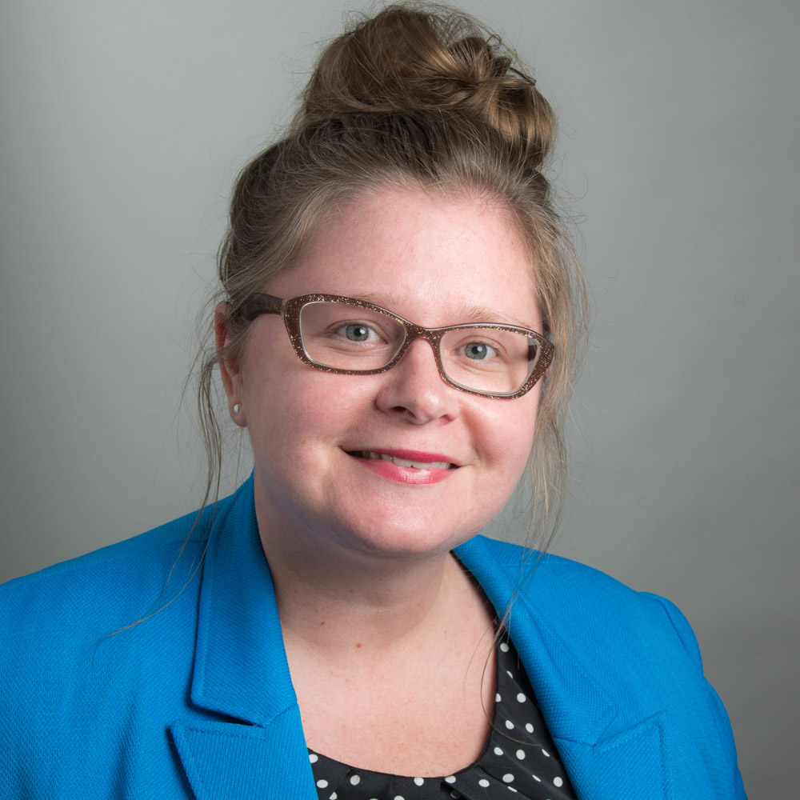
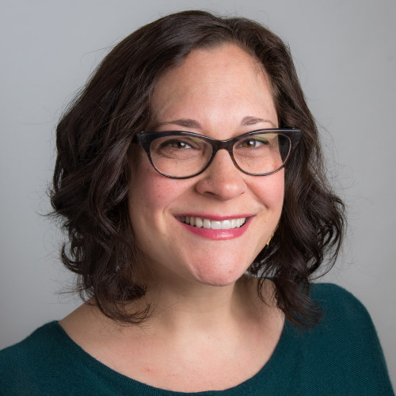
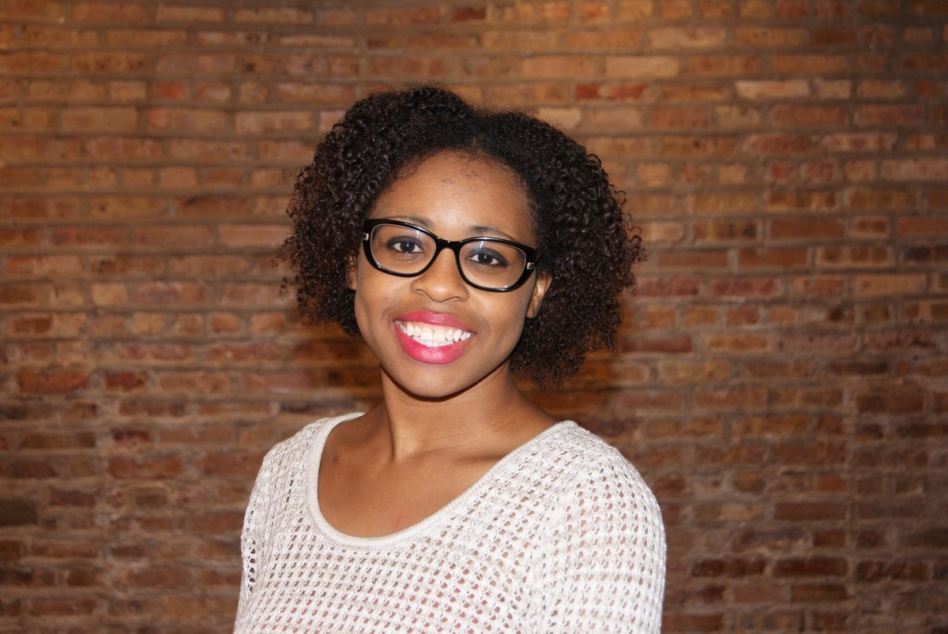
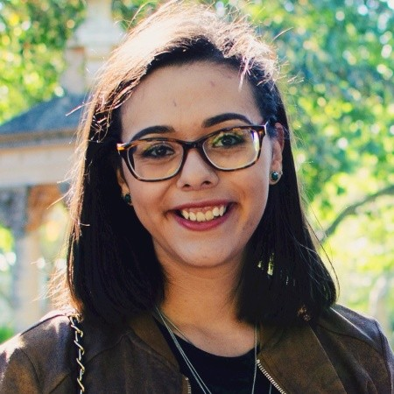
ODLOS Staff
Jody Gray – Director of the Office for Diversity Literacy and Outreach Services
Gwendolyn Prellwitz – Assistant Director for Recruitment and Retention
Kristin Lahurd – Assistant Director for Literacy and Continuing Education
Amber Hayes – Outreach and Communications Program Officer
Briana Jarnagin – Member Services Assistant
Notes:
Note what everyone does in the office

Slide 7
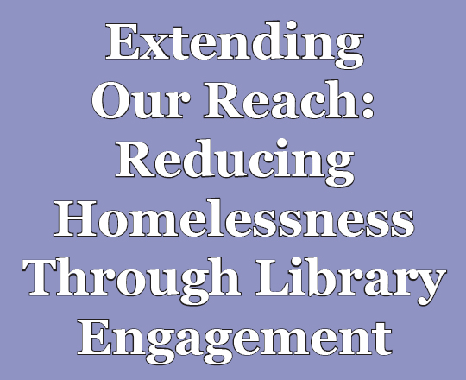
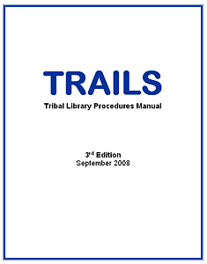
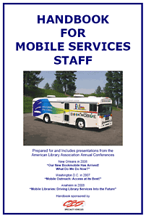
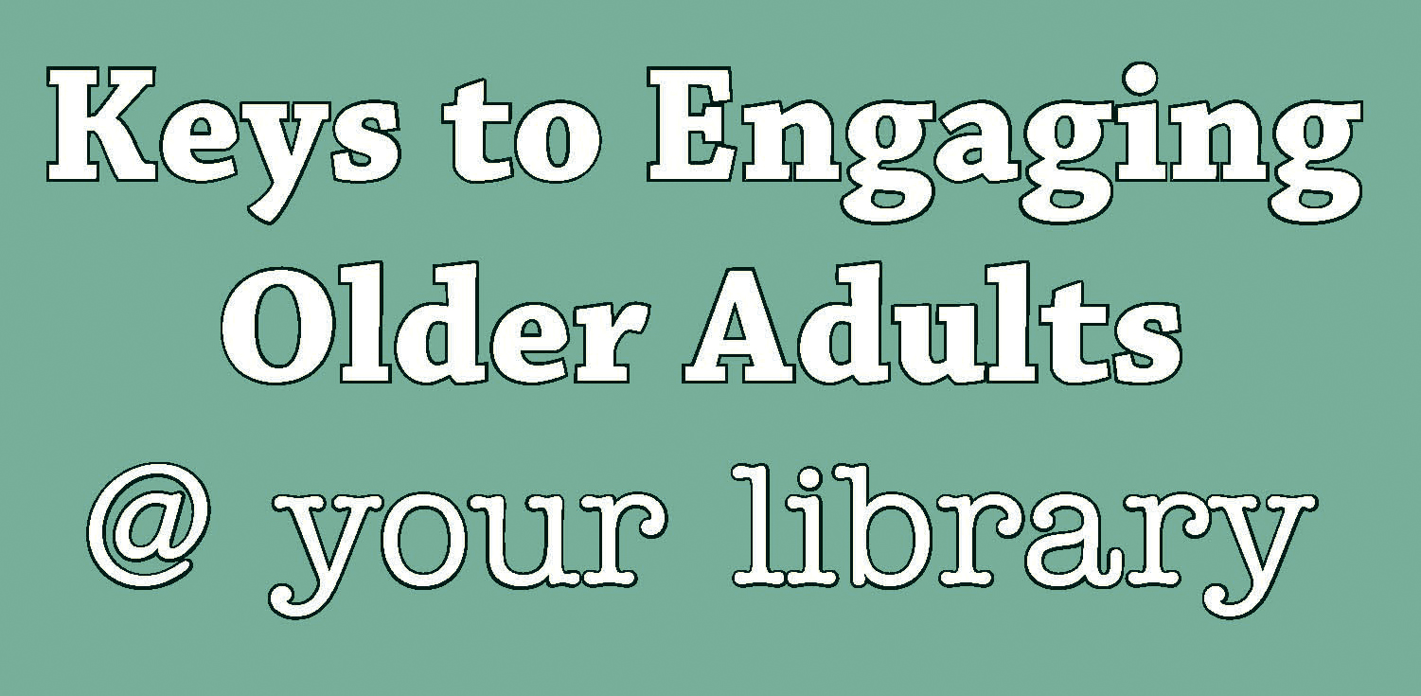
Outreach Toolkits
http://www.ala.org/aboutala/offices/diversity/initiatives
Notes:
Homelessness – SRRT updating
Literacy for All – Committee on Literacy updating
Open to all – most recent
Keys to engaging – being updated
TRAILS – being updated

Slide 8
Upcoming Toolkits
Guide to Building Support for your Tribal Library
A joint project from the Rural, Native and Tribal Libraries of All Kinds (RNTLOAK) committee and the American Indian Library Association.
This step-by-step guides provides libraries with the tools to advocate for their library and opportunities for collaboration.

Slide 9
American Dream Literacy Initiative

Slide 10
American Dream Literacy Grant 10-Year Report
Provided by the Dollar General Literacy Foundation
188 libraries served in 33 states
6 rounds of grants
More than $1.5 million in grants

Slide 11
National Bookmobile Day

Slide 12
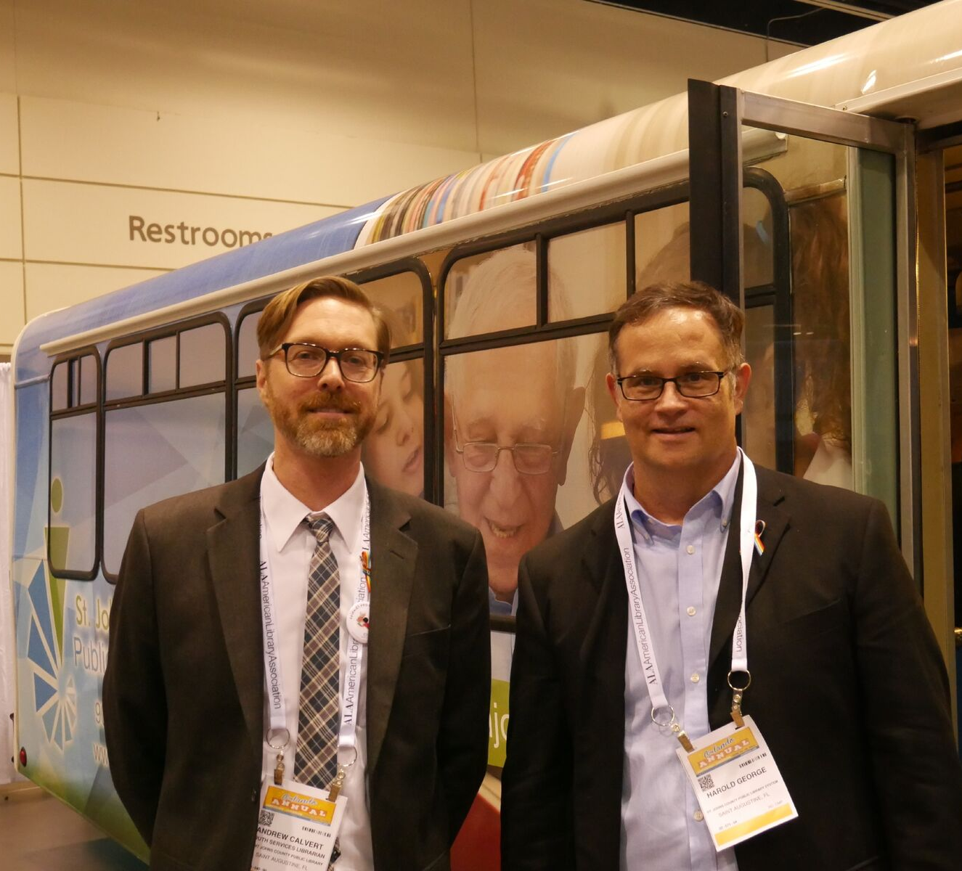
April 10, 2019
National Bookmobile Day is an opportunity for bookmobiles fans to make their support known—through thanking bookmobile staff, writing a letter or e-mail to their libraries, or voicing their support to community leaders.
Wednesday of National Library Week
In collaboration with ABOS and ARSL
Notes:
History: Began in 2010 because we wanted to recognize bookmobile contribution to public life. Key goals for Bookmobile Day: 1) Demonstrate to the profession, friends and trustees that bookmobile services are a core component of library service delivery, demonstrating to the local community that bookmobiles are vital and that use growing, making a case for continued support and funding. Demonstrating through the national media that bookmobiles are modern, changing, and dynamic mobile information centers for the 21st century.
Collaboration between ALA, ABOS, and ARSL

Slide 13
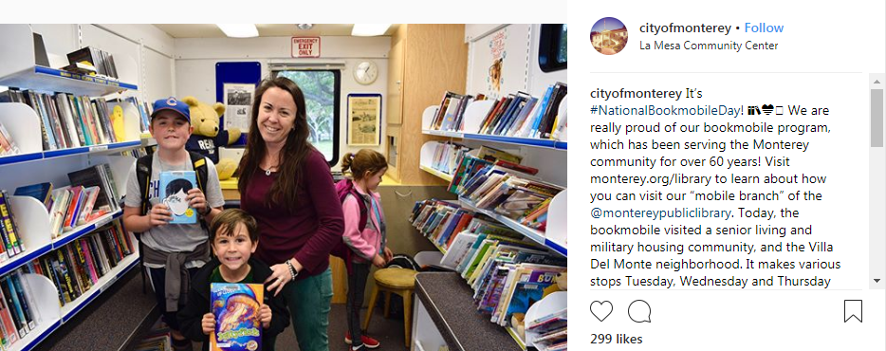
Get involved
http://www.ala.org/aboutala/bookmobileday
https://www.facebook.com/bookmobileday
#BookMobileDay2019
#NationalLibraryWeek
#BookMobile

Slide 14
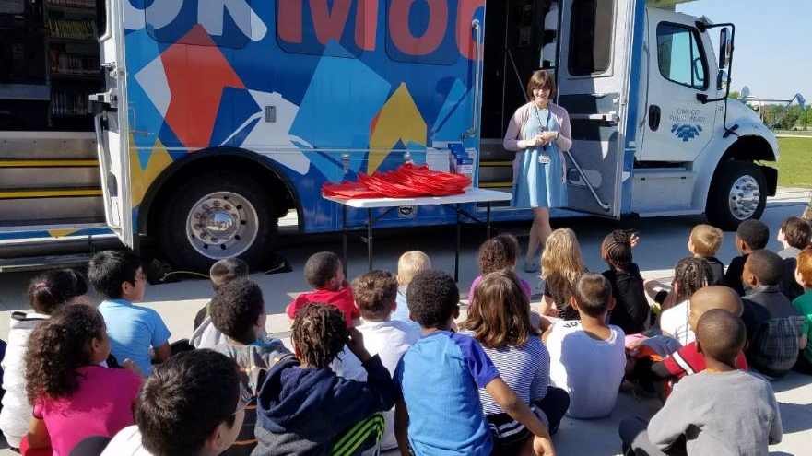
Questions?

